Slide 1




E-Formula Technologies, Inc.
Company Overview
October 2018

Slide 2
Agenda
Company Summary
Business Units
Smart Energy Management
Repair Service
Data Center
AIoT Solution
What’s Our Differences
Organization
Management Team
Licenses
Clients & Partners
ICT Construction

Slide 3
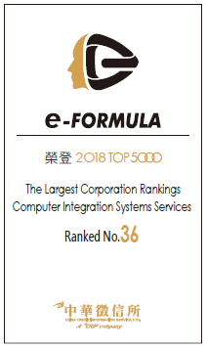
Company Summary
Capital
Registered: US$ 17 Million
Facility
Average Annual Operating Revenue US$ 30 Million
Romania: Bucharest
Certificate
ISO 9001-2008 awarded in 2008.
TL 9000 awarded in 2009.
ISO 27001 for Information Security Management Systems awarded in 2014.
Taiwan: Taipei, Taoyuan, Taichung
Philippines: Manila, Cebu
EF HQ was established in Taipei, Taiwan in 2007.
Award
The 11th Golden Torch Awards for the Top Ten Enterprises
National Quality Awards
ROC Fine Product Evolution Awards
2018 TOP 5000 SI Company Ranked No.36

Slide 4
What’s Our Differences
HVAC Installation and Operating License – Level A
Profession
Finance
Healthy financial status with awarded government fund.
Competence
One-stop service
Utility Installation and Construction License – Level A
E/M Engineering License – Level A
10% plus of employees awarded with PMP license
Solutions-> EPC-> Operation & Maintenance-> Repair & Optimization
In-house certified Electrical PE + technicians & labors

Slide 5
Organization
 |  |  |  |  |  |  |  |  |  |  |  |  |  |  |  |  |  |  |  | Chairman
 |  |  |  |  |  |  |  |  |  |  |  |  |  |  |  |  |  |  |  | 董事長
 |  |  |  |  |  |  |  |  |  |  |  |  |  |  |  |  |  |  |  |  |  |  |  |  |  |  |  |  |  | Audit & Risk Control Office
 |  |  |  |  |  |  |  |  |  |  |  |  |  |  |  |  |  |  |  |  |  |  |  |  |  |  |  |  |  | 稽核室
 |  |  |  |  |  |  |  |  |  |  |  |  |  |  |  |  |  |  |  | Chief Executive Office
 |  |  |  |  |  |  |  |  |  |  |  |  |  |  |  |  |  |  |  | 執行長室
RD Office |  |  |  |  |  |  | Chief Operating Office |  |  |  |  |  |  |  |  |  |  |  |  | Chief Marketing Office |  |  |  |  |  |  |  |  |  | Chief Financial Office |  |  |  |  |  |  |  |  | Chief Human Resource Office
研發室 |  |  |  |  |  |  | 營運長室 |  |  |  |  |  |  |  |  |  |  |  |  | 行銷長室 |  |  |  |  |  |  |  |  |  | 財務長室 |  |  |  |  |  |  |  |  | 人資長室
Repair BU |  |  |  |  | Data Center BU |  |  |  |  | Energy Management BU |  |  |  |  | AIoT Solutions |  |  |  |  | Sales BU |  |  |  |  | Administration |  |  |  |  | Finance & Accounting Office |  |  |  |  | Legal Affairs Office |  |  |  | General Administrations
維修服務處 |  |  |  |  | 數據中心建置處 |  |  |  |  | 能源管理服務處 |  |  |  |  | 智聯網事業部 |  |  |  |  | 市場發展處 |  |  |  |  | 市場管理處 |  |  |  |  | 財務處 |  |  |  |  | 法務室 |  |  |  | 管理處
 | QC Dept. |  |  |  |  | Engineering |  |  |  |  | Engineering |  |  |  |  | Engineering |  |  |  |  | Smart EMS |  |  |  |  | Overseas |  |  |  |  | Accounting |  |  |  |  |  |  |  |  | HR & Admin. Office
 | 品管部 |  |  |  |  | 規劃部 |  |  |  |  | 規劃部 |  |  |  |  | 規劃部 |  |  |  |  | 能源 |  |  |  |  | 海外 |  |  |  |  | 會計室 |  |  |  |  |  |  |  |  | 人資暨行政室
 | Taoyuan Dept. |  |  |  |  | M&E Integration |  |  |  |  | Construction |  |  |  |  | M&E Integration |  |  |  |  | AIoT |  |  |  |  | SRP |  |  |  |  | Finance |  |  |  |  |  |  |  |  | MIS office
 | 桃園維修部 |  |  |  |  | 機電整合部 |  |  |  |  | 施工部 |  |  |  |  | 建置部 |  |  |  |  | 資通 |  |  |  |  | SRP 專案 |  |  |  |  | 財務室 |  |  |  |  |  |  |  |  | 資訊室
 |  |  |  |  |  | IT service |  |  |  |  | IT Developing |  |  |  |  | Solution & Operation |  |  |  |  | Data Center |  |  |  |  |  |  |  |  |  | Procurement Office |  |  |  |  |  |  |  |  | Logistics office
 |  |  |  |  |  | IT服務部 |  |  |  |  | IT 發展部 |  |  |  |  | 對策營運部 |  |  |  |  | 機房 |  |  |  |  |  |  |  |  |  | 採購室 |  |  |  |  |  |  |  |  | 倉管組
 |  |  |  |  |  |  |  |  |  |  | Documents |  |  |  |  | IT Integration |  |  |  |  | Repair
 |  |  |  |  |  |  |  |  |  |  | 內業 |  |  |  |  | 資通整合部 |  |  |  |  | 維修

Slide 6
Our Management Team
Position | Name | Background
Chairman | Peter Chang | University of Texas, USA - Executive Master of Business Administration Parsons – Marketing Director of Asia
Chief Executive Officer | Robin Chen | National Taipei University, Taiwan - PhD. Of Business Administrator Tung-I Information Service Co, Ltd. - Chief Operation Officer
Chief Technology Officer | Max Liu | National Cheng Kung University, Taiwan - PhD. of Mechanical Engineering ITRI, Green Energy and Environment Research Laboratories - Expert
Chief Human Resource Officer | Ada Ho | National Chung Hsing University, Taiwan - Bachelor of Foreign Languages and Literatures e-Formula Technologies, Inc. - QA. ISO Expert
Chief Marketing Officer | Tina Cheng | Brock University, Canada - Bachelor of Economic & Business Admin Raytheon SRP Taiwan O&M Project - Program Director
Quality Assurance Officer | Jocelyn Lin | JinWen University of Science & Technology - Bachelor of Insurance Hong Yun Technology Co., Ltd.
Chief Operating Officer | Frank Chiu | National Taiwan University, Taiwan - Executive Master of Business Administration Taiwan Mobile - Network Engineering Manager
Chief Engineer | Danny Lee | National Taipei University, Taiwan - Bachelor of Science in Mechanical Engineering WECL Consultant - Mechanical Design Manager
Director of Repair BU | Michael Liu | National Chiao Tung University, Taiwan - Master of Communication Engineering Microelectronics Technologies. Inc. - RD Director
Director of AIoT BU | Alan Lo | National Chiao Tung University, Taiwan - PhD of Computer Science HERE Co., Ltd. - CEO
Director of EMS BU | Richard Lu | National Cheng Kung University, Taiwan - Master of Mechanical Engineering Dyna(Shanghai) International Trading Co., Ltd.
Director of Data Center BU | Leo Chen | LingTung University, Taiwan - Bachelor of Information Management VEE Telecom Multimedia Co., Ltd - CEO Assistant
Regional Director in Asia-Pacific | Matthew Arthur Miller | Gulf Breeze, FL USA Raytheon, SRP Taiwan. - Facility Manager

Slide 7




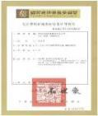
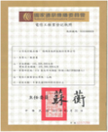
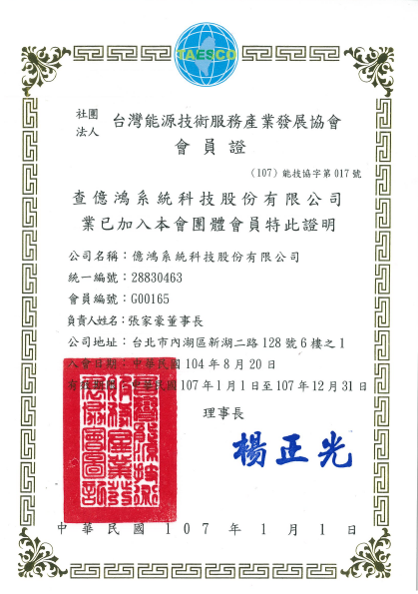
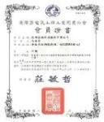
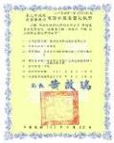

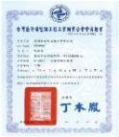
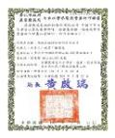

Our Licenses
ISO 9001:2008
TL9000
ISO 27001
Radio Import Permit
Telecom Engineering
License
TAESCO License
E/M Engineering
License_A Level
Taiwan Electrical Contractors Association Certificate
HVAC Industry Operating License A Level
HVAC Association Certificate A Level
Waterpipe Installation Contractors License_ A Level
Utility Engineering
Association Certificate A Level

Slide 8












































Our Clients & Partners
Clients
德明科大
Partners

Slide 9

Smart energy management

Slide 10
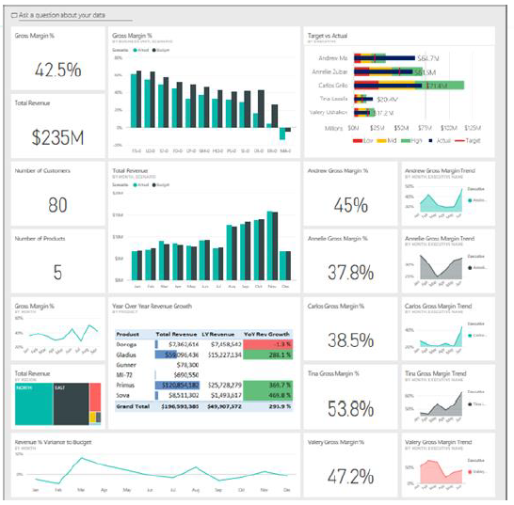
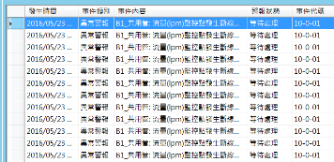
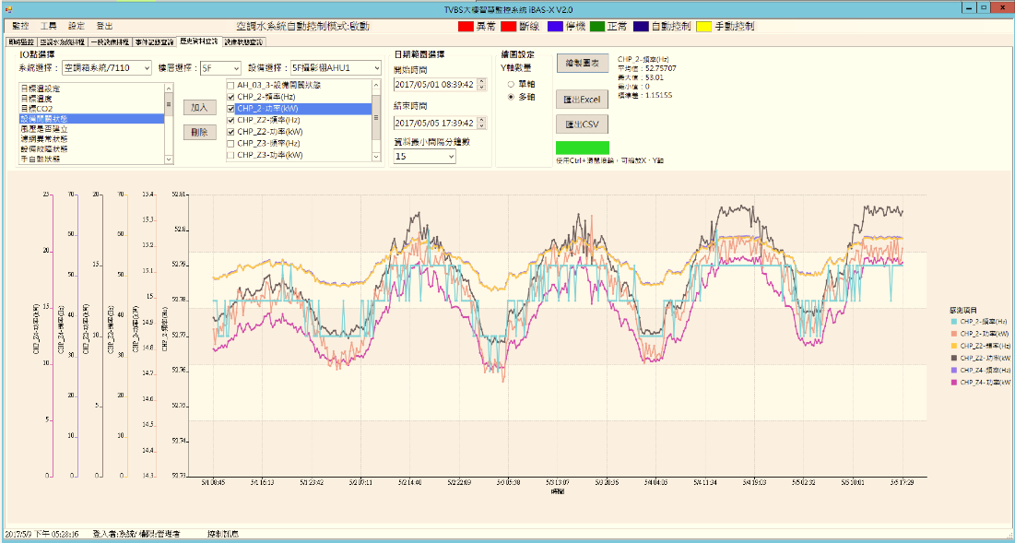
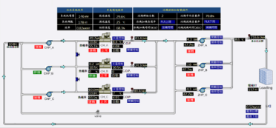
e-FOM Smart Energy Mgmt. Service
Dashboard
Intelligent O&M
Big data analysis
BIM (optional)
AI best
decision
Energy saving
e-FOM (Platform)
Energy report
Demand control
PDM. report
Management Tier
Baseline ANAL.
Intelligent SCADA
Alarm
Information inquiry
Control
Monitoring Tier
Data Collection
Optimized control
Schedule Control
Smart meter
Field sensor
HVAC/Power
LED/Solar/Wind

Slide 11



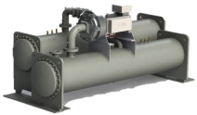
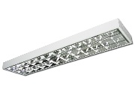

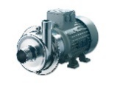
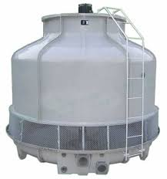
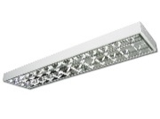
e-FOM Intelligent SCADA
SCADA
Low emergency repair cost
Increase equipment life cycle
Low operation cost
Optimize operational control through SCADA to optimize equipment performance and reduce energy costs
IMS provide trend analysis for repair in advanced before its sudden shut down
Use big data to analyze equipment operating hours and performance data to predict equipment maintenance time and reduce equipment damage risk
Wisdom monitors all equipment operations, records all operational data, and reduces manpower
伺服器
……
Modbus

Slide 12
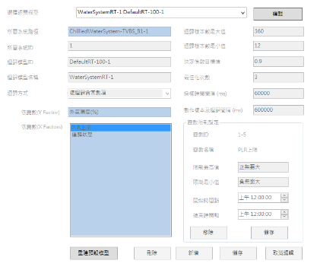

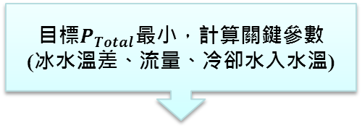
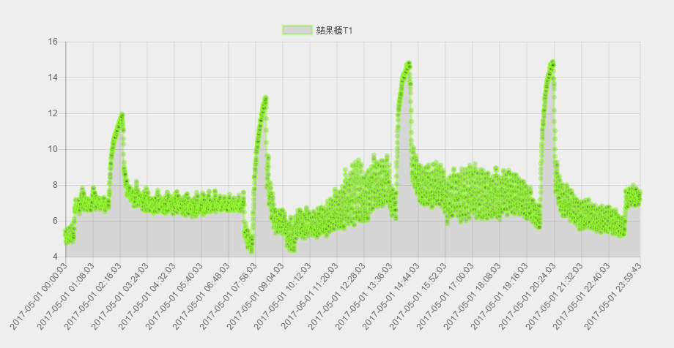
e-FOM AI Best Decision
Artificial Intelligence learning
Power consumption model
(chiller, water pump, cooling tower)
Hydronic total energy equation
Adaptive learning mechanism
Self modeling create
Calculate key parameters, Goal minimal P_{-Total,} (Temperature, Flow)
Chiller scheduling and parameter setting control, pump and cooling tower frequency setting control
System efficiency monitoring and learning adjustment
Big data analysis

Slide 13
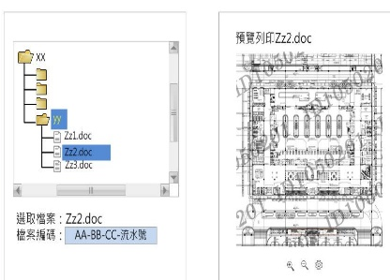
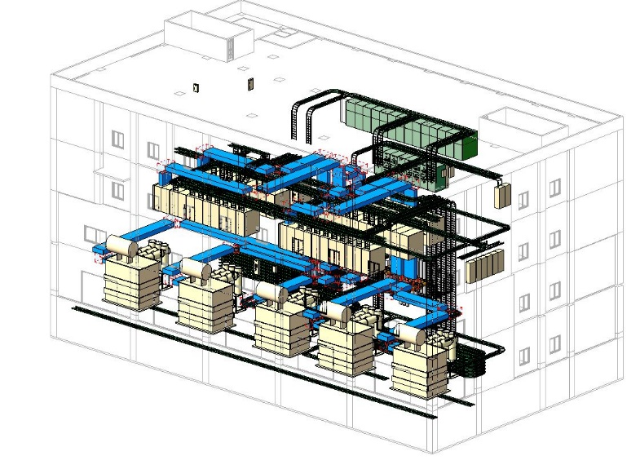
e-FOM Intelligent O&M System
BIM Data Base
Low repair cost
Rational use of space
Low construction cost
Using a 3D model, piping and equipment for early detection of conflict points, reducing errors of
Because the equipment system is built for the 3D model, the fault point can be clearly displayed.
Established with 3D models to effectively arrange pipeline and equipment locations
伺服器
Modbus
Building Information Modeling

Slide 14
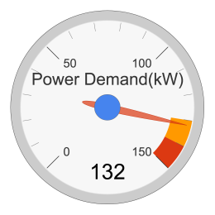
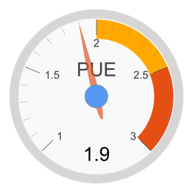
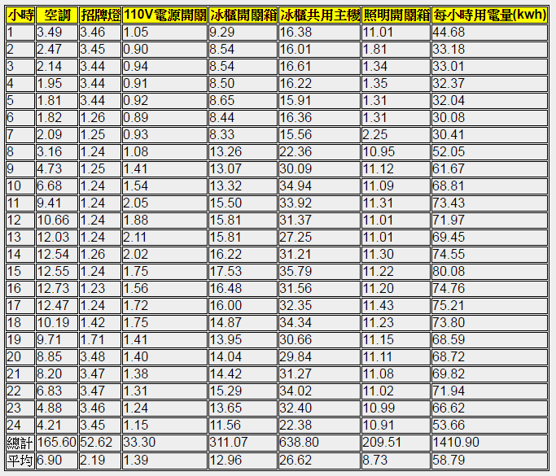
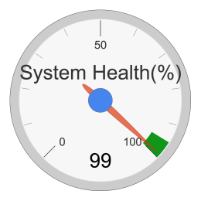
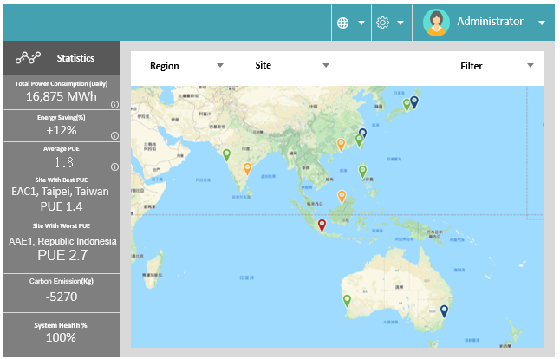
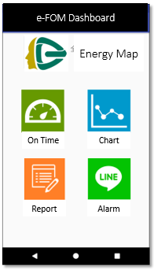
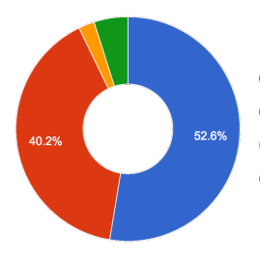
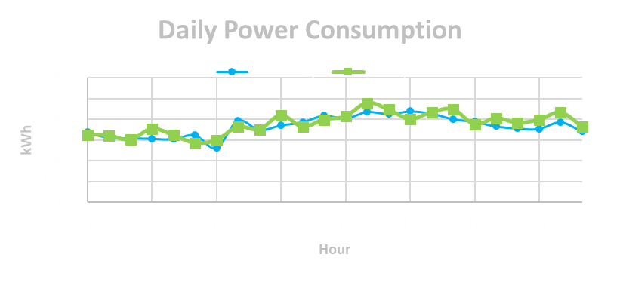
Customized Dashboard
On Time
Report
Trend chart
Cloud
e-FOM Dashboard
Notes:
保全省下金額

Slide 15





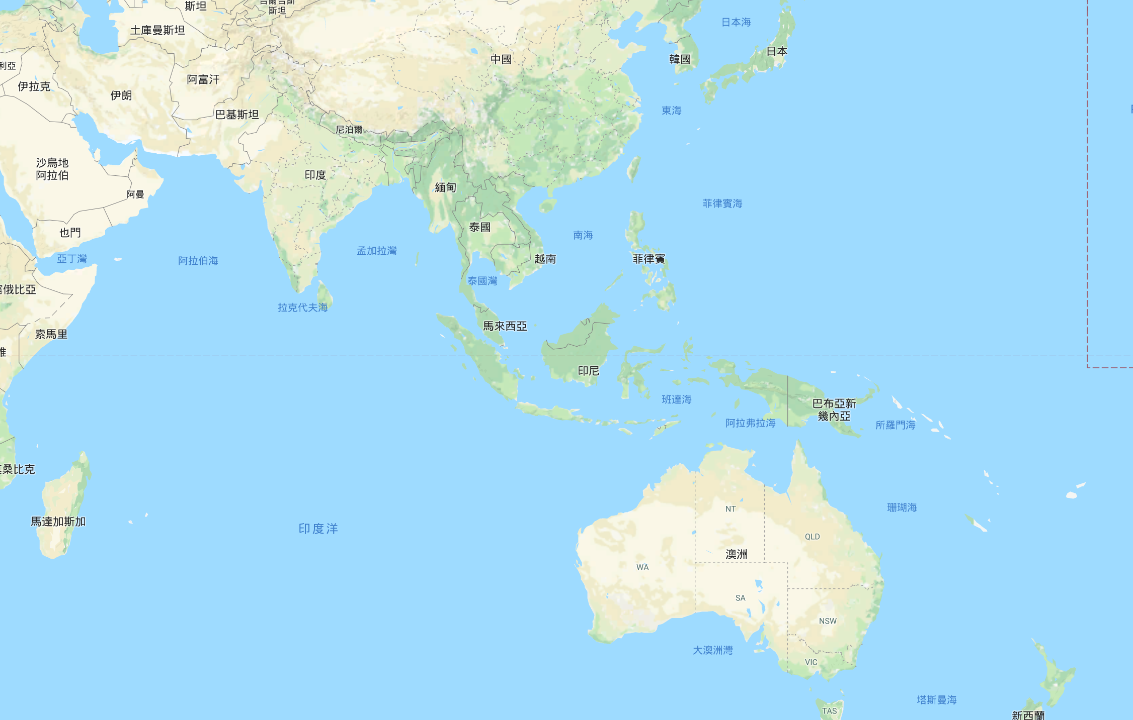




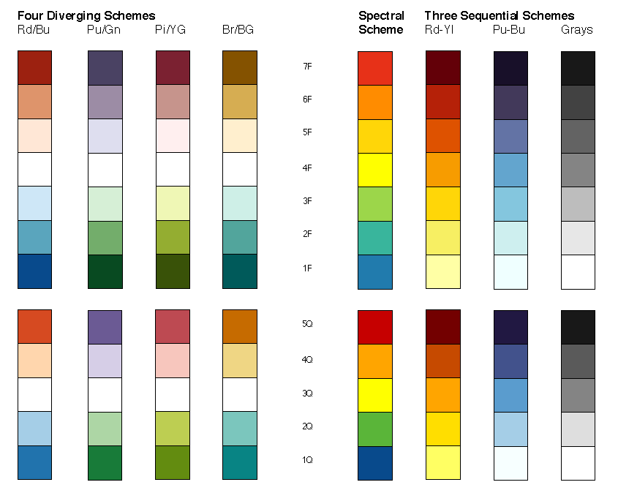

Dashboard - energy map
Administrator
Statistics
Region
Site
Filter
Total Power Consumption (24Hrs)
16,875 MWh
Power Consumption Compare
+12%
Average PUE
1.8
Site With Best PUE
EAC1, Taipei, Taiwan
PUE 1.4
Site With Worst PUE
JAKABARE, Tanjung Pakis,
Republic Indonesia
PUE 3.1
PUE
3.5
3.0
Total System Health
2.5
100%
2.0
1.5
1

Slide 16
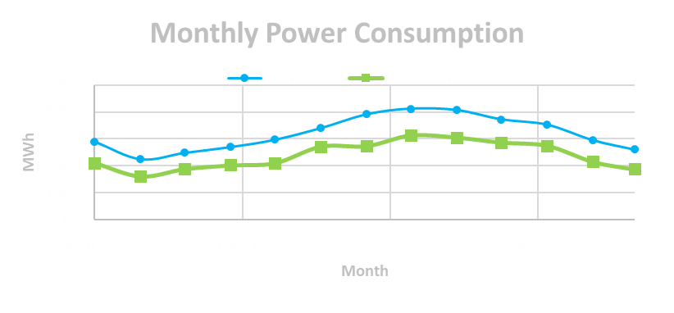
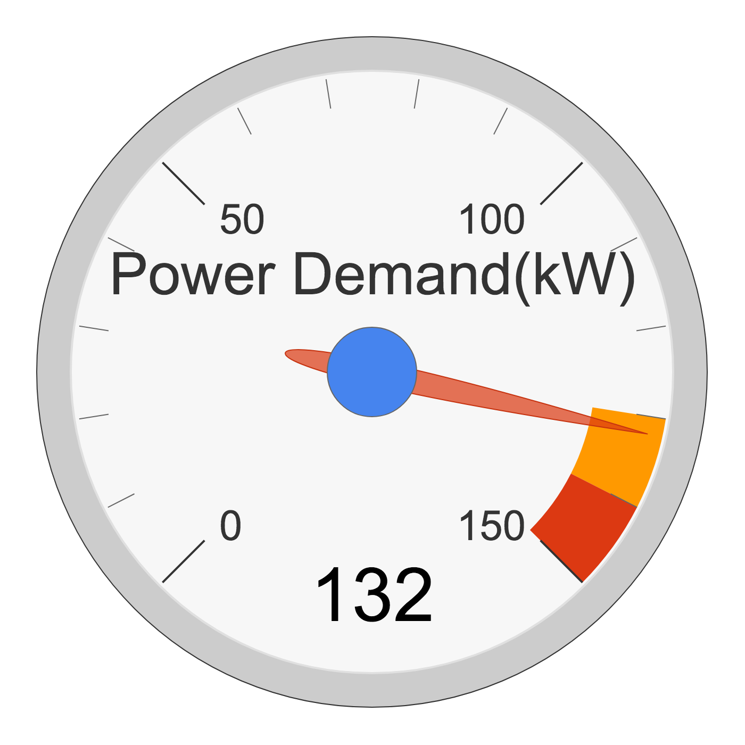
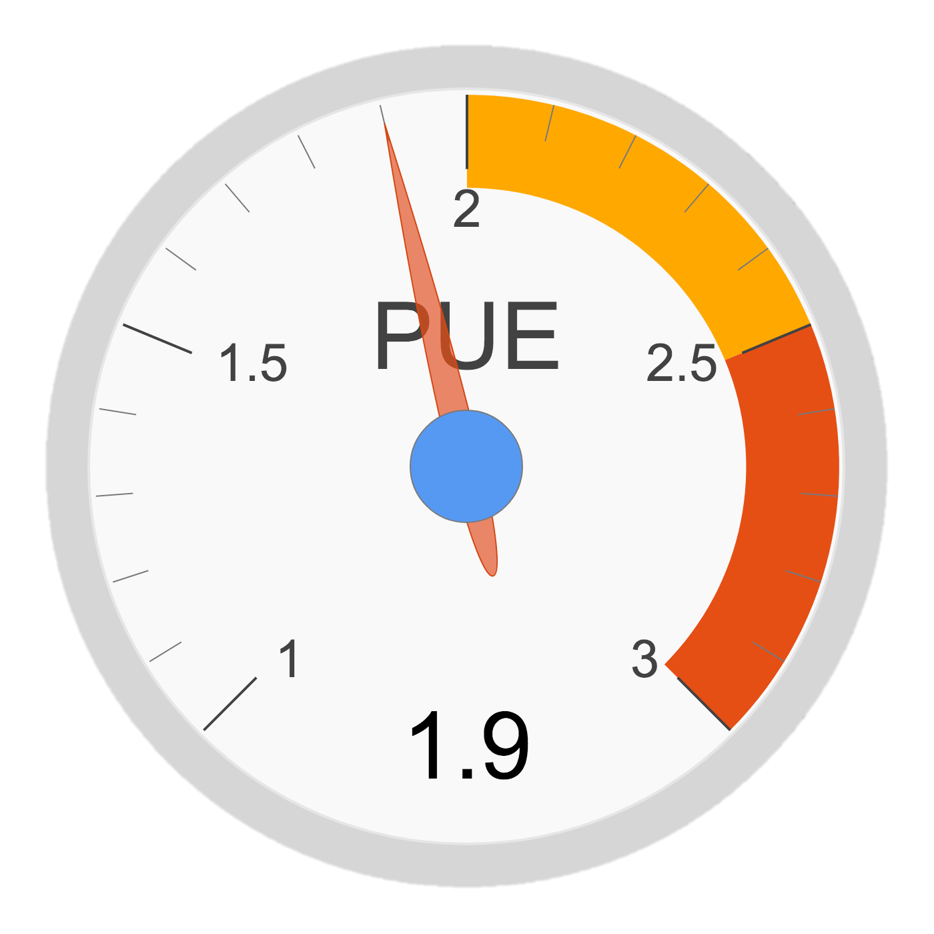
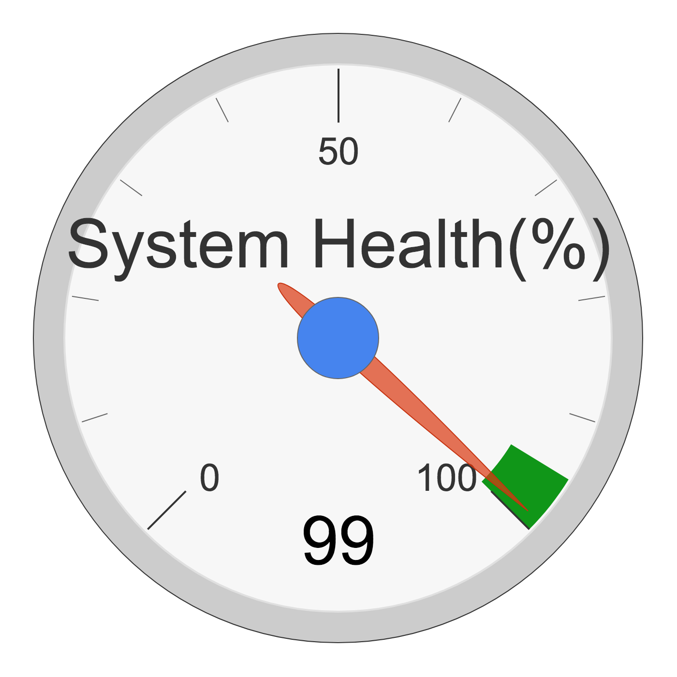
Dashboard – individual site
Administrator
Statistics
Region
Site
Filter
Total Power Consumption (24Hrs)
16,875 MWh
Metronode DC2, Perth, Australia
Power Consumption Compare
+12%
Average PUE
1.8
Site With Best PUE
EAC1, Taipei, Taiwan
PUE 1.4
Site With Worst PUE
JAKABARE, Tanjung Pakis,
Republic Indonesia
PUE 3.1
Total System Health
100%
PUE
3.5
3
2.5
2
1.5
1

Slide 17
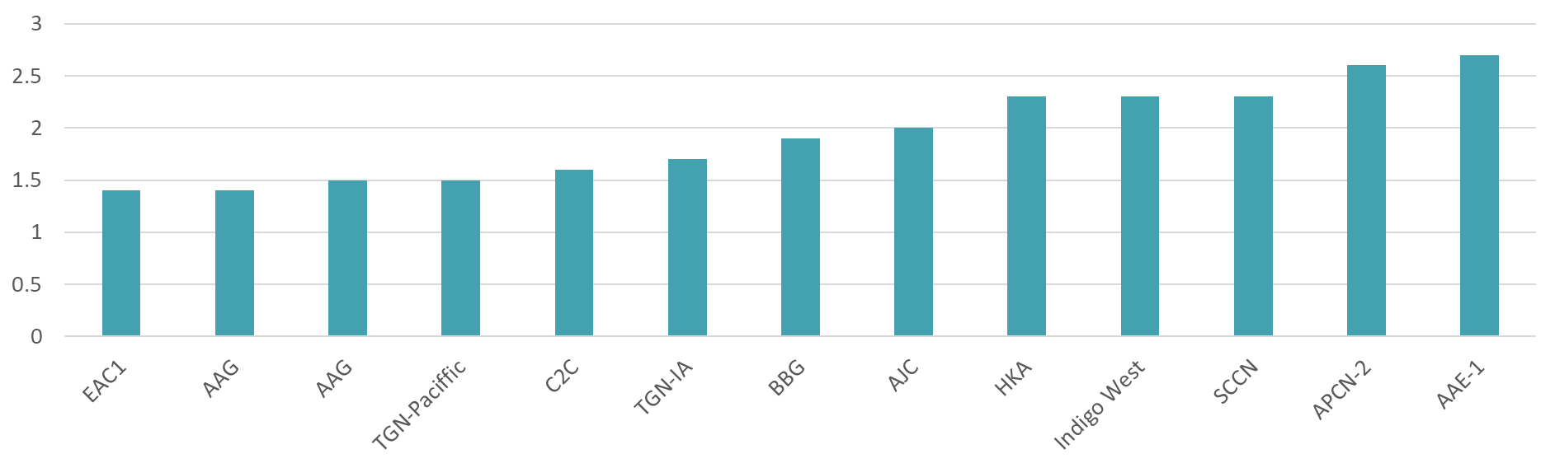
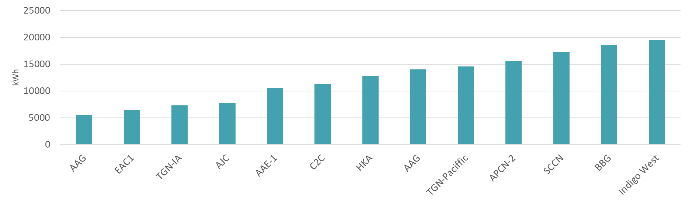
Dashboard – all sites
Administrator
Statistics
PUE
Region
Total Power Consumption (24Hrs)
16,875 MWh
Power Consumption Compare
+12%
Average PUE
1.8
Site With Best PUE
EAC1, Taipei, Taiwan
PUE 1.4
Power Consumption Compare (24 Hrs)
Region
Site With Worst PUE
JAKABARE, Tanjung Pakis,
Republic Indonesia
PUE 3.1
Total System Health
100%

Slide 18
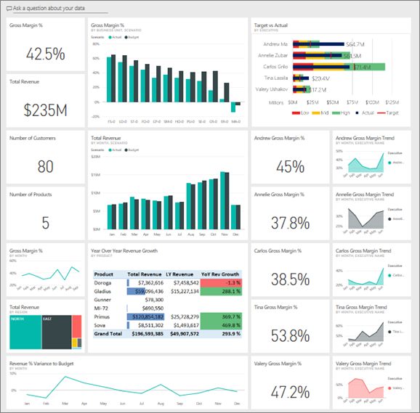
EF-Dashboard (Summary Platform) Platform)

Slide 19
Smart Energy Mgmt. Benefit
Extra Get
Equipment life cycle
Risk & Manpower
Initial Stage
Intermediate Stage
Final Stage
100 % Energy Saving
Energy
Cost
EMS
Benefit
$$$
Energy
Saving
Cost
EMS
Cost
Energy
Cost
Energy Cost
Before EMS
Implementation
After EMS
Years

Slide 20
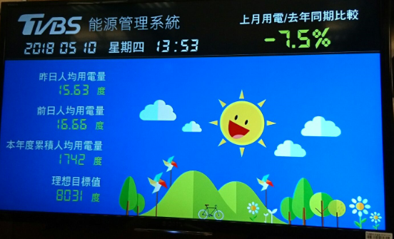
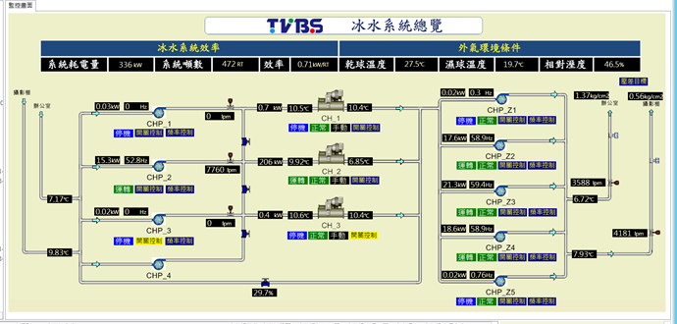
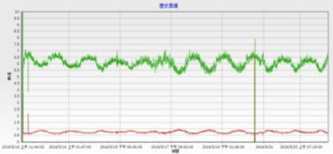
EMS Success Stories
TVBS SCADA & EMS Project
  Project Summary
  1. SCADA system, including: Electric power, Air-con, Exhaust, UPS and General I/O
  2. Water system and AHU of air-con, Scheduled fan control.
  3. Dashboard
  4.Energy Saving: > 23%
overall energy Dashboard
Telstra EAC1 Smart Monitoring
System Performance (kw/RT)
Chiller COP

Slide 21
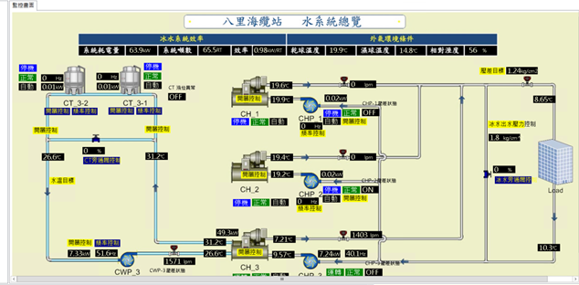
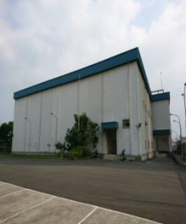
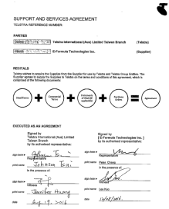
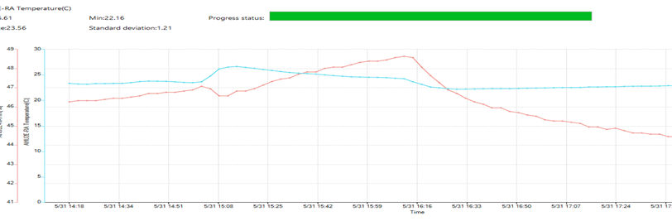
EMS Success Stories
Telstra Bali CLS EMS Project
EMS for Cable Landing Station :
EF has a frame contract to cover cases from the whole Asia area.
Through energy saving platform, we can control air-conditioning system for the best utilization.
PLC/SCADA/Dashboard
  Energy Saving: 25~35%
Telstra EAC1 Smart Monitoring
Effectiveness Analysis
Notes:
04/12/11
21

Slide 22
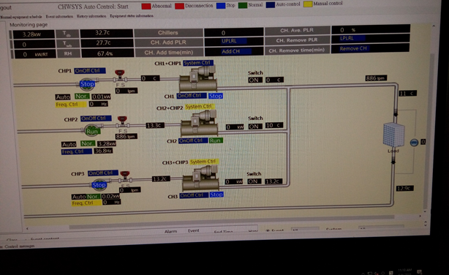
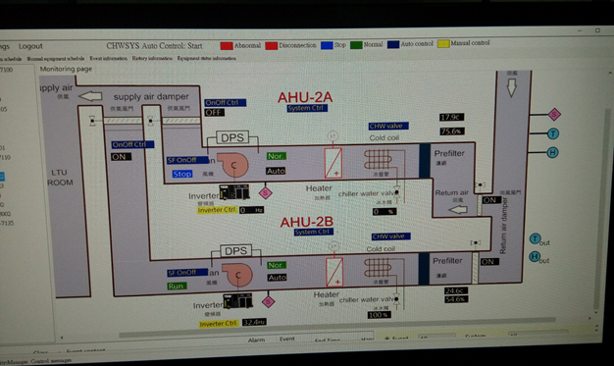
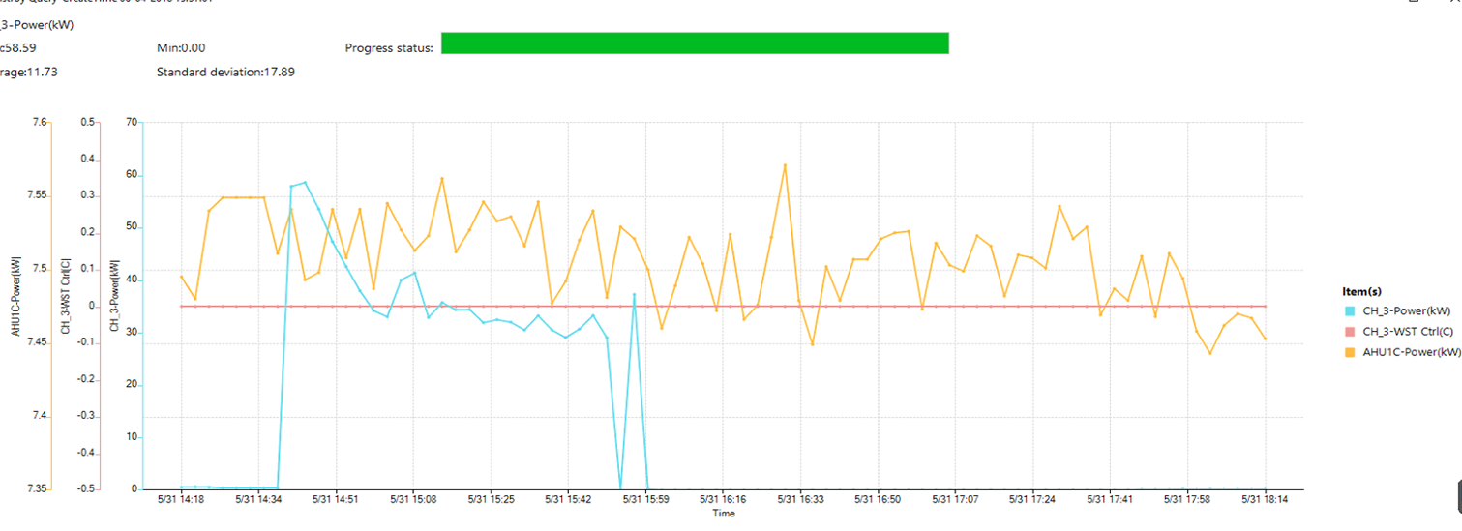
EMS Success Stories
Telstra C2C cable station in Philippines
EMS Project
  Project Summary
  1. SCADA system, including: Electric power, Air-con, Exhaust,
  2. Water system and AHU of air-con, Scheduled fan control.
  3. Dashboard
  4.Energy Saving: 48%
Smart Monitoring
Chiller side
Smart Monitoring
Air side
Effectiveness Analysis

Slide 23
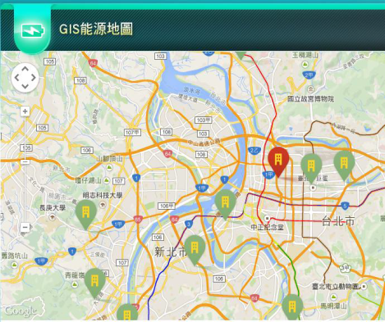


EMS Success Stories
Convenience Store & Supermarket
EMS Project
Project Summary
1. Installation of transformer panel, PLC, VFD…
2. Refrigerator Auto Temperature control, 22.5% saving on power consumption
3. Central Control / Management
2,500 stores total saving : 4 million USD per year
Energy Map
Performance Comparison
Power Comparison

Slide 24


EMS Success Stories
Reseller EMS POC Project
EMS for PXMart:
Electrical system and show case temperature data collection.
On and off control for light signs through energy saving platform.
Remote control through energy saving platform.
POC construction work by Feb. 2017
POC verification from March to Jun. 2017
System Power Analysis
Effectiveness Analysis
Smart Monitoring
Temperature
Notes:
04/12/11
24

Slide 25



CPC Micro-Grid Application
EMS Success Stories
  Project Summary
  1. SCADA system, including: energy storage system, renewable energy, charging station and energy consumption of gas station
  2. Dashboard
  3. System anomaly and failure alarm
  4. Automated demand response

Slide 26

Data Center

Slide 27



Data Center Solutions
Data center refers to IT room, cloud, big data or data saving space.
Our solutions:
Schneider– Data Center Infrastructure Solutions
We provide overall data room planning, construction, maintenance and repair services.
Huawei– Data Center Infrastructure Solutions
Delta– Data Center Infrastructure Solutions
Data Center maintenance and repair

Slide 28





Data Center Infrastructure Solutions
Schneider
Resource Advisor
Data Center Operation
Building Operation
Power Monitoring Expert
Data Center Expert
A suite of modular and integrated DCIM software tools
that enable effective data center management.
Notes:
Schneider Electric offers a comprehensive Data Center Management Software layer, which addresses different parts of the facility and the data center.
StruxureWare Resource Advisor
StruxureWare Data Center Operation
StruxureWare Data Center Expert – previously known as StruxureWare Central
StruxureWare Power Monitoring Expert – previously known as PowerLogic ION Enterprise
StruxureWare Building Operation – previously known as Andover Continuum or TAC Vista

Slide 29







Data Center Infrastructure Solutions
Huawei
Power-SMR
Expansion to (<=144kw)
Expansion to (<=180kW)
Expansion to (180kW – 1440 kW)
Combination
Air Conditioning Unit
Power-UPS
High
Medium
UPS5000-A
Small
UPS2000-G
25-800kVA
UPS2000-A
Capacity
< 20kVA
25 kVA-800kVA
Notes:
Schneider Electric offers a comprehensive Data Center Management Software layer, which addresses different parts of the facility and the data center.
StruxureWare Resource Advisor
StruxureWare Data Center Operation
StruxureWare Data Center Expert – previously known as StruxureWare Central
StruxureWare Power Monitoring Expert – previously known as PowerLogic ION Enterprise
StruxureWare Building Operation – previously known as Andover Continuum or TAC Vista

Slide 30

Data Center Infrastructure Solutions
Delta
Notes:
Schneider Electric offers a comprehensive Data Center Management Software layer, which addresses different parts of the facility and the data center.
StruxureWare Resource Advisor
StruxureWare Data Center Operation
StruxureWare Data Center Expert – previously known as StruxureWare Central
StruxureWare Power Monitoring Expert – previously known as PowerLogic ION Enterprise
StruxureWare Building Operation – previously known as Andover Continuum or TAC Vista

Slide 31



Operation & Maintenance
We provide daily or regular preventive maintenance, emergency services, corrective services and 7*24 services to extend the life of Equipment Rooms.
Maintenance Items
Electrical/Mechanical system
HVAC system
Monitoring system
SMR
Fire system
Generator
UPS

Slide 32



Data Center Successful Case
Data Center Infrastructure Project
Data Center Infrastructure:
Interior design works
Power system
Fire system (FM200, CO2)
HVAC system
CCTV system
SCADA
@ TWM 4G Data Center, Taiwan

Slide 33





Data Center Successful Case
Cabling Deployment
Cabling works at Data Center
@ Bali, Taiwan
@ Manila, Philippines

Slide 34




Data Center Successful Case
Telstra CLS & Data Center Maintenance Project
Facility System O & M
24/7
Electrical (incl. UPS & Generator)
HVAC
BMS
Fire alarm
@ Taiwan & Philippines

Slide 35




Data Center Successful Case
Raytheon-SRP Maintenance Project
Facility System O&M
TIA-942 Level 4
20 people on site 24/7
Electrical (incl. UPS)
HVAC
FMAS
Fire alarm (Notifier NFS-320)
High-Voltage (69Kv substation*2 sets)
Generator (2087Kw*6 sets+ Switchgear
4160V 6 sets)
@ Raytheon SRP Site Taiwan

Slide 36
Data Center Case References
No. | Project Name | Client | The status of implementation (annual)
 |  |  | 2008 | 2009 | 2010 | 2011 | 2012 | 2013 | 2014 | 2015 | 2016
1 | TWM North Equipment room maintenance | TWM | ■ | ■ | ■ | ■ | ■ | ■ | ■ | ■
2 | TFN North Equipment room maintenance | TFN | ■ | ■ | ■ | ■ | ■ | ■ | ■ | ■
3 | TFN IDC Equipment room maintenance | TFN | ■ | ■ | ■ | ■ | ■ | ■ | ■ | ■
4 | Hsinchuang Equipment room maintenance | Taiwan MEDIA | ■ | ■ | ■ | ■ | ■ | ■ | ■ | ■
5 | E&M System Maintenance Service of Tamsui CLS | Telstra (Pacnet) |  |  | ■ | ■ | ■ | ■ | ■ | ■ | ■
6 | HQ Building New Construction Project – Water Supply & Drainage System | Taiwan Cooperative Bank |  |  |  |  | ■
7 | Taoyuan Office Storage Compartment Construction Works & TECO Guanyin Office Storage Fire Control Works | APT |  |  |  |  | ■
8 | Morgan Stanley Air conditioning maintenance | Morgan Stanley |  |  | ■
9 | Equipment room maintenance project | IBM |  |  | ■
10 | Pacnet Tamsui CLS additional 4 racks, power work and fiber installation | Telstra (Pacnet) |  |  |  |  | ■
11 | Pacnet Telehouse Relocation | Telstra (Pacnet) |  |  |  |  | ■
12 | SongShan Cultural and Creative Park | TWM |  |  |  |  |  | ■
13 | Power and electric Telehouse high-voltage substation improvement work | TWM |  |  |  |  |  | ■
14 | Power and electric telehouse installation | TWM |  |  |  |  |  | ■
15 | Syntrend ADM Telehouse Construction Works | APT |  |  |  |  |  |  | ■ | ■ | ■
16 | 4G Telehouse Construction Works(Kaohsiung) | VIBO (T Star) |  |  |  |  |  |  | ■ | ■

Slide 37
Data Center Case References
No. | Project Name | Client | The status of implementation (annual)
 |  |  | 2008 | 2009 | 2010 | 2011 | 2012 | 2013 | 2014 | 2015 | 2016
1 | Hsichi Equipment room maintenance | Taiwan MEDIA | ■ | ■ | ■ | ■ | ■ | ■ | ■ | ■
2 | Yilan Equipment room maintenance | Taiwan MEDIA | ■ | ■ | ■ | ■ | ■ | ■ | ■ | ■
3 | Kaohsiung Equipment room maintenance | Taiwan MEDIA | ■ | ■ | ■ | ■ | ■ | ■ | ■ | ■
4 | Access to Equipment room air conditioning maintenance | FET |  | ■ | ■ | ■ | ■ | ■ | ■ | ■
5 | Bali CLS EAC1, EAC2 , Neihu Telehouse and Backhaul Maintenance | Telstra (Pacnet) |  | ■ | ■ | ■ | ■ | ■ | ■ | ■ | ■
6 | Beitou Depot utilities, fire control and air-conditioning system maintenance | TRTC |  |  | ■
7 | Tamsui Line station lighting maintenance | TRTC |  |  | ■
8 | Fubon Momo Equipment room maintenance | Momo |  |  |  |  |  |  | ■ | ■ | ■
9 | Ministry of Education Equipment room fire control and air-conditioning system maintenance | MOE |  |  |  |  |  |  |  | ■ | ■
10 | Concert Hall CH#2 Centrifugal Chiller Plant Retrofit Project | National Theater & Concert Hall |  |  |  |  | ■
11 | Vantone Taipei 2011 Residential Building Construction Project – Water & Electricity Works | Vantone |  |  |  |  | ■
12 | Taiwan Telehouse Re-Instatement Work | Telstra (Pacnet) |  |  |  | ■
13 | Judicial Office Building – Water Supply & Drainage System for HVAC | Judicial Yuan |  |  |  | ■ | ■
14 | Taiwan C2C 2AB Google IRU Project (Phase 1 – 3) | Google |  |  |  |  |  |  |  | ■ | ■

Slide 38

ICT Construction

Slide 39






Successful Case
OSP/Backhaul Deployment and Maintenance
OSP Deployment
@ FET N1/N2, Taiwan
@ Telstra , Taiwan
@ PLDT, Manila, Philippines

Slide 40





Successful Case
Communications for MRT
Communication System:
Broadcasting
CCTV
PIDS
@ Airport MRT, Taiwan

Slide 41







Successful Case
4G BTS, Microwave in Taiwan and Philippines
Wireless Installation:
Civil Works
BTS, Antenna/Cabinet Installation, Tower Rigging
Commissioning & Integration
@ Taiwan and Philippines

Slide 42







Successful Case
OPTIX & Access Deployment in Philippines
OPTIX & Access Deployment:
Site Survey
Technical Equipment Installation (MSAN, PSTN, SW)
Migration
CO & Curbside Equipment
Provisioning
Commissioning
@ Philippines

Slide 43








Successful Case
Highway ETC System Infrastructure
ETC System Infrastructure:
Civil works
Steel Structure works
Telecom
CCTV
Electrical system works
@ Taiwan Highway
Boring Piles

Slide 44




Successful Case
Taoyuan International Airport Terminal 2
Fire Alarm System Upgrade
Fire Alarm System
Intelligent Detectors (Honeywell)
Life Safety System (Honeywell)
Input Modules (Honeywell)
Interface Modules (Honeywell)
Intelligent Control Point (Siemens)
@ Taiwan Taoyuan International Airport Terminal 2

Slide 45



Successful Case
Network Optimization Drive Test
Scope of Work:
DT Technician Services
Rigger Services
DT Analysis Engineer Services
@Taiwan CHT
Network Quality Control
Local Application Service
Professional Analysis
4G/3G Testing Verify System
Mobile Network
Mobile Advice/IoT

Slide 46
Rosenberger Antenna Solutions
1. Outdoor BTS System
-Base Station Antennas
-Microwave Antennas
-Passive Components
-Coax Feeder System
-Fiber to the Antenna
2. Indoor Coverage
-Active & Passive DAS
3. RF Coaxial Product

Slide 47
ICT Construction Case References
No. | Project Name | Client | The status of implementation (annual)
 |  |  | 2012 | 2013 | 2014 | 2015 | 2016
1 | Highway Electronic Toll Collection System Infrastructure Project (North 2 District & Central 1 District) | Far Eastern Electronic | ■ | ■ | ■
2 | North 1 & 2 District Pipeline/Cable/Telecom Facilities/Telehouse Equipment Relocation & Demolition Works | FET/NCIC | ■ | ■ | ■ | ■ | ■
3 | Communication System, Central Monitoring System and Passenger Information System Installation Project | TTYMRT | ■ | ■ | ■
4 | Judicial Yuan Air Conditioning System and Pipe System Installation Project | Fure-Lin Engineering Co. |  |  | ■
5 | LTE Project for TI Service Project | NOKIA |  |  | ■ | ■
6 | eAIP System Maintenance | Civil Aeronautics Administration |  |  | ■ | ■
7 | Auto Fare Collection(AFC) Relocation Project and Wire Arrangement Project | TRTC |  |  |  | ■
8 | HP Information Equipment Maintenance | ASUS |  |  |  | ■
9 | HP Information Equipment Maintenance | Kinmax |  |  |  | ■
10 | Passenger Information Display System Software Integration and Hardware Upgrade Project | TRTC |  |  |  |  | ■
11 | Tetra System Handset Commissioning and Upgrade Project | TRTC |  |  |  |  | ■
12 | Reverse Engineering for Circuit Board | TRTC |  |  |  |  | ■
13 | AP Installation and Wire Arrangement Project | St. Shine Optical Co. |  |  |  |  | ■
14 | WLAN Equipment Purchase Project | St. Shine Optical Co. |  |  |  |  | ■

Slide 48

AIoT Solutions

Slide 49
AIoT Solutions Architecture
What we focus on
INTELLIGENCE SERVICE
INTELLIGENCE AUTOMATION
SOLUTIONS
LOCATION
SERVICE
IMS (PATROL)
ALARM SYSTEM
EMS
B2G
  Schools
  Stadiums
  Public Space
  Transportation
  Government Buildings
B2B
  Parking Lots
  Hospitals
  Factory
  Retail & Malls
  Corporate offices
SURVEILLANCE
BIM
IMS(EQIPEMENT)
CLOUD
API
EF - Platform
FRONTEND SERVICE (DASHBOARD)
LOCATIONS
BACKEND SERVICE
COMMUNICATION
WIFI | BLE | LORA | NB-IoT
EQUIPMENT
METERS
SENSORS
CONTROLLERS
COMERAS

Slide 50



AIoT EMS Dashboard
-Telstra EMS (Dashboard)
Cloud based & Visualization
Power Consumption Monitoring
Powering Saving Monitoring

Slide 51




AIoT BIM Service
Scope of the work
Building Information
Repair Management
Real-time 3D information
Integrating with EMS

Slide 52




AIoT Location Service (Smart Hospital)
-Taichung Tzu-Chi Hospital
Indoor Navigation
Asset Tracking
Patients Tracking

Slide 53








AIoT Location Service (Car Finding)
-Large Scale Parking Lots
Indoor Navigation
Car Finding
AR Guiding

Slide 54



AIoT Patrol Management System
- PSS Group Parking Lots and Security
Check IN/OUT
Task Assign
Issue Handle
Assets Logs
Analysis Report

Slide 55

AIoT Surveillance Solutions

Slide 56





Successful Case
AIoT Car-Plus CarShare System & APP
Scope of Work of Platform:
Operation Management
Parking Management
GIS Management
Car Rental Management
Customer Management
Repair and Maintenance
APP (iOS & Andorid)
@ Car-Plus Taiwan

Slide 57

Repair & Reverse engineering Service

Slide 58


Comprehensive Repair
Reverse Engineering:
Establish key repair techniques
Generate schematic diagram & BOM
Quality Management:
Complete SOP
Integrate Management System
Mature Warranty Service
Service Field:
Telecom, transportation, banking, military modules
Product Capability:
Self-developed repair management platform
Over thousands of repair capability

Slide 59






Reverse Engineering
Without having any circuit diagram and technical support from original vendor, EF is able to present the following BOM, configuration, and schematic diagram of each module by years of experience and high tech instrument!

Slide 60

Repair for High-tech equipment
@ With self-developed repair management system, which overcome the massive repair threshold, achieving dull challenge of quality and quantity.
Warranty return is Less then 3%
@ Provide the comprehensive repair service for high-tech equipment, including telecom / transportation / power / microwave / control / optic etc. modules.

Slide 61

Repair Flow Chart
Repair Flowchart
Notes:
04/12/11
61

Slide 62


Repair Capability
Based on the TL9000 and ISO 9001 standard, we provide different repaired lead-time with repair reports and standard burning test in our simulation systems to meet the Clients requests.
Types we can repair:
GSM 2G & 3G BTS/BSC
RF / Power modules
Internet equipments
Microwave equipments
Fiber transmission equipments
Exchanged equipments
Repeater
SMR
Public Transportation

Slide 63

Repair Database System

Slide 64




Successful Case
TRTC PCB Repair
Service Includes:
Examination
Clean
Component Repair
Testing
QC
For TRTC PCB Repair

Slide 65







Successful Case
Telecom 2G & 3G Module Repair
Module Includes:
Moto Node B : T Star
Nokia/Ericsson 3G : China Unicom
Nokia 2G : FET
Siemens 2G : TWM
Nortel 2G : CHT

Slide 66






Re-export for Radio Module
Re-export for Radio Module
We can export radio module to other countries.
Reduce the quantity control by NCC.
Including Nortel/ZTE/ALU/Ericsson/Motorola/Siemens/Nokia, etc.

Slide 67






Repair Successful Case
Repair Service in Romania
Telecom module repair
SMR
UPS
Rectifier
Microwave
ODU & IDU

Slide 68
Repair Case References
No. | Description of Repair Project | Area | Client | The status of implementation (annual)
 |  |  |  | 2008 | 2009 | 2011 | 2013 | 2015 | 2016
1 | SMART Motorola TSA-Repair Project | Philippines | Edgecomm | ■ | ■ | ■ | ■ | ■ | ■
2 | VERIZON Nortel CDMA Repair Service | USA | Tempest | ■ | ■ | ■ | ■ | ■ | ■
3 | AMAS Ringing Generator Repair | Taiwan | TWM | ■ | ■ | ■ | ■ | ■ | ■
4 | SMR Repair Service | Taiwan | TWM | ■ | ■ | ■ | ■ | ■ | ■
5 | Siemens Repair Services | Taiwan | TWM | ■ | ■ | ■ | ■ | ■ | ■
6 | Microwave Repair Service | Taiwan | TWM | ■ | ■ | ■ | ■ | ■ | ■
7 | Nortel / NEC / Mitsubishi Transmission | Asia | Telstra (Pacnet) | ■ | ■ | ■ | ■ | ■ | ■
8 | Lucent SDH / AnyMedia Repair | Taiwan | TWM |  | ■ | ■ | ■ | ■ | ■
9 | Nortel S8000 & S2000 & 6000 Repair | Taiwan | CHT |  | ■ | ■ | ■ | ■ | ■
10 | Repeater Repair (Multi-Vendors) | Taiwan | CHT |  | ■ | ■ | ■ | ■ | ■
11 | Satellite Equipment Repair | Taiwan | CHT |  | ■ | ■ | ■ | ■ | ■
12 | Motorola 3G Node-B repair | Taiwan | Vibo |  | ■ | ■ | ■ | ■ | ■
13 | Andrew Repeater & Alcatel BTS Repair | Taiwan | Vibo |  | ■ | ■ | ■ | ■ | ■
14 | Alcatel BTS Repair | Thailand | Truemove |  | ■ | ■ | ■ | ■ | ■
15 | Ericsson & Alcatel BTS Repair | Laos | Laos |  | ■ | ■ | ■ | ■ | ■
16 | Lucent Anymedia Repair | Taiwan | FET |  |  | ■ | ■ | ■ | ■
17 | Lucent RG Repair | Taiwan | FET |  |  | ■ | ■ | ■ | ■
18 | Anymedia POTS Repair | Taiwan | FET |  |  |  | ■ | ■ | ■
19 | UTStarcom AN-2K Repair | Taiwan | APT |  |  |  | ■ | ■ | ■
20 | Microwave Repair | Taiwan | APT |  |  |  |  | ■ | ■
21 | Cisco 3500, 2500, 5510 Repair | Taiwan | Gamania |  |  |  |  | ■ | ■
22 | Arrow Span MeshAP 3100 & Cisco Switch Router | Taiwan | MITAC |  |  |  |  | ■ | ■
23 | Huawei Repair | Romania | Huawei |  |  |  |  | ■ | ■
24 | Fujitsu (Fan, SLTE) Repair | Asia | GCX |  |  |  |  | ■ | ■
25 | Type371 Electric Multiple Unit Door Engine Control Unit PCB Repair | Taiwan | TRTC |  |  |  |  | ■ | ■

Slide 69
E-formula always provide
High-quality, Reliable services
within your Budget!
Thank you.
Website: www.e-formula.com
Email: Service@e-Formula.com

