Slide 1

PROCUREMENT FOR DEVELOPMENT
Michael Pryor
Consultant
World Bank
LUXEMBOURG, 29 OCTOBER 2026
Official Use Only

Slide 2


Our mission is to end extreme poverty and boost shared prosperity on a livable planet.
Health Services
Deliver quality affordable health services to 1.5B people.
Mission 300
Provide 300M people in Sub-Saharan Africa with electricity access.
Agriconnect
Help 300M farmers move up the value chain.
Capital Support
Provide access to capital to 80M more women and women-led businesses.
Water Forward
Partner to improve water security for over 1B people.
Social Protection
Reach at least 500M more people with social protection systems.
Broadband Internet
Enable 300M more women to use broadband internet.
Job creation
is central to
what we do.
Official Use Only

Slide 3

$250 Billion
in active projects
+1,600
projects in 130 countries
Scale of Opportunities
40,000
procurement opportunities each year, covering Works, Goods, Consulting and
Non-consulting services
Official Use Only

Slide 4

Roles in World Bank Procurement
Government
World Bank
Suppliers
Official Use Only

Slide 5
Government
Prepare procurement strategies and plans
Design and launch procurements
Evaluate bids
Award and manage contracts
Prepare procurement strategies and plans
Design and launch procurements
Evaluate bids
Award, sign, and manage contracts
Roles in World Bank Procurement
Official Use Only

Slide 6
The World Bank
Roles in World Bank Procurement
Ensure funds are used for their intended purpose
Provide procurement oversight and advice
Help strengthen Borrower procurement capacity and performance
Official Use Only

Slide 7
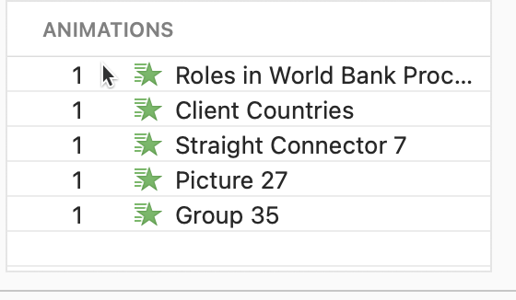
Suppliers
Participate in Early Market Engagement
Identify and respond to procurement opportunities
Prepare and submit responsive bids
Contract delivery
Provide feedback to strengthen future
procurement processes
Roles in World Bank Procurement
Official Use Only

Slide 8
Benefits for Suppliers
Scale
Global Reach
Reliability
Flexibility
Sectoral
Diversity
Billions of dollars worth of business
Opportunities to work globally
Opportunities to expand in new and existing markets
Equal opportunity
& fair treatment
Certainty of process
& high standards
of integrity
Demand for variety of specializations
Variety of contract sizes
Opportunities suitable for SMEs to large multinationals
Official Use Only
Official Use Only

Slide 9

Quality-based awards – 50% minimum technical weighting for most international procurement
Early market engagement – structured engagement before bidding
Smarter contract packaging – aggregation to attract strong international participation
Stronger payment security – expanded use of direct payment mechanisms
Enhanced procurement complaint system
More local participation – minimum 30% local labor under International Works Contracts
A new procurement approach
Official Use Only
RECENT PROCUREMENT REFORMS

Slide 10
Quality over cost: average technical/quality weighting given to most international procurements has increased to 51% since the changes were implemented, up 10 percentage points.
Proactive market engagement: Expanded WB and Borrower outreach through 270+ EME events with (13,500+ participants) and 170+ global business engagements (12,800+ participants)
Improved competition: average number of bids per contract has increased from 4 to 5
Growing diversity: among leading supplier countries, strengthening market reach
Impact
Official Use Only
RECENT PROCUREMENT REFORMS

Slide 11
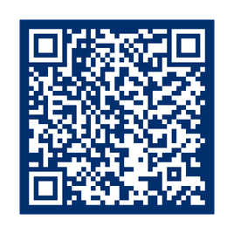
Interested in bidding on
World Bank–financed contracts? Visit the Suppliers’ Hub to:
Explore business opportunities
Use SOURCe, the AI assistant for suppliers
Stay informed about procurement events and E-Learning
Sign up for email alerts to receive updates on projects, including new procurement notices
Consult procurement regulations and standard bidding documents
SCAN TO ACCESS
THE SUPPLIERS’ HUB
www.worldbank.org/suppliershub

