Slide 1
Science and Technology Park
Rzeszów-Dworzysko
ECONOMIC HEART OF THE CITY AND THE ENTIRE REGION

Slide 2
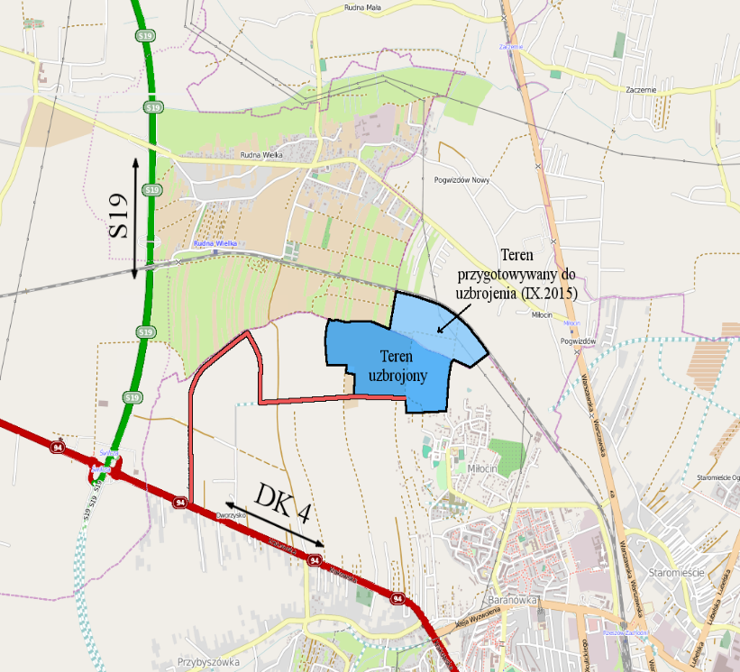
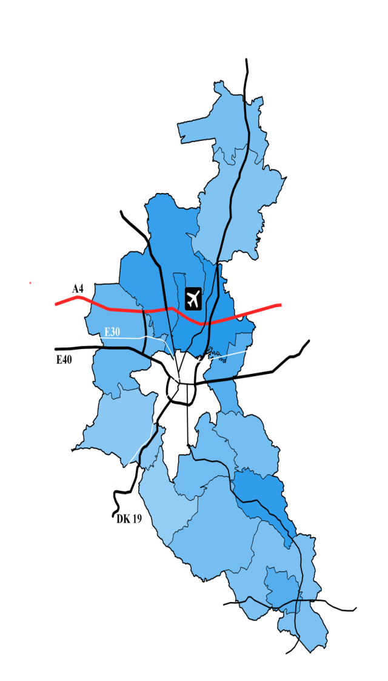
SCIENCE AND TECHNOLOGY PARK RZESZÓW-DWORZYSKO
PERFECT LOCATION
Motorway A-4
Expressway S-19
International Airport
Rzeszów-Jasionka
Main Railway Line E-30
Germany-Poland-Ukraine

Slide 3
SCIENCE AND TECHNOLOGY PARK RZESZÓW-DWORZYSKO
In southeastern Poland, in the vicinity of Rzeszów-Dworzysko Science and Technology Park is the Aviation Valley, famous for its aerospace industry and pilot training centers. This region has a heavy concentration of aerospace industry, scientific research centers, as well as educational and training facilities.
Many companies decided to invest in Aviation Valley. The most known are:
MTU Aero Engines Polska
Borg Warner Turbo Systems
Goodrich Corporation
OPTeam S.A.
Polimarky

Slide 4
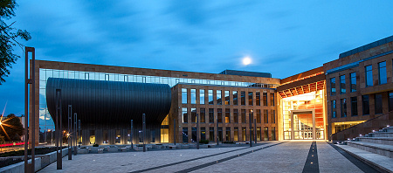
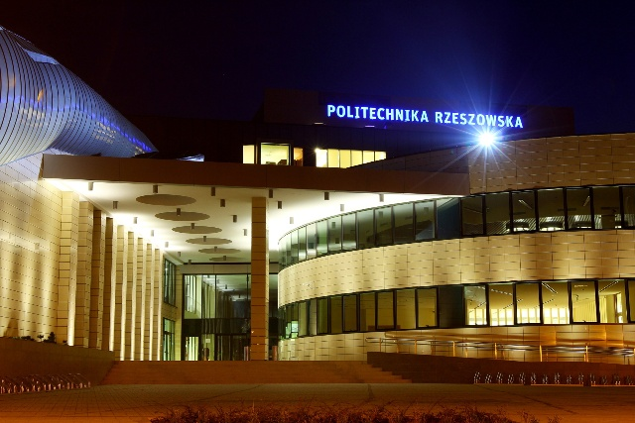
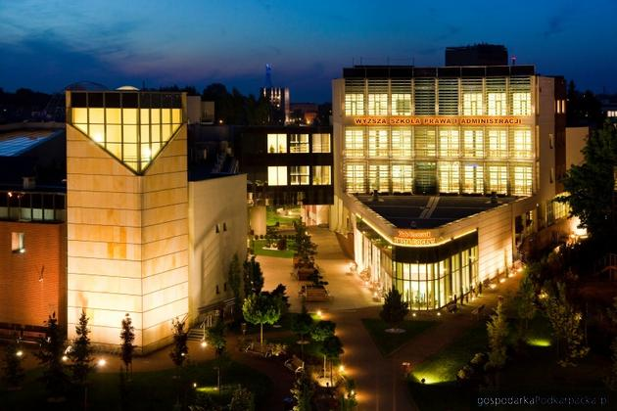
SCIENCE AND TECHNOLOGY PARK RZESZÓW-DWORZYSKO
PROXIMITY TO UNIVERSITIES AND HIGHER EDUCATION
UNIVERSITY OF RZESZÓW
RZESZÓW UNIVERSITY OF TECHNOLOGY
UNIVERSITY OF INFORMATION TECHNOLOGY AND MANAGEMENT IN RZESZÓW
SCHOOL OF LAW AND PUBLIC ADMINISTRATION IN RZESZÓW
SCHOOL OF MANAGEMENT IN RZESZÓW
SCHOOL OF ENGINEERING AND ECONOMICS IN RZESZÓW

Slide 5
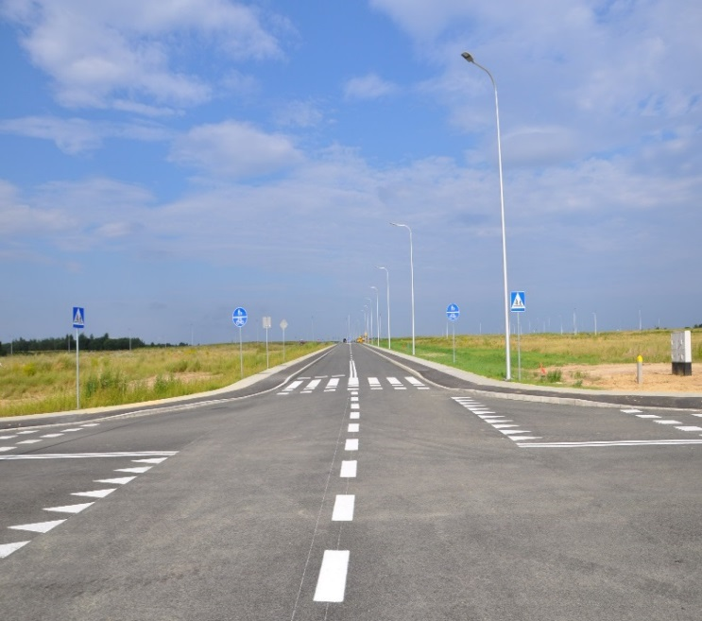
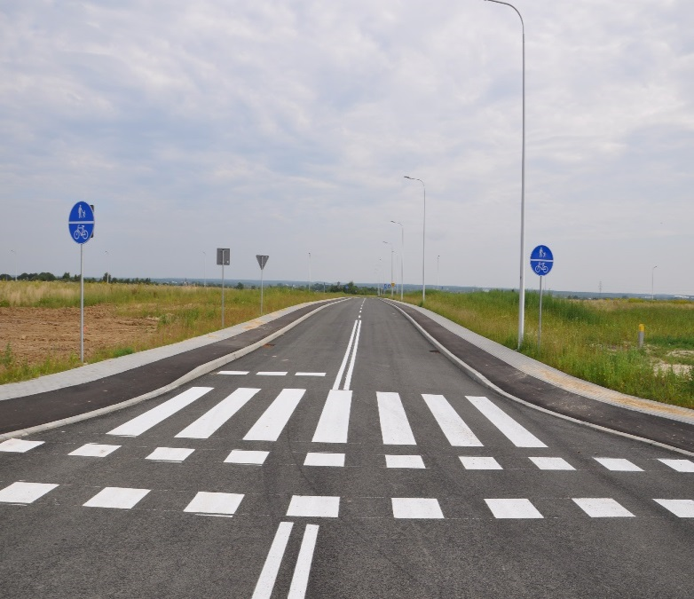
SCIENCE AND TECHNOLOGY PARK RZESZÓW-DWORZYSKO
THE FIRST STAGE OF THE TERRITORIAL DEVELOPMENT OF THE LAND WITH AN AREA OF 55,47 HA HAS BEEN COMPLETED, INCLUDING:
roads - 5,3 km
bike paths - 0,9676 ha
pavements - 0,8651 ha
lighting with LED technology – 128 lamps

Slide 6
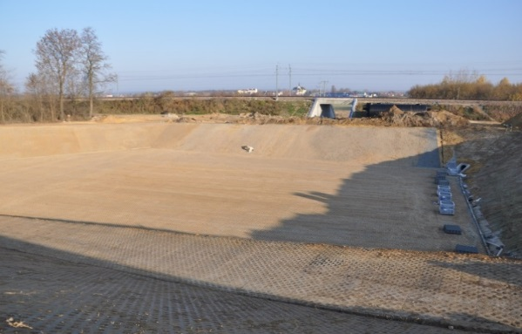
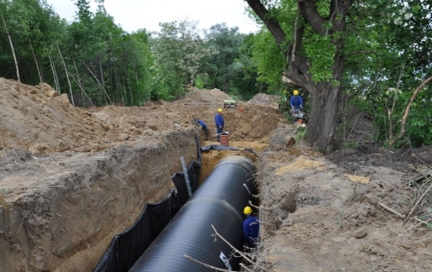
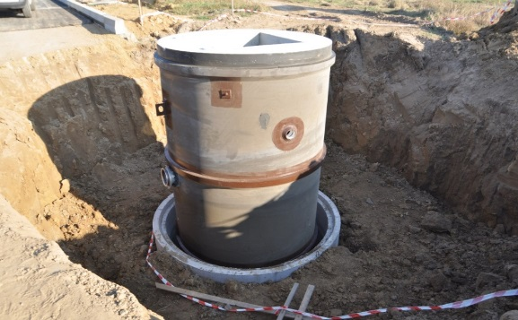
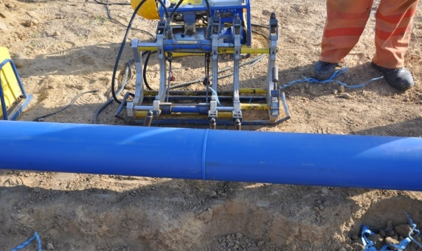
SCIENCE AND TECHNOLOGY PARK RZESZÓW-DWORZYSKO
sanitary and water supply networks - 12,4 km
3 pumping sanitary sewage
storm water drainage network: 9,4 km
gas pipelines: 6,2 km
retention reservoir

Slide 7
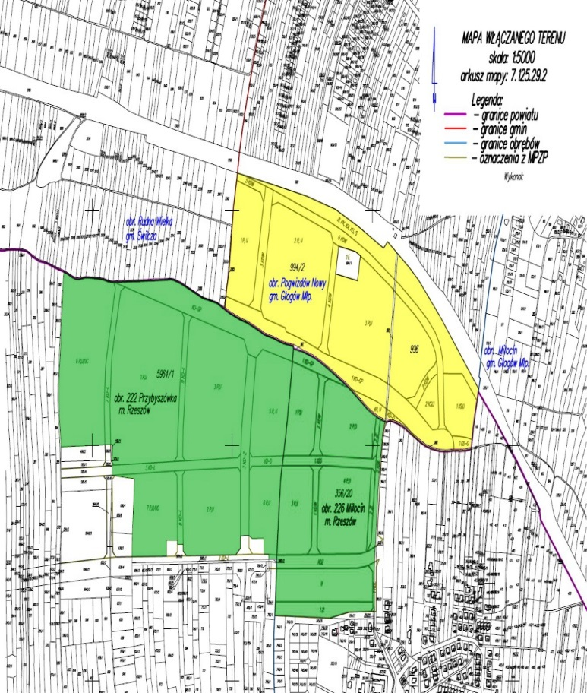
SCIENCE AND TECHNOLOGY PARK RZESZÓW-DWORZYSKO
MAP OF THE PNT RZESZÓW-DWORZYSKO
55.47 ha fully developed area, located within the administrative boundaries of Rzeszow (shaded in green) - put into operation. 27.48 ha area fully developed area, located in the commune Glogow Malopolski, completion of the project implementation- the third quarter of 2015. (shaded in yellow) TOTAL AREA of the PARK - 82.95 ha

Slide 8
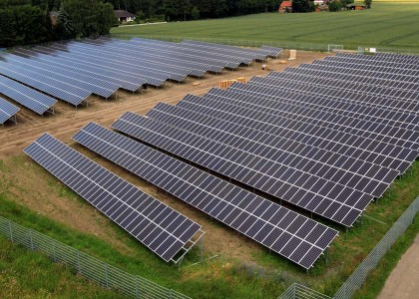
SCIENCE AND TECHNOLOGY PARK RZESZÓW-DWORZYSKO
II STAGE OF THE CONSTRUCTION OF PNT RZESZÓW-DWORZYSKO
Fotovoltaic farm with an area of 1 ha and power energy of 700 kWh

Slide 9
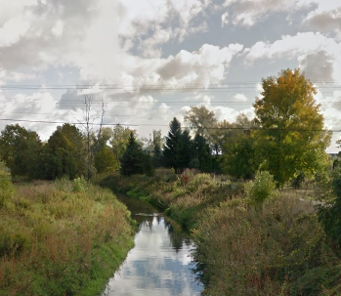
SCIENCE AND TECHNOLOGY PARK RZESZÓW-DWORZYSKO
II STAGE OF THE CONSTRUCTION OF PNT RZESZÓW-DWORZYSKO
Regulations of the ditch No. 5 which drains the rain water from the area of the Park to the Czarna River.

Slide 10
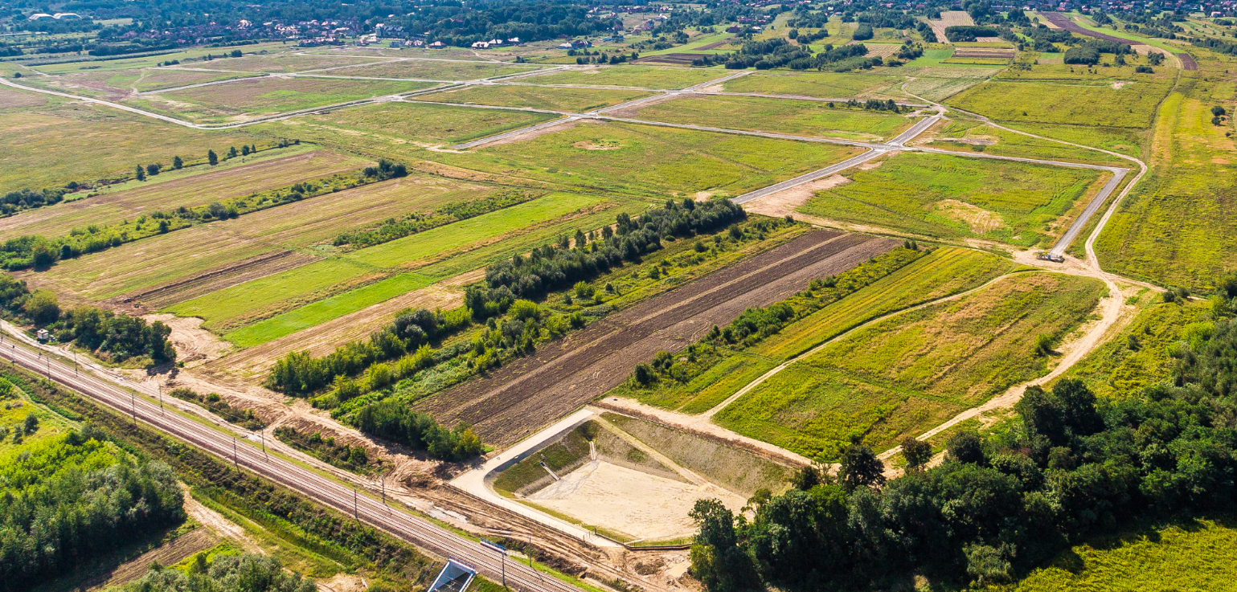
SCIENCE AND TECHNOLOGY PARK RZESZÓW-DWORZYSKO
The strategic aim of PNT is to create conditions for using of scientific and industrial potential of the region, stimulate local entrepreneurship and creation of new jobs. This will help to attract companies and new technologies, improve the business and investment attractiveness of the region podkarpackie

Slide 11
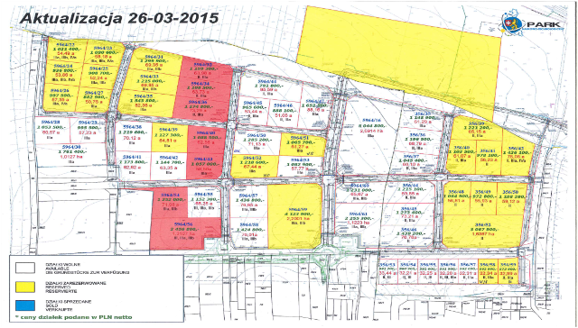
SCIENCE AND TECHNOLOGY PARK RZESZÓW-DWORZYSKO
INVESTMENT PLOTS CURRENTLY AVAILABLE (highlighted in white )

Slide 12
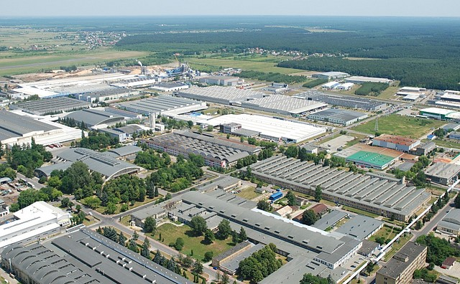
SCIENCE AND TECHNOLOGY PARK RZESZÓW-DWORZYSKO
On 02.12.2014 the Council of Ministers adopted a draft regulation amending the regulation on Special Economic Zone Euro Park Mielec.
This regulation incorporates into the zone the land of 110 ha, including the land situated in the Science and Technology Park Rzeszów-Dworzysko

Slide 13
SCIENCE AND TECHNOLOGY PARK RZESZÓW-DWORZYSKO
PUBLIC AID FOR ENTREPRENEURS IN THE SEZ EURO-PARK MIELEC
The Special Economic Zone EURO – PARK MIELEC offers public aid in the form of corporate income tax exemptions to entrepreneurs doing business in the zone against the valid business license.
According to the regional aid map, the maximum intensity of public aid for the areas in SEZ EURO-PARK MIELEC is as below:
50% for investment sites in the podkarpackie voivodeships.
The above intensity is applicable to large entrepreneurs, it is increased by 10 % in case of medium and 20% in case of small entrepreneurs.

Slide 14
SCIENCE AND TECHNOLOGY PARK RZESZÓW-DWORZYSKO
THE RULES FOR RECRUITMENT AND SELECTION OF FUTURE INVESTORS:
Investor`s application to the Office of the Science and Technology Park in the headquarters of Starostwo Powiatowe (District Authorities) in Rzeszów
Assesment of the potential inwestor`s innovativeness level by a team of experts appointed by Zarząd Powiatu (District Board)
Approval of Zarząd Powiatu for the project implementation in the Park
Call for bids for the sale of land for investors meeting the criteria for the operation within the Park

Slide 15
SCIENCE AND TECHNOLOGY PARK RZESZÓW-DWORZYSKO
The benefits of investing within PNT Rzeszów – Dworzysko
Excellent communication system,
Sites have a clear legal status,
Investment area is covered by the local zoning plan
part of Special Economic Zone „EURO- PARK” Mielec
Photovoltaic farm – II stage – 30.09.2015

Slide 16
SCIENCE AND TECHNOLOGY PARK RZESZÓW-DWORZYSKO
Park Rzeszów – Dworzysko is currently the largest and the most attractive, completely developed investment area within the administrative boundaries of the city of Rzeszów, and the entire Podkarpackie Voivodeship.
Park Rzeszów-Dworzysko is not only a new places of work. With this investment, Rzeszowski District will create an economic heart of the city and the entire region

Slide 17
SCIENCE AND TECHNOLOGY PARK RZESZÓW-DWORZYSKO
THANK YOU FOR YOUR ATTENTION

