Slide 1
NSPA procurement Overview
Luxembourg Industry Day
Mr Christian GRONNEROD
Chief of Division, Life Cycle Management Office

Slide 2
NSPA procurement overview
Aligned with NSPA Procurement Operating Instruction 4200-01
Objective
Contractual Frameworks (Services, Materiel, Works)
Principles
Competition
Outline Agreements (OAs), Call-Off Purchase Orders (POs), Standalone POs
Support NATO with agile, competitive, high quality and professional procurement services in the best interest of customers
Cost + Reimbursement, Time & Materiel
Basic Contractual Instruments (BCIs), Rapidly Useable Enabling Contracts (RUECs), Online Catalogues (E-CAT)
Types of Competitions
International Competitive Bidding (ICB)
Limited Competition
Single Source (SiSo)
Sole Source (SoSo)
Foreign Military Sales (FMS)
Consolidation
Transparency & Equal Treatment
Industrial Benefit Redistribution
Industry Connection: >70K Companies in Source File & >10K Active Firms

Slide 3
NSPA Procurement cycle
1. Need Identification
2. Solicitation & Tendering
3. Supplier Evaluation & Selection
4. Contract Award
5. Contract Management
Agile Requirements Definition
Streamlined Approval Processes
Pre-negotiated Contracts & Framework Agreements
Risk Management and Contingency Planning
Strategic Commercial Partners
Dedicated Procurement Teams
Regulatory Flexibility

Slide 4
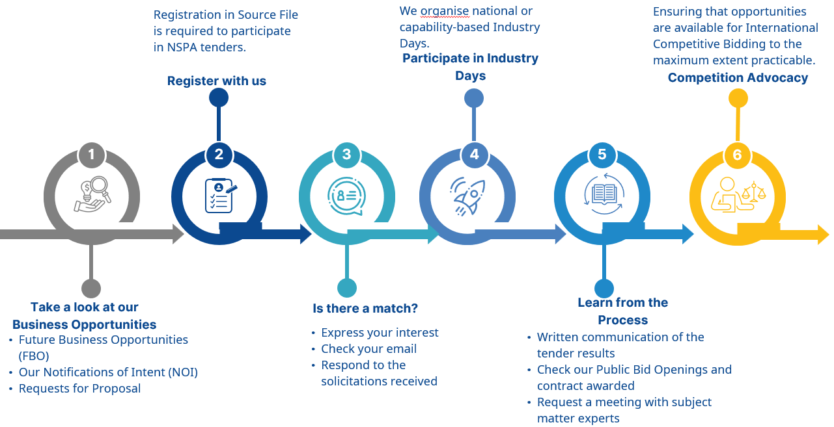
How to do business with nspa

Slide 5
Thank you.

