Slide 1
IMPLEMENTATION OF INTERNATIONAL SANCTIONS IN LUXEMBOURG
ECONOMIC AND FINANCIAL SANCTIONS IN THE GLOBAL CONTEXT Luxembourg Chamber of Commerce – 20 September 2022
National competent authorities, legal framework and general considerations
20 September 2022
Michel Leesch
Deputy Director
Directorate of European Affairs and International Economic Relations

Slide 2
outline of presentation
Introductory remarks
Sanctions – a tool of the EU Common Foreign and Security Policy and the role of the Ministry of Foreign and European Affairs (MFEA)
The MFEA as sanction maker
The MFEA as coordinator of the national implementation of sanctions
The MFEA as interface between Luxembourg and the European and international institutions
Legal framework
Closing statements

Slide 3
1. INTRODUCTORY REMARKS
Implementation of international sanctions in Luxembourg
National competent authorities
Legal framework
General observations

Slide 4
2. Sanctions – a tool of the EU Common Foreign and Security Policy and the role of the Ministry of Foreign and European Affairs (MFEA)
The MFEA as sanction maker
The MFEA is the representative in the European Council geographical and thematic groups that analyze the political opportunity of using sanctions to influence a certain situation as part of the EU’s common foreign and security policy (CFSP).
The MFEA coordinates the LU position at national level

Slide 5
2. Sanctions – a tool of the EU Common Foreign and Security Policy and the role of the Ministry of Foreign and European Affairs (MFEA)
The MFEA as coordinator of the national implementation of sanctions
Ministerial competencies defined via Grand-Ducal decree
MFEA (Directorate of European Affairs and International Economic Relations) responsible for the general coordination of the implementation of international sanctions in Luxembourg
Each Ministry/Authority in charge of the implementation of sanctions in its area of competence
Specific role of Ministry of Finance and Office for the Control of Exports, Imports and Transit (OCEIT) within the Ministry of Economy
MFEA provides support to other authorities

Slide 6
2. Sanctions – a tool of the EU Common Foreign and Security Policy and the role of the Ministry of Foreign and European Affairs (MFEA)
The MFEA as interface between Luxembourg and the European and international institutions
MFEA represented in various Commission and Council groups that discuss implementation issues
Opportunity to discuss specific issues that national operators / authorities may encounter
National coordination of Commission requests, Council work

Slide 7
3. LEGAL FRAMEWORK
European and national legal frameworks
EU sanction regimes established by Council Decisions and Council Regulations for matters that fall within the competence of the EU.
Two national laws relate to the implementation of sanctions in Luxembourg
Law of 19 December 2020, on the implementation of restrictive measures in financial matters
Law of 17 June 2018 (‘export control law’)
Legal framework deliberately broad
Criminal provisions for non-compliance with restrictive measures

Slide 8
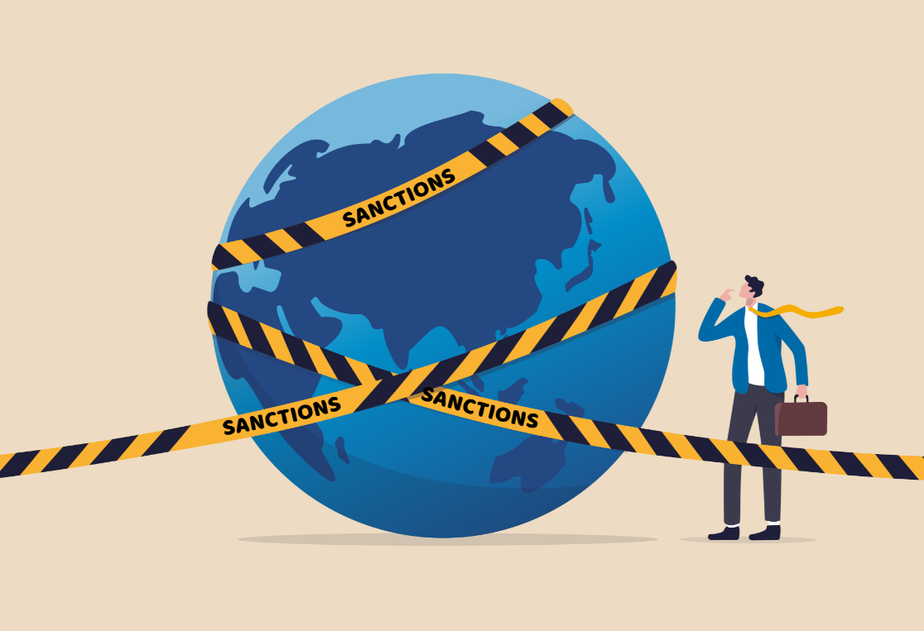
4. CLOSING STATEMENTS
Sanctions are only one tool to promote the objectives of the CFSP.
The MFEA has three roles to play when it comes to sanctions: sanction maker, sanction coordinator and interlocutor of international and European institutions.
We stand ready to assist with questions regarding the
implementation of sanctions and to guide you towards
the national competent authority.
We do not replace legal counsel.
We represent Luxembourg in various Council and Commission groups and channel information (for instance on concrete implementation issues) from operators and national authorities to the adequate Council/Commission fora.
Contact information: sanctions@mae.etat.lu

Slide 9
Thank you very much for your attention!

