Slide 1


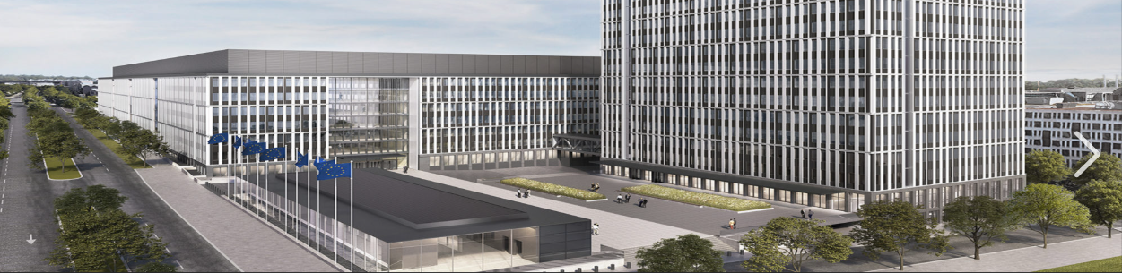
OIL. Office of Infrastructures and Logistics Luxembourg.
OIL.006. 002. Contracts and calls for tenders

Slide 2

Speakers:
Dragos PLAMADEALA
Finance & Contract Management — OIL.06
Acting Head of Sector.
Juan Antonio DURAN BLAZQUEZ
Finance & Contract Management — OIL.06
GPP & SPP Helpdesk Officer for Luxembourg and Grange
EMAS Responsible for OIL.06
Contact: OIL-APPELS-OFFRES@ec.europa.eu

Slide 3


What we will cover ?
01 🔎 WHERE TO FIND OPPORTUNITIES
Discover procurement opportunities offered by OIL and other EU institutions.
02 📋 HOW TO PARTICIPATE
Understand the main steps and requirements of EU procurement procedures.
03 ✓ HOW TO AVOID COMMON MISTAKES
Practical tips to prepare and submit compliant tenders.

Slide 4
01 🔎 WHERE TO FIND OPPORTUNITIES?

Slide 5
Office for Infrastructure and Logistics in Luxembourg (OIL)
Part of the European Commission.
Main responsibilities:
  Management of Commission buildings in Luxembourg
  Technical infrastructure and maintenance
  Logistics and facility management
  Catering, childcare facilities and support services
  Procurement of services, supplies and works related to infrastructure
Objective:
  Ensure the operational functioning of the European Commission in Luxembourg.

Slide 6
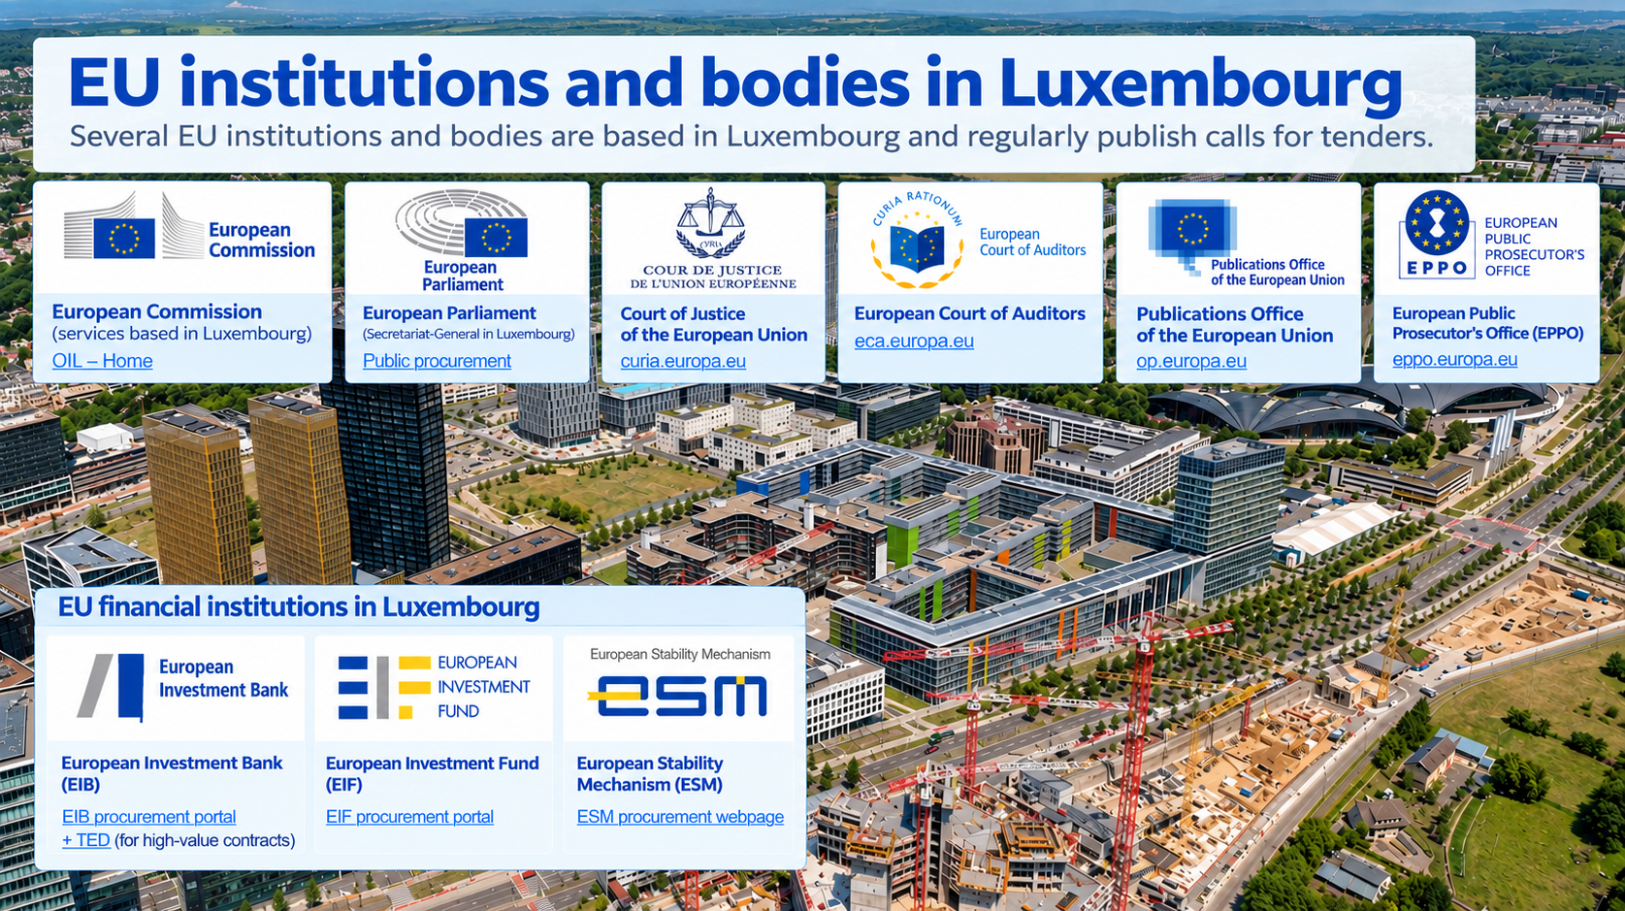
EU financial institutions in Luxembourg

Slide 7

EU institutions and bodies in Luxembourg. Where and how to find EU calls for tenders
European Commission (services based in Luxembourg)
OIL – Home
European Parliament (Secretariat-General in Luxembourg)
https://www.europarl.europa.eu/contracts-and-grants/en/public-procurement
Court of Justice of the European Union
https://curia.europa.eu
European Court of Auditors
https://www.eca.europa.eu
Publications Office of the European Union
https://op.europa.eu
European Public Prosecutor’s Office(EPPO)
Procurement | European Public Prosecutor’s Office

Slide 8



EU financial institutions in Luxembourg
Luxembourg is also home to major European financial institutions:
These institutions finance projects across Europe and also publish procurement procedures, although they follow their own procurement rules and procedures.
Organisation | Type | Where procurement is published
European Investment Bank (EIB) | EU financial institution | EIB procurement portal + TED (for high-value contracts) Published tenders
European Investment Fund (EIF) | EU financial institution | EIF procurement portal
European Stability Mechanism (ESM) | Intergovernmental financial institution | ESM procurement webpage

Slide 9
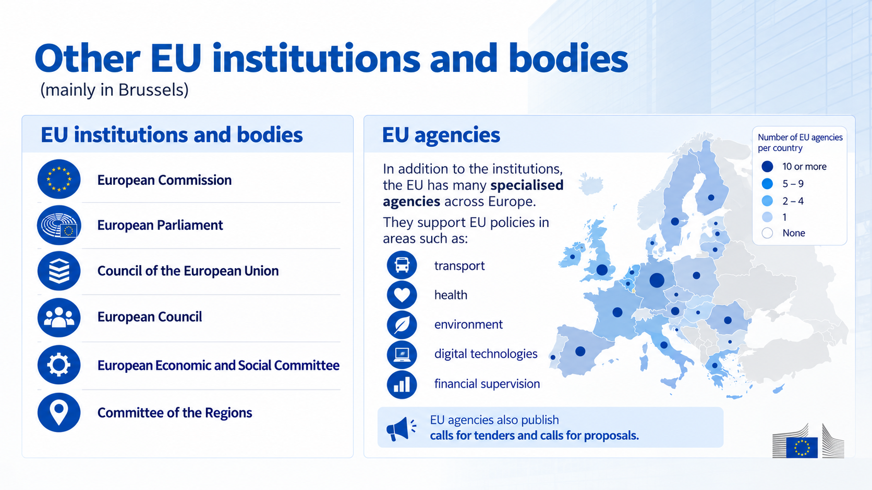
Other EU institutions and bodies
(mainly in Brussels)
European Commission
European Parliament
Council of the European Union
European Council
European Economic and Social Committee
Committee of the Regions

Slide 10
OIL. Target sectors. What does OIL buy?
  🏢Infrastructure & technical maintenance (CPV 50000000-9 – 50790000-4)
  🔒Insurance, security, utilities & energy services (CPV 65200000-5 – 79714000-2)
  🏢 Technical studies & real estate manag. support (CPV 70300000-4 – 71335000-5)
  🏢 Supply and installation of technical systems (CPV 33700000-7 – 90920000-2)
  🧹Cleaning, hygiene & waste management (CPV 30100000-0 – 39130000-2)
  🪑Office, technical equipment & supplies (CPV 15800000-6 – 55520000-1)
  🍽 Catering & food services (CPV 37500000-3 – 85312110-3)
  🧸Childcare equipment & services (CPV 60100000-9 – 63520000-0)
  🚚Mobility & logistics services (CPV 65200000-5 – 79714000-2)
  🏢 Works (CPV 65200000-5 – 79714000-2)

Slide 11
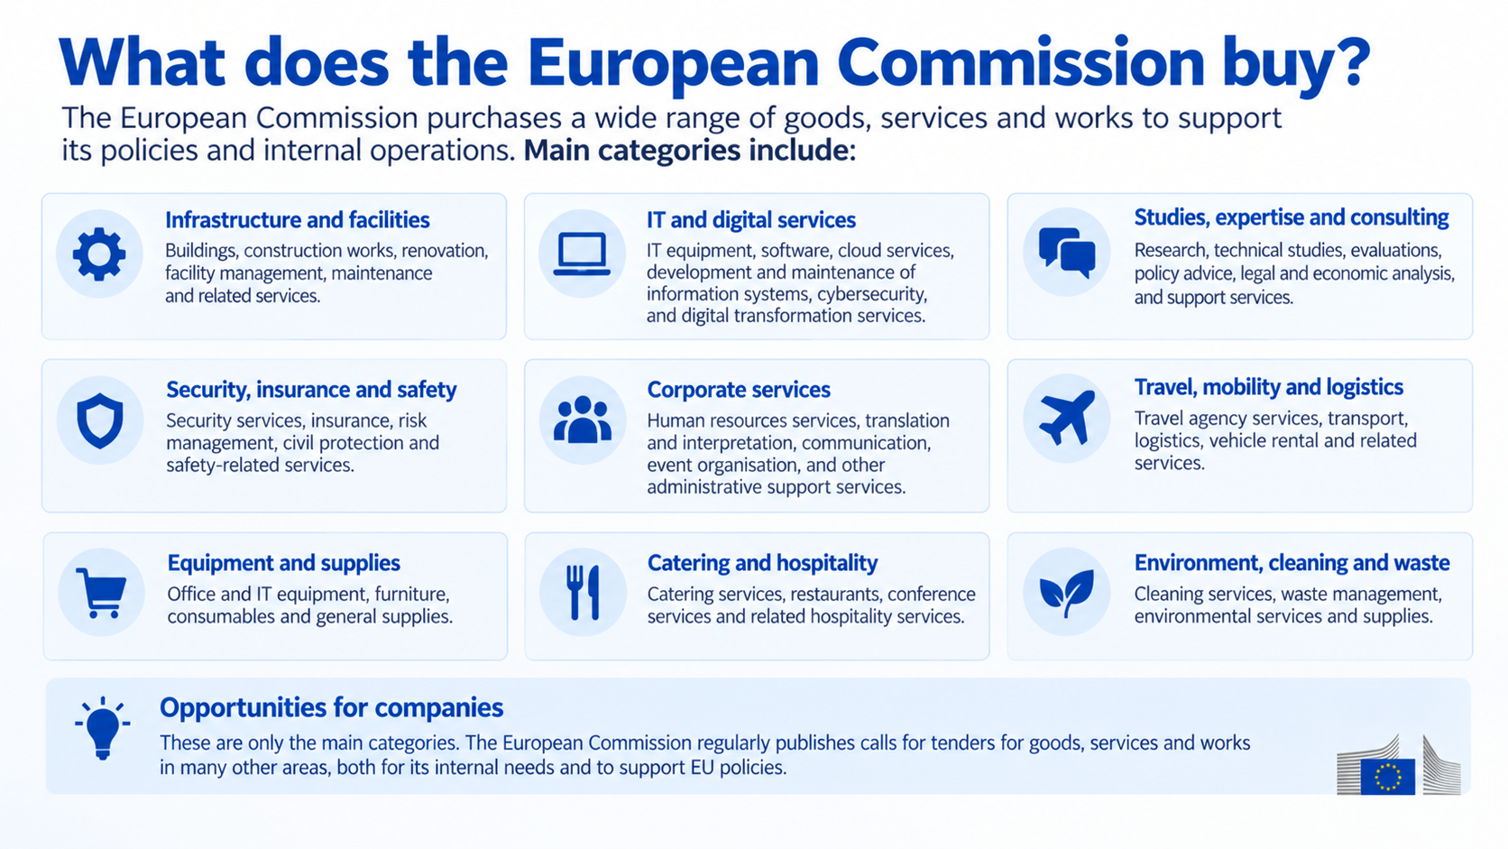
OIL. Target sectors. What does OIL buy?
  🏢Infrastructure & technical maintenance (CPV 50000000-9 – 50790000-4)
  🔒Insurance, security, utilities & energy services (CPV 65200000-5 – 79714000-2)
  🏢 Technical studies & real estate manag. support (CPV 70300000-4 – 71335000-5)
  🏢 Supply and installation of technical systems (CPV 33700000-7 – 90920000-2)
  🧹Cleaning, hygiene & waste management (CPV 30100000-0 – 39130000-2)
  🪑Office, technical equipment & supplies (CPV 15800000-6 – 55520000-1)
  🍽 Catering & food services (CPV 37500000-3 – 85312110-3)
  🧸Childcare equipment & services (CPV 60100000-9 – 63520000-0)
  🚚Mobility & logistics services (CPV 65200000-5 – 79714000-2)
  🏢 Works (CPV 65200000-5 – 79714000-2)

Slide 12
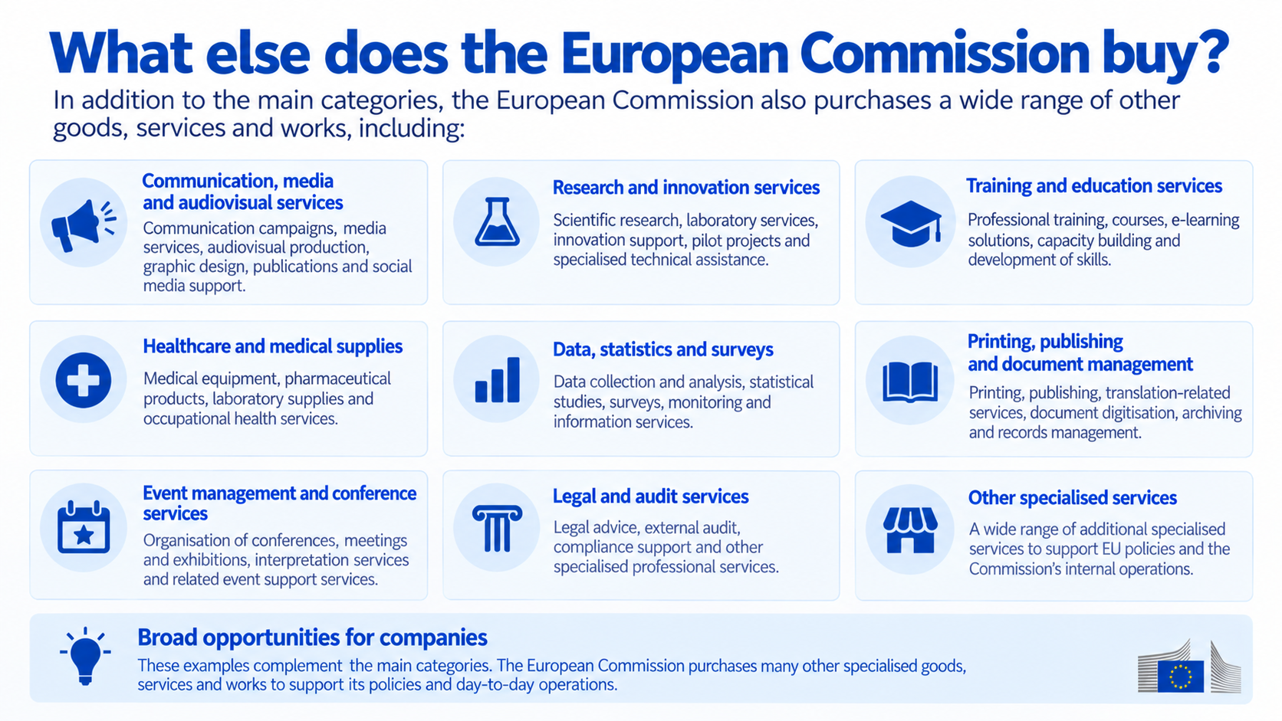
OIL. Target sectors. What does OIL buy?
  🏢Infrastructure & technical maintenance (CPV 50000000-9 – 50790000-4)
  🔒Insurance, security, utilities & energy services (CPV 65200000-5 – 79714000-2)
  🏢 Technical studies & real estate manag. support (CPV 70300000-4 – 71335000-5)
  🏢 Supply and installation of technical systems (CPV 33700000-7 – 90920000-2)
  🧹Cleaning, hygiene & waste management (CPV 30100000-0 – 39130000-2)
  🪑Office, technical equipment & supplies (CPV 15800000-6 – 55520000-1)
  🍽 Catering & food services (CPV 37500000-3 – 85312110-3)
  🧸Childcare equipment & services (CPV 60100000-9 – 63520000-0)
  🚚Mobility & logistics services (CPV 65200000-5 – 79714000-2)
  🏢 Works (CPV 65200000-5 – 79714000-2)

Slide 13
02 📋 HOW TO PARTICIPATE

Slide 14
Publication of EU procurement procedures
EU institutions (Commission, Parliament, CJEU, Court of Auditors, Publications Office)
Above EU thresholds
(Services & supplies > about €140,000 | Works > €5.38 million)
→ Publication in OJEU
→ Practical access: TED + Funding & Tenders Portal
Below EU thresholds (> about €140,000 | Works > €5.38 million)
→ Could be published on the Funding & Tenders Portal => PIN (Prior Information Notice).
→ Always on institutional websites

Slide 15

Where and how to find EU calls for tenders
1️⃣ Funding & Tenders Portal.
Procurement - Online Manual - Funding Tenders Opportunities
Participant register
Companies wishing to participate must register in the EU Participant Register and obtain a PIC (Participant Identification Code).
2️⃣ Official Journal of the European Union (OJEU)
TED – Tenders Electronic Daily
Online database of EU public procurement notices
Search by sector, country or keywords
Possibility to create automatic alerts

Slide 16
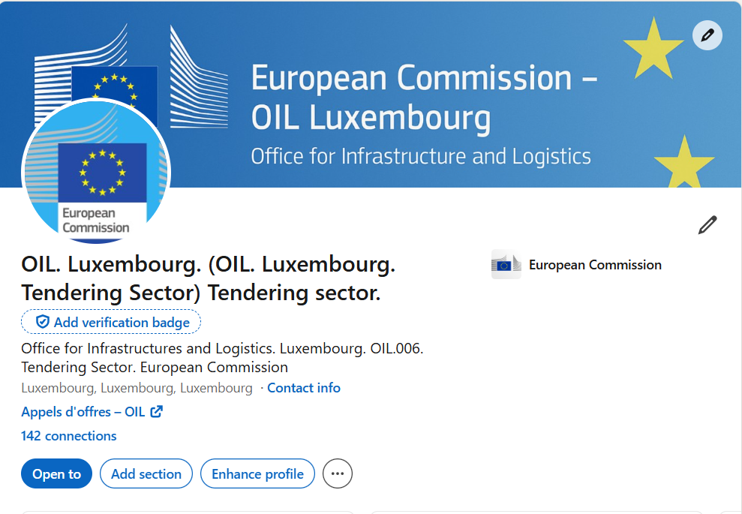
Where and how to find EU calls for tenders
3️⃣ Other information channels
Institutional website:
LinkedIn pages of EU institutions:
OIL: https://www.linkedin.com/in/oil-luxembourg-tendering-sector-4885b2315/

Slide 17
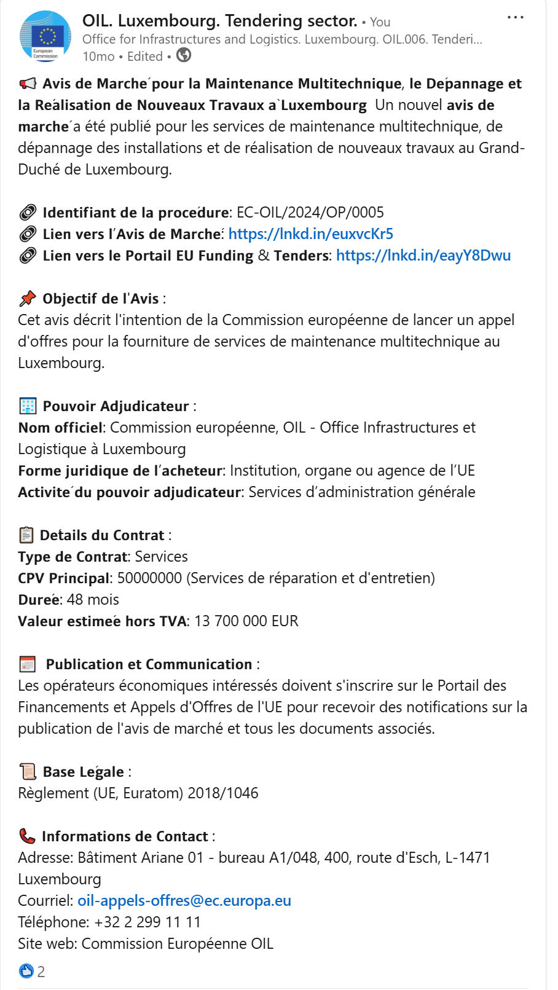
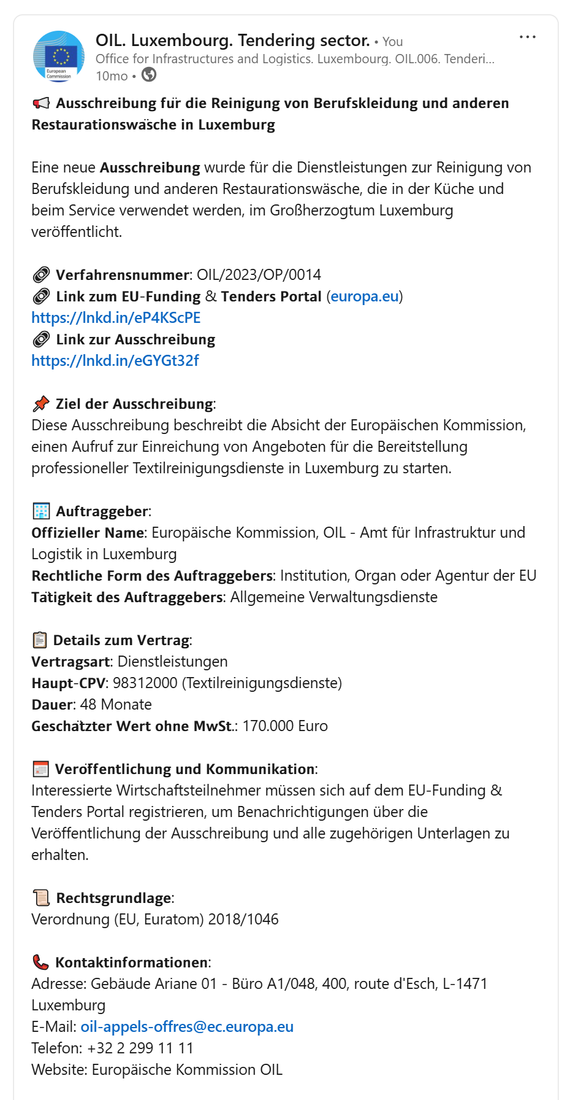
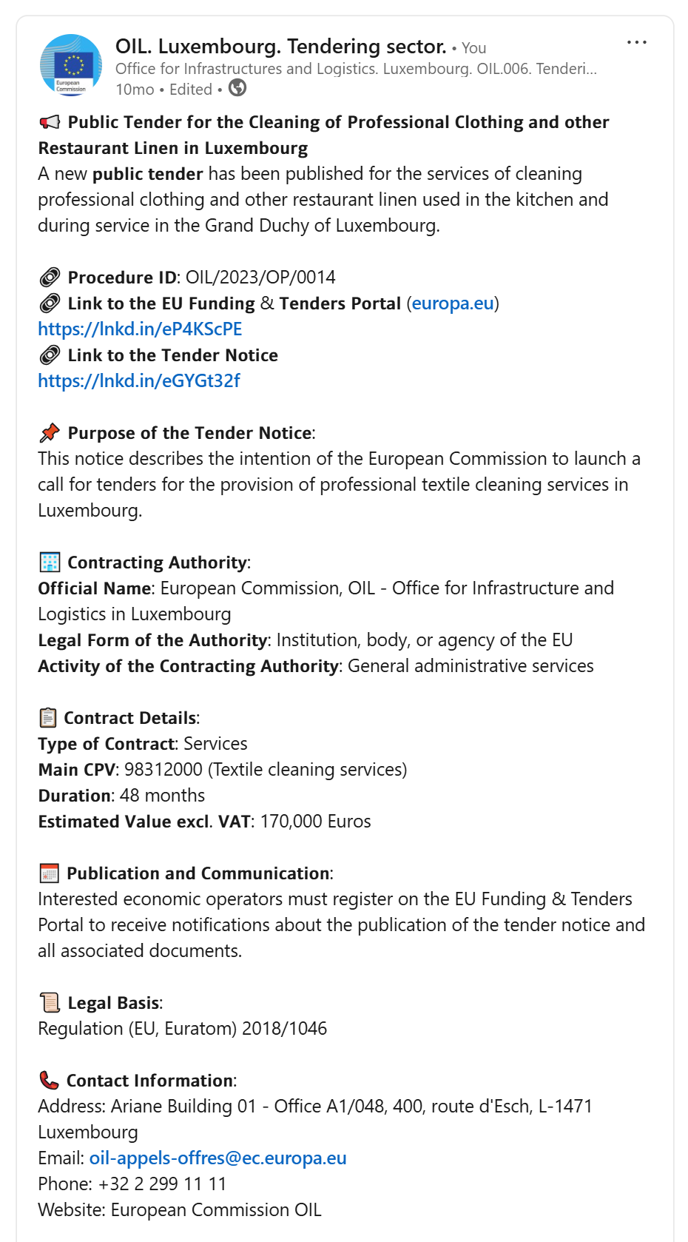
OIL LinkedIn Profile

Slide 18
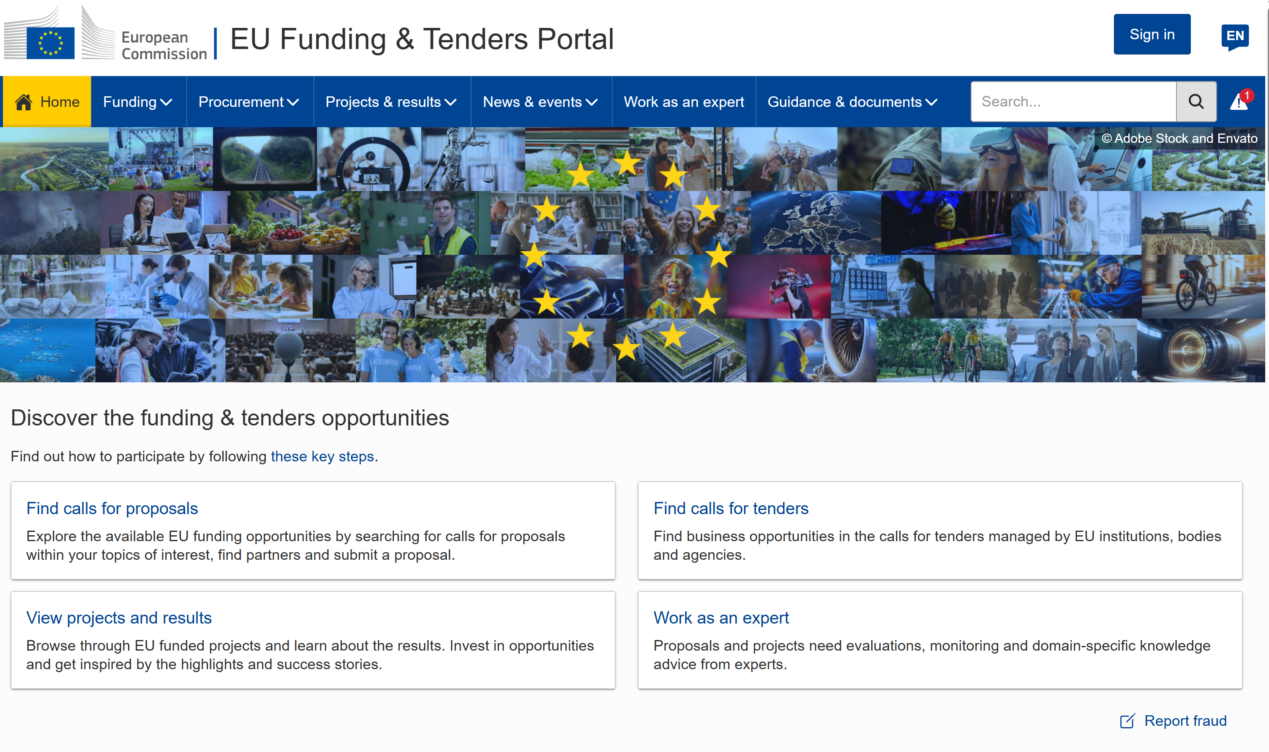
Where and how to find EU calls for tenders

Slide 19
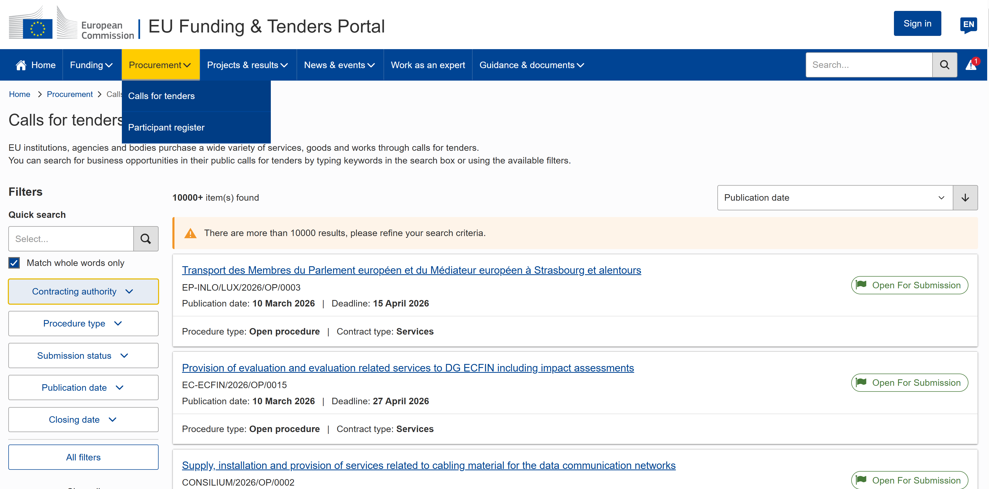
Where and how to find EU calls for tenders

Slide 20
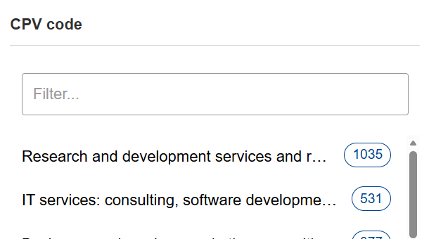
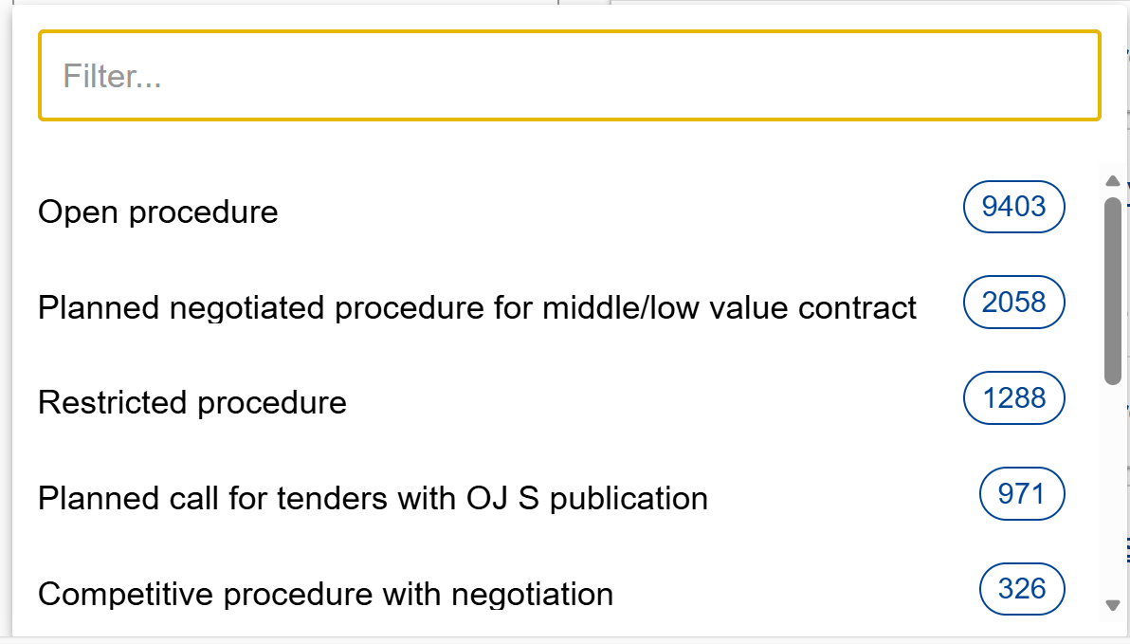
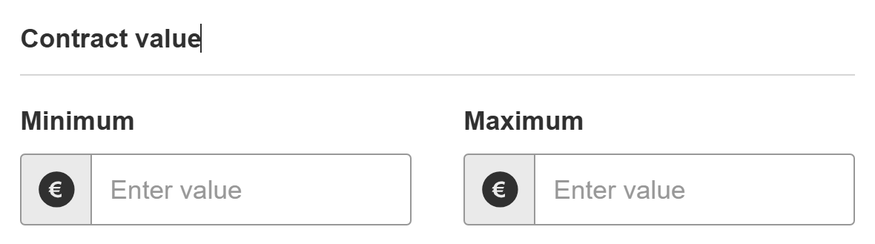
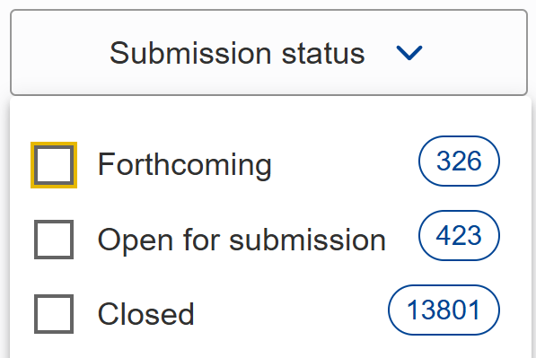
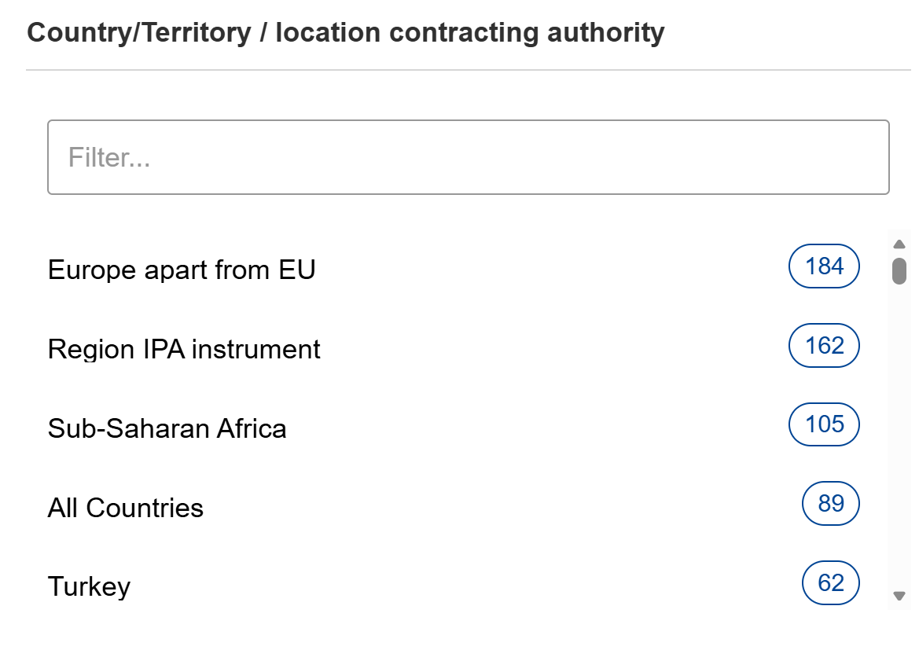
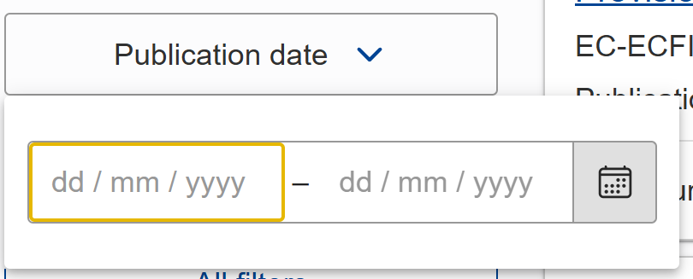
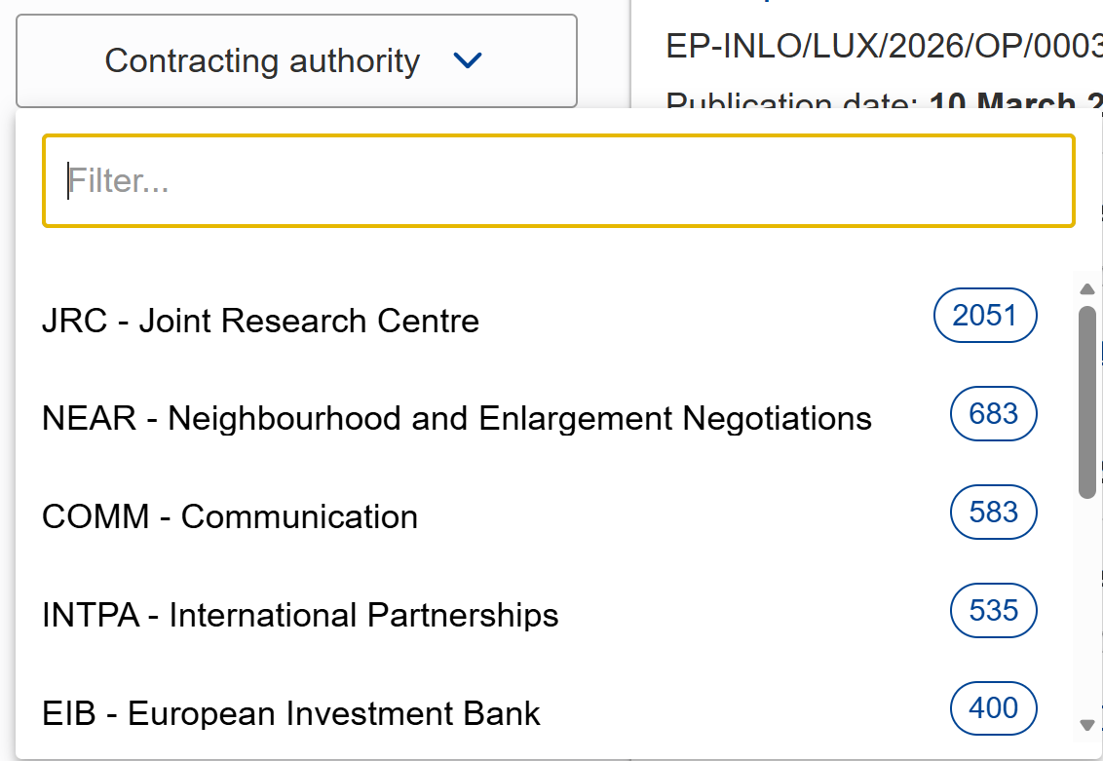
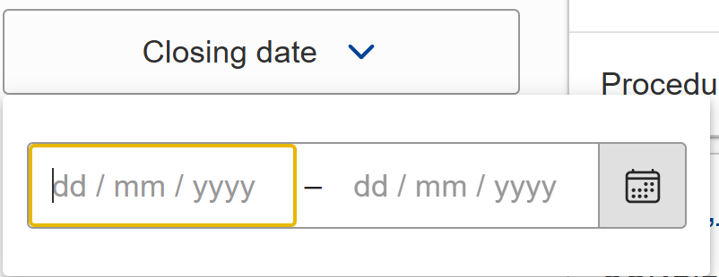
Search Filters

Slide 21
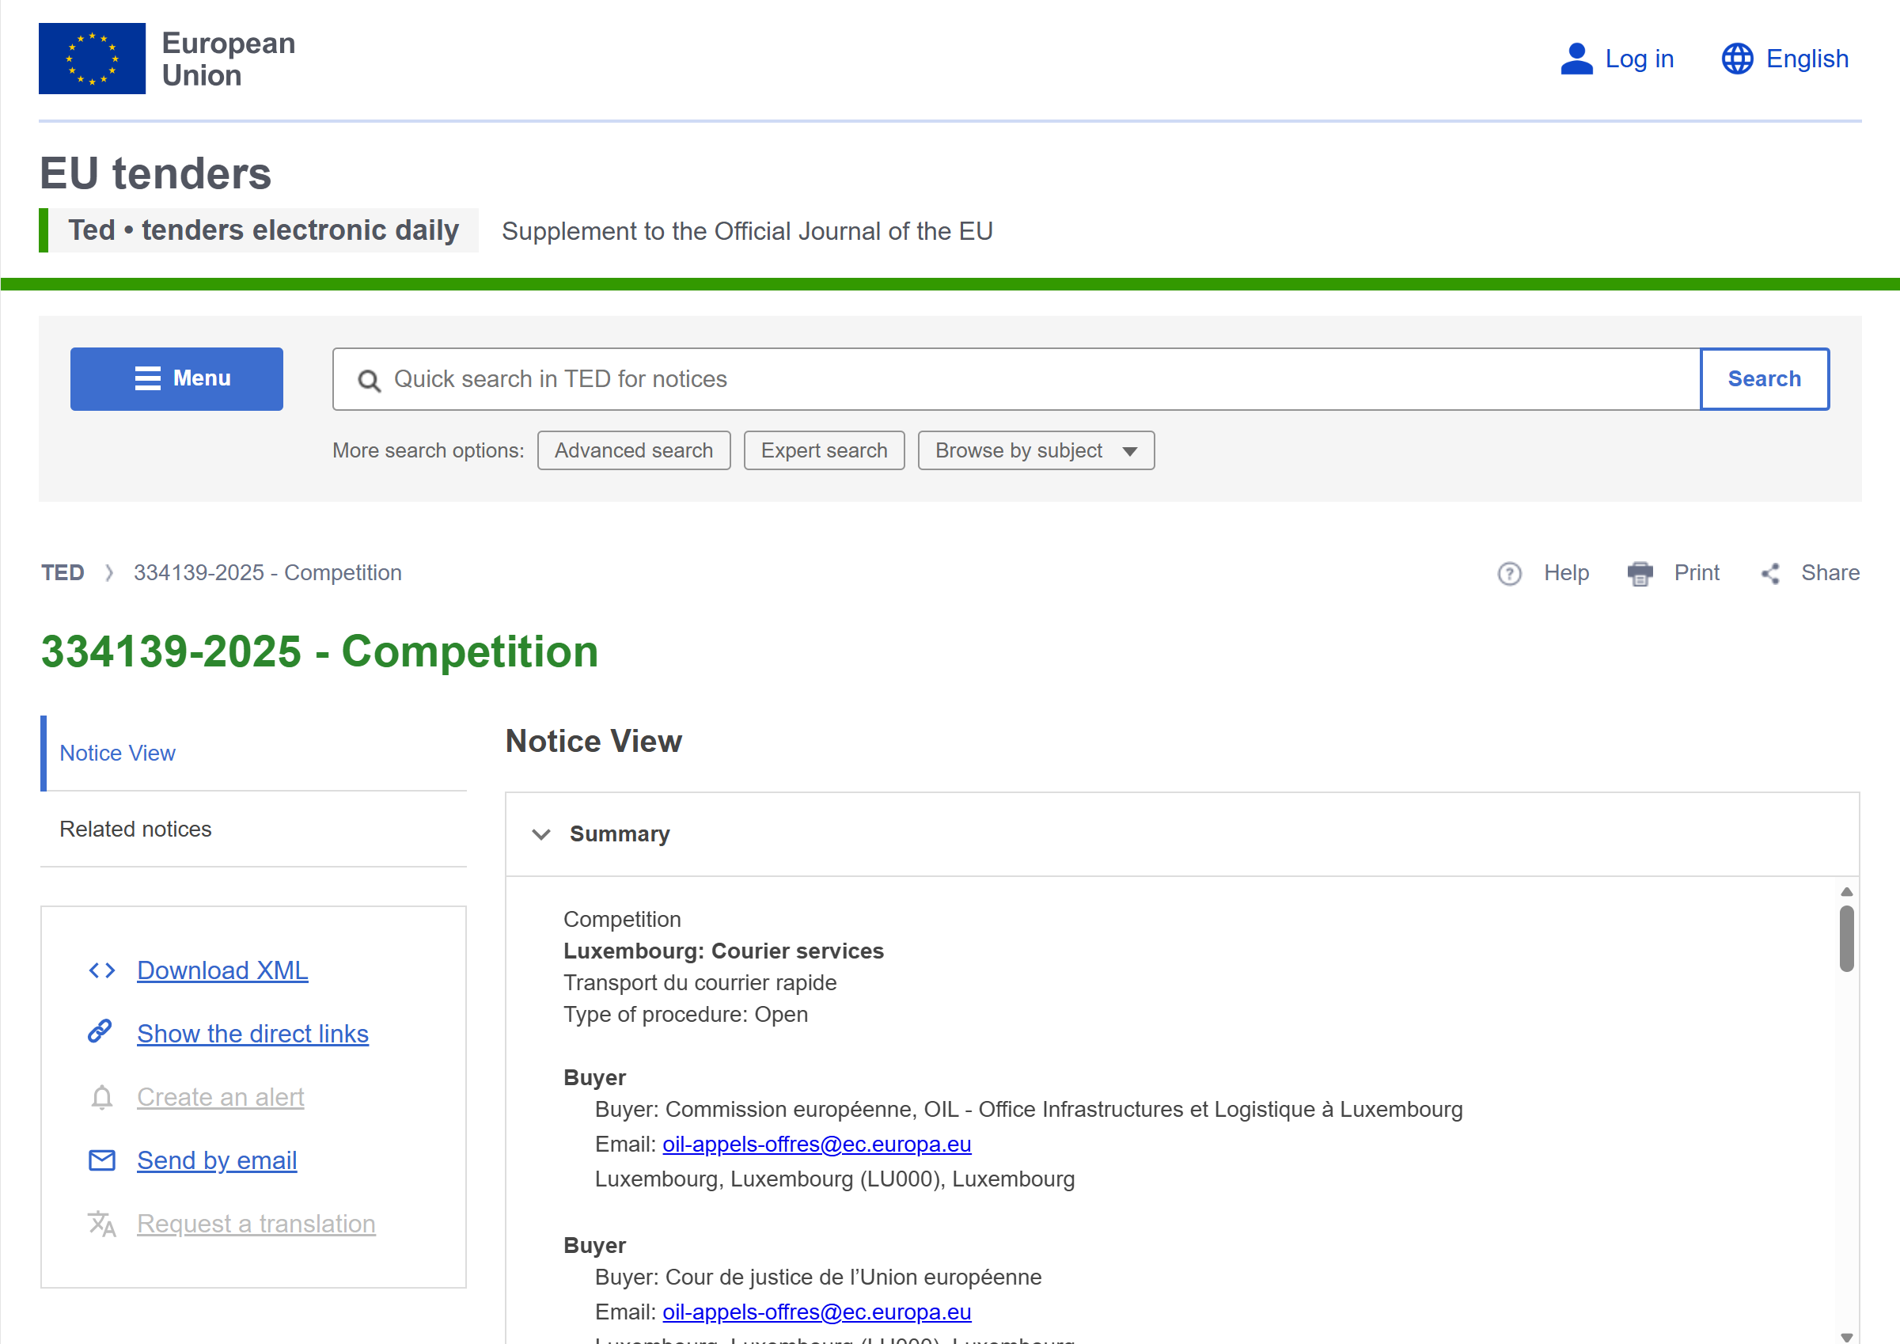

Slide 22
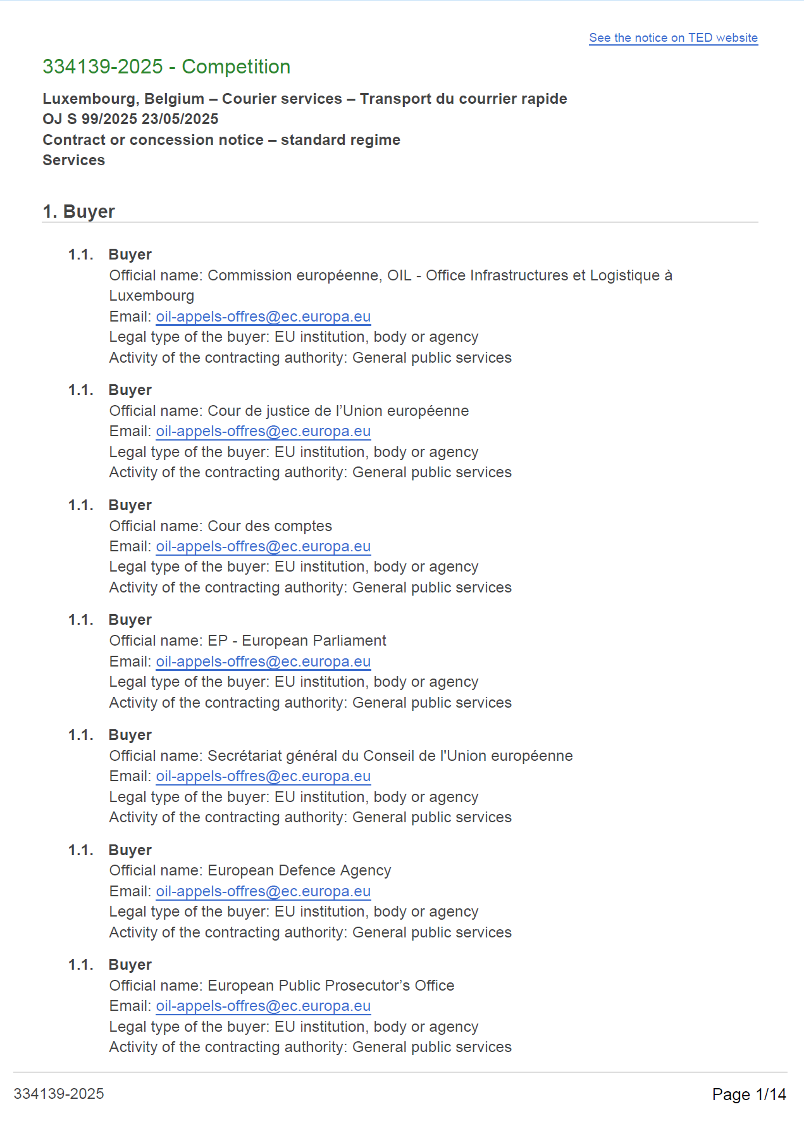
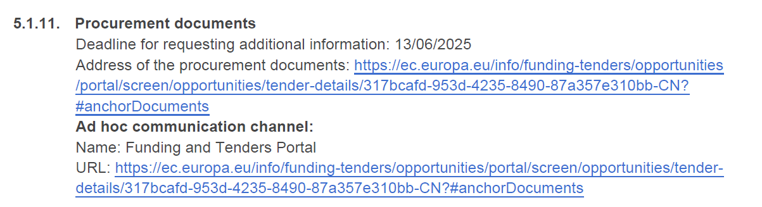
Contract Notice Extracts
A contract notice is the official announcement of a procurement procedure. It informs the market about the opportunity and provides the key elements of the foreseen contract, such as the contracting authority, the subject of the contract, the deadline for submission and the selection criteria. It also includes a link to the procurement documents, where companies can find the detailed specifications and instructions for submitting their offer.

Slide 23
03 ✓ HOW TO AVOID COMMON MISTAKES

Slide 24
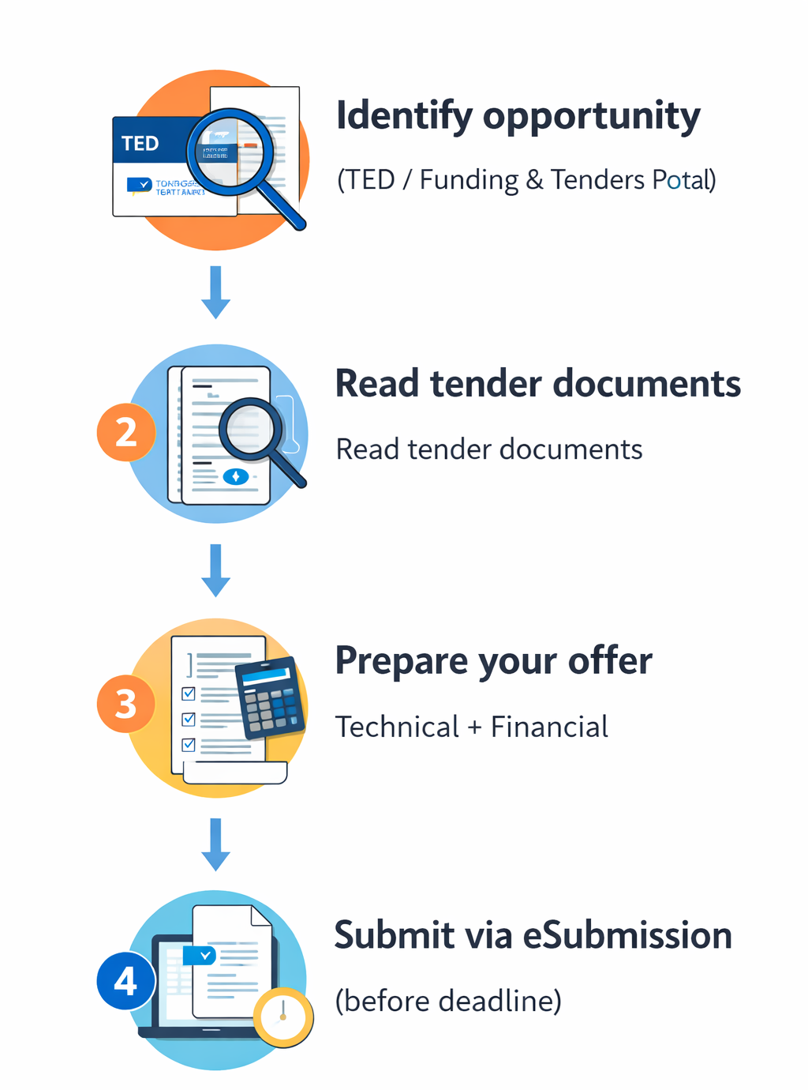
What to do after identifying a relevant call for tenders
Carefully read the procurement documents
Analyse the contract notice (ted.europa.eu), tender specifications, technical requirements, selection criteria, and award criteria.
Verify eligibility and requirements
Ensure your organisation meets the legal, financial, and technical capacity requirements.
Register for access the procurement platform
Access the tender through the relevant platform (e.g. the EU Funding & Tenders Portal, TED – Tenders Electronic Daily or the contracting authority’s platform).

Slide 25
Verify eligibility and requirements
Ensure your organisation meets the legal, financial, and technical capacity requirements.
Exclusion criteria
Ensure the company is not in a situation that prevents participation in EU procurement (e.g. bankruptcy, fraud, corruption, serious professional misconduct, or unpaid taxes/social security).
Selection criteria
Demonstrate the organisation’s capacity to perform the contract, including:
– Financial capacity (financial stability, turnover, economic standing)
– Technical and professional capacity (relevant experience, references, staff expertise).
Award criteria
These are the criteria used to evaluate and rank the tenders. The contract is awarded to the tender offering the best value for money, based on quality and price.

Slide 26
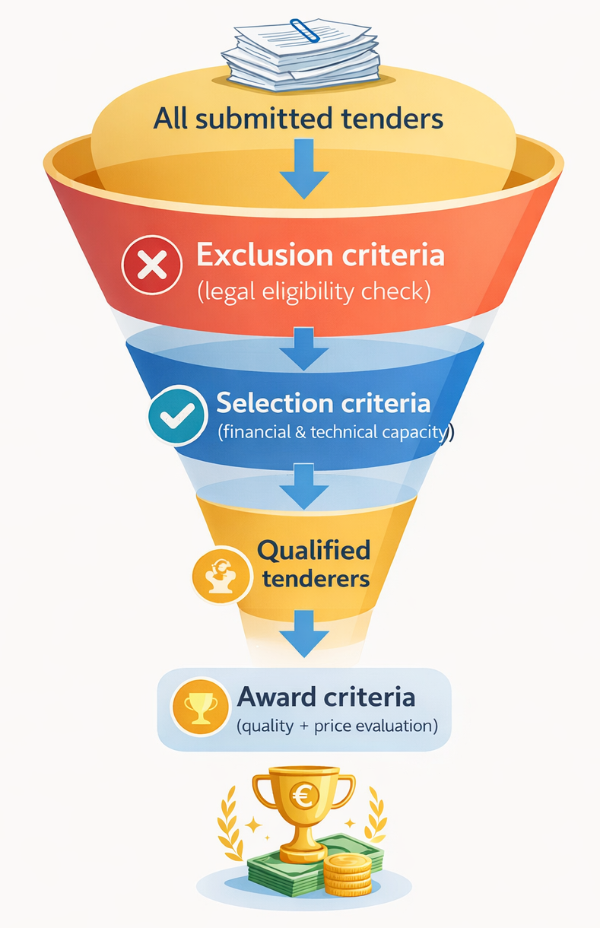
During the tender period
Ask clarification questions if necessary
  Submit questions to the contracting authority through the EU Funding & Tenders Portal (eSubmission / Q&A section) within the deadline if any requirement is unclear.
If in doubt, please ask clarification questions. …
Prepare the tender documentation
  Draft the technical offer and financial offer, and gather all required administrative documents.
Form a consortium or subcontract if needed
  Identify partners if the contract requires additional expertise or capacity.

Slide 27
Prepare your tender -Tender documents and offer structure
Tender documents usually include:
Technical specifications (description of the services, supplies or works required)
Administrative specifications (legal conditions, exclusion, selection and award criteria)
Draft contract (terms and conditions of the future contract)
Price schedule / Bill of quantities (!to be completed by the tenderer!)
Your tender must normally include:
Financial offer (mandatory – using the price schedule provided)
Technical offer (if required in the tender specifications)
Administrative documents (declarations and supporting documents)

Slide 28
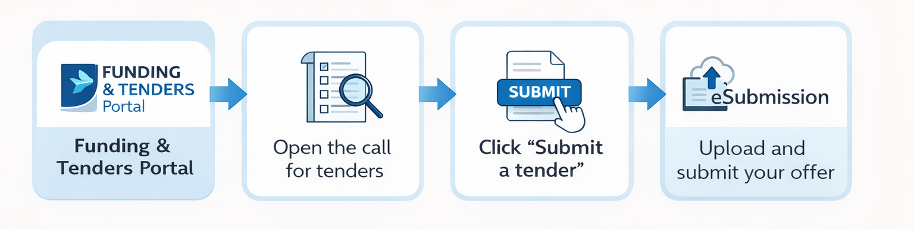
Submission of tenders
Tenders must be submitted electronically via eSubmission through the Funding & Tenders Portal.
The system ensures:
confidentiality
equal treatment
secure submission.
Submission by email or post is not accepted.
Registration is required: companies must register in the EU Participant Register and obtain a PIC (Participant Identification Code).

Slide 29
Tender submission – key rules
⏱ Respect the submission deadline: late tenders are automatically rejected.
! Don’t leave it for the last minute of available time!
📩 Confirmation of submission:
eSubmission provides an electronic timestamp and receipt as proof of submission.
🔁 Tenders can be withdrawn or replaced before the deadline, but only the last submitted offer will be considered.
📄All required documents must be included at the time of submission, including the financial and technical offer, which is mandatory.

Slide 30
Tips to avoid irregular or non-compliant tenders
⚠️ Submit a complete offer
Include ALL required offer documents. The most important is the offer (Financial and if necessary Technical). Financial or technical offers cannot be modified after submission.
⚠️ Define partners from the start
Clearly indicate consortium partners or entities whose capacities you rely on.
⚠️ No changes after submission
New companies cannot be added once the deadline has passed.
⚠️ Follow the tender instructions carefully
Read the specifications and include all required documents.
⚠️ Separate financial and technical offers correctly
Sometimes the financial information appears in the technical offer leading to contradictions, which can lead to rejection in some procedures.

Slide 31
Thank you for listening!

