Slide 1
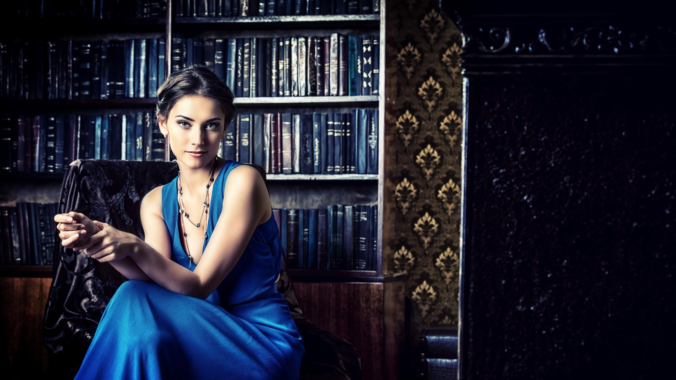
#1 French Cosmetics factory in Uzbekistan

Slide 2
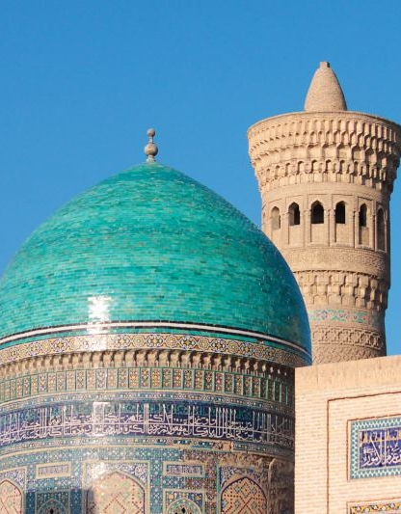
1997 - 2017
1997-1998
Nicolas van Beek @ French Embassy in Tashkent, Uzbekistan;
2004
Setup of a first pharmacy in the country side of Uzbekistan;
2016-2017
Creation of the #1 French cosmetics factory in Uzbekistan.
Notes:
20 years in close contact with UZ

Slide 3
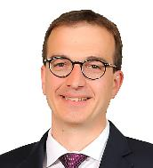
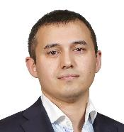
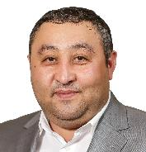
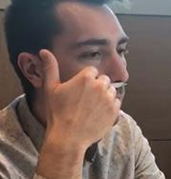
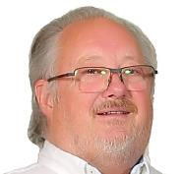
FRANCO-UZBEK MANAGEMENT
Nicolas van Beek
Javokhir Nurmetov
Samandar Samatov
CEO Europe Product & Marketing Entrepreneur
CEO Uzbekistan
Former Uzbek Diplomat
Business Development Uzbek Entrepreneur
Sylvain Cara
Christian Dampeirou
Perfumer French Perfumer
Scientific Director French Chemist & Scientist

Slide 4
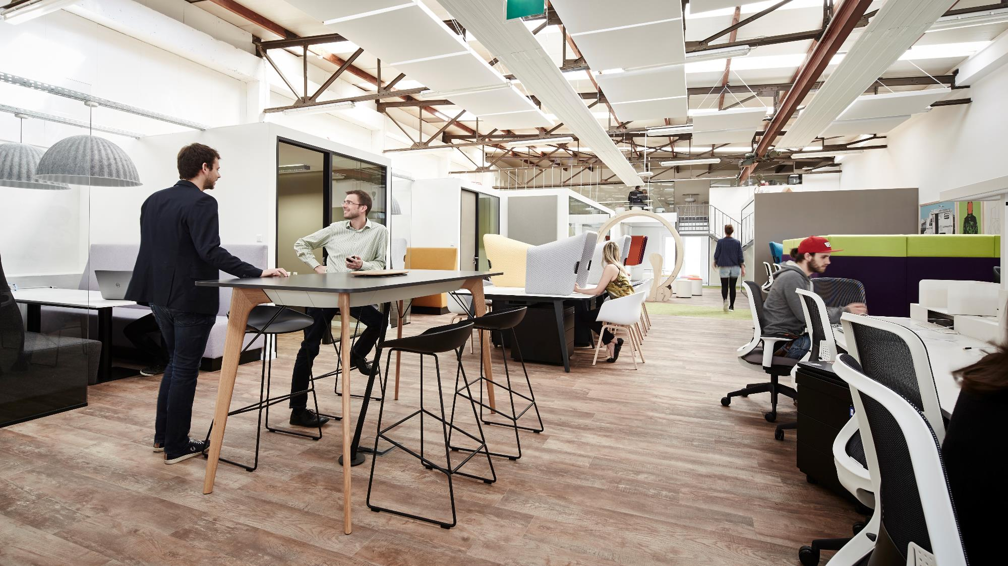
MARKETING @LUXEMBOURG
Notes:
Working in 3 countries: Lux

Slide 5
PRODUCT DEVELOPMENT@LABORATOIRE JNS LABS, FRANCE

Slide 6
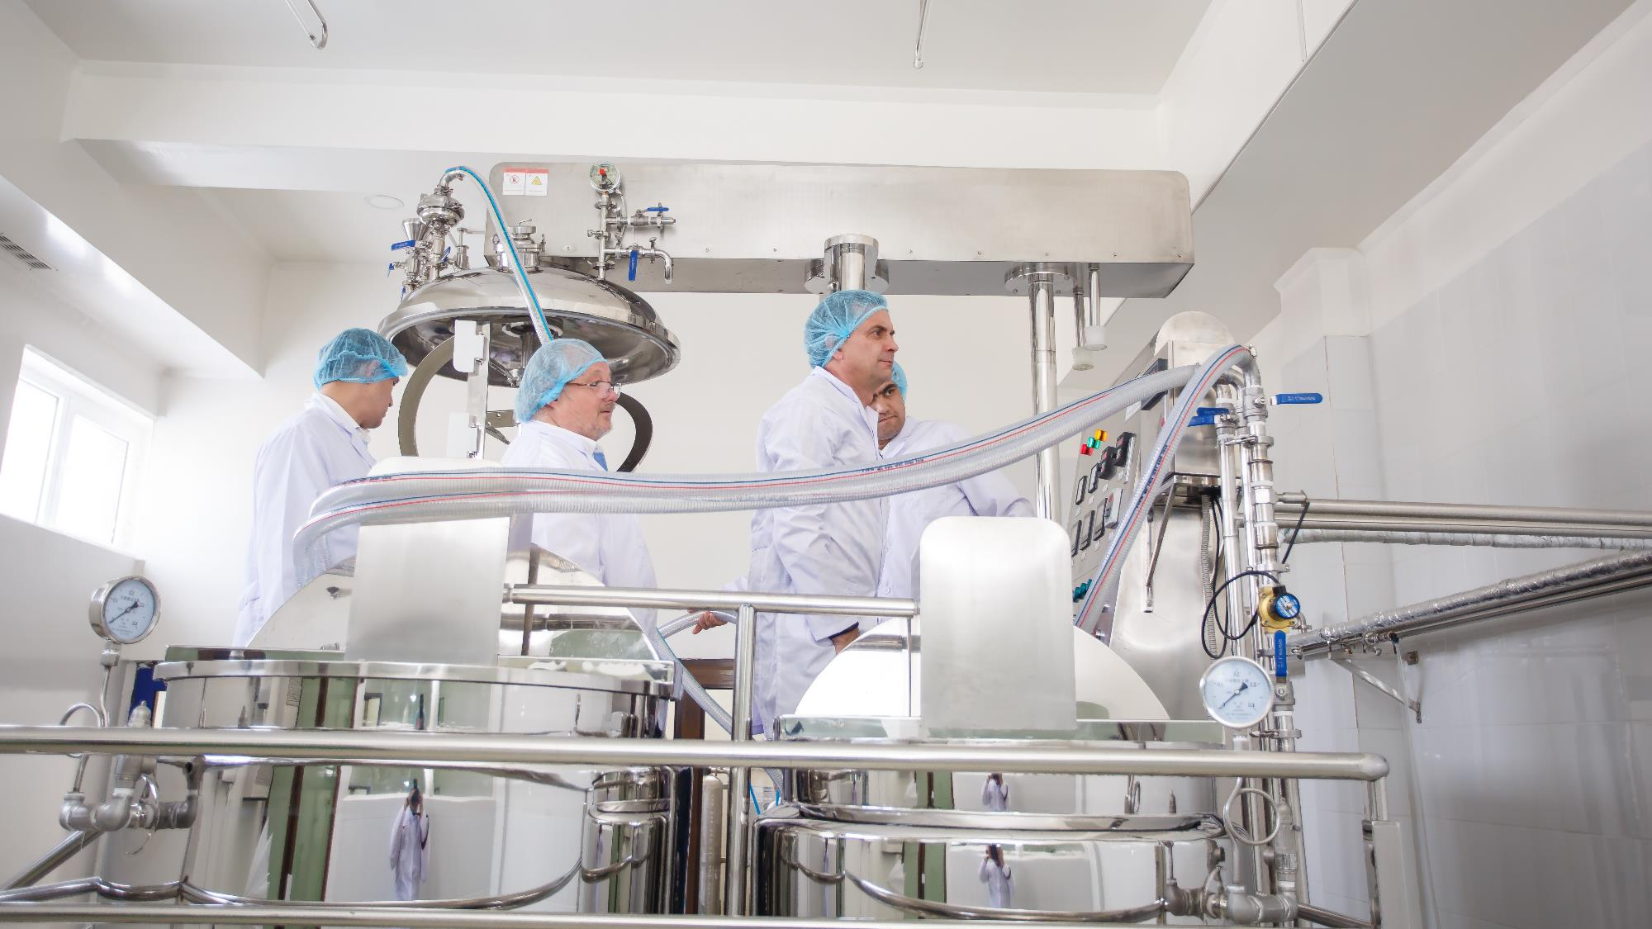
PRODUCTION SITE @TASHKENT, UZBEKISTAN

Slide 7
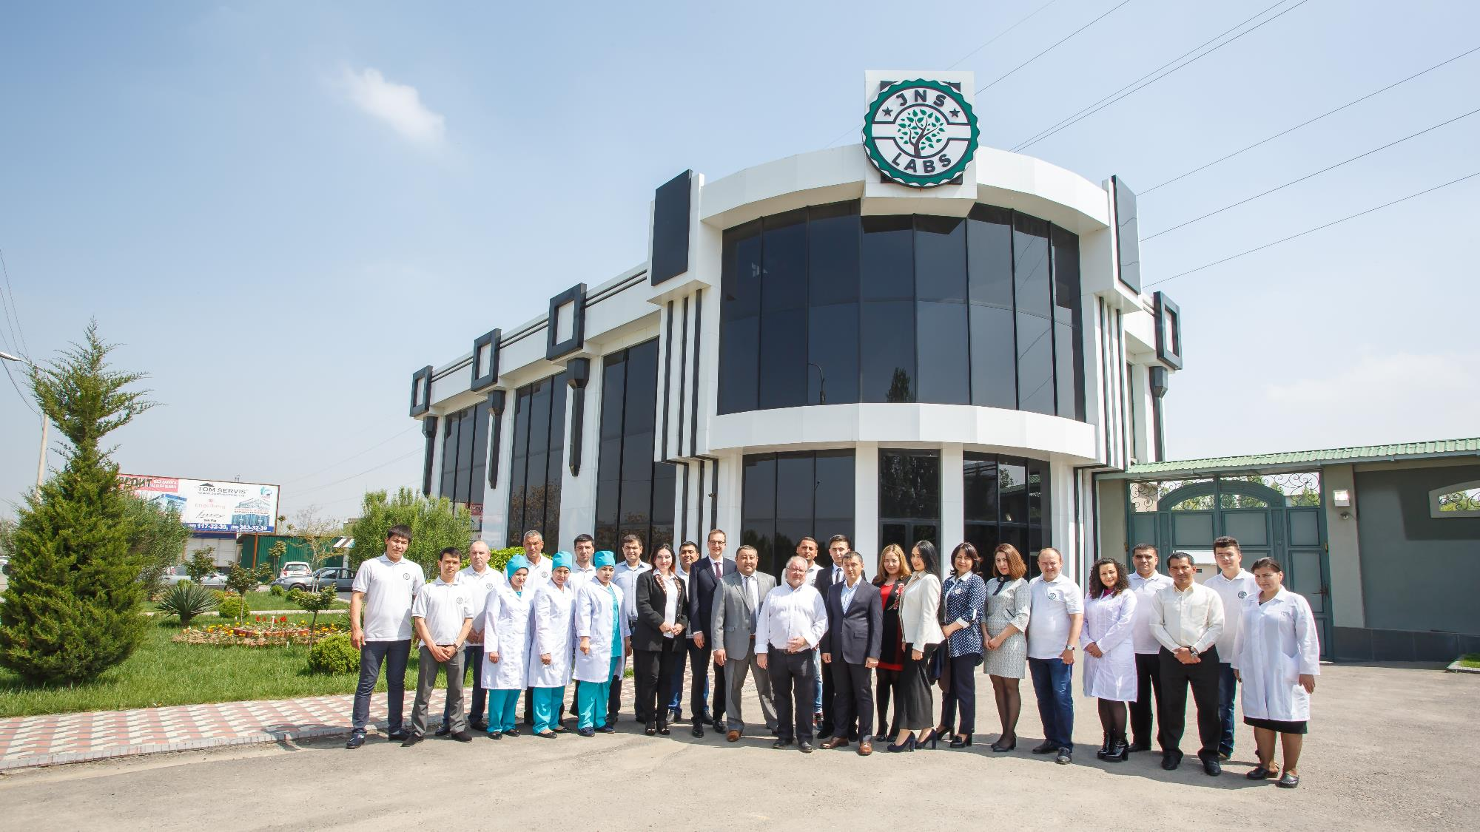
JNS LABS LLC, TASHKENT, UZ
Notes:
Today, we have 40 employees and 20 sales agent

Slide 8
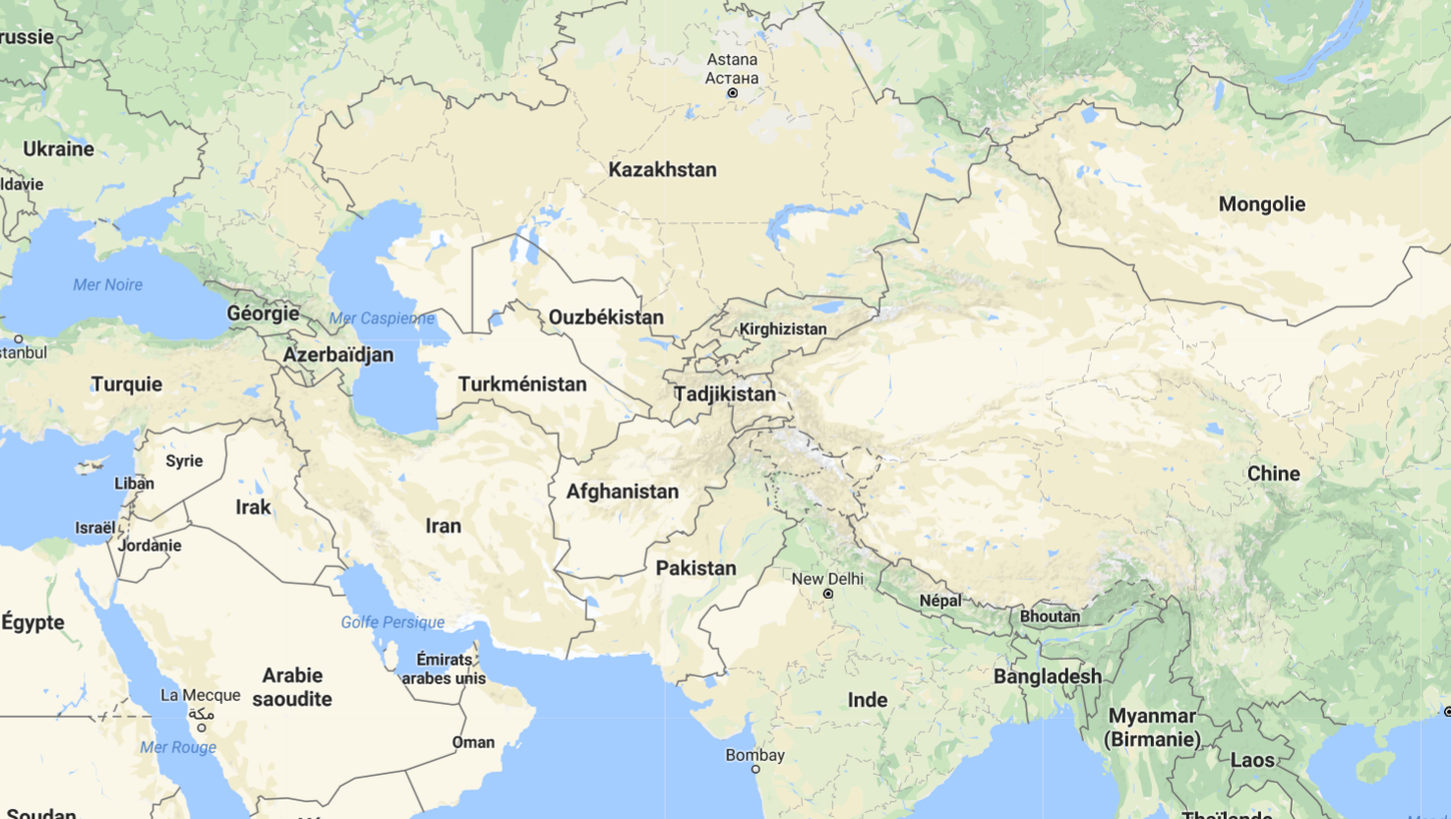
MARKET : CENTRAL ASIA, POPULATION OF 90 MILLION

Slide 9
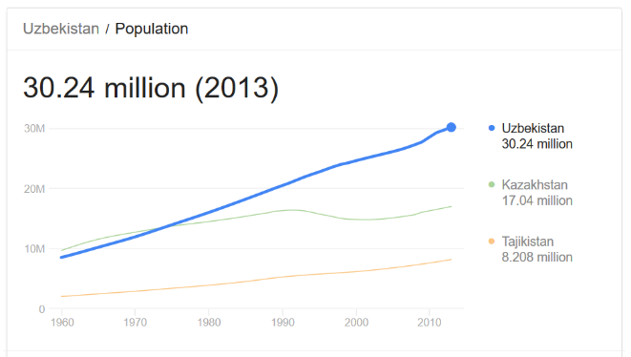
POPULATION GROWTH, UZBEKISTAN
Notes:
These countries like Uzbekistan have a growing population

Slide 10
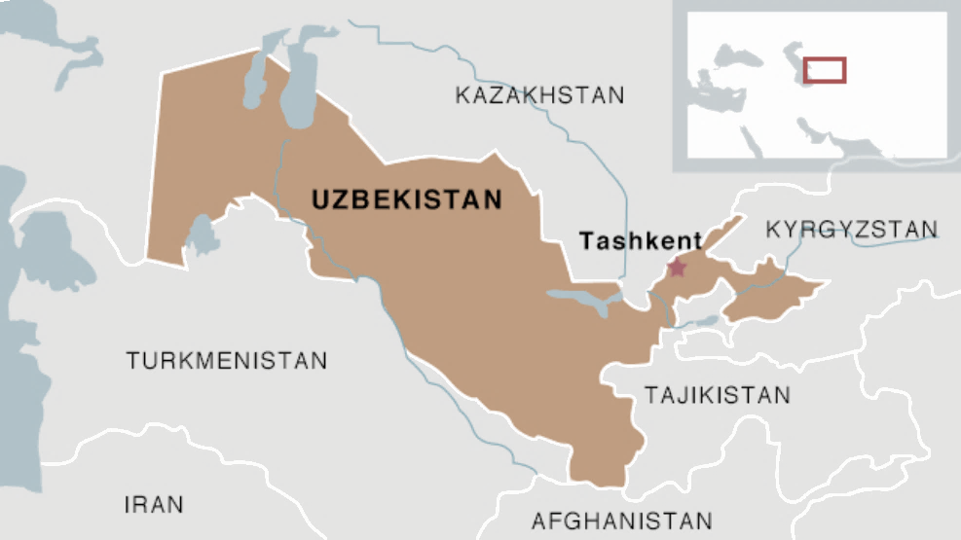
COSMETICS GROWTH POTENTIAL in UZ
650 grams
per capita
RU
UZ
65 g
SKIN-CARE COSMETICS CONSUMPTION IN 2014
In grams per capita
Source: Euromonitor
Notes:
With a strong growth potential for cosmetics compared to Russia

Slide 11
CHALLENGES FOR UZBEKISTAN CONSUMERS
Unhealthy low cost products
Quality Cosmetics are not accessible to all
Notes:
We are here to answer 2 main challenges

Slide 12
QUALITY CERTIFICATION: JNS LABS CERTIFIED
Quality.
Formulas elaborated and tested in France at European standards.
Health.
90 to 100% of natural ingredients. 0% of parabens, aluminum salts, mineral oils, BHT, EDTA…
Nature. We care the environment and animal wellbeing. 0% of CFC, silicones & animal extracts in the products.
OBJECTIVE
100% NATURAL
Notes:
Our first answer is the creation of a quality certification

Slide 14
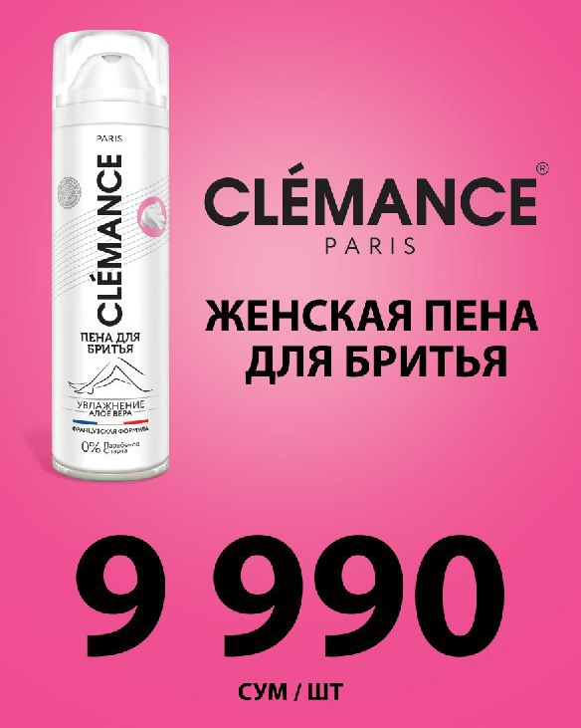
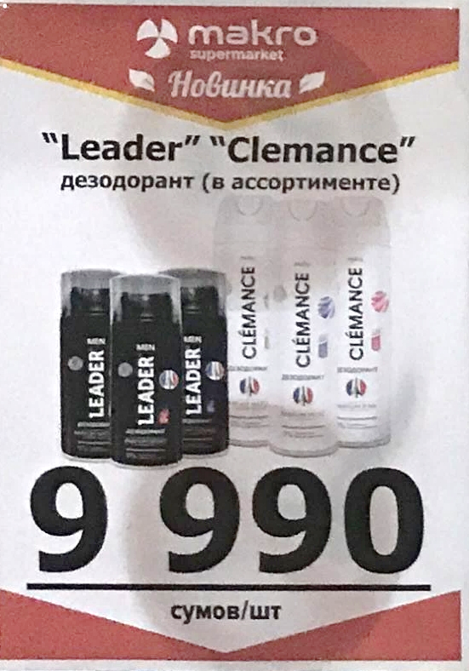
JNS LABS PRICING POLICY
1€
Notes:
Second solution is to kep prices low, so even people with low revenues can benefit from cosmetics

Slide 15
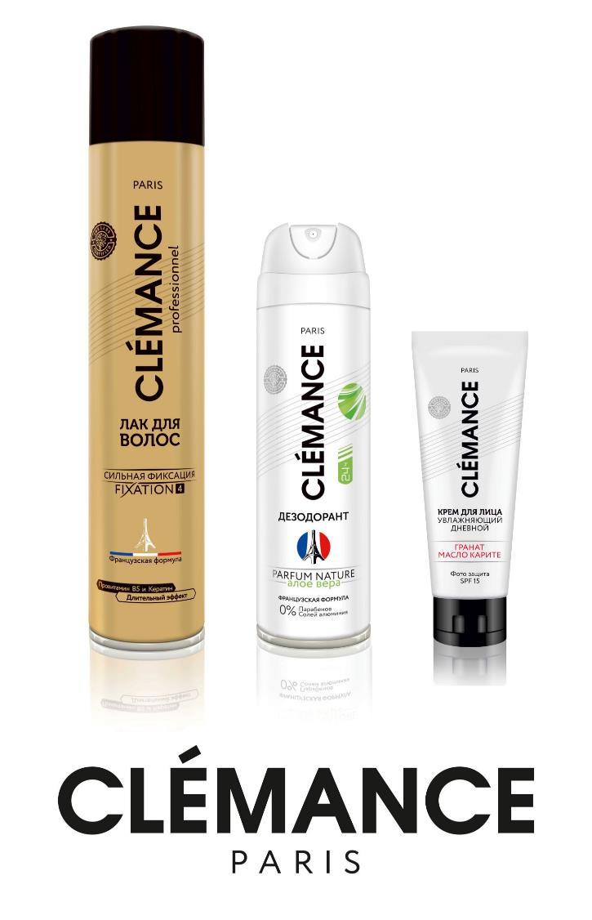
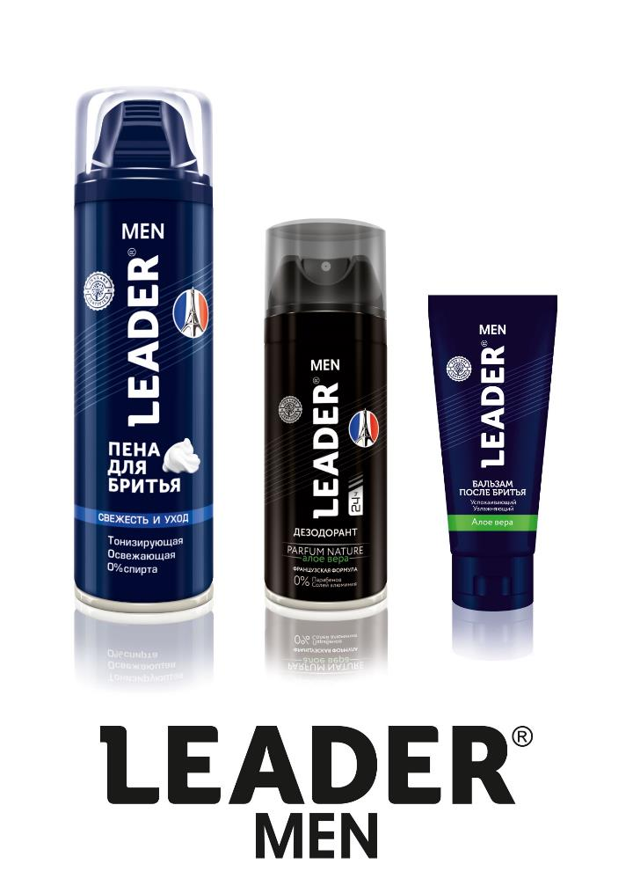
COSMETICS BRANDS

Slide 16
CLEMANCE PARIS DEODORANTS (ONLINE MEDIA)

Slide 17
LEADER MEN DEODORANTS (ONLINE MEDIA)

Slide 18
HOME CARE BRAND

Slide 19
LA ROSÉE ONLINE MEDIA MARKETING

Slide 20
JNS LABS CONSUMER PANEL
Notes:
JNS LABS success is also thanks to its close contact with local consumers.

Slide 21
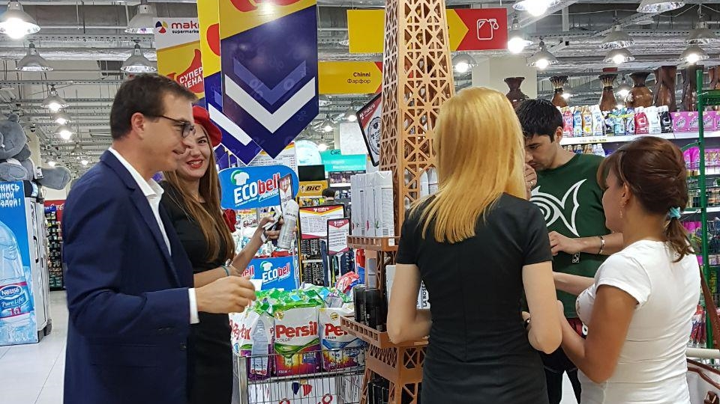
PROMOTION IN SUPERMARKETS
Notes:
We are also presenting our products in supermarkets, so eople can test the perfumes and discover the brands

Slide 22
PROMOTION IN SUPERMARKETS

Slide 23
ADVERTISING ON CARS

Slide 24
JNS LABS – NTLUX SA
3a Bld du prince henri
1724 Luxembourg
Luxembourg
Contact: Nicolas VAN BEEK nvanbeek@jnslabs.com
+352 621490810

