Slide 1
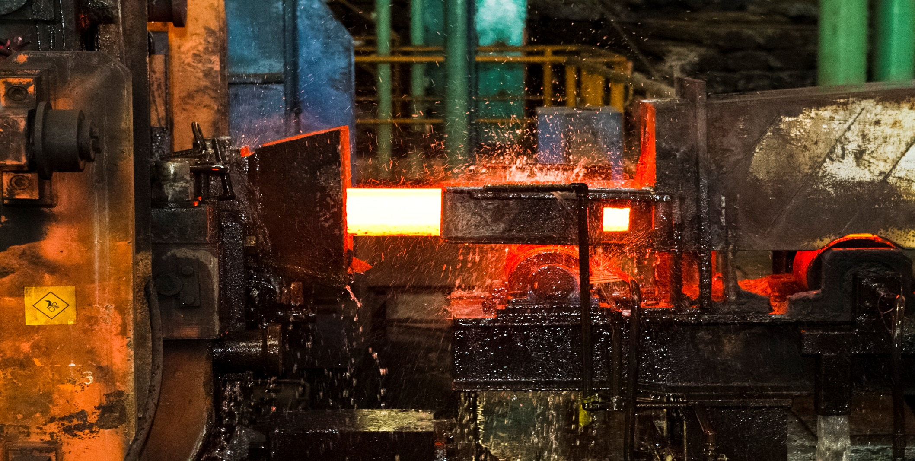
ArcelorMittal Costa Rica
Notes:
1

Slide 2
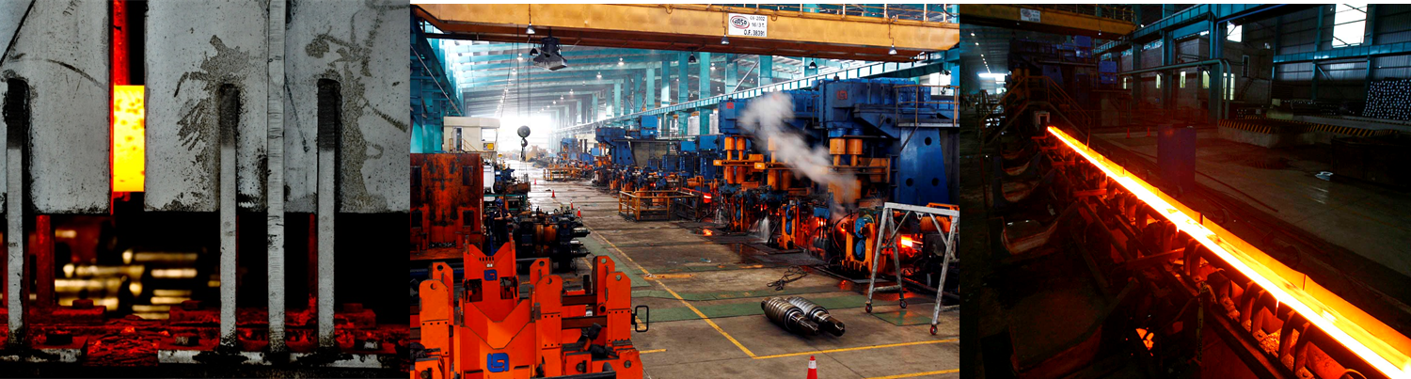
ArcelorMittal Costa Rica
is a producer of steel products for
the construction sector,
the agriculture and
the industry.
Notes:
2

Slide 3
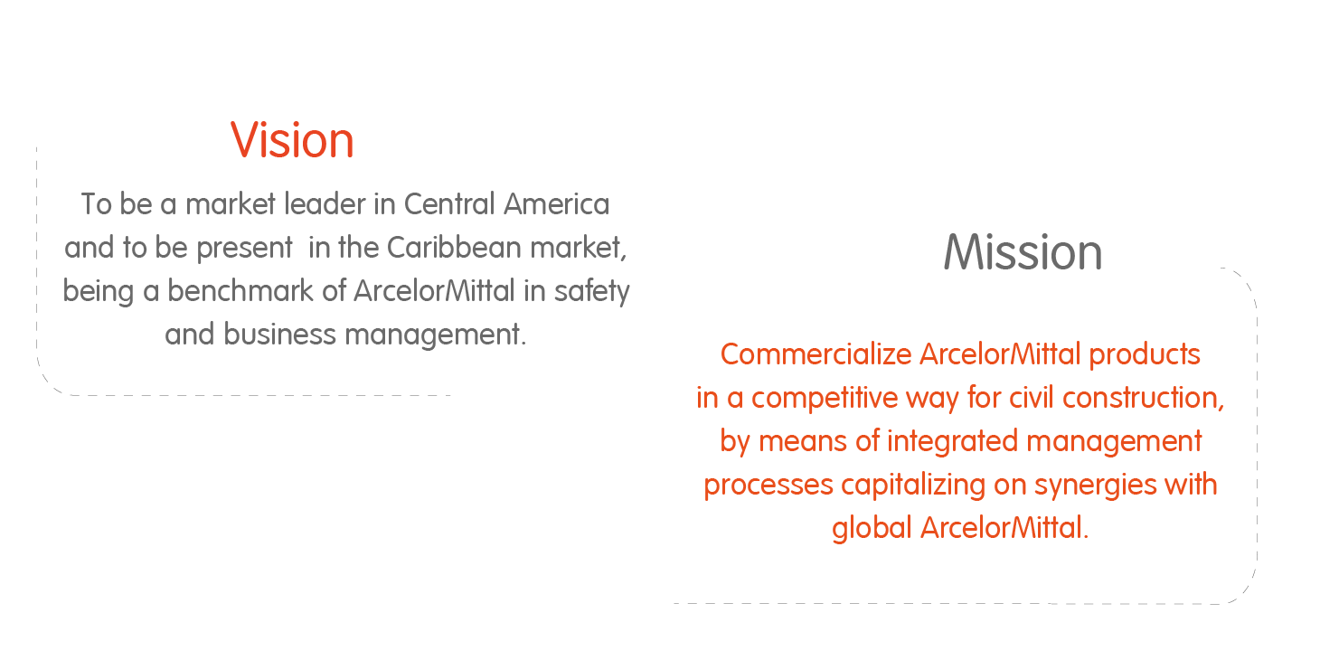
Our Strategy
Notes:
3

Slide 4
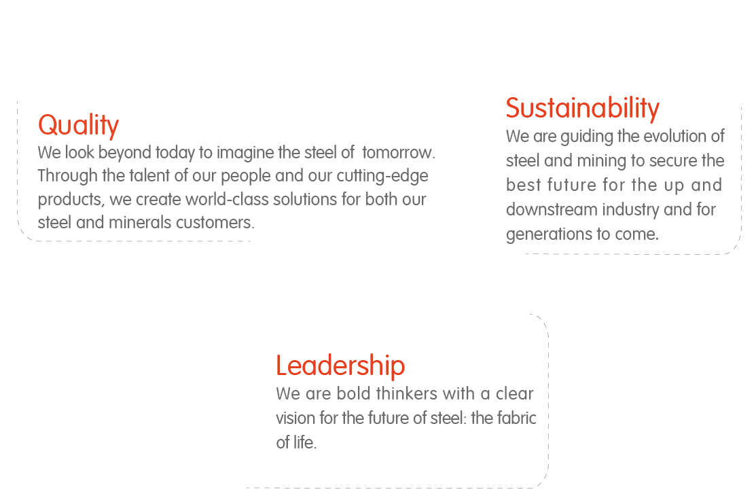
Our Principles
Notes:
4

Slide 5
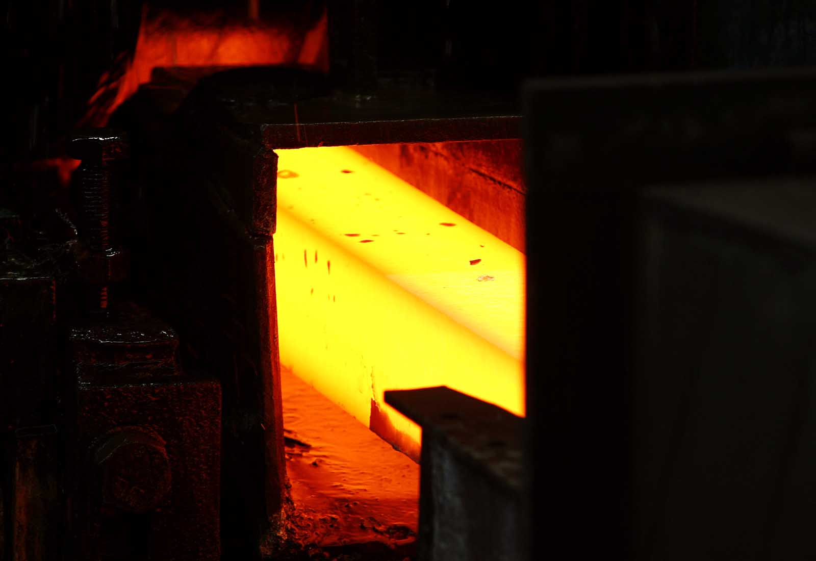
We rely on important local suppliers :
  Energy
    Electricity : ICE (Instituto Costarricense de Electricidad)
    Oil : RECOPE (Refinadora Costarricense de Petróleo)
  Logistics
    Railways : INCOFER (Instituto Costarricense de Ferrocarriles).
    Trucking companies
Notes:
5

Slide 6
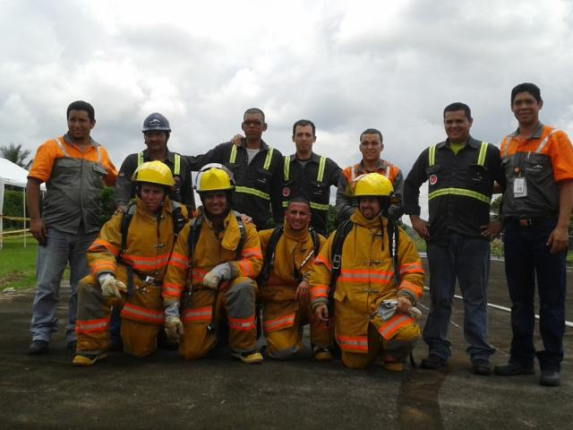
Our Number 1 Priority : Health & Safety
We are focused on further reducing the rate of severe injuries and fatality prevention.
Our number 1 priority is present in everything we do.
It is a part of our DNA, to guarantee that the Health & Safety is an integral component of our leadership, quality and sustainability.
Notes:
6

Slide 7
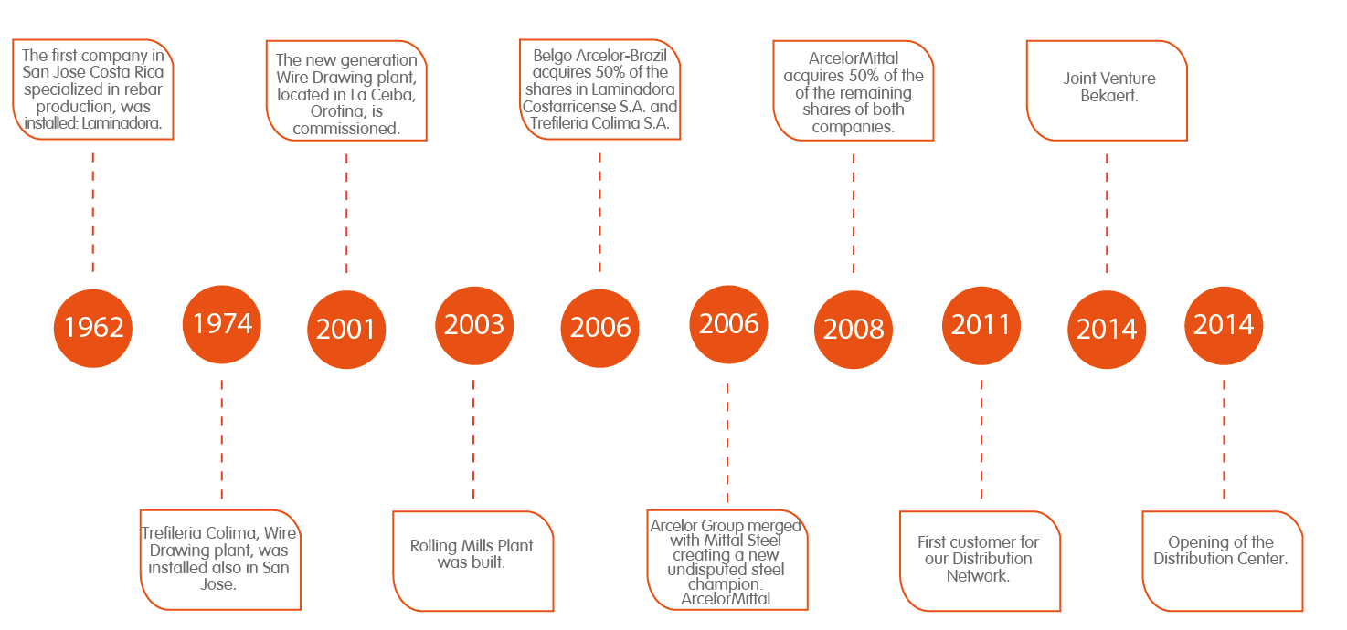
Our History
Notes:
7

Slide 8
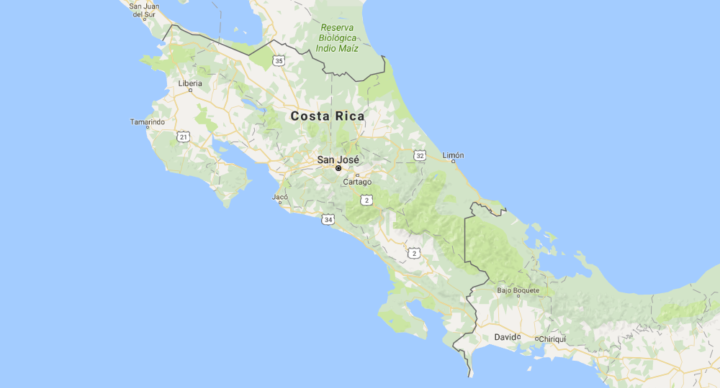

Our Plants
Distribution
Center North Zone
Rolling Mill
Distribution
Center
Pacific Zone
Distribution Center and
Cut & Bending Facility
Main Office
Notes:
8

Slide 9
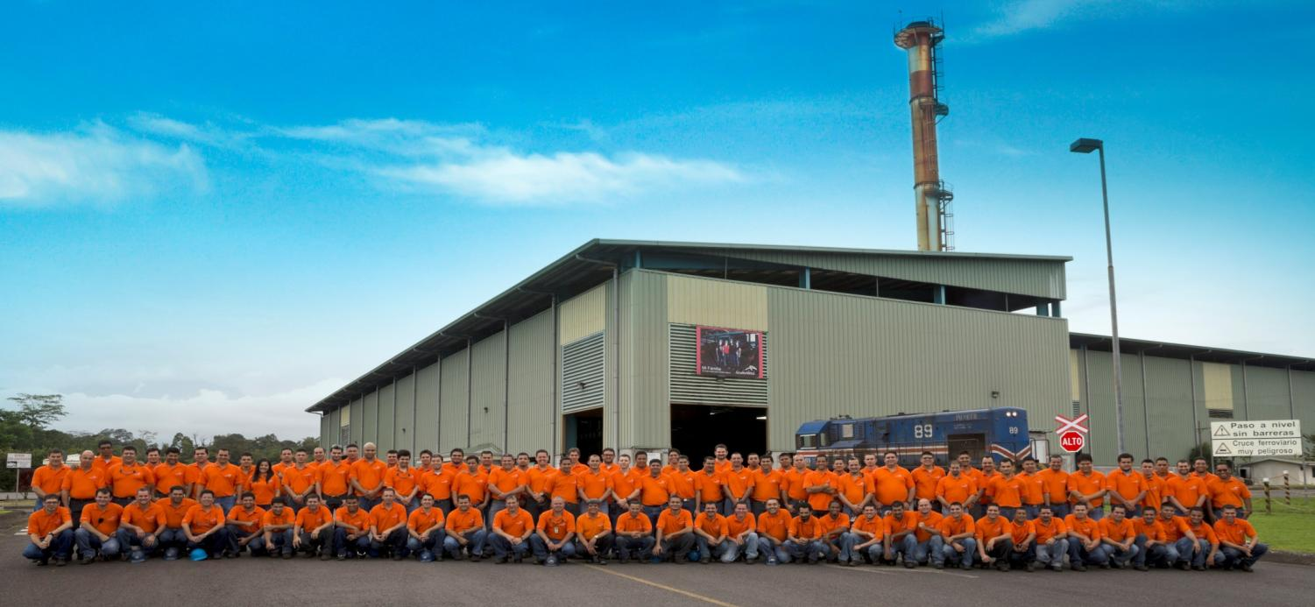
Our Rolling Mill
Location:
Jimenez de Pococi, Limon.
Headcount:
90 employees.
Extension:
25.000 m2
Capacity:
350.000 metric tons per year.
Notes:
9

Slide 10

Our Main Office
Location:
Escazu, San Jose.
Headcount:
32 employees.
Notes:
10

Slide 11
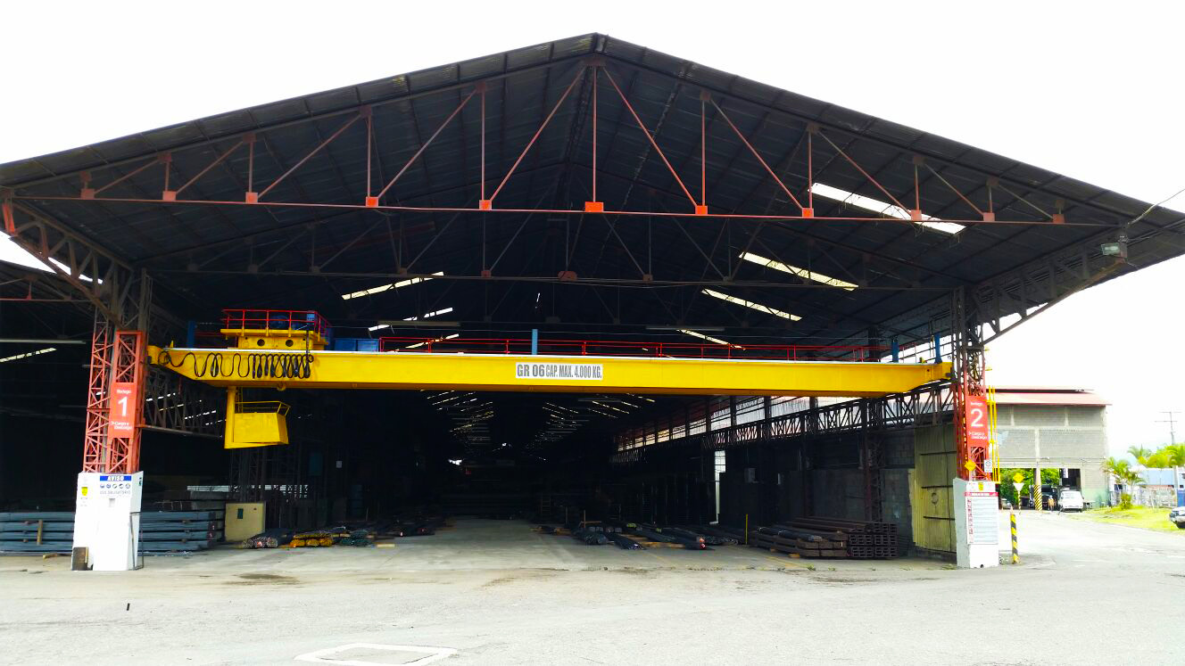
Our Distribution Center
Location:
Tibas, San Jose.
Headcount:
12 employees.
Extension:
13.489 m2
Activity :
Distribution of ArcelorMittal products.
Notes:
11

Slide 12
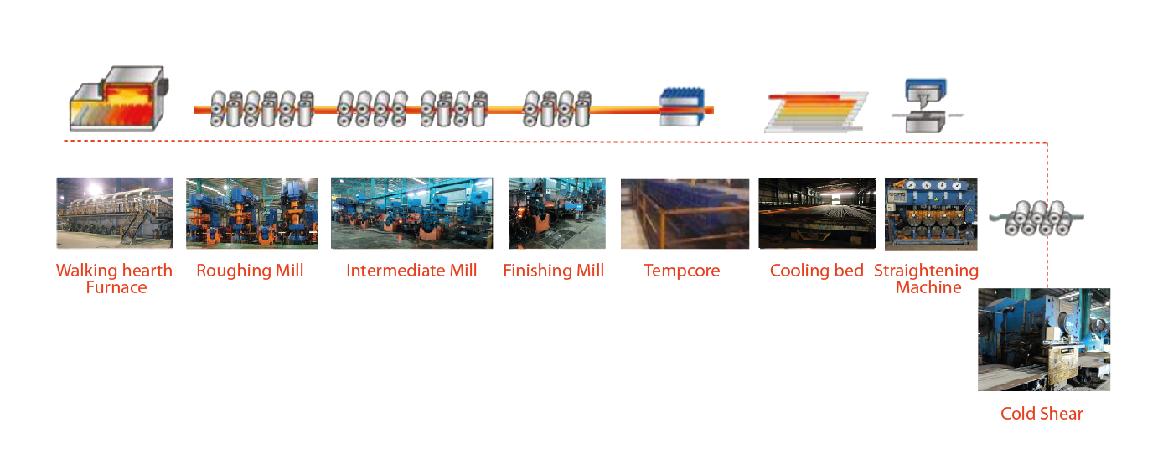
Our Rolling Mill
Notes:
12

Slide 13
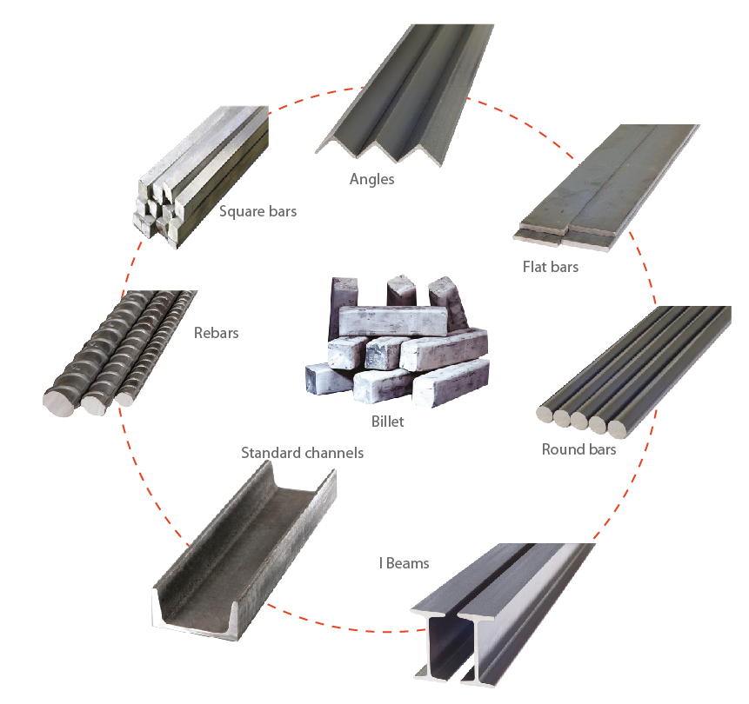
Our Products
Billet applications
The Company introduced an Integrated Management System for Quality, Environment and Safety that allow us to be certified on:
ISO 14001: Environmental Management System.
OHSAS 18001: Health and Safety Management System
Our rebars are certified by INTECO (INTE 06-09-01, INTE 06-09-02, ASTM A615 and ASTM A706)
Notes:
13

Slide 14
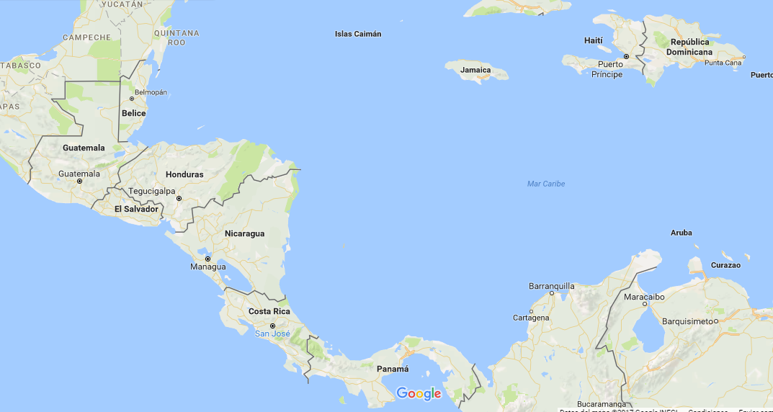
Our Export Activities
  An industrial and commercial network allows us to satisfy the needs of our clients in Central America and Caribbean Region.
Notes:
14

Slide 15
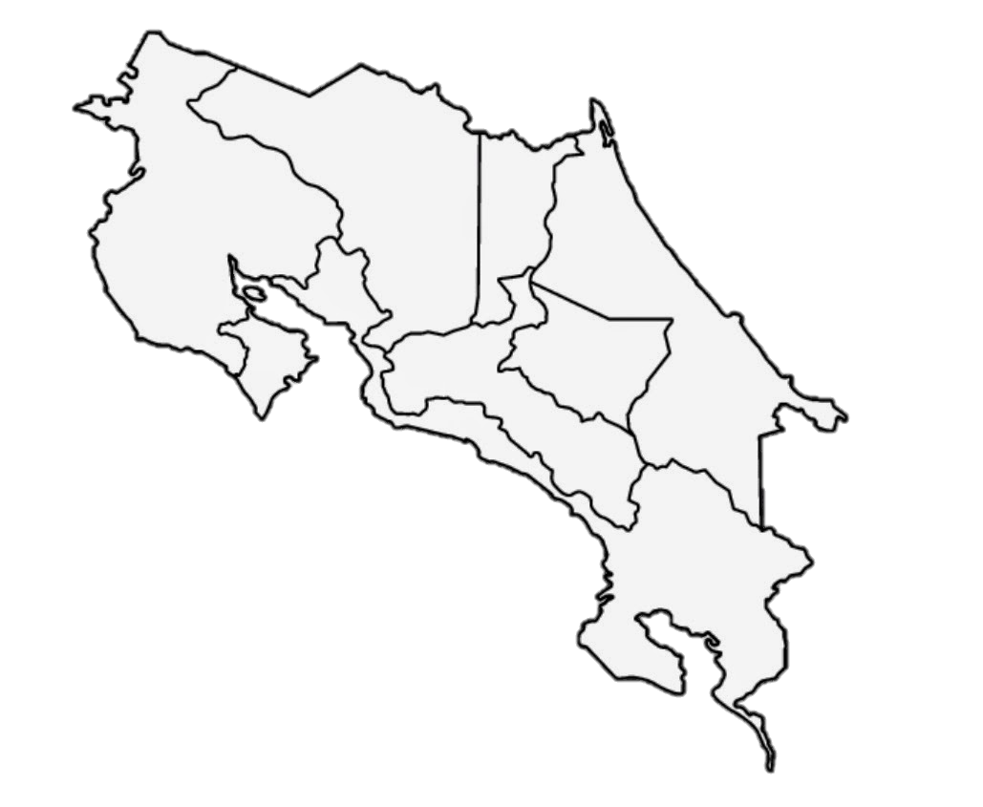

Our Distribution Network – Costa Rica
New Members for 2017
Notes:
15

Slide 16
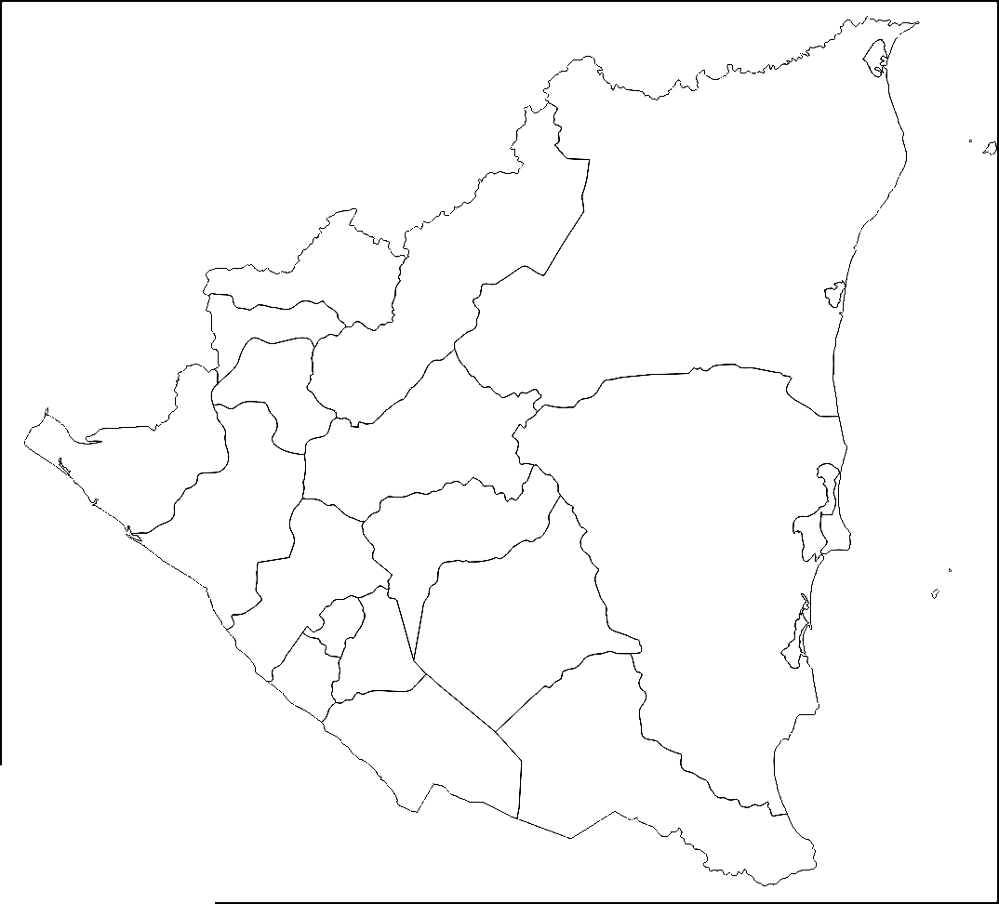
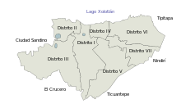
Our Distribution Network – Nicaragua
Oficina Central y Planta Tipitapa
Sucursal y Planta Cofradía
Sucursal Managua Xiloa
Sucursal Managua Norte
Sucursal Managua Rubenia
Sucursal Managua El Edén
Sucursal Chinandega
Sucursal Sébaco
New Salespoint

Slide 17
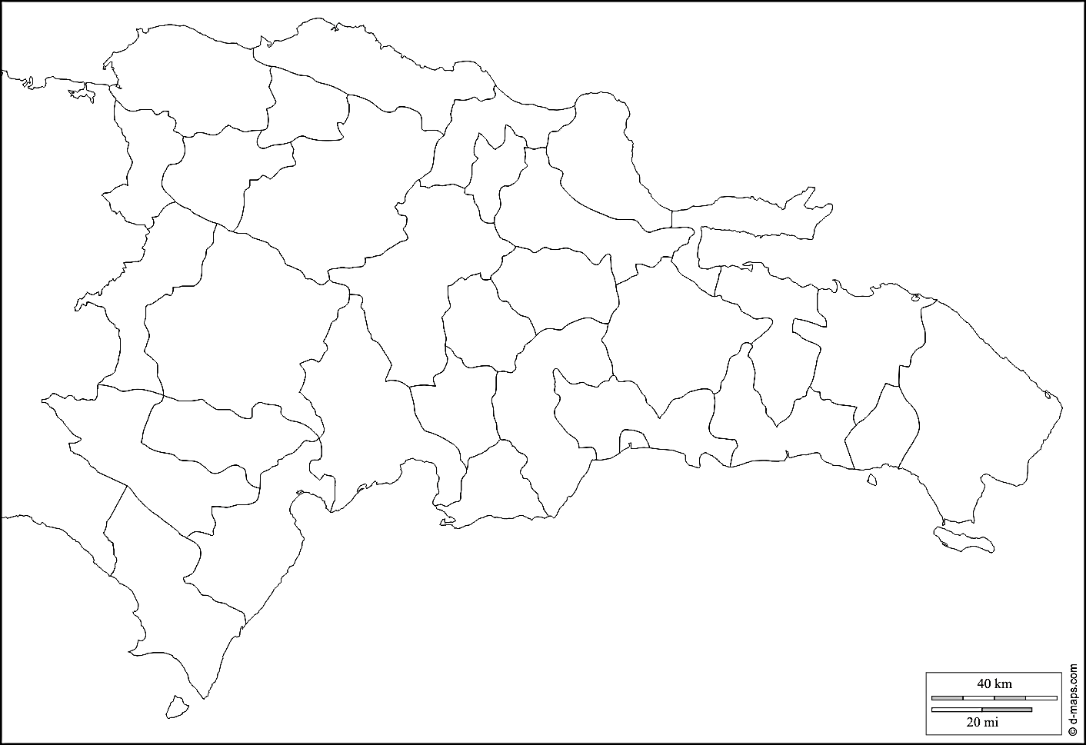
Our Distribution Network – Dominican Republic
Sucursal Santo Domingo

Slide 18
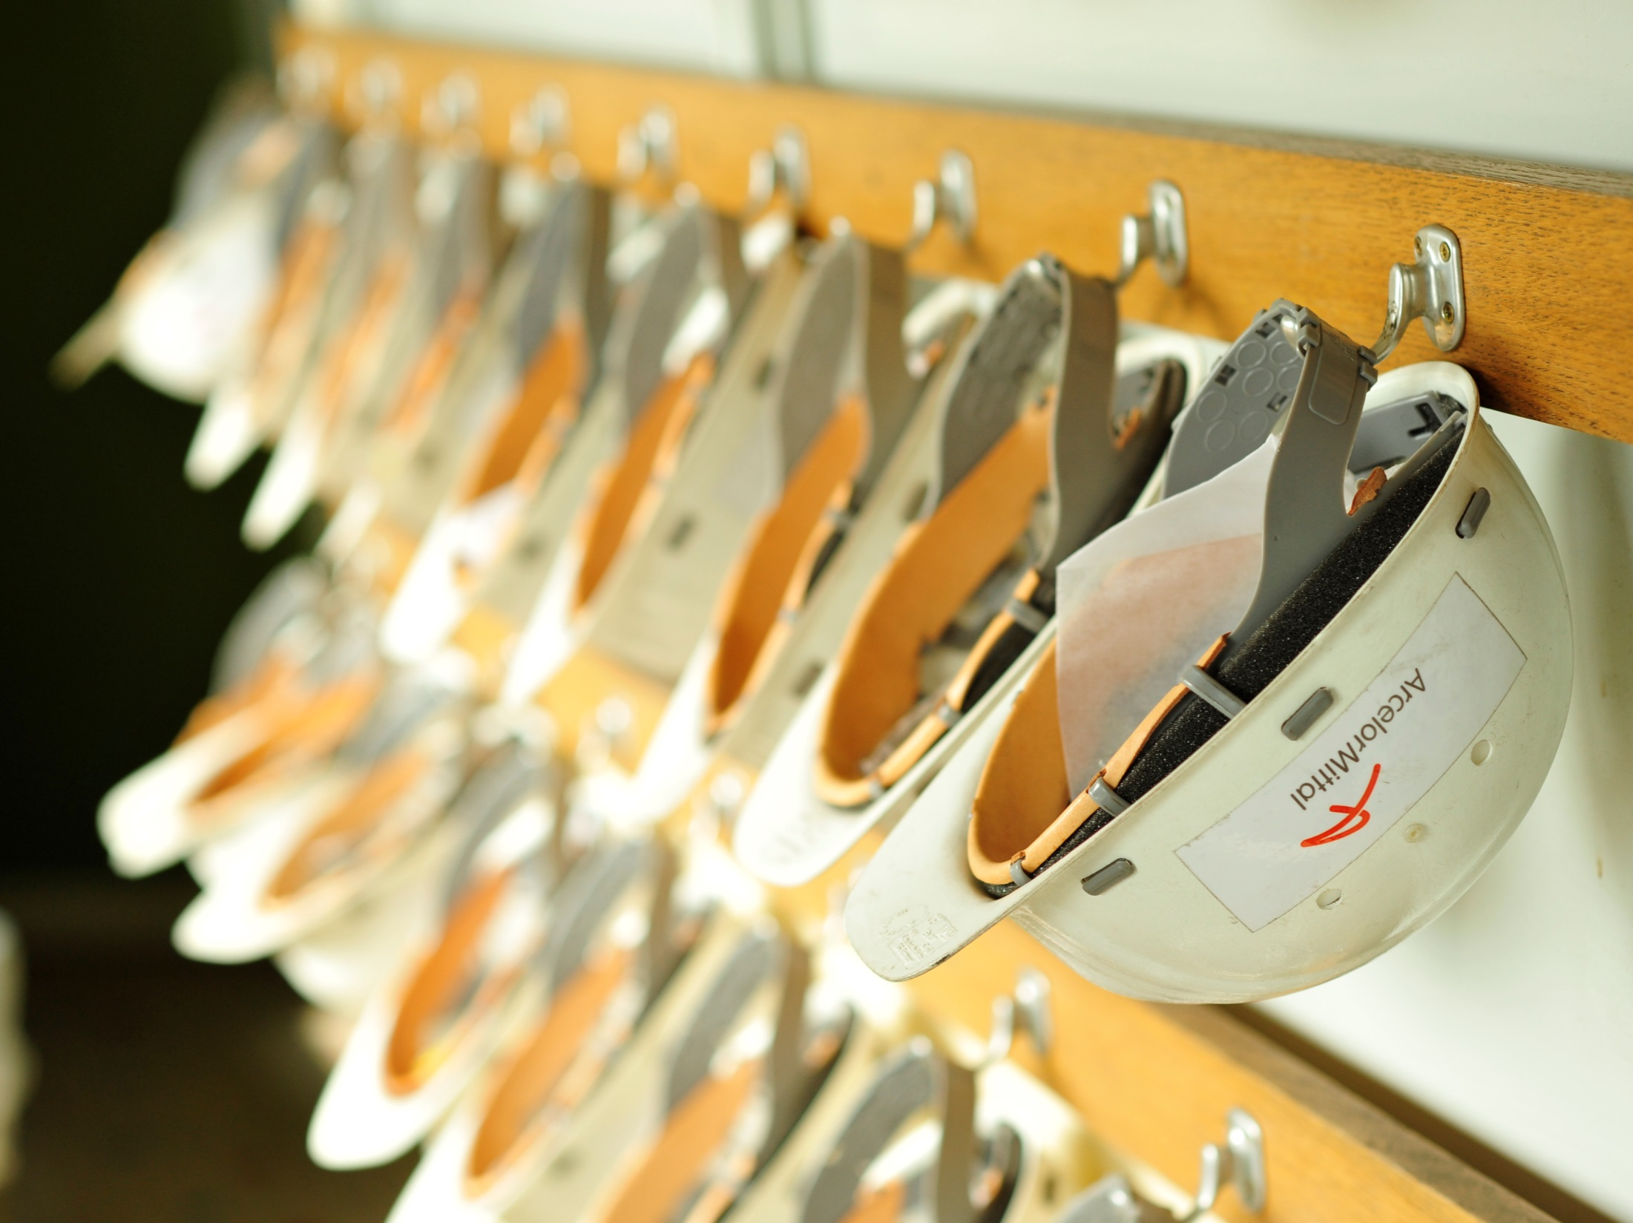
Our
essence
Our product is steel, but the value comes from our people.
We are entrepreneurs and we have an innovative spirit.
It allows us to successfully reach all our objectives.
Notes:
18

