Slide 1
PRESENTATION TO THE LUXEMBURG CHAMBER OF COMMERCE
Erwin De Weerdt, President
February 6, 2017

Slide 2
Based in Brussels, EURACEN represents and defends the business expansion of SMEs both in Belgium, and by extension in Europe,
and at the other side of the Ocean in
Belize, Costa Rica, the Dominican Republic, El Salvador, Guatemala, Honduras, Nicaragua and Panama

Slide 3
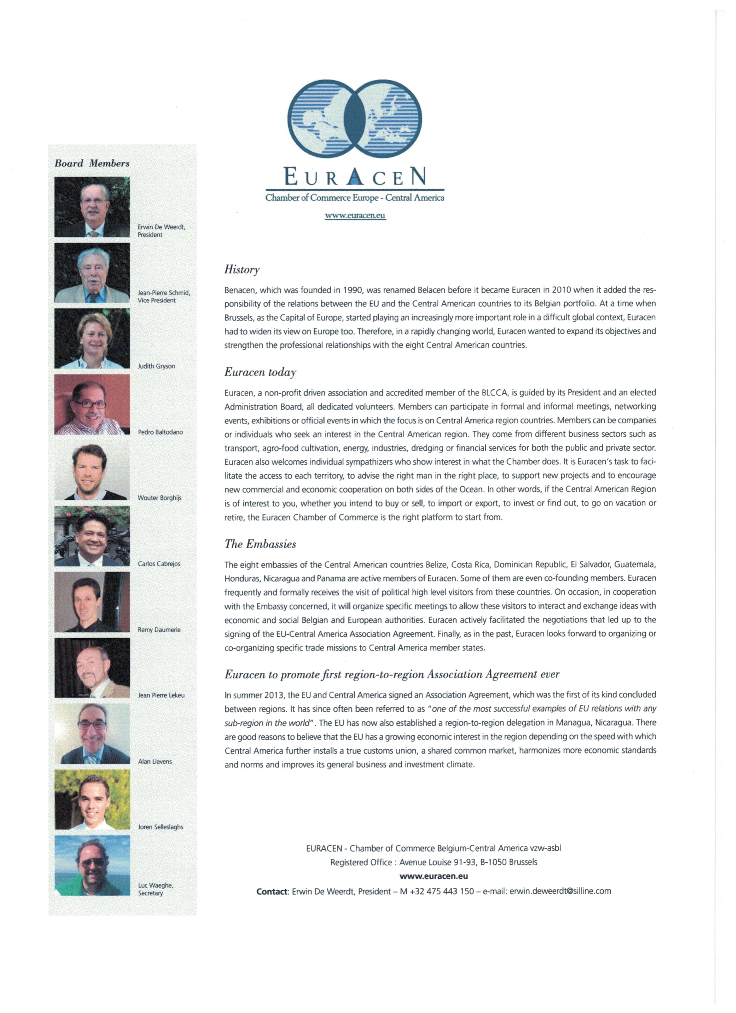
and it works!

Slide 4
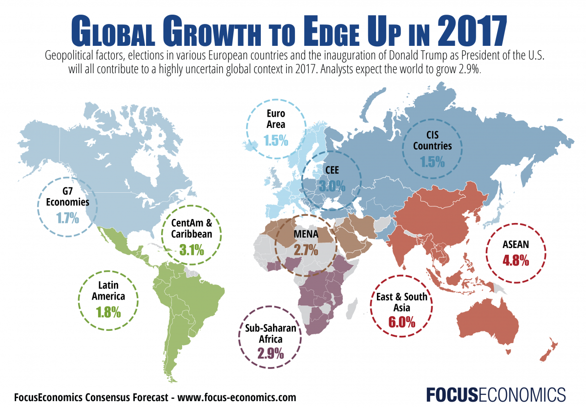

Slide 5
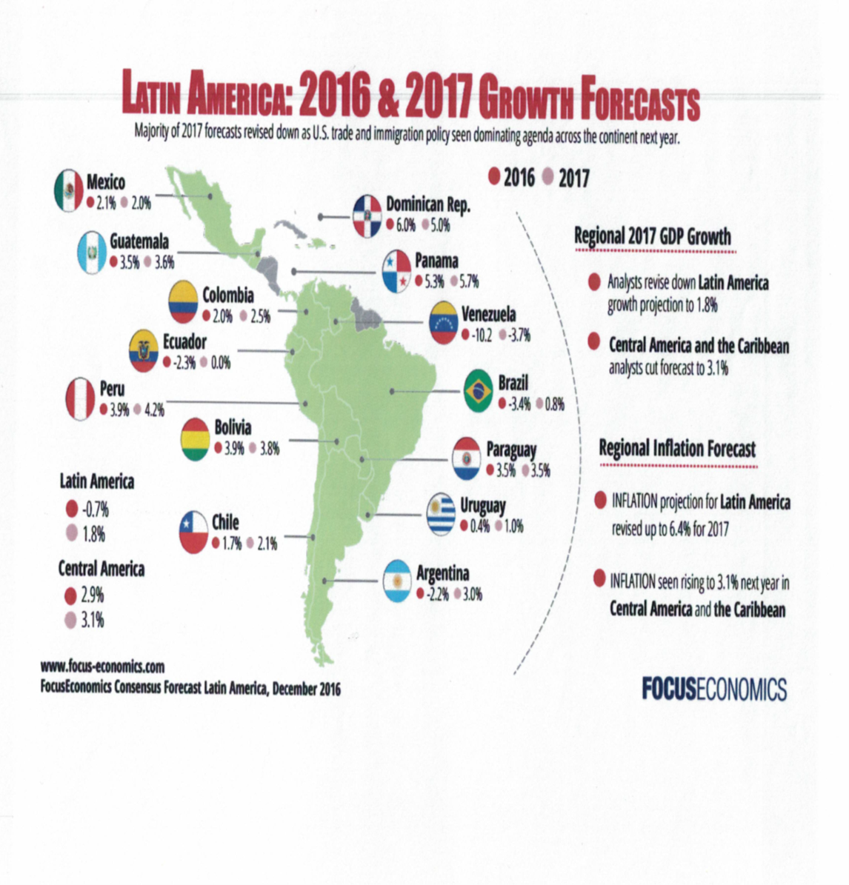

Slide 6
Belize Economic Outlook
January 17, 2017
In November, Belize’s exports shrank a massive 50.0% year-on-year, with sugar exports accounting for the lion’s share of the drop, decreasing by 98.9% after bulk sugar shipments ran out for 2016. Meanwhile, imports were down by a modest 9.0%, thus widening the trade deficit. On a more positive note, the number of overnight tourist arrivals reached a record high in December. Nevertheless, Belize is unlikely to have crawled out of the ongoing recession by year-end—the country contracted for a third consecutive quarter in Q3.

Slide 7
Costa Rica Economic Outlook
January 17, 2017
The Costa Rican economy performed relatively well in 2016 thanks to robust private consumption and resilient fixed investment. Sector-wise, the economy was propped up by a solid rebound of the agricultural and manufacturing sectors, while services continued to expand. However, recent data confirm that growth momentum took a hit at the start of H2 as GDP decelerated in Q3. The country’s fiscal imbalances will continue to be at the center of the policy debate. Important steps were made last year with the approval of some measures that will allow public spending to be reduced. Although those steps represented an improvement over previous fiscal rules, a great deal of measures—such as revenue collection measures and the introduction of a Value-added Tax—are still pending.

Slide 8
Domin. Rep. Economic Outlook
January 17, 2017
The Dominican economy is expected to have grown at the fastest pace in the region last year, on the back of the strong expansion recorded in the mining, construction, tourism and agricultural sectors. The economy was also supported by a substantial increase in remittances, especially from the Dominican diaspora in the U.S., the most important source of foreign remittances for the country. In spite of this, in the third quarter the economy decelerated from the impressive growth reading recorded in Q2, mainly on the back of a weaker expansion in industry, though this suffered from a very high base effect. The latest monthly data suggest the economy is experiencing a further deceleration in growth, as the rate of expansion in tourist arrivals decelerated in both October and November.

Slide 9
El Salvador Economic Outlook
January 17, 2017
El Salvador’s economy is likely to have expanded at a steady, albeit modest rate in Q4 2016. According to the most recent Central Bank data, nominal wage increases, higher bank lending and remittances led to robust domestic demand growth in October, while the external sector also improved thanks in large part to lower oil prices. Encouragingly, following a staff visit to the country in December 2016, the IMF judged there to be strong political support in El Salvador for an economic reform program, while acknowledging that differences exist between the IMF and the government regarding how to reduce the country’s sizeable budget deficit. If it comes to fruition, the program would help stabilize the government’s shaky fiscal position and could act as a catalyst for growth.

Slide 10
Guatemala Economic Outlook
January 17, 2017
The Guatemalan economy lost momentum in the third quarter of last year, as investment growth sagged amid a still uncertain political environment. Data for Q4 indicate that the economy likely ended the year on a higher note. The Central Bank’s economic activity index edged up to 3.1% year-on-year in November from 3.0% in October, which mainly reflected increases in manufacturing, transport, financial services and agriculture, among other sectors. Meanwhile, remittances, which account for almost 10% of GDP, continued to grow in December at a much faster pace, reaching USD 679 million—the highest remittance inflow in 15 years. On 30 December, President Jimmy Morales announced a minimum wage increase of around 6.0%.

Slide 11
Nicaragua Economic Outlook
January 17, 2017
Growth remained robust in 2016, though the economy likely shifted into a lower gear. Recent economic activity indicators, coupled with a slowdown in GDP growth in Q3, hint at a further slowdown in the second half of last year, following the deceleration in H1. Adverse weather conditions and globally low commodities prices have heavily weighed on Nicaraguan exports. The poor performance of the external sector has nevertheless been mitigated to an extent by strong domestic demand, which has been sustained by robust household consumption and an expansive fiscal policy.

Slide 12
Honduras Economic Outlook
January 17, 2017
Honduras’ economy remained robust in 2016, but it slowed down slightly as it entered the second half of the year. In Q3 it expanded at a slower pace in annual terms due to the negative performance of the external sector, which more than offset stronger domestic demand. The latter was backed by solid government consumption and fixed investment. Overall, the economy of the country is expected to have stayed broadly stable in 2016. The government implemented important reforms to support growth and capped expenditure, in order to honor its agreement with the IMF.

Slide 13
Panama Economic Outlook
January 17, 2017
Panama’s fast-growing economy has been hampered by a slowdown in maritime trade and a challenging scenario in the region. Q3’s growth moderated as output was dragged down by a slowdown in the country’s all-important service sector. The print underscores the external headwinds the small open economy is facing as the revenues generated by the expanded Panama Canal since its June opening have dissapointed. The latest indicators suggest that the economy closed the year in a soft patch and likely expanded in 2016 at the slowest rate since 2009. Economic activity in October decelerated compared to the previous month. Cargo tonnage in Panamanian ports and Panama Canal earnings dropped in annual terms by over 10.0% and 3.0% respectively in the January to October period

Slide 14
What’s our mission?
INTERNALLY
professionalize the organization
raise image
strenghten relationships with eight Ambassadors and staff
raise awareness among members and non-members
explain reason of existence to different target audiences
look for relevant funding
have more private people and business professionals join

Slide 15
What’s our mission?
EXTERNALLY
establish direct contacts with all relevant stakeholders
build relationships with Chambers of Commerce and professional associations in Belgium/Europe and overseas
focus on early bird news gathering about new buzz opps
organize relevant seminars, workshops, conferences, events, …
win interest of media (print, radio, TV, digital)

Slide 16
Situation analysis
current context for EURACEN?
how do we function today?

Slide 17
SWOT analysis

Slide 18
Stakeholders
all eight Embassies
existing members
potential new members, with emphasis on PME managers
other Chambers of Commerce, relevant professional associations
European, (inter)national political, economical,financial representatives home and abroad
education world
ngo’s, social media,charity initiatives
the media and the public in general

Slide 19
Strategy
Reverse thinking
what have eight CA economies to offer
what do they need?
Get into the media
(inter)national, radio, TV, digital
Set up tailor made study trips

Slide 20
Actions
strong Board
dedicated workgroups
new alliances with
AWEX (Agence wallonne à l'exportation et aux Investissements étrangers), FIT (Flanders Investment & Trade), BECI (Brussels Enterprises Commerce and Industry), EIB (Export-Invest Brussels), BFTA (Belgian Foreign Trade Agency and Trade4You), Unizo (Unie van Zelfstandige Ondernemers), …
early stage concertation with all eight Ambassadors
coop with Embassy staff and advisors
coop with Press Club Brussels Europe and with media

Slide 21
Last but not least…
… our bi-lingual website English-Spanish …
www.euracen.eu

Slide 24
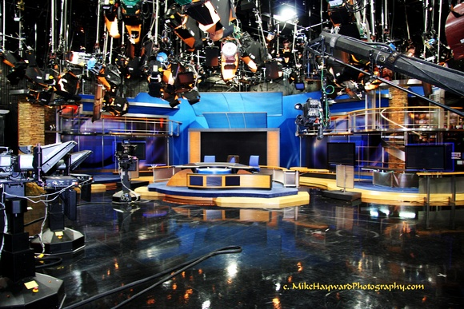
Thank You !

