Slide 1
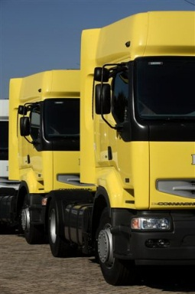
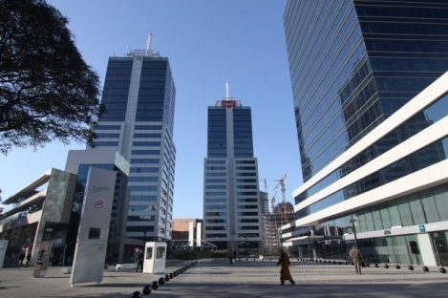
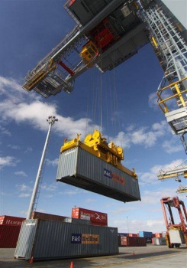
Cultural & Business approach to the Uruguayan market
Countries seminar: “Discover the business potential of Argentina, Chile and Uruguay”. Luxembourg Chamber Of Commerce
Luxembourg Chamber Of Commerce
Wednesday, 14th of June 2017

Slide 2
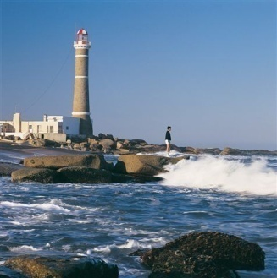
Uruguay : Cultural approach
The population of Uruguay is approximately 3,3 million. About 60% lives in Montevideo.
Uruguayans are the result of different immigration waves, mainly from Europe, particularly Spain and Italy, but also France and other European origins. Jewish of different nationalities, Armenian and Lebanese also came in search of opportunities and refuge.
Descendants of Africans brought during the slavery period, between XVIII century and beginnings of XIX, currently represent 8% of the population.
There are no indigenous ethnic groups.
Notes:
2

Slide 3
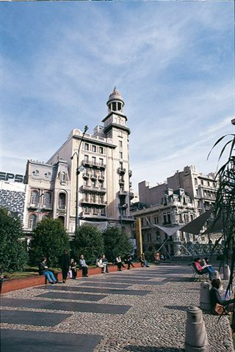
Cultural approach
Uruguay has been unique in Latin America thanks to the establishment of a welfare state in the early twentieth century.
Egalitarian society with a strong predominance of the middle class.
Uruguayan Culture is noted for tolerance and inclusiveness.
Spanish is the official and most used language. English is the most used foreign language by the business community. Portuguese is also present as a result of having a long border with Brazil and because of trade and tourism between both countries.
Notes:
3

Slide 4
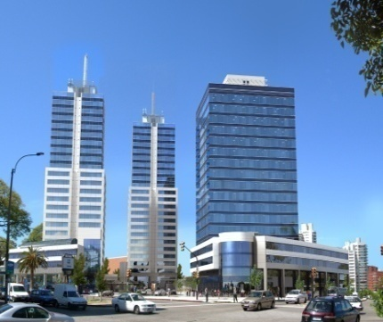
Business approach
Uruguayans are very friendly and open to business with Europeans due to their origins.
Every business is done in a social context, Uruguayans assign great value to interpersonal relations.
Greetings are warm and accompanied by a firm handshake.
Uruguayans dress conservatively.
Direct contact in Spanish is appreciated. Be ready to make small talk before the business discussions begin.
Print all materials in Spanish, from business cards to brochures.
Notes:
4

Slide 5
Business approach
One of the big challenges for business in the country is the size of its market.
Corruption is not a big problem in the country and Justice is independent although it’s still very slow.
There are some complexities and red tape in the formalities that should not discourage Luxembourg exporters.
It is important to engage in associations or partnerships with Uruguayans to take advantage of their know how. Uruguayans are among the best-educated workforce on the continent.
Notes:
5

Slide 6
Business approach
It is important to be informed of the current trade laws, mainly to have access to the Mercosur.
Uruguay aims to become a point of transit and distribution. Usually the firms that invest there try to benefit from the several Free Trade Zones and advantages offered by a Free Port like Montevideo’s.
This country is the strategic point for the region, thus being the perfect distribution spot.
Notes:
6

Slide 7
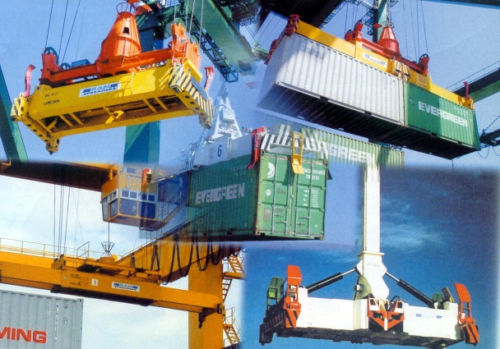
General Commerce Regime:
The export and import Regime is totally free.
Free exchange market has no restrictions for foreign trade.
Common external tariff varies from 0% to 20% with exceptional rates of 35%.
0% tariff between MERCOSUR members ( with exceptions).
Notes:
7

Slide 8
Doing business in Uruguay
Choice of entity :
Individuals and legal entities can set up an enterprise in Uruguay without any prior formalities or special authorizations from the government ( except projects with impact on the environment, public concessions, insurance and banking activities or sectors in which there is a State monopoly).
The corporation is the most commonly used type of legal entity by foreign investors.
Capital and Holding requirements :
There are no specific rules establishing percentages for foreign investment participation. There are no minimum or maximum capital requirements.
There is no requirement stating that directors or managers must be Uruguayan residents or nationals.
Notes:
8

Slide 9
Selling to the Government:
International public tender is the most common mode of selection.
No local presence in the country is required to become a government contractor & sell to the government, but companies must register with the RUPE (Registro Unico de Proveedores del Estado). (Single Registry of State Providers).
RUPE was established for the entire administration in September 2013: Imperative for the Government, Ministries, public enterprises, decentralized organizations.
How to registrer?
1) Go to www.comprasestatales.gub.uy
2) Acces button
3) Choose option “ Registrarse como proveedor”
4) The company may register directly or through its representative.
Notes:
9

Slide 10
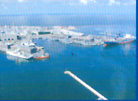
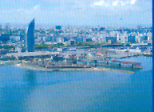
Logistics Very Attractive Regimes…
Montevideo : Free Port
Montevideo: first and only Free Port on South Atlantic Coast.
« Free transit of goods » no authorizations or formal procedures are required
Within port facilities, goods are exempt from all import taxes.
Strategic location and modern infrastructure
Notes:
10

Slide 11
…Logistics Very Attractive Regimes
Free trade Zones:
Are exempt from corporate income and wealth tax as well as from any other tax created or to be created in the future
Introduction of goods into the FTZ is free from all import taxes
Authorized to develop any industrial, commercial or service activity.
Free zones – Business Platforms:
Shared service centers, regional headquarters, financial services, contact centers, software development, IT solutions, Logistics & distribution centers, commercial and Trading activity
Notes:
11

Slide 12
Thanks for your kind attention
Jimena Villar Bouchacourt
Economic and Commercial Attaché
E-Mail: montevideo@sprb.brussels

