Slide 1
Luxembourg – Taiwan Joint Business Council
Luxembourg Innovation Landscape

Slide 2
Innovation is in our DNA?

Slide 3
Innovation is in our DNA?
Agriculture
1850
1900
1950
1980
2000

Slide 4
Innovation is in our DNA?
Agriculture
Industrialisation
iron & steel
1850
1900
1950
1980
2000

Slide 5
Innovation is in our DNA?
Agriculture
Industrial
diversification
Industrialisation
iron & steel
1850
1900
1950
1980
2000

Slide 6
Innovation is in our DNA?
Agriculture
Industrial
diversification
Industrialisation
iron & steel
Financial sector
1850
1900
1950
1980
2000

Slide 7
Innovation is in our DNA?
Agriculture
Industrial
diversification
Focus on
key innovation sectors
Industrialisation
iron & steel
Financial sector
1850
1900
1950
1980
2000

Slide 8
Innovation is in our DNA?
Agriculture
Industrial
diversification
Focus on
key innovation sectors
Industrialisation
iron & steel
Financial sector
1850
1900
1950
1980
2000
Public Funded Research

Slide 9
How do others evaluate us in terms of innovation?

Slide 10
How do others evaluate us in terms of innovation?
European Commission

Slide 11
How do others evaluate us in terms of innovation?
European Commission
2018
European Innovation
Scoreboard
Innovation leader
Strong Innovators
Moderate Innovators
Modest Innovators

Slide 12
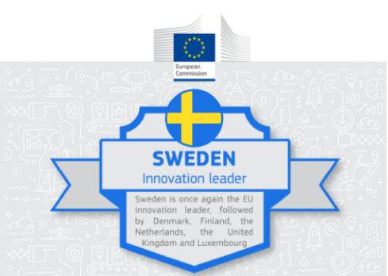
How do others evaluate us in terms of innovation?
European Commission
Denmark
human resources and innovation-friendly environment
Luxembourg
attractive research system
Sweden:
Innovation Leader
France
finance & support
Ireland
innovation in SMEs, employment impacts & sales impacts
Belgium
innovation linkages & collaboration

Slide 13
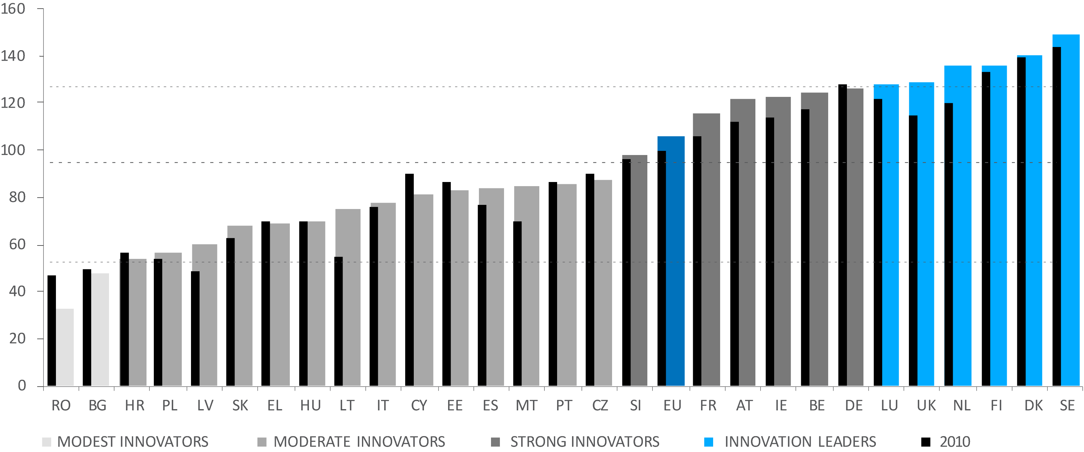
How do others evaluate us in terms of innovation?
European Commission

Slide 14
How do others evaluate us in terms of innovation?
European Commission

Slide 15
How do others evaluate us in terms of innovation?
Global Innovation Index*
*Cornell University, INSEAD & World Intellectual Property Organisation (WIPO)

Slide 16
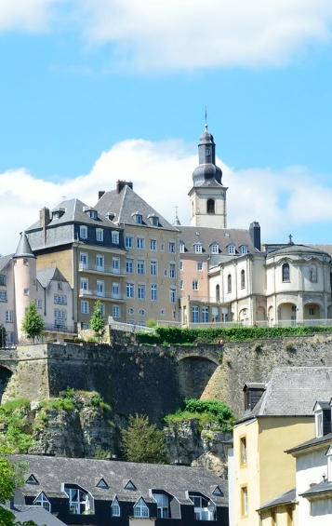
How do others evaluate us in terms of innovation?
Global Innovation Index*
# 15
Luxembourg
*Cornell University, INSEAD & World Intellectual Property Organisation (WIPO)

Slide 17
How do others evaluate us in terms of innovation?
Global Innovation Index*
# 13
Japan
# 15
Luxembourg
*Cornell University, INSEAD & World Intellectual Property Organisation (WIPO)

Slide 18
How do others evaluate us in terms of innovation?
Global Innovation Index*
# 12
South Korea
# 13
Japan
# 15
Luxembourg
*Cornell University, INSEAD & World Intellectual Property Organisation (WIPO)

Slide 19
How do others evaluate us in terms of innovation?
Global Innovation Index*
# 12
South Korea
# 13
Japan
# 15
Luxembourg
China
# 17
*Cornell University, INSEAD & World Intellectual Property Organisation (WIPO)

Slide 20
How do others evaluate us in terms of innovation?
Number of researchers per
million inhabitants*
*World Bank

Slide 21

How do others evaluate us in terms of innovation?
Number of researchers per
million inhabitants*
5,058
Luxembourg
*World Bank

Slide 22
How do others evaluate us in terms of innovation?
Number of researchers per
million inhabitants*
1,177
China
5,058
Luxembourg
*World Bank

Slide 23
How do others evaluate us in terms of innovation?
Number of researchers per
million inhabitants*
1,177
China
5,058
Luxembourg
Japan
5,231
*World Bank

Slide 24
How do others evaluate us in terms of innovation?
Number of researchers per
million inhabitants*
1,177
China
5,058
Luxembourg
Japan
5,231
7,087
South Korea
*World Bank

Slide 25
Who are the Main Actors?

Slide 26
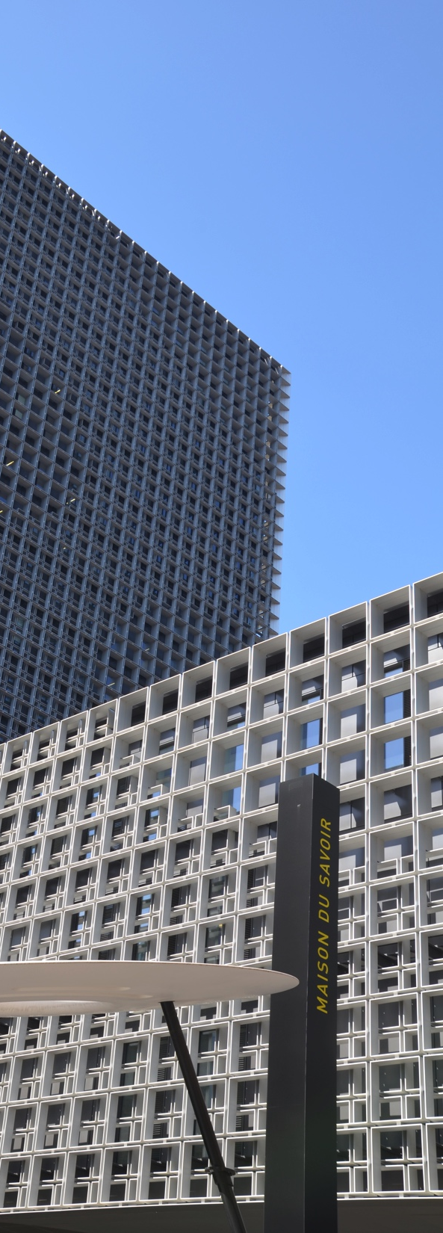
Who are the Main Actors?
University of Luxembourg:

Slide 27
Who are the Main Actors?
University of Luxembourg:
  Founded in 2003

Slide 28
Who are the Main Actors?
University of Luxembourg:
  Founded in 2003
  Multilingual, international and research-oriented
Role is to foster innovation that will drive sustainable socio-economic growth

Slide 29
Who are the Main Actors?
University of Luxembourg:
  Founded in 2003
  Multilingual, international and research-oriented
  850 Scientific and research staff + 242 Professors
Role is to foster innovation that will drive sustainable socio-economic growth

Slide 30
Who are the Main Actors?
University of Luxembourg:
  Founded in 2003
  Multilingual, international and research-oriented
  850 Scientific and research staff + 242 Professors
  6,500 Students from 110 different countries
Role is to foster innovation that will drive sustainable socio-economic growth

Slide 31
Who are the Main Actors?
University of Luxembourg:
  Founded in 2003
  Multilingual, international and research-oriented
  850 Scientific and research staff + 242 Professors
  6,500 Students from 110 different countries
Role is to foster innovation that will drive sustainable socio-economic growth

Slide 32
Who are the Main Actors?
University of Luxembourg:
Pillars of Excellence:
Finance & Financial Innovation

Slide 33
Who are the Main Actors?
University of Luxembourg:
Pillars of Excellence:
Materials
Science
Finance & Financial Innovation

Slide 34
Who are the Main Actors?
University of Luxembourg:
Pillars of Excellence:
Materials
Science
Computer Science
& ICT Security

Slide 35
Who are the Main Actors?
University of Luxembourg:
Pillars of Excellence:
Materials
Science
Computer Science
& ICT Security
European &
International Law
Finance & Financial Innovation

Slide 36
Who are the Main Actors?
University of Luxembourg:
Pillars of Excellence:
Materials
Science
Computer Science
& ICT Security
European &
International Law
Finance & Financial Innovation

Slide 37
Who are the Main Actors?
Luxembourg Institute of Science &
Technology (LIST):

Slide 38
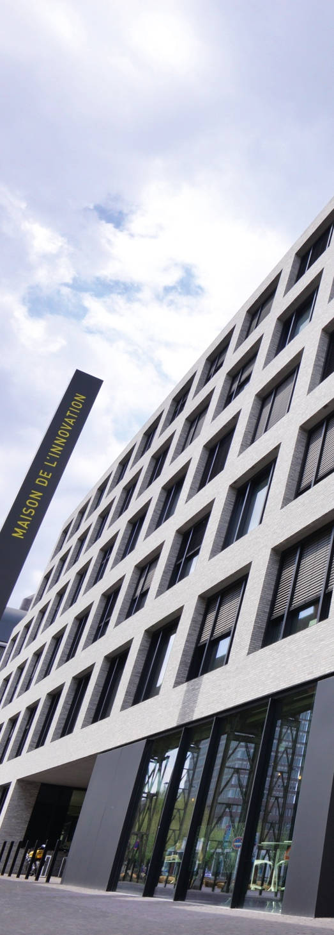

Who are the Main Actors?
Luxembourg Institute of Science &
Technology (LIST):
R&D Infrastructures:

Slide 39
Who are the Main Actors?
Luxembourg Institute of Science &
Technology (LIST):
R&D Infrastructures:
  National Composites Centre

Slide 40
Who are the Main Actors?
Luxembourg Institute of Science &
Technology (LIST):
R&D Infrastructures:
  National Composites Centre
  Materials Characterisation & Testing Centre

Slide 41
Who are the Main Actors?
Luxembourg Institute of Science &
Technology (LIST):
R&D Infrastructures:
  National Composites Centre
  Materials Characterisation & Testing Centre
  Environmental Research & Technology Centre

Slide 42
Who are the Main Actors?
Luxembourg Institute of Science &
Technology (LIST):
R&D Infrastructures:
  National Composites Centre
  Materials Characterisation & Testing Centre
  Environmental Research & Technology Centre
  Connected Objects

Slide 43
Who are the Main Actors?
Others:

Slide 44
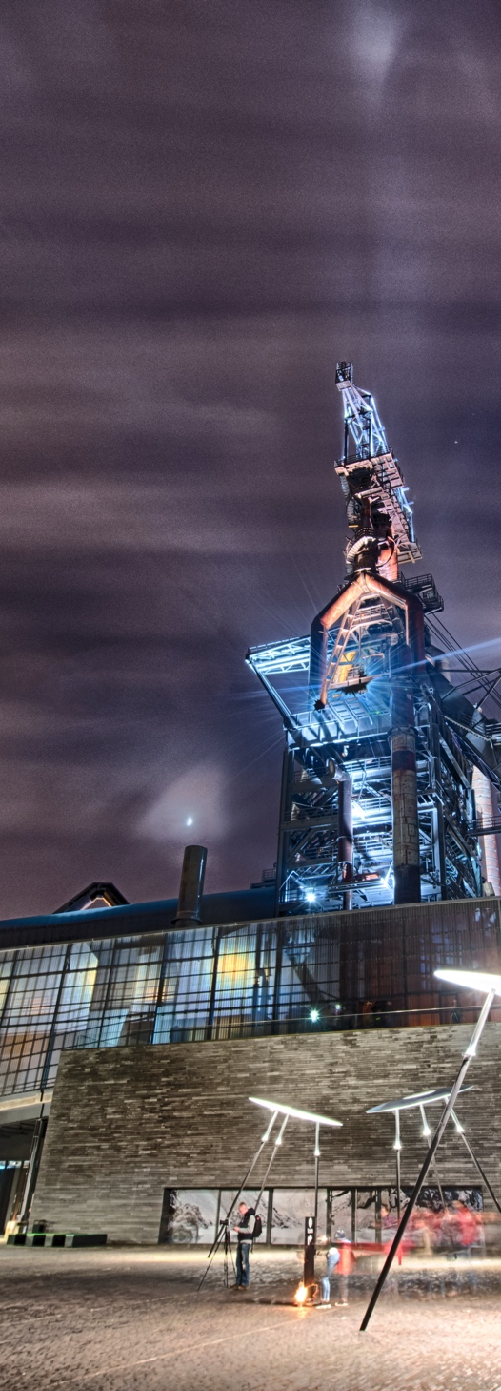
Who are the Main Actors?
Others:
  Luxembourg Institute of Health

Slide 45
Who are the Main Actors?
Others:
  Luxembourg Institute of Health
  IBBL (Integrated BioBank of Luxembourg)

Slide 46
Who are the Main Actors?
Others:
  Luxembourg Institute of Health
  IBBL (Integrated BioBank of Luxembourg)
  Luxembourg Institute of Socio-Economic Research (LISER)

Slide 47
Who are the Main Actors?
Others:
  Luxembourg Institute of Health
  IBBL (Integrated BioBank of Luxembourg)
  Luxembourg Institute of Socio-Economic Research (LISER)
  Max Planck Institute Luxembourg for International, European & Regulatory Procedural Law

Slide 48
Who are the Main Actors?
Others:
  Luxembourg Institute of Health
  IBBL (Integrated BioBank of Luxembourg)
  Luxembourg Institute of Socio-Economic Research (LISER)
  Max Planck Institute Luxembourg for International, European & Regulatory Procedural Law
  European Centre for Geodynamics & Seismology
  …

Slide 49
What about the Private Sector?
Innovative sectors:

Slide 50
What about the Private Sector?
Innovative sectors:
Automotive Components
Creative Industries
Digital Technologies
Cleantech
Finance
Health Sciences &
Technologies
Materials and Manufacturing
Space Technologies
Logistics

Slide 51
What about the Private Sector?
Support schemes:

Slide 52
What about the Private Sector?
Support schemes:
  National funding programmes

Slide 53
What about the Private Sector?
Support schemes:
  National funding programmes
  European funding programmes

Slide 54
What about the Private Sector?
Support schemes:
  National funding programmes
  European funding programmes
  European Space Agency funding programmes

Slide 55
What about the Private Sector?
Support schemes:
  National funding programmes
  European funding programmes
  European Space Agency funding programmes
  Company performance programmes

Slide 56
What about the Private Sector?
Support schemes:
  National funding programmes
  European funding programmes
  European Space Agency funding programmes
  Company performance programmes
  Luxembourg Cluster Initiative
  …

Slide 57
How is Innovation
Shaping our Future?
Some examples

Slide 58
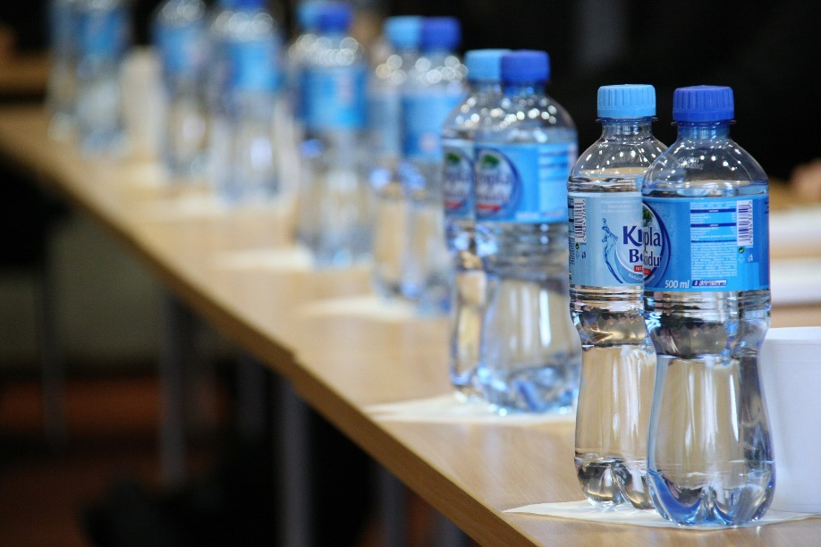
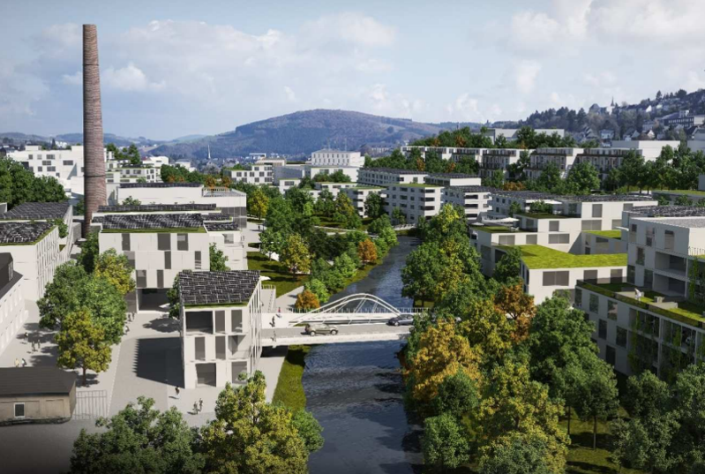

How is Innovation
Shaping our Future?
Circular Economy
PlastiPET
Competitive value chain for plastic bottle re-use
City Hotspot Wiltz
Implementing the circular economy

Slide 59
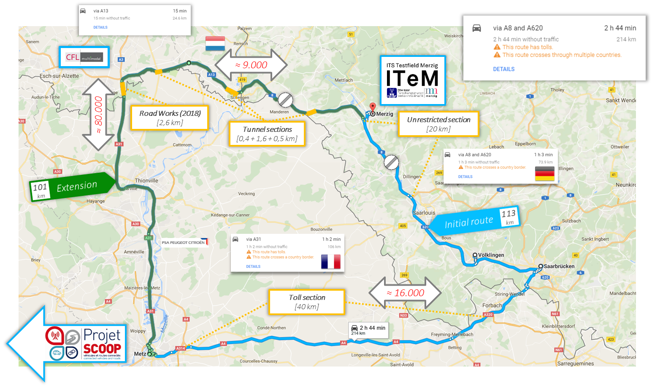
How is Innovation
Shaping our Future?
Autonomous Driving Test-bed

Slide 60

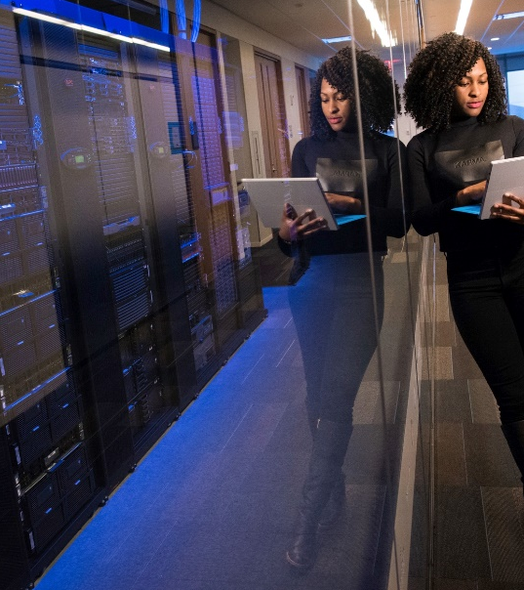

How is Innovation
Shaping our Future?
High Performance Computing for Big Data Enabled Applications

Slide 61

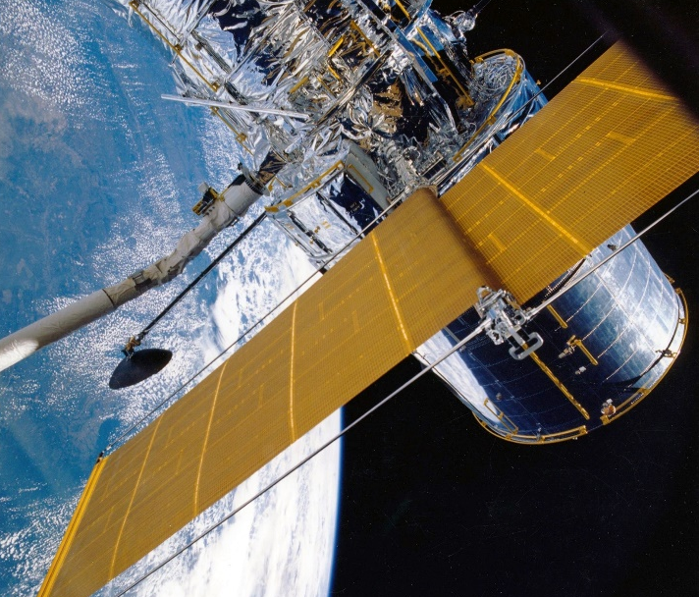

How is Innovation
Shaping our Future?
Space Resources

Slide 62
  Ian CRESSWELL
    Head of International Affairs
    LUXINNOVATION GIE
    5, avenue des Hauts-Fourneaux
    L-4362 Esch-sur-Alzette
    T (+352) 43 62 63 - 664
    M (+352) 621 348 059
    ian.cresswell@luxinnovation.lu

Slide 63
Innovation made in Luxembourg
Some examples:

Slide 64

Innovation made in Luxembourg
Some examples:
Putting the ball in ballpoint pens
If you write with a ballpoint pen, there is a very good chance that the ball at its tip was made in Luxembourg, where hard materials manufacturer Ceratizit turns out 12 billion such balls every year. This represents 40 to 45 % of the global production.

Slide 65
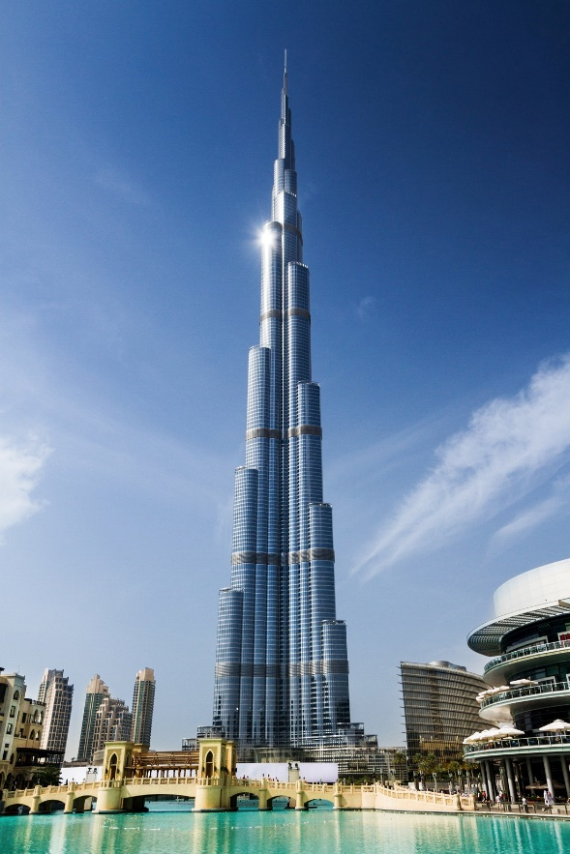
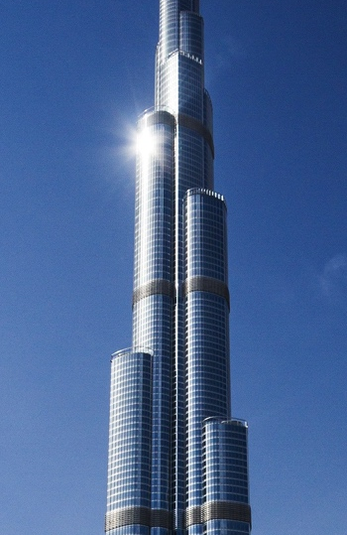
Innovation made in Luxembourg
Some examples:
Burj Khalifa Tower:
the world's tallest tower
Guardian Luxguard S.A., based in Luxembourg, developed and supplied 600,000m2 of low-emissivity glass for the 206-storey Burj Khalifa Tower. Located in the United Arab Emirates, the tower reaches a height of 828m.

Slide 66
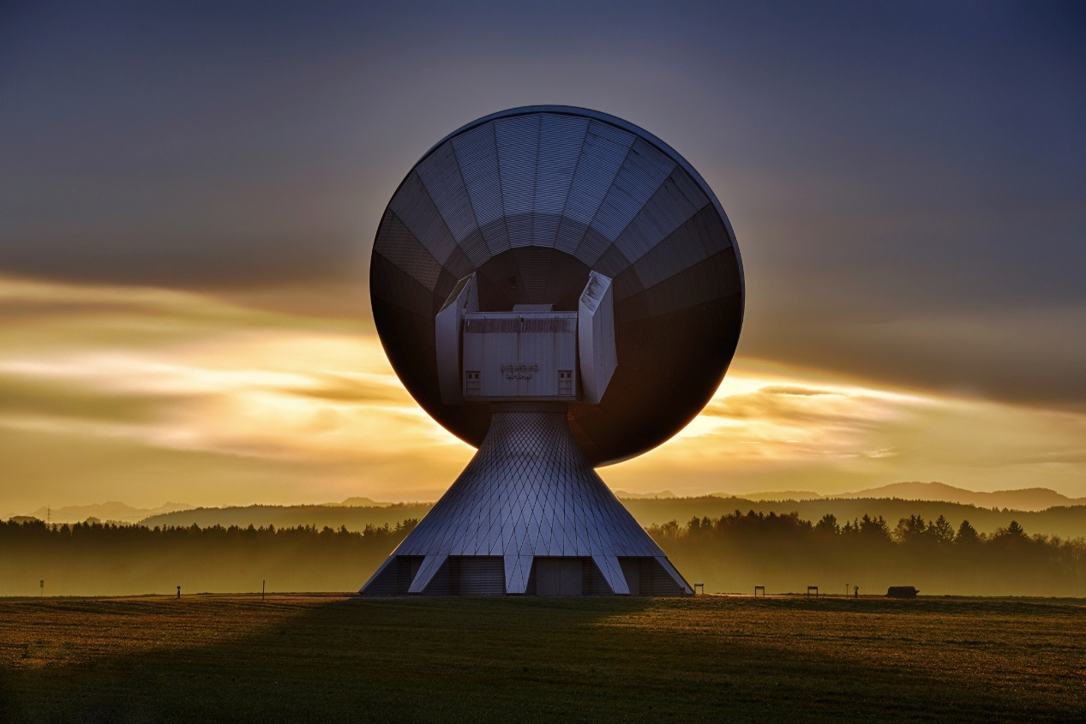
Innovation made in Luxembourg
Some examples:
Satellite pioneers
from Luxembourg
SES S.A., created in Luxembourg in 1985,
is one of the world’s leading providers of satellite communications and broadcasting services.
SES operates a fleet of more than 50 geo-stationary reaching 99% of the world’s population and transmits vital services to keep billions of people connected around the globe.

