Slide 1
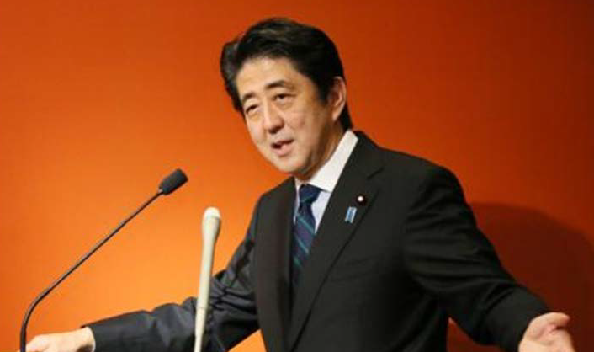
Japanese Economy
“Abenomics” is progressing!
4th of July, 2014
Yoshinori NARAZAKI
Embassy of Japan in Luxembourg

Slide 2
Japan as a huge market
World’s Third largest economy(2013)
United States 17.4 trillion $
China 9.2
Japan 4.9
Germany 3.6
France 2.7
Population - 126 million - world’s tenth
GDP per capita – 38,410 $

Slide 3
The Challenges of Japanese Economy
15 years of deflation
Long-lasting economic stagnation
Large national debt

Slide 4
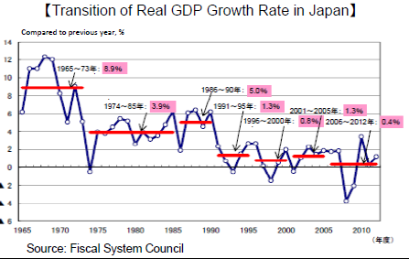

Slide 5
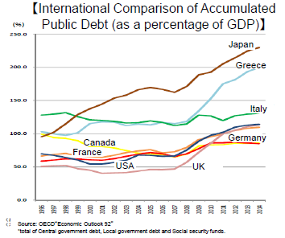

Slide 6
“Abenomics” and “the three arrows”
Japan must manage its national debt while maintaining its social security system, which is under growing pressure due to the aging population.
Robust economic growth is therefore essential to resolve this dilemma.
Since taking office in late 2012, Prime Minister Shinzo Abe has taken an initiative of a decisive economic strategy consisting of three pillars, dubbed “the three arrows”.

Slide 7
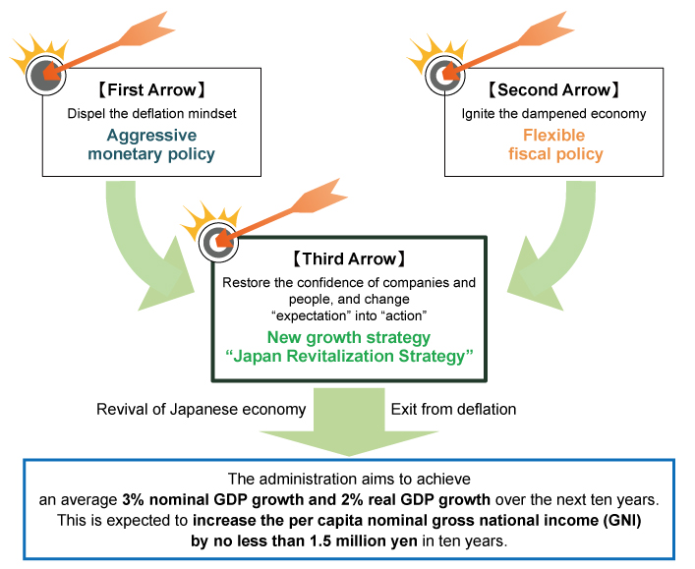
Three arrows of “Abenomics”
"Price Stability Target" of 2 Percent
About 10 trillion yen emergency economic measures, etc
Double the monetary base, etc

Slide 8
Third Arrow - structural reform of the economy – Key concepts(1)
Promotion of Investment
-Bold regulatory and institutional reform, bold tax incentives for capital investment
Strengthen Utilization of Human Resource
-Support the advancement of women’s roles in the workforce
Creation of New Markets
-Expand the market size of health care, disease prevention and other life-related industry
-Expand PPP/PFI

Slide 9
Third Arrow - structural reform of the economy – Key concepts(2)
Global Economic Integration
Promote integration with the global economy through foreign direct investment
Promote economic cooperation such as TPP and the Japan-EU EPA
Establish the National Strategic Special Zones

Slide 10
You already see emerging changes

Slide 11
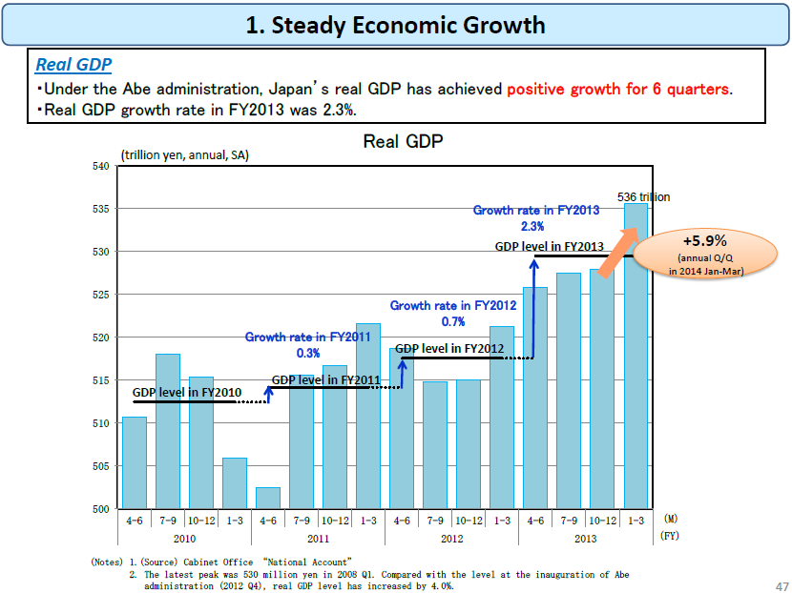
+6.7%
(2nd Preliminary Estimates)

Slide 12
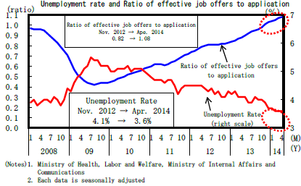
Decreasing Unemployment Rate
Unemployment rate now stands at 3.5% in May

Slide 13
More positive changes
More capital investment
[2014 1Q: 21.0%(annual Q/Q); 8.4%(Y/Y)]
Higher wages decided
[average wage increase: 2.2%]
Changes in corporate culture in Japan
[e.g. substantial increase in outside directors/stock buy-backs]

Slide 14
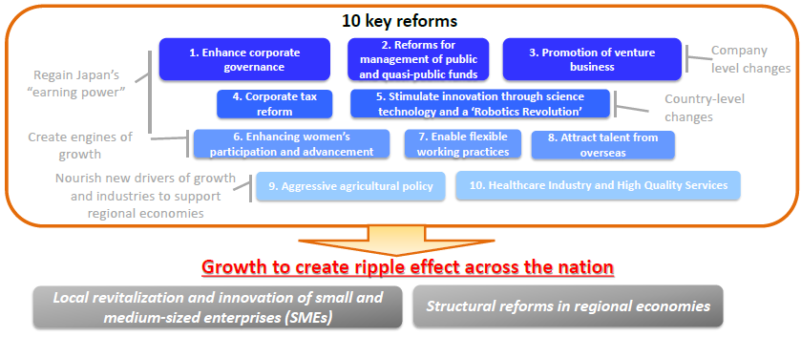
Overview of the Revision of Japan Revitalization Strategy
Revised in 24 June 2014

Slide 15
Revised New Growth Strategy
Examples of new measures;
Pro-growth corporate tax reform
-reduce the percentage level of the effective corporate tax rate down to the twenties in several years
Labor Market Reform
-a new working-hour system under which payments will be made based on the outcomes rather than the hours worked

Slide 16
Strong will to go through
“Growth Strategy is progressing without stopping”
“There is neither taboo nor sanctuary for growth strategy of Abenomics. There is only one thing, the strong will to go through persistently”

Slide 17
Short videos
which will give you some hints for doing business in Japan
Attention to detail
Japan to the World
You can find these videos, and some others through the website below.
http://japan.kantei.go.jp/letters/charms/list.html

