Slide 1

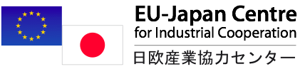
Is Japan a potential market for you?
Learn about Japan
Find key contacts
Identify cooperation opportunities
Support available
funded by the European Commission and METI
managed by the EU-Japan Centre
www.eu-japan.eu

Slide 2
EU-JAPAN CENTRE
for Industrial Cooperation
Authorities
European Commission – DG Enterprise & Industry
Japanese Ministry of Economy, Trade & Industry (METI)
Head Office in Tokyo (since 1987)
30 staff (18 in Tokyo, 12 in Brussels)
Mission
Promote Industrial Cooperation between the EU and Japan
Activities
Policy Analysis and Advices
Services to Business
Promotion of Industrial Innovation and R&D
www.eu-japan.eu

Slide 3
Activities
Missions
Partnering
Support
SERVICES to BUSINESS
SUPPORT
&
GUIDANCE
PARTNERING
MISSIONS
INNOVATIONR&D
PROMOTION
INFORMATION
Info
Desk
Hot Desk
in Tokyo
Enterprise
Europe
Network
H2020
NCP in Japan
Training Missions
in Japan
Training
Match-making Missions
in Japan
Promotion of Japan-EU Innovation and
S&T cooperation
Information
Website
Webinars
BtoB
Networking
Events
Clusters
Support
Publications
Study Visits
in the EU
E-Learning
www.eu-japan.eu

Slide 4
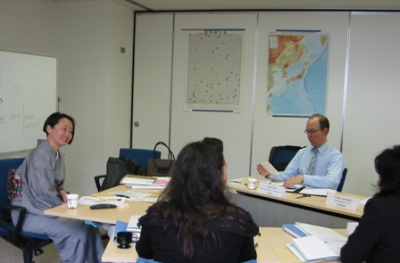
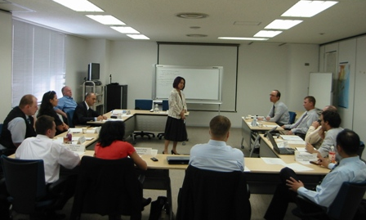
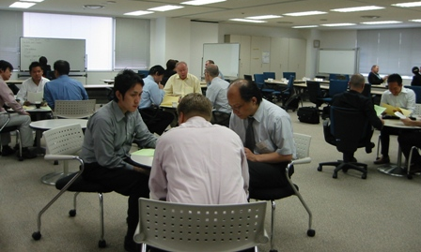
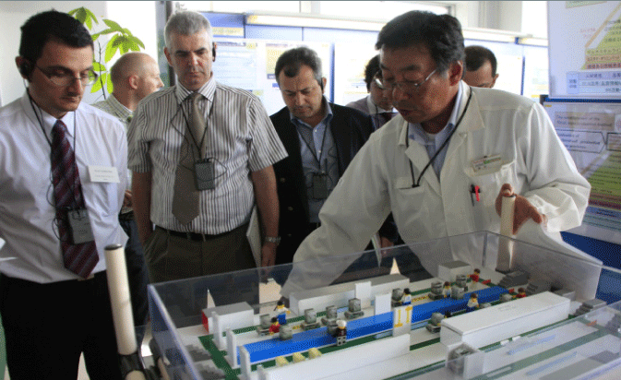
Activities
Missions
Partnering
Support
FOR BUSINESS MANAGERS/EXECUTIVES FROM EU SMEs
HRTP – Japan Industry Insight (4/5-week Managerial training programme)
4 to 5-week course on “how to do business in Japan” including group and individual company visits, basic language classes, lectures, negotiation simulation exercises, joint study sessions, regional economy trips.
Japanese lesson
Next session: May/June 2015
Application Deadline: February 2015
Thematic lectures on Japan
Joint Session w/ JP managers
Company visits
www.eu-japan.eu

Slide 5
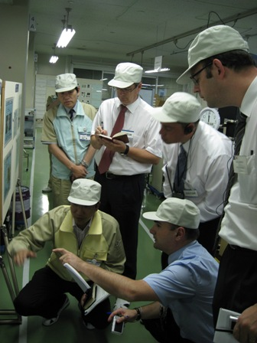
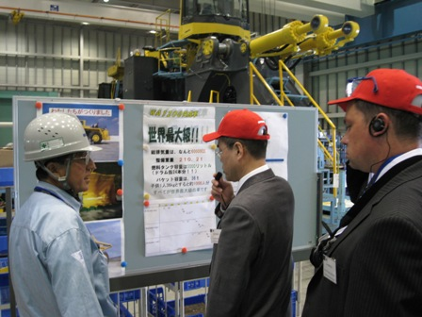
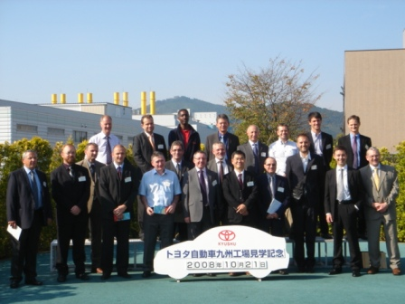
Activities
Missions
Partnering
Support
FOR BUSINESS MANAGERS/EXECUTIVES FROM EU SMEs
World Class Manufacturing (1-week Topical Mission)
Features:
Hands-on lectures at Japanese
manufacturing companies
(e.g. Toyota, Ricoh)
Lecture by WCM experts
Group dynamics and mutual learning
Next sessions :
17 - 21 November Application Deadline: 15 September 2014 | July 2015 Application Deadline: March 2015
www.eu-japan.eu

Slide 6
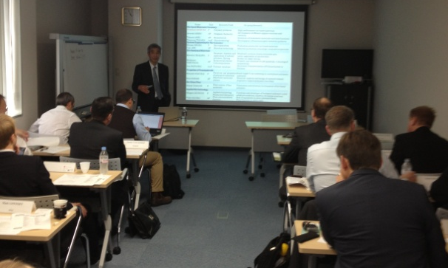
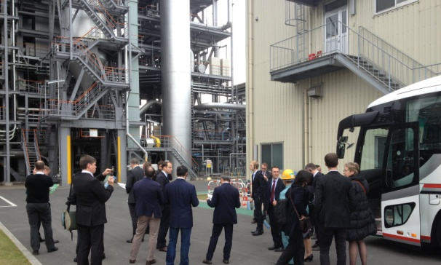
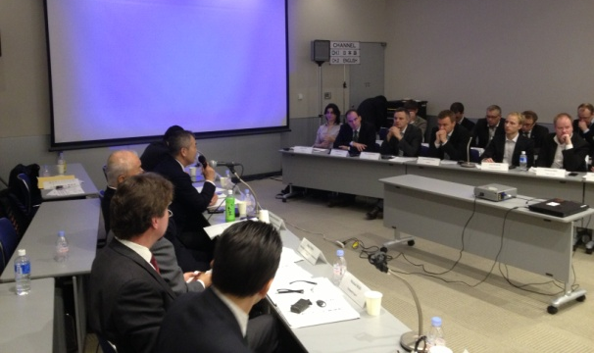
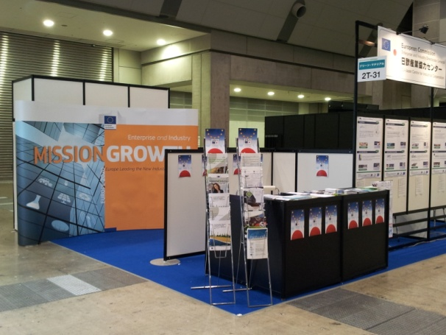
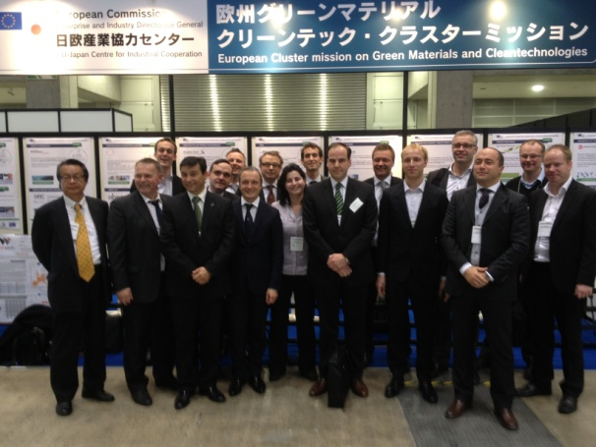
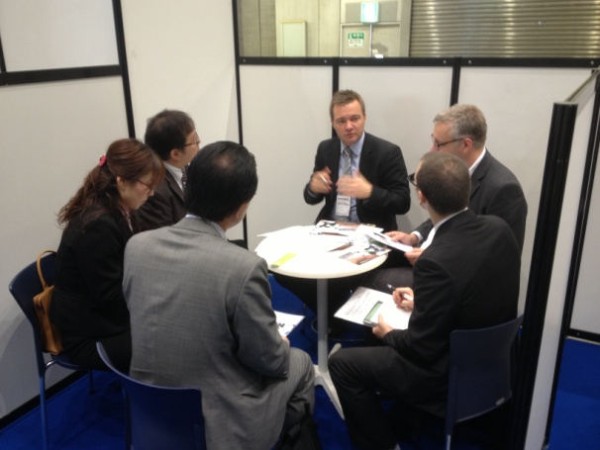
Activities
Missions
Partnering
Support
FOR EU CLUSTERS MANAGERS AND EXECUTIVES FROM SMEs
Cluster support mission (2-day training & 3-day BtoB Mission)
Thematic lectures
Company visits
Joint Session w/ JP clusters
Booth on the Fair
EU Delegation
B2B meetings
www.eu-japan.eu

Slide 7
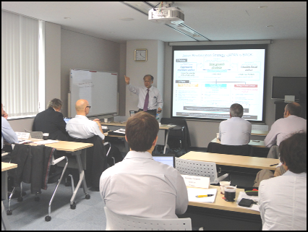
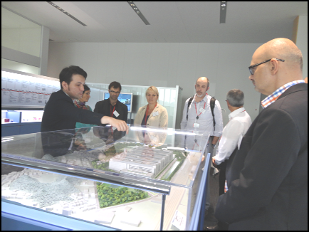
Activities
Missions
Partnering
Support
FOR EU CLUSTERS MANAGERS AND EXECUTIVES FROM SMEs
Cluster support mission (2-day training & 3-day BtoB Mission)
Day-1: seminars & lectures
Biotechnology Industry in Japan
Status & Challenges of Bio Medical Market in Japan
Day-2: Group Company Visits
Visit 1: Chugai Pharmaceutical Company Ltd. (Tokyo)
Visit 2: Kanagawa Science Park Inc. (Kanagawa)
Visit 3: Neo‐ Morgan Laboratory Incorporated (Kanagawa)
Visit 4: Oxford Immunotec KK (Kanagawa)
Visit 5: Takeda Pharmaceutical Company Ltd. (Kanagawa
www.eu-japan.eu

Slide 8
Activities
Missions
Partnering
Support
FOR EU CLUSTERS MANAGERS AND EXECUTIVES FROM SMEs
Cluster support mission (2-day training & 3-day BtoB Mission)
Day-3 to 5: @ the trade fair
B to B meetings
Cluster Summit
Individual presentations
Final debriefing session
www.eu-japan.eu

Slide 9

Partnering support via Enterprise Europe Network www.een-japan.eu
Activities
Missions
Partnering
Support
FOR EU SMEs
Promotion of Company Profiles
Promotion of company profiles via Japanese multipliers
Information seminars in Japan
Newsletters in Japanese
www.eu-japan.eu

Slide 10
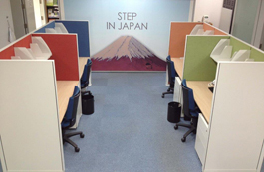
www.eu-japan.eu/other-support
Activities
Missions
Partnering
Support
OTHER SUPPORTS
a “Hot Desk” in Tokyo – “Step in Japan”
Market entry plan in Japan - “Keys to Japan” (JMEC)
Practical information on Japan in www.eubusinessinjapan.eu
Tax in Japan – helpdesk https://twitter.com/JTPPHELPDESK
Public Procurement - calls dissemination and guidance
www.eu-japan.eu

Slide 11
FOR EU COMPANIES HOSTING ENGINEERS STUDENTS
Activities
Missions
Partnering
Support
“VULCANUS” programme
Opportunity for EU companies to host Japanese science & engineering students to work on R&D projects.
Before the students join the companies they will have taken a 4-month language course in the language spoken in the company.
4 – MONTH
Language lesson
& Cultural study
8 – MONTH
Internship in industries or
R&D laboratories
www.eu-japan.eu

Slide 12
JAPAN-EU PARTNERSHIP in INNOVATION, SCIENCE & TECHNOLOGY (STI)
Activities
Missions
Partnering
Support
Objectives
Better understanding EU framework programme (Horizon 2020) and other EU programmes
by Japanese researchers, managers, policy makers and funding organisations.
Promotion of STI related opportunities
Improve JP-EU S&T cooperation coordination
Activities
Infodesk - H2020 National Contact Point in Japan
Bilateral information seminars
Training courses for Japanese on EU projects management
Training for European on Japanese programmes accessible from EU Member States
or useful for cooperation with Japan
Newsletter
4 – MONTH
Language lesson
& Cultural study
8 – MONTH
Internship in industries or
R&D laboratories
www.eu-japan.eu

Slide 13
Activities
Missions
Partnering
Support
USEFUL LINKS & CONTACTS
Head Office in Japan Shirokane-Takanawa Station bldg 4F 1-27-6 Shirokane, Minato-ku Tokyo 108-0072 Tel: +81 (0)3 6408 0281 Fax: +81 (0)3 6408 0283 | Office in the EU Rue Marie de Bourgogne 52, B-1000 Brussels Tel: +32 (0)2 282 0040 Fax: +81 (0)2 282 0025
EU-Japan Centre EEN Japan EU Business in Japan Business Round Table Jeupiste | www.eu-japan.eu www.een-japan.eu www.eubusinessinjapan.eu www.eu-japan-brt.eu www.jeupiste.eu
www.eu-japan.eu

