Slide 1
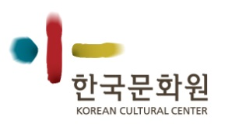
Culture in the Korean business environment
Lidia Iancu
Korean Cultural Center Brussels

Slide 2
Outline
KCC – window on Korea for the EU
Essentials of Korean culture
Cultural Differences in Korean business environment
Notes:
Good morning everyone,
I am here to try and clarify some of the culture-related aspects of the Korean business environment today. My presentation is divided in two main parts. In the first part I will shortly introduce the Korean Cultural Center in Brussels and the highlights of Korean culture worldwide. In the second part I will develop some of the cultural aspects that, should you know them, will make it easier to do business with Koreans and to build strong partnerships with Korean partners.

Slide 3
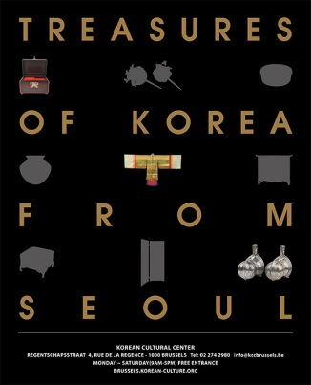
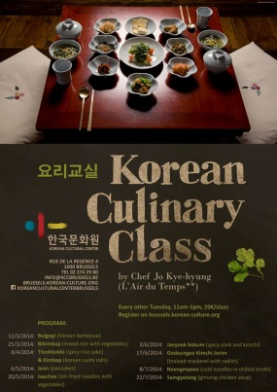
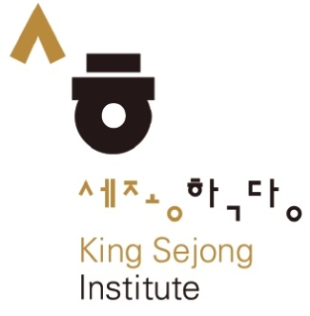
Korean Cultural Center Brussels
An institution with European vocation
Facilities
Numerous cultural activities
Notes:
First, a few words on the Korean Cultural Center that opened in Brussels only in November last year. We are part of a wider network of Korean Cultural Centers that counts currently 27 institutions worldwide. Our mission is, as you would expect, to promote Korean culture, in all its aspects, and to enhance cultural cooperation between the European Union member states and Korea. Unlike other Korean cultural centers that focus mainly on the national dimension, we focus on a broader European dimension. From the heart of Europe, the capital of the EU, we strive through our cultural programs to facilitate contact and co-operation with one of EU’s like-minded strategic partners.
In order to offer a comprehensive cultural experience of Korea we have opened in the center town of Brussels a spacious Cultural Center renovated and landscaped according to Korean principles and philosophy. The Center is equipped with a gallery, a multifunctional hall, a kitchen, classrooms, meeting rooms and a library. We therefore engage in various types of cultural activities such as exhibitions, concerts, conferences, movie projections, cooking classes, language classes, workshops and so on. With our exhibitions we have until now alternated contemporary and modern art with traditional arts. Currently the Center is hosting its fourth temporary exhibition which displays a selection of Korean traditional artifacts including jewelry, ceramics, folk paintings, furniture and many many others.
Our Culinary Classes are taught by the apprentice of Sang Hoon Degeimbre, a famous Belgian Chef. We have a movie program entitled Korean Film Fridays – every Friday evening we propose a Korean movie for free. We also host the King Sejong Institute which provides Korean language classes from beginner to advanced.
If you are available and curious of Korean culture and in particular of music, tomorrow evening we have a Korean traditional music concert. In case you are in Brussels you are welcome to join us!

Slide 4
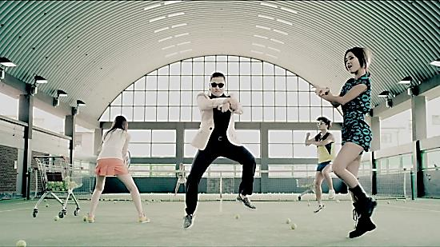
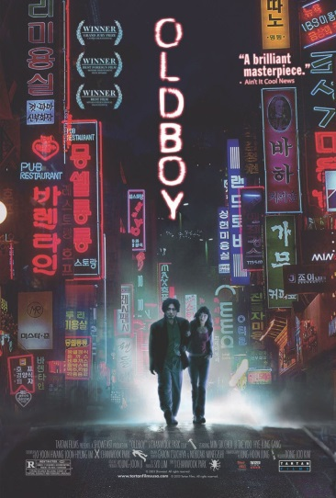
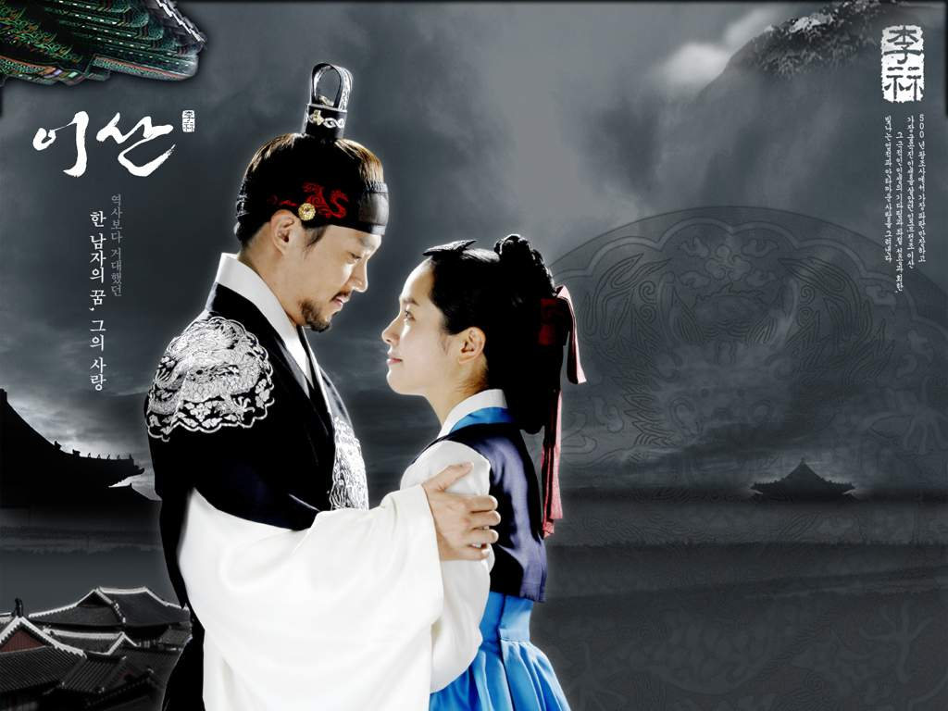
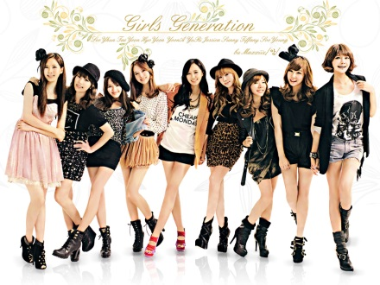
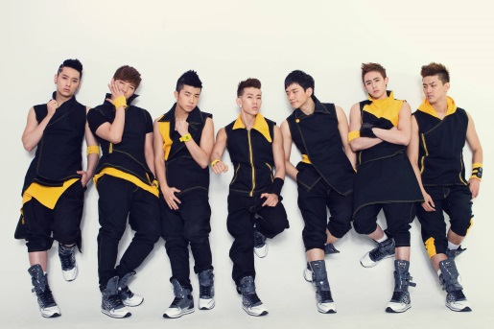
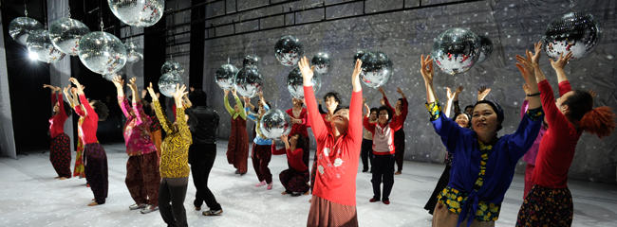
Highlights of Korean culture
Notes:
You should know that nowadays Korea is one of the leading cultural exporters in the world. Perhaps you have already heard the term Hallyu also known as the “Korean wave”. The term refers to a relatively recent surge in Korean cultural exports in the fields of music, cinema and TV drama that have become extremely popular in most of Asia, in the Middle East, in Latin America and even in the U.S. and Europe. The most famous example of the Korean wave is without a doubt PSY with his “Gangnam Style”. His video recently reached 2 billion views in Youtube.
Korean cinema is another success story. Korean directors such as Kim Ki-duk, Park Chan-wook and Lee Chang-dong have since the early 2000 produced films that have been prized or nominated at International Film Festivals such as Cannes and Berlin. Perhaps you have already heard of or seen “Oldboy” which has recently been remade by Hollywood, or Kim Ki-duk’s “Spring, Summer, Autumn, Winter and Spring”.
Another successful cultural product, very popular among the young generation, is K-pop! K-pop stands for Korean popular music and includes all boy or all girls-bands which can sing and dance in perfect synchronization.
Besides the Korean films, TV dramas are also a very popular Korean export. “Jewel in the Castle” , which has been exported in 87 countries, is Korea’s first worldwide television hit and many others have followed in its success.
Popular culture is not the only cultural export of Korea though. Looking at the International Competitions of Classical music we can’t help but notice the rise of a very skilled and talented generation of Korean artists. It was only a month ago Soprano singer Sumi Hwang won the Queen Elisabeth 2014 Voice competition.
Finally, Korean contemporary dance is yet another focal point of Korean culture. Korean dancers and choreographers are gaining more and more international recognition. Looking only at this year in Europe, Korea was the country in focus at the Belgian modern dance festival “Land of Dance” in Liege and their special guest, Eun Mee Ahn, is one of Korea’s most original and most appreciated choreographers.
With these elements we have barely scratched the surface of Korean culture but it is our hope that it will somehow prove useful in your interactions with Korean business partners.

Slide 5
Culture in the Korean business environment
A. First impression
Greeting = bowing
Vertical structure of relationships – use titles
Notes:
We pass on our second and most important part: the cultural code of Korean business relations. I can not stress enough how much importance culture plays in developing business relationships.
First aspect I’d like to point out is first impression. As in most countries, but perhaps even more in Korean society, the first impression is extremely important and may determine the outcome of the meeting or business partnership. In Korean culture 2 gestures stand out: greeting and correctly addressing your partner.
As some of you already know, in many Asian countries, people bow when greeting. Korea is no exception. So in order to start your business meeting according to the Korean etiquette, with your back straight and your arms alongside your body, lean in front and greet when meeting your Korean partner. This applies not only for the first meeting but for every meeting and for every time you see the person, even if it is several times during the same day. Nowadays businessman in Korea have taken the habit of shaking hands and you will most probably be invited to shake the hand of your partner. To be on the safe side wait for him to extend his hand for a handshake and do not initiate it! Should your partner be older or higher ranking it is impolite to tend him your hand for a handshake. More generally speaking in Korea it is considered good manners to bow first before an elderly person and use polite words or expressions. In a nutshell try to honor them while being humble. For the first meeting I also advise you to treat your partners with respect and show humility when talking about your achievements. It is not polite to boast about wealth, success or achievements.
Greeting also means addressing your Korean partner. When a Korean introduces himself, pay attention not only to the name but also to the title he is carrying and address them using that title. For example Minister Kim, or Counselor Lee or Secretary Song, etc. Always use the formal title when addressing a Korean person and avoid as much as possible using the pronoun “you” or calling them Mr. or Mrs. Lee, Kim. And why is that you might ask. Unlike in Western countries relations in Korea are not horizontal but vertical. Because in Korea relations are vertical most often they do not call each other by their names but by their status or titles. Even within the family between brothers and sisters have specific titles/names that they use to call each other. Whether it is at school or in a company there will always be senior members and junior members and their titles depend on this status. This derives from the idea that the entire Korean society is a bigger family for each Korean.

Slide 6
Culture in the Korean business environment
B. Hierarchy
Traditional society
Showing respect to one’s elders:
General manners
Table manners
Notes:
Modern society that keeps it’s traditions. And since we are speaking about superior and junior members I’d like to emphasize a second aspect: the importance of hierarchy! Confucianism is still very present in the Korean society and Korea is probably one of the most Confucian societies of nowadays. So the Korean social relationships are centered on Confucian duties and obligations. This is why relations are vertical in Korea – almost every relationship is based on the idea that one person has a higher status. The status you have implies certain obligations: the person of lower status is duty-bound to respect and obey and the person of higher status has the responsibility of looking after and protect his lower status fellows. These rules apply to everyone from families, to graduates of the same university, to company workers and to people from the same hometown or region.
In practice this implies a certain code of conduct that you should be aware of when interacting with Koreans and especially with Koreans of higher status or older than you. The rules are numerous but I will only mention the ones that will probably apply to your situation. We have already spoken about how to greet a Korean but I should mention that you should also bow to the person you are introduced to and to the person you want to thank.
When seated do not shake your leg (s) as it’s considered impolite and Korean have this belief that you are losing your luck when you shake your leg.
Second, when on the phone do not hang up before the other does.
Just like here it is not polite to point at someone, to talk loudly in public spaces and to cough or sneeze without covering your mouth. The latter applies also to laughing so you should cover your mouth when laughing but this is done mainly by women.
You should take your shoes off when entering a person’s home or when eating in a Korean traditional restaurant.
It is also important to know the table manners. You should wait for the elder person to begin eating before you start eating yourself – this means do not touch the cutlery before the elder(s) have started using theirs. Also you should not finish eating before him so try to pace yourselves to finish after them.
You should turn your head to the side when drinking with a higher status person and you should not drink facing them – it is considered impolite. If you are offered a drink even if you do not drink it is impolite to refuse the first glass.
Very important : do not blow your nose while at the table. Excuse yourselves and go out to do it of you really need to. Korean food is sometimes very spicy so take small quantities to try it first.
As a side note, if your Korean partner invites you to have a drink after work do not refuse as it’s the best opportunity to develop your relationship with them. If you do go drinking with Koreans you should never pour your own drink. Pour and receive drinks with both hands. Try to take the first drink together with everyone. Remember to turn your head to the side when drinking.
Do not smoke in front of a person of higher status and if you are a woman you should not smoke in the company of men.
When a Korean gets a promotion or gets married or engaged it is customary that he invites his colleagues to dinner or for a drink. Korean like to share food together so don’t be surprised when you see them sharing a casserole of stew. It is also common for a single person to pay for everyone, usually the elder. Because it’s so common Korean take turns in paying the bill.

Slide 7
Culture in the Korean business environment
C. Preserving face
The rules of accepting/refusing a deal
Criticism and praise
Use euphemisms
Notes:
It is important to know that Koreans are traditionally not straightforward and they tend not to like it when you are being straightforward to them. This means that you should not take their first answer as the final answer because Koreans abide by the rules of proper manners which require them to politely refuse 3 times an offer before giving their final answer (but, be careful, that doesn’t mean they will accept only after 3 times). In other words even if the deal you are proposing interests them they will politely refuse it several times to “save face” before being able to accept it. The same goes for refusals – Koreans will not immediately refuse a deal that is clearly in their disadvantage. According to Confucian teachings it is not proper to express one’s likes or dislikes overtly. Therefore you should repeat your proposition several times in order to receive the “real” answer. If you are wondering how many times you should make an offer, I’m afraid you will need to figure it out by yourself. Try to play it by the ear or follow your instinct.
The same rule applies to criticism. If you need to criticize a Korean colleague or partner you should cloak your criticisms in a veil of respectfulness and deliver them in private. Koreans will basically do everything they can to avoid losing face because in Confucianism losing face was grounds for deep shame.
Should you be praised by a Korean partner or colleague play it down. For example if you speak Korean and they tell you “Oh, you speak Korean so well” your answer should be “I really can’t speak well Korean” or something in this sense. Humility is a valued quality in Korea
This brings me to another important point : the use of euphemisms. Due to the fact that the Korean code of conduct requires them to not say things straight forward they like to use mild alternatives or substitutes that will soften the phrase and you should try to use them too.
If you have any curiosities about Korean culture in general or a particular aspect of Korean culture be sure to check out our web-site or come visit us in Brussels, we are next to the Small Sablon Church. We have a big library with books in 4 languages: English, French, Dutch and Korean. You and also find us on Facebook.

Slide 8
Thank you!

