Slide 1
THE WAŁBRZYCH SPECIAL ECONOMIC ZONE
„INVEST-PARK”
GOOD INVESTMENTS
ZONE
Barbara Kaśnikowska,
President of WSEZ „INVEST-PARK”
Luxembourg, April 21, 2015

Slide 2
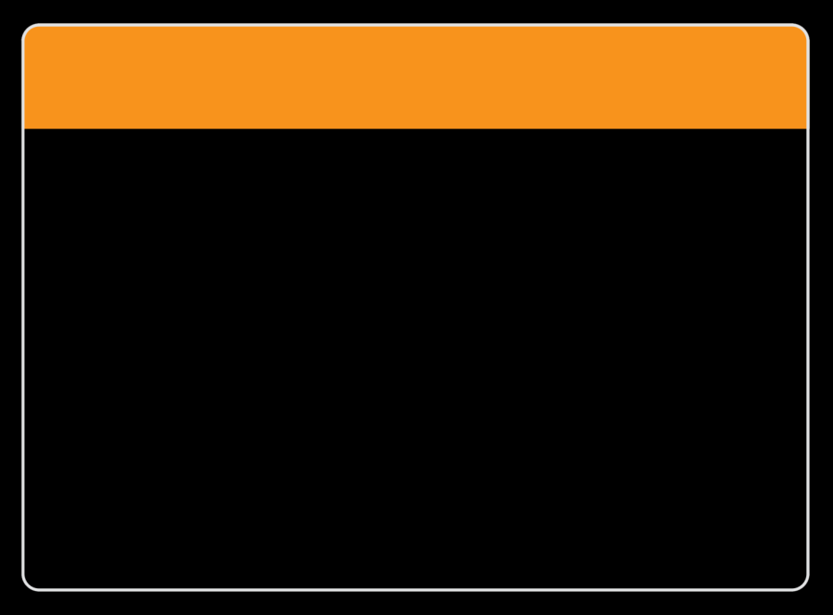
Wałbrzych Special Economic Zone „INVEST-PARK” according to fDi magazine of the Financal Times group
4th best
zone in Europe
22nd
worldwide
in 2014
commended
for
soft landing
services

Slide 3
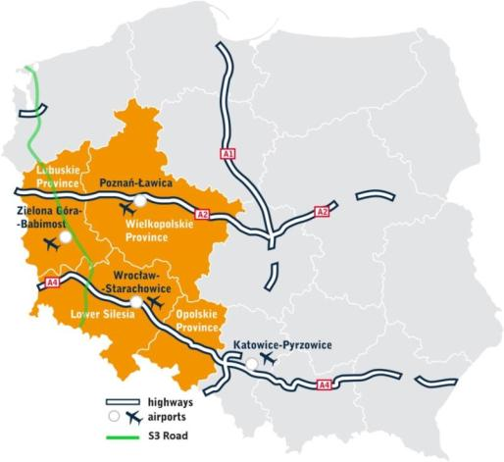
Wałbrzych Special Economic Zone „INVEST-PARK” GOOD INVESTMENTS ZONE
over
40,000
jobs created
total capital
expenditure:
over 4,5 BLN
EUR
174
companies
over 2,650 ha of land for investments
in 44 subzones
more information: mapa.invest-park.com.pl

Slide 4
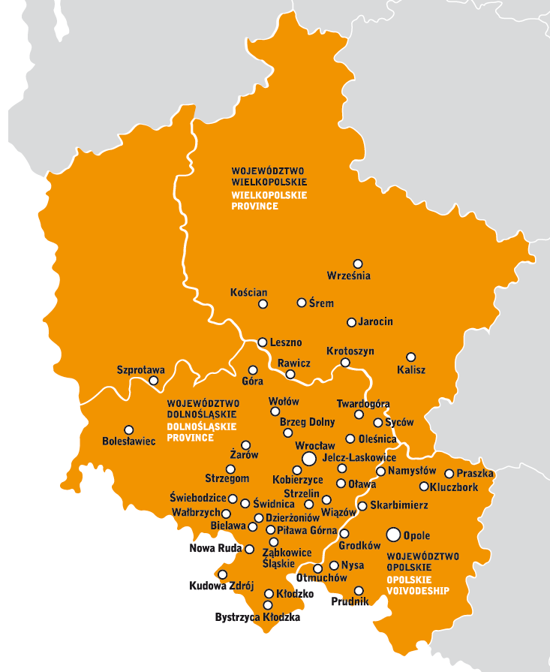
Wałbrzych Special Economic Zone „INVEST-PARK” GOOD INVESTMENTS ZONE
food
processing
7%
KEY INDUSTRIES
household
appliances
5%
automotive
23%

Slide 5
Wałbrzych Special Economic Zone „INVEST-PARK” GOOD INVESTMENTS ZONE
Some of the world’s largest corporations
have placed their trust in us:
WSEZ INVESTORS

Slide 6
Wałbrzych Special Economic Zone „INVEST-PARK” INVESTORS FROM BENELUX
total capital
expenditure:
over 342 MLN
EUR
over
4,000
jobs created

Slide 7
Wałbrzych Special Economic Zone „INVEST-PARK” SUPPORT FOR INVESTORS
Training courses for employees
INVEST in EDU
Purchasing groups
HR club
Modern shop floor and office spaces
Support and assistance at every stage of the investment and in running a business

Slide 8
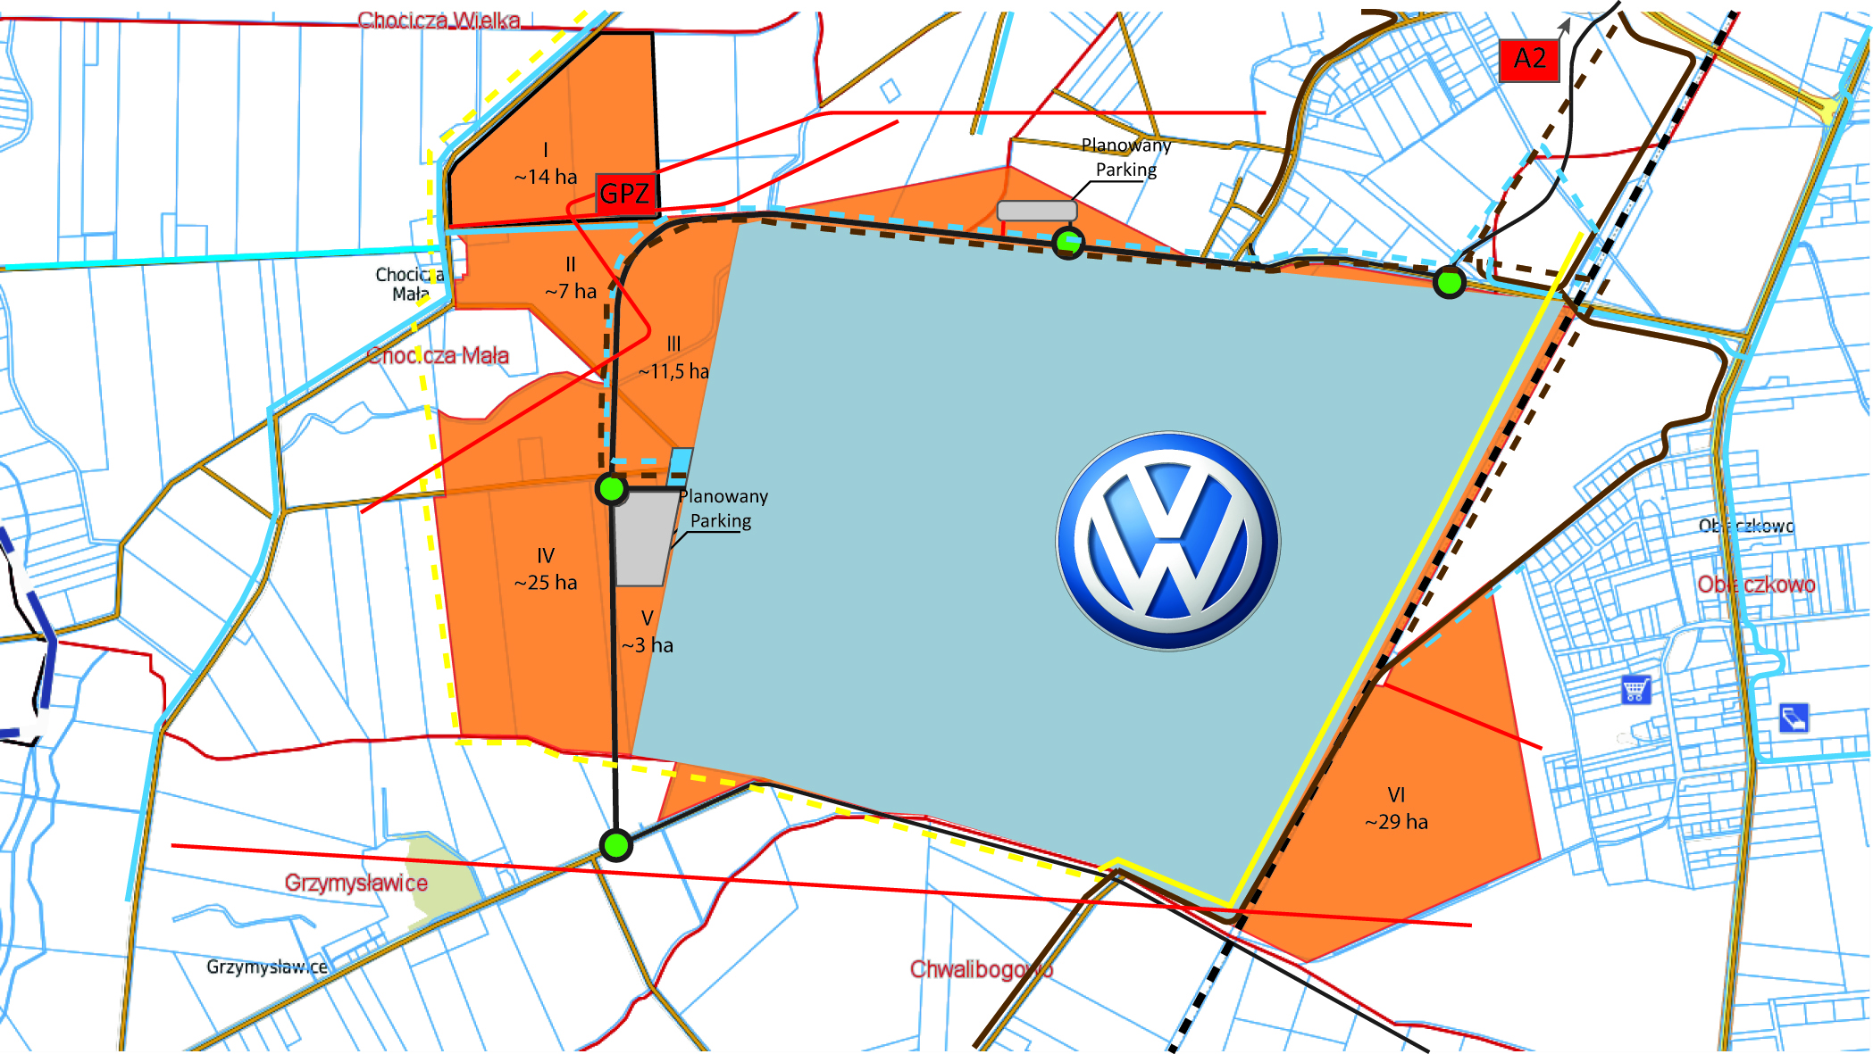
Wałbrzych Special Economic Zone „INVEST-PARK” WRZESNIA ECONOMY ACTIVITY ZONE
90 ha
of available investment
land
staff training center for automotive industry
Conditions for the automotive cluster creation
(VW and 39 companies from automotive industry
operating within the WSEZ)

Slide 9
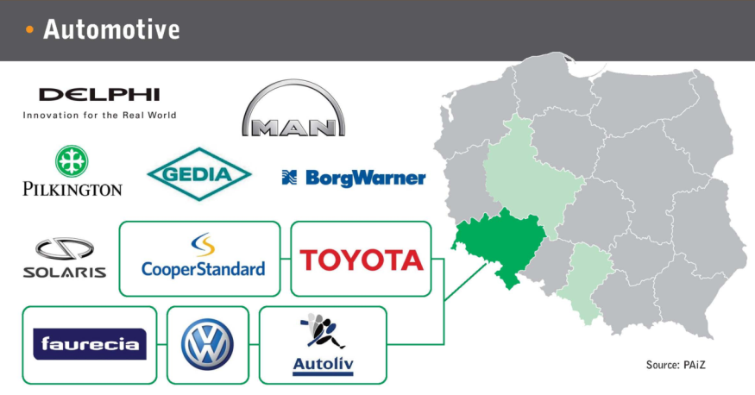
Wałbrzych Special Economic Zone „INVEST-PARK” SERVICES AND MANUFACTURING HUBS IN POLAND

Slide 10
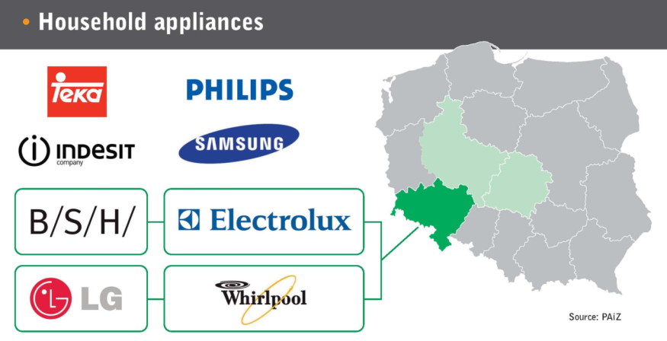
Wałbrzych Special Economic Zone „INVEST-PARK” SERVICES AND MANUFACTURING HUBS IN POLAND

Slide 11
WROCŁAW CENTRE OF IT/BPO

Slide 12
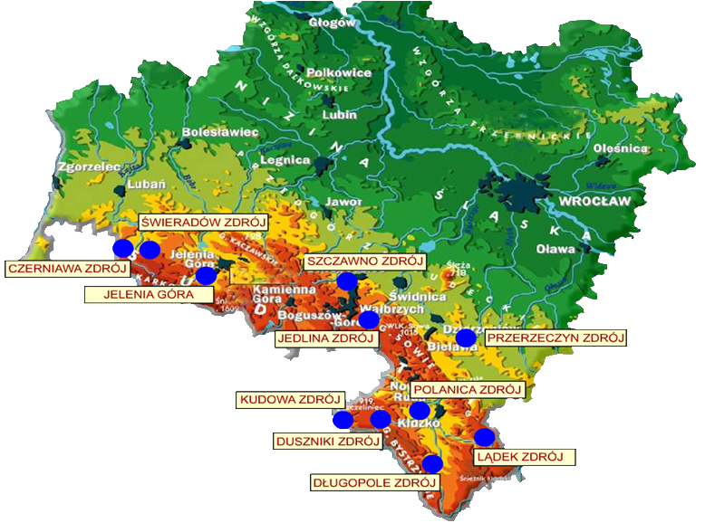
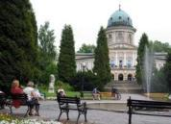
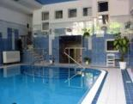
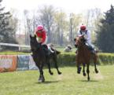
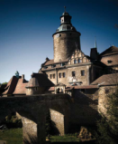
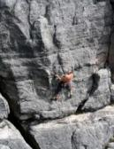
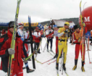
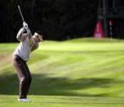
LOWER SILESIA INVESTMENT AND TOURISM REGION

Slide 13
THE WAŁBRZYCH SPECIAL ECONOMIC ZONE
„INVEST-PARK”
JOIN THE BEST!
Thank you for attention
Barbara Kaśnikowska,
President of WSEZ „INVEST-PARK”

