Slide 1
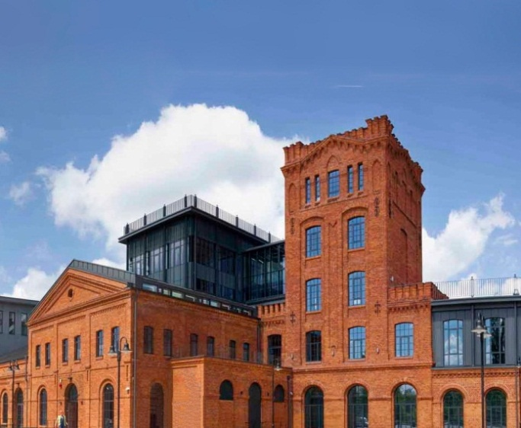
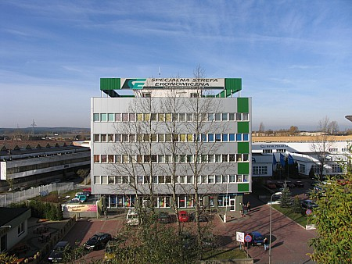
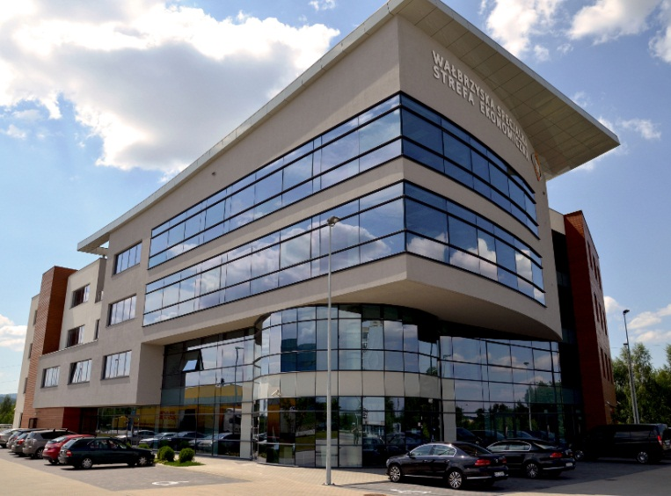
SPECIAL ECONOMIC ZONE
THE BEST PLACE TO INVEST IN POLAND

Slide 2
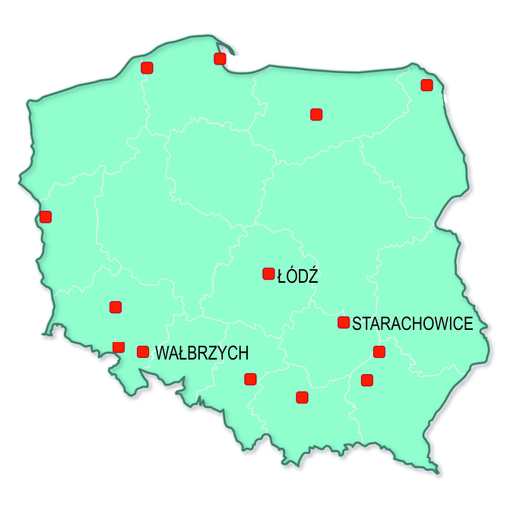
SPECIAL ECONOMIC ZONE
Special Economic Zone (SEZ) is an area designated by the Polish Government, where business activity can operate on preferential conditions (State Aid).
The State Aid in SEZs is granted in a form of a total exemption from Corporate Income Tax (CIT) from the activity conducted within the Zone’s area.
Two possible titles of the State Aid:
new investment project,
creation of new workplaces.
There are 14 SEZs in Poland, which are supposed to operate till 2026.

Slide 3
LEVEL OF STATE AID
55%
45%
of eligible costs for small enterprises
According to EU definition SMEs are companies that employ up to 250 workers and their yearly turnover does not exceed 50 M EUR.
45%
35%
of eligible costs for medium enterprises
35%
25%*
of eligible costs for large enterprises
* The level of the State Aid can be different and depends on economic conditions in the region, e.g. for West Warsaw subregion amounts to 20% for large enterprises.

Slide 4
CONDITIONS
100 000 €
minimal value of a new investment project (investment can not be started before obtaining SEZ permit)
> 5 YEARS
maintaining investment and business activity (3 years for SMEs)
> 5 YEARS
creation of new jobs and maintaining employment level (3 years for SMEs)

Slide 5
REGIONAL OPERATIONAL PROGRAMME 2014-2020
ROP IS A DOCUMENT REGULATING THE USAGE OF THE UNION FUNDS IN POLAND. THERE ARE 16 PROGRAMMES IN POLAND – SEPARATE FOR EACH REGION
ROP COOEXISTS WITH OTHER EU PROGRAMMES AND IMPLEMENTS EUROPEAN POLICY IN POLAND
ROP IS FINANCED FROM THE EUROPEAN REGIONAL DEVELOPMENT FUND AND EUROPEAN SOCIAL FUND
THE MAIN OBJECTIVE OF ROP IS ECONOMIC GROWTH AND EMPLOYMENT IN EACH REGION
MAIN AREAS OF SUPPORT:
RESEARCH; DEVELOPMENT; INNOVATIVE AND COMPETITIVE ECONOMY; EMPLOYMENT AND RAISING OF THE QUALIFICATIONS OF WORKERS

Slide 6
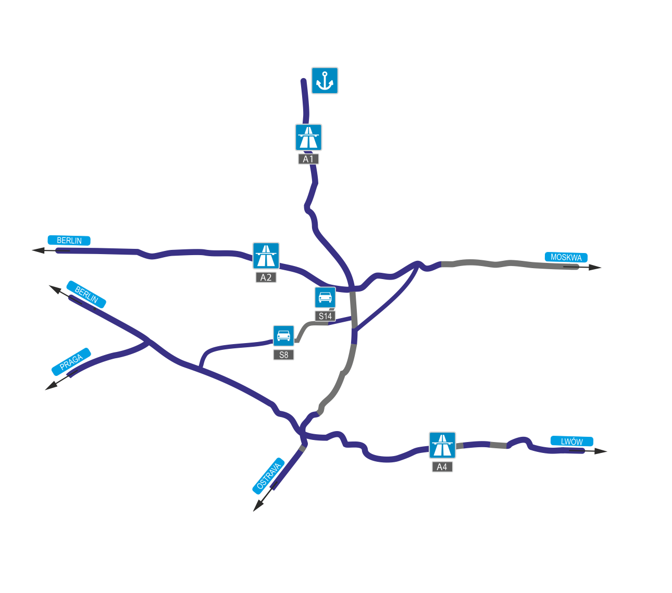
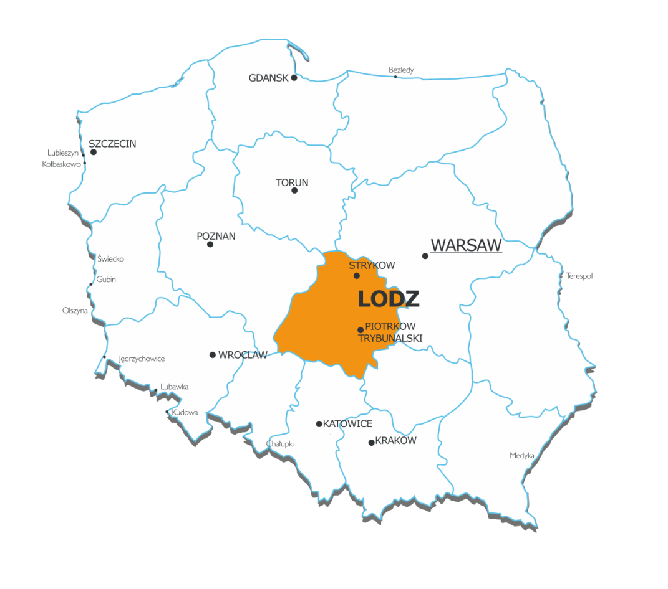
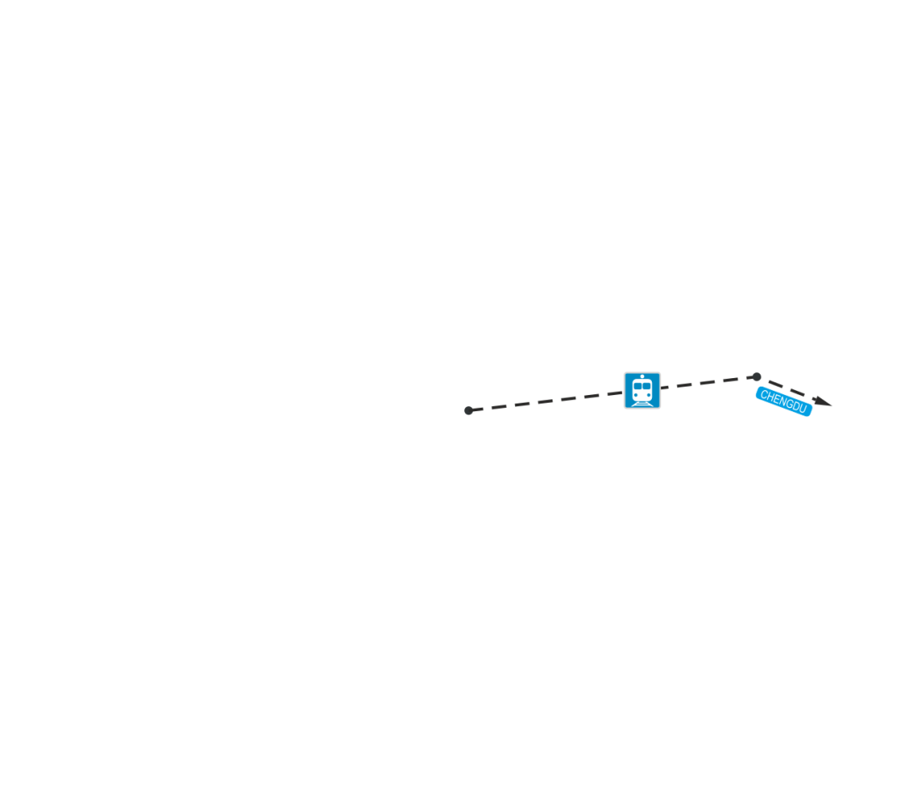
LODZ REGION
Official name: Lodzkie Voivodship
Area: 219 sq. km
Population: 2 513 093 (*6th place in Poland)
A1 and A2 motorways junctions
S8 and S14 express roads
Lodz airport with cargo terminal – central location in the country
weekly cargo train from China (Chengdu)

Slide 7
KEY SECTORS IN LODZ REGION:
medicine, pharmaceutics and cosmetics
advanced construction materials
modern textile and clothing industry (including design)
power engineering including renewable energy sources
agriculture and food processing
Lodzkie Voivodship
According to the Regional Innovation Stategy for Lodz Region, LORIS 2030

Slide 8
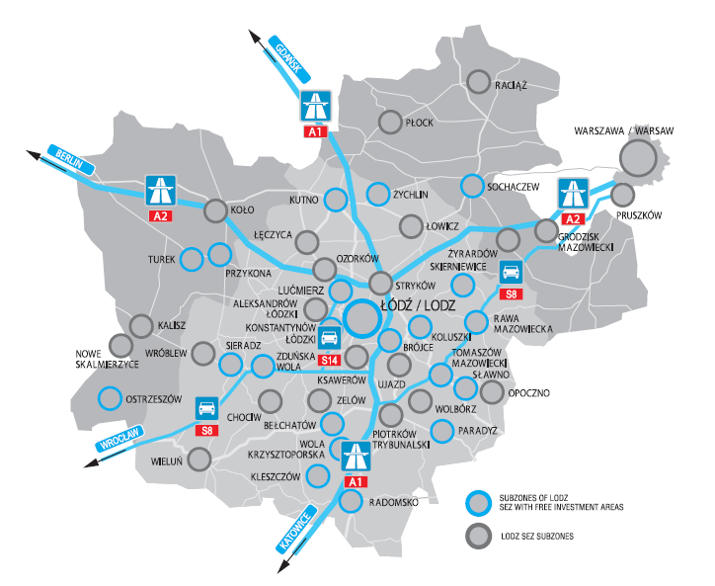
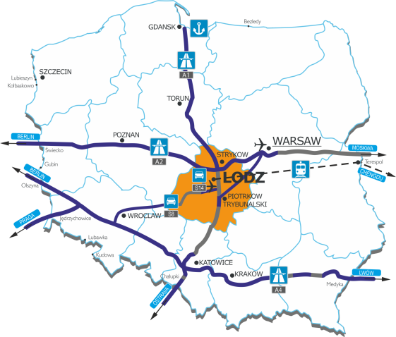
LODZ SEZ LOCATION
44 subzones in Central Poland

Slide 9
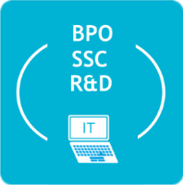
LODZ SPECIAL ECONOMIC ZONE
SCOPE OF ACTIVITIES IN LODZ SEZ:
PRODUCTION:
including food processing
SERVICES:
including storage
BPO / SSC/ IT / R&D:
including accountancy and bookkeeping, call centre services, technical analyses

Slide 10
IT/BPO
PHARMACEUTICS & COSMETICS
PACKAGING
HOUSEHOLD APPLIANCES/ ELECTRO- ENGINEERING
BELGIUM INVESTORS
Notes:
Over 250 investment projects.

Slide 11
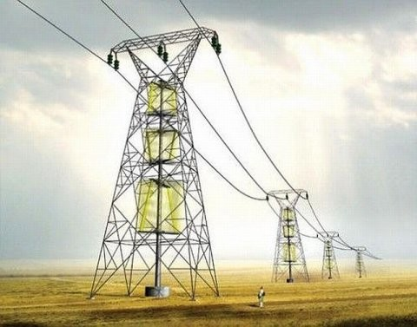
PRE AND POST INVESTMENT CARE IN LODZ SEZ:
cooperation with local, regional and central authorities
cooperation with business partners and support in establishing contacts (vocational education, universities, developers, ICT cluster, etc.)
meetings integrating entrepreneurs
assistance in preparing the offer for the procedure
assistance in finding suppliers and customers by organizing business mixers and preparing sector-oriented databases of companies in the region

Slide 12
LODZ SEZ AND RESULTS
1302
44
201
152
TOTAL AREA (HA)
SUBZONES
ACTIVE ISSUED
INVESTORS OPERATING IN SEZ
* as of 1st of January 2015

Slide 13
RESULTS – NEW WORKPLACES
* as of 1st of January 2015

Slide 14
RESULTS – INVESTMENT OUTLAYS (BILLION EUR)
* as of 1st of January 2015

Slide 15
LODZ SPECIAL ECONOMIC ZONE – ACHIEVEMENTS
According to the Global Freezones of the Year 2014 ranking published by fDi Magazine, Lodz SEZ is the best SEZ in Europe for SME sector.
Title for the institutions with most creative and ground-breaking activities in the field of attracting investment projects to the regions.
„One of the best rated by investors Special Economic Zones in Poland in years 2009-2012”.

Slide 16
LODZ SPECIAL ECONOMIC ZONE – ADDITIONAL ACTIVITIES
cooperation with academic institutions
vocational education support
assistance in establishing cooperation of schools with companies
member of ICT Central Poland Cluster
founder of Lodz Educational Cluster

Slide 17
WE INVITE YOU TO
Lodz Special Economic
Zone Joint Stock Co.
90-349 Łódź, Poland 22/24. Tymienieckiego St.
www.sse.lodz.pl
info@sse.lodz.pl

Slide 18
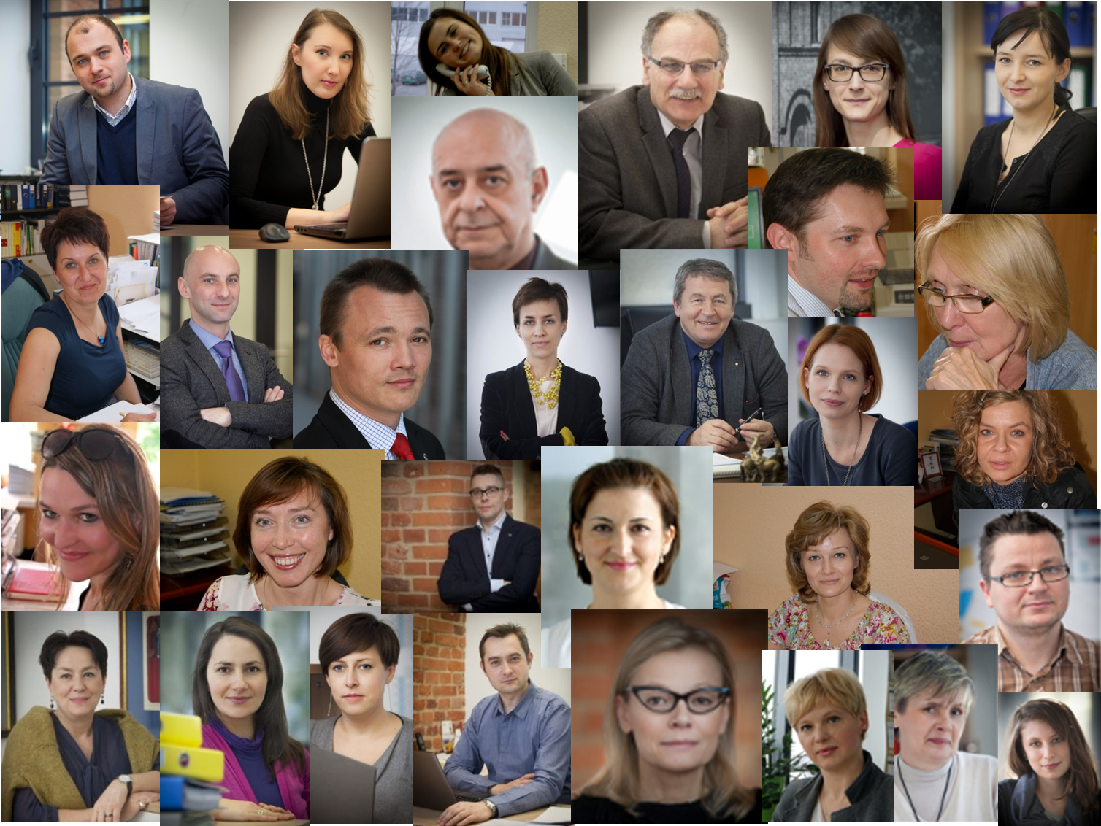
„OPTIMO MODO”

