Slide 1
Investment climate and Tax Incentives for Foreign Companies Exporting and Investing in Uzbekistan
Presented by: BOTIR PARPIYEV, chairman

Slide 6
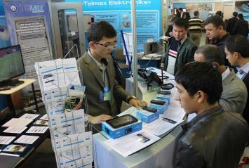
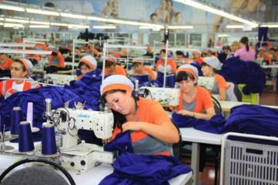
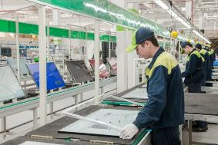
The Law of the Republic of Uzbekistan «On Guarantees And Measures On Protecting The Rights Of Foreign Investors» guarantees and protects the rights of foreign investors engaged in investment activities on the territory of the Republic of Uzbekistan.
Foreign investors operating in the Republic of Uzbekistan are provided with favorable treatment and protection of their investments.

Slide 7
Exporting enterprises endowed with tax benefits which go in the form of decreasing the rates of Corporate Income Tax, Property Tax and Unified Tax Payment (for small business).
Whether the export share in total sales estimates 15 to 30 percent - the rates are reduced by 30 percent, and if the export share is over 30 percent – the rates are reduced by 50 percent.
Example:
The Corporate Income Tax rate for 2017 is set at 7.5 percent. If the export share in total sales of a given company estimates 15 to 30 percent - the rate would be 5.25 percent, if the share is over 30 percent - the rate would be 3.75 percent.
For a small business entities current rate of the Unified Tax Payment set at 5 percent level would decrease down to 3.5 percent and 2.5 percent respectively.

Slide 8
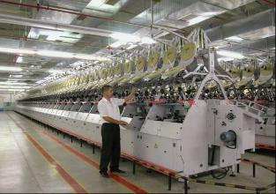
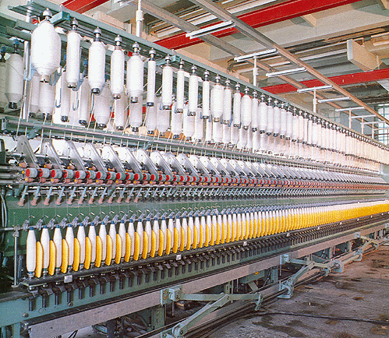
Enterprises specializing in production of textiles, readymade garments, haberdashery, perfumery and cosmetic products, glassware, electrical appliances and furniture hardware are exempt from:
Corporate Income Tax;
Property Tax;
Obligatory contributions to the Republican Road Fund;
Unified Tax Payment (for small business)

Slide 9
Companies making private investments into the field of production of construction materials, as well as food, electronic, light industry, silk, chemical and pharmaceutical industry for a certain period (3 to 7 years) regarding the amount of investments are exempt from:
Corporate Income Tax;
Property Tax;
Tax On The Improvement And Development Of Social Infrastructure;
Obligatory contributions to the Republican Road Fund;
Unified Tax Payment (for small business)
Moreover, starting with January 2016 foreign investors' dividend on shares held by them in joint-stock companies are exempt from tax up to January 1, 2020.

Slide 10
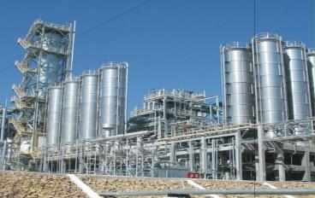
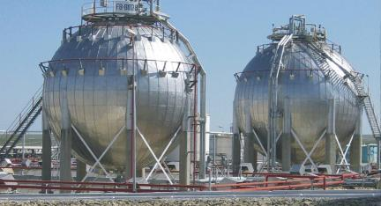
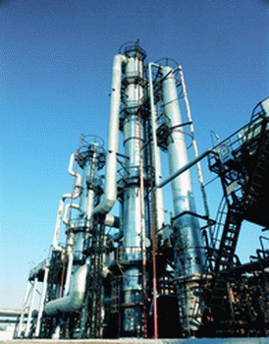
Foreign companies engaged in prospecting and exploration of oil and gas, as well as attracted foreign contractors and subcontractors are exempted from paying of all taxes and mandatory contributions to the public off-budget funds for the period of exploration.
Joint ventures in oil and gas formed with the participation of foreign companies engaged in prospecting and exploration of oil and gas are exempt from Corporate Income Tax for a 7 year period from the start of production of oil or gas.

Slide 11
Investors and parties of Production Sharing Agreements related to the prospecting and exploration of mineral resources in the area of the Republic of Uzbekistan obliged to pay only those taxes with defined rates that are set in the agreements, namely Corporate Income Tax, Land Tax, Excise tax, Subsoil Taxes and Special Payments and Tax on Water Consumption.

Slide 12
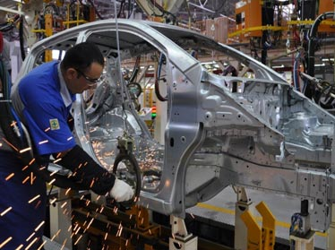
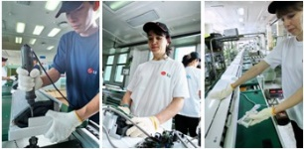
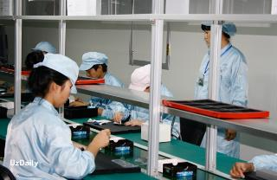
Newly established enterprises with foreign investments where the share of foreign investor is not less than $5 million (in terms of money) according to the Presidential Decree from April 10, 2012 whether the tax legislation would change are allowed to apply those legislation and regulations regarding 7 out of 15 major taxes and obligatory payments which were in force at the date of their registration over 10 year period from their registration.

Slide 14
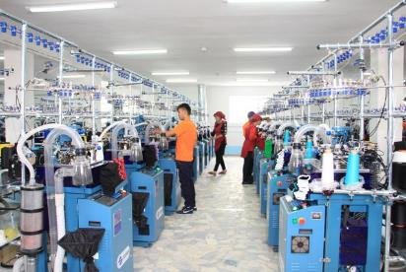
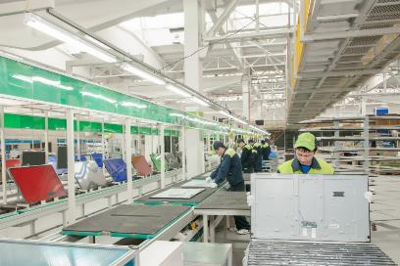
Special customs, currency and tax regimes along with simplified procedure for entry, stay and exit permits for employed citizens - non-residents of the Republic of Uzbekistan function on the territory of Free Economic Zones.

Slide 15
from 300 thousand US dollars to 3 million US dollars
3 years
from 3 million US dollars to 5 million US dollars
5 years
from 5 million US dollars to 10 million US dollars
7 years
from 10 million US dollars and more
10 years
with the application for the next 5 years on the income tax rate and a single tax payment of 50 percent below the current rates.

Slide 16
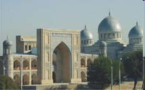
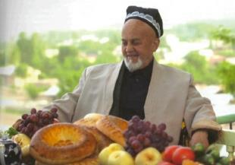
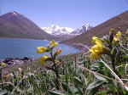
To ensure intensive development of tourism, effective use of tourist potential and strengthening of entrepreneurial activity in Uzbekistan, legal entities are exempted for a period of 5 years from the payment of profit tax, land tax and property tax, as well as a single tax payment, when they put into operation hotels and motels level of not less than 4 stars and certified in accordance with the established procedure.

Slide 17
Utilizing tax incentives granted to enterprises with foreign investment helps to save about $ 700 million annually.
Through the use of tax incentives a certain company can save about $1 million on average per year.

Slide 18
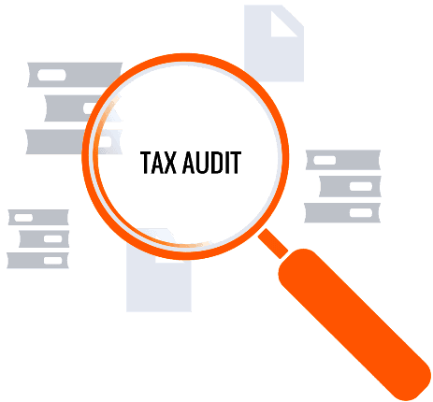
Along with benefits, Uzbekistan established clear mechanism of tax audit over business activities which is carried out only by a Decision of the Republican Council for the Coordination of Regulating Authorities.
As a result of measures taken over the last 10 years the number of tax audits has been decreased by almost 2,5 times. Today tax audits cover about 1 percent of the total number of business entities.

Slide 19
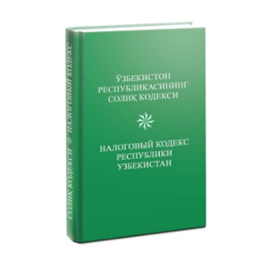
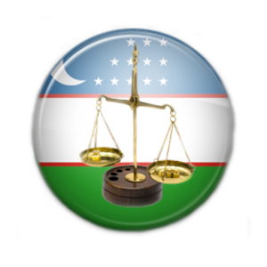
Since June 1, 2014 sanctions for the business entities according violations of the regulatory acts are not applied if those acts were not placed in official websites of related authorities.
From 1 January 2017 canceled all kinds of unscheduled inspections of business entities except tax examinations in due to liquidation of the legal entity, as well as carried out exclusively by a decision of the National Council on the coordination of the regulatory authorities short-term tax examinations on the basis of appeals of individuals and legal entities on the facts of violations of the law;

Slide 20
Abolished all kinds of counter tax examinations of the legal entities, including by criminal case’s;
newly established production enterprises with foreign investments granted the right to use in the next five years taxes and other obligatory payments (except for the resource and customs duties) in force on the date of their state registration;
Suspension of bank accounts regarding business entities in case of tax non-compliance can be carried out by the tax service only on a court decision.

Slide 21
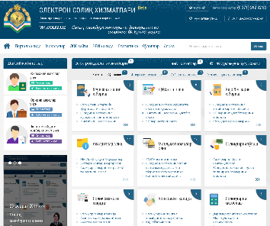
«Personal Cabinet of Business Entity» allowing to carry out:
interactive issuance and filing of financial, tax, statistical and other reports;
payment of taxes, utility bills and public fees for the examination and issuance of permits and licenses through the Internet banking;
obtaining information and creating opportunities to use other types of online public services.

Slide 22
In order to create a favorable investment climate and business environment, on September 2, 2017,
Presidential Decree "On Priority Measures for Liberalizing Currency Policy" was adopted
UZS

