Slide 1
BeLCol asbl/vzw
Belgium-Luxembourg- Colombia
CHAMBER OF COMMERCE
Non profit organization
Colombia in Luxembourg
24th April 2015
Chamber of Commerce of Luxembourg

Slide 2
Main topics
Colombia
Bilateral Trade
Free Trade Agreement Europe - Colombia
A new bilateral Chamber of Commerce
Cooperation network

Slide 3
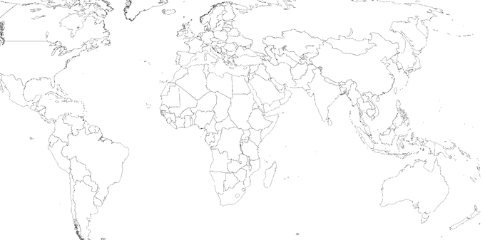
WHY BeLCol?
A missing platform to strengthen the ties between the Belgian, Luxemburguese and Colombian business communities.
An opportunity to create a local body to promote investments, commercial exchange and project development to foster economic development in Colombia.
The recent Free Trade Agreement that came into force in August 2013.
Colombia:
Economical and Political stability, foreign investment confidence.
Big and young population, and qualified and competitive human resources.
Industrialization of the Colombian economy.
Strategic geographical location, an export platform with access to global markets.
Recognition of European quality standards
Growing goods consumer culture

Slide 4
Short term needs
Financial support to BeLCol's operation by the Federal and Regional entities
Web page development
Direction, business support
Campaign to recruit new members in BeLux
A Board of Directors has been elected end of 2014

Slide 5
A new bilateral Chamber of Commerce
Mission and vision:
A non profit organization, officially registered end August 2013.
Like a complementary body to facilitate and optimize the development of bilateral relationships.
Building progressively a broad network of contacts to establish a collective support and a cooperative perspective to the bilateral relationships; accumulating experiences to offer advantages to the members.
Objective: To contribute to both the promotion and growth of commercial relations and investments, and support projects with the aim of strengthening strategic links between BEL, LUX and COL.

Slide 6
Information centralisation and disclosure (bilateral relationships, statistics and key data about the countries and its markets, as well as business and cooperation opportunities, fairs and events, etc) promoting bilateral exchanges.
Collaboration agreements with governmental authorities and agencies promoting foreign trade, investment and tourism, such as Procolombia and local Chambers of Commerce. Communication facilitation between them and the members, as well as development and support to missions.
Enterprises/Institutional/Academical directory, as well as professionals network, of affiliates to facilitate contacts and business agendas.
Support and assistance to enterprises and organizations (specially SMEs) interested in the other market for the promotion and business solidification and experiences exchange.
Promotion and support to the establishment of enterprises in Colombia, as a gateway to the Americas, and enterprises in Belgium and Luxembourg, as a gateway to Europe.

Slide 7
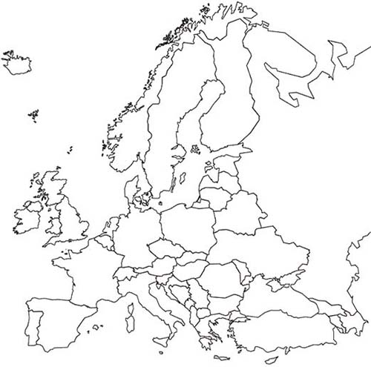
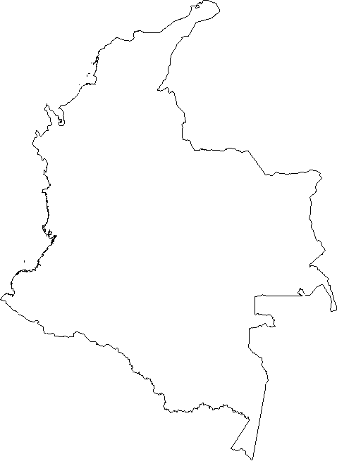
CAAC
BeLCol

Slide 8
Founding members
Wouter Florizoone
Master in environmental engineering. Vrije Universiteit Brussel VUB, Universidad Politecnica de Catalunya, University College of Gent.
Projects and business development: Flanders Smart Hub, VOKA, Flemish government, Abcdario. Languages: NL-ENG-ESP-FR
Benoît Desirotte
Master in Economics, European studies and International tax. ULB - SOLVAY - ICHEC Ecole Supérieure de Sciences Fiscales.
Manager in Transfer Pricing: Ernst & Young Mexico and Belgium, DWVA. Languages: FR-ENG-ESP-NL
Paola Murcia.
Master of Science, International Relations and Business. U. Nal de Costa Rica, VUB
Policy adviser, Logistics coordinator. Dole, FIATA, CLECAT. Languages: ESP-ENG-NL-FR
Lucía Mora
Economist. Professional in Finances and International Trade. Master in Finances. U. del Rosario, U. Nal Autónoma de México UNAM, ICHEC Enterprises - Brussels Management School.
Financial Analyst: Bancafe - Davivienda, AIESEC en Colombia, DHL European HQ, BNP Paribas Fortis. Languages: ESP-ENG-FR
Team: + Jorge Nova, Jorge Bernal, Andres Franco.

Slide 9
2015’s Board of Directors
Daniel H. JORDAN – President
TBC – Vice President
Johan Dexters – Treasurer
Paola Murcia – Secretary

Slide 10
BeLCol asbl
Belgium-Luxembourg - Colombia
CHAMBER OF COMMERCE
Non profit organisation
www.belcol-cc.com info@belcol-cc.com
+32 473 784882
Thank you for your attention.

