Slide 1
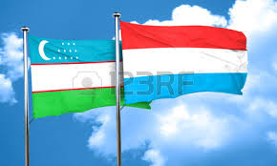
Luxembourg-Uzbekistan business relations A focus on financial services
18 September 2017

Slide 2
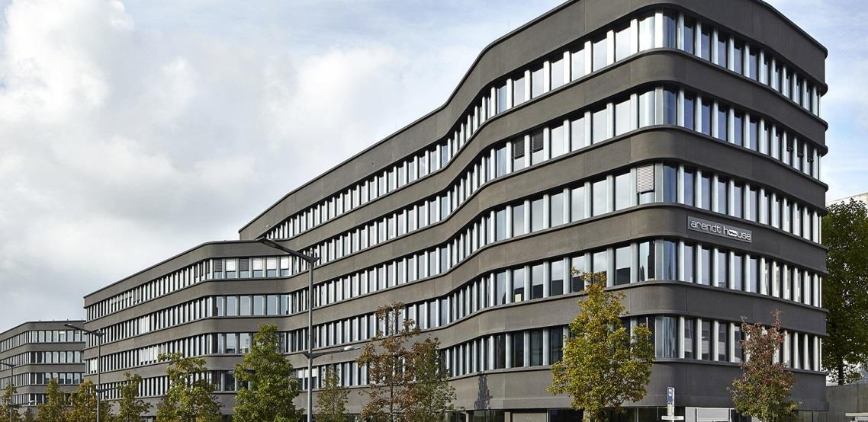
Arendt & Medernach’s story in Uzbekistan
Moscow office opened in October 2012
Covering RUS, UKR, KAZ, UZB, AZ, Eastern EU Member States
First visit to Uzbekistan in 2017
DTT in force since 2002
Quick growing market
As of today (% of business in Eastern countries)
Russia 60 %
Ukraine 15%
Kazakhstan 20%
Uzbekistan still less than 5%

Slide 3
Luxembourg players (industry) active in Uzbekistan

Slide 4
Luxembourg players (finance) active in Uzbekistan

Slide 5
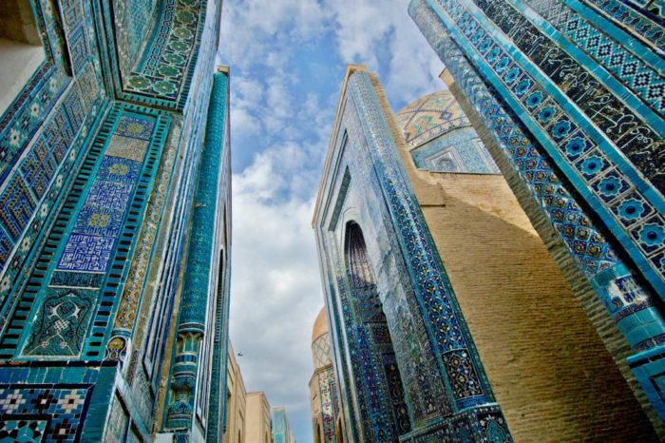
Market for Luxembourg financial service providers
Governmental entities
State owned companies
Sovereign funds
Institutional investors
Private investors

Slide 6
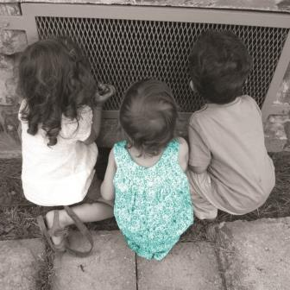
Interest for Uzbek investors
Wealth structuring
Banking
Residence/working
permits
regulated
non - regulated
private
corporate
private
professional

Slide 7
Visas for investors
Interesting solution for Uzbekistan individuals
Immigration to Luxembourg
Available options
Advantage of Luxembourg
Uzbek Specifics
Investments of 500 000 EUR into existing or newly created business
Investments of 3 000 000 EUR into Luxembourg structure
Placement of 20 000 000 EUR on the deposit on a Luxembourg bank account
No requirement to buy state bonds or securities
No requirement to buy real-estate
Speed of the authorities in comparison with other EU member States
No quotas
No Embassy in Uzbekistan, applications should be sent either directly to MAE or to the Embassy of Uzbekistan in Belgium, or via Consulate of Belgium in Tashkent, Uzbekistan
Citizens of Uzbekistan are not allowed to have a second citizenship

Slide 8
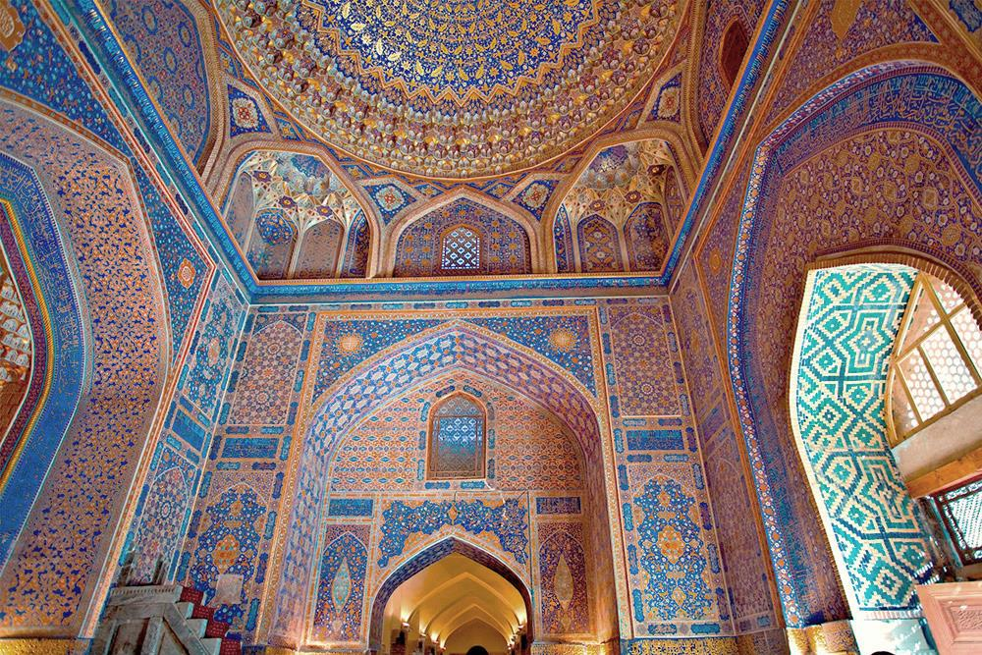
Services required (financial sector) by the various types of clients / investors
Tax Advisors
Legal Advisors
Auditors
Accountants
Real Estate Agents
Banks
Asset Managers
Fund Managers
✓
Concierge Services & Family Offices

Slide 9
Opportunities
New market to develop
Investors open-minded to consider new solutions
Interesting double tax treaty
Investment protection treaty
Dynamic reforms made by the new President
Recent changes in the currency control regulations
Cooperative Luxembourg Embassy in Moscow
Seminar of Financial Center of Luxembourg in 2012 (20 participants from Uzbekistan)
Expo 2017 Future Energy in Astana (friendly relations
between Uzbekistan and Luxembourg representatives)

Slide 10
Legal & Tax Luxembourg Double Tax Treaty (DTT) Network

Slide 11
Legal & Tax
Investment protection treaties entered into by the Belgo-Luxembourg Economic Union
Treaties in force
Treaties pending
1. Albania 2. Algeria 3. Argentina 4. Armenia 5. Azerbaijan 6. Bangladesh 7. Benin 8. Bolivia 9. Bosnia & Herzegovina
10. Bulgaria 11. Burkina Faso 12. Burundi 13. Cameroon 14. Chile 15. China 16. Croatia 17. Cyprus 18. Czech Republic 19. Egypt 20. El Salvador 21. Estonia 22. Gabon 23. Georgia 24. Hong Kong 25. Hungary
26. India
27. Indonesia 28. Kazakhstan 29. Kuwait
30. Latvia 31. Lebanon
32. Libya 33. Lithuania 34. Macedonia 35. Madagascar 36. Malaysia 37. Malta 38. Mauritius 39. Mexico 40. Moldova 41. Mongolia 42. Morocco 43. Mozambique 44. Paraguay 45. Peru 46. Philippines 47. Poland
48. Romania
49. Russia 50. Saudi Arabia
51. Serbia 52. Singapore
53. Slovakia 54. Slovenia 55. South Africa 56. Sri Lanka 57. Thailand
58. Tunisia 59. Turkey 60. Ukraine
61. United Arab Emirates
62. USA *
63. Uruguay
76. Cuba
77. Ethiopia 78. Guatemala 79. Ivory Coast
80. Korea 81. Liberia 82. Mauritania 83. Montenegro 84. Nicaragua 85. Oman
86. Pakistan 87. Panama 88. Qatar 89. Rwanda
90. Sudan 91. Tajikistan 92. Togo 93. Uganda 94. Zambia
68. Bahrain 69. Barbados 70. Belarus 71. Botswana 72. Brazil 73. Comoros 74. Congo, DR 75. Costa Rica
64. Uzbekistan
65. Venezuela
66. Vietnam 67. Yemen
* Treaty of friendship, establishment and navigation

Slide 12
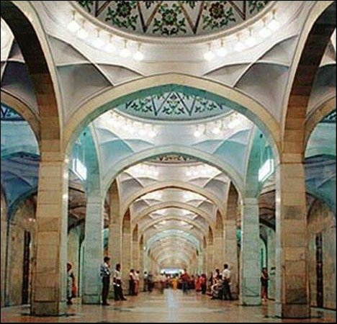
Challenges
Luxembourg products and services are still widely unknown
Limited number of Luxembourg service providers active on the market
Strong bureaucratic structure
Most of big operational companies are state-owned
Entry visa to Uzbekistan

Slide 13
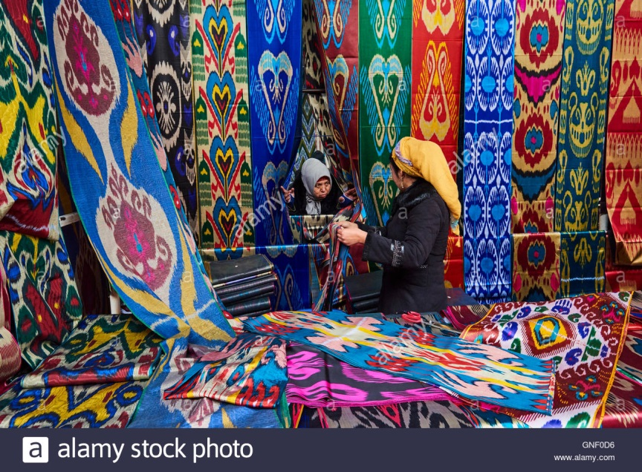
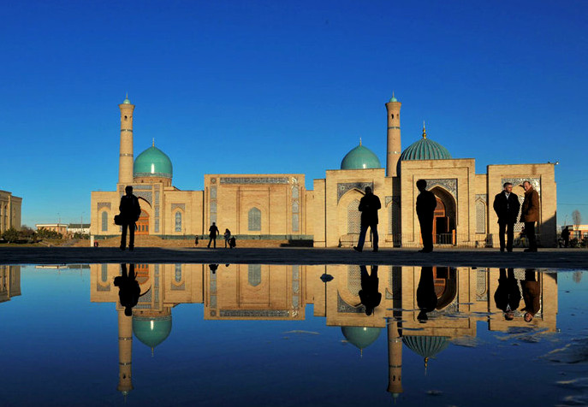
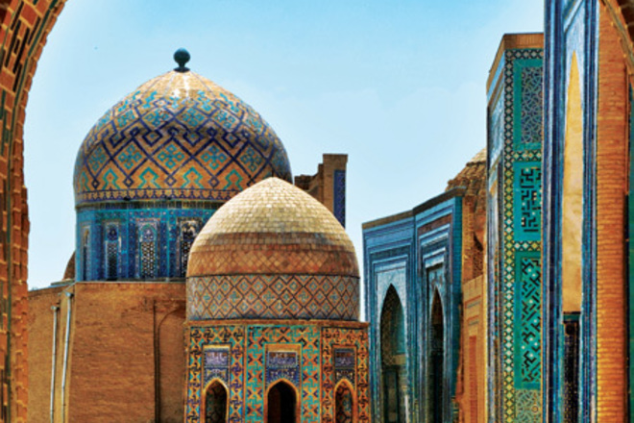
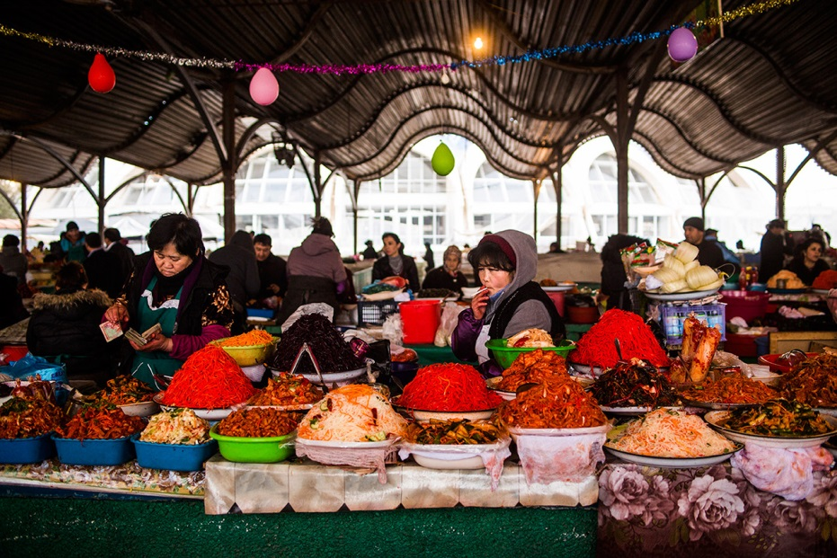
Impressions of Uzbekistan

Slide 14
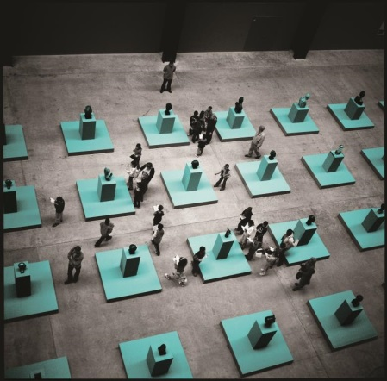
Thank you!

Slide 15
Contact us
Max Kremer
Partner
Banking and Financial Services
Tel : +352 407878 353
Email : max.kremer@arendt.com
Liudmila Gorodnikova
Associate
Banking and Financial Services
Tel : +352 407878 7900
Email: liudmila.gorodnikova@arendt.com

