Slide 1


  EUROCHAMBRES
The Association of European Chambers of Commerce and Industry
The sole responsibility of this presentation lies with the author. The European Union is not responsible for any use that may be made of the information contained therein.
Notes:
14/06/2017
1

Slide 2
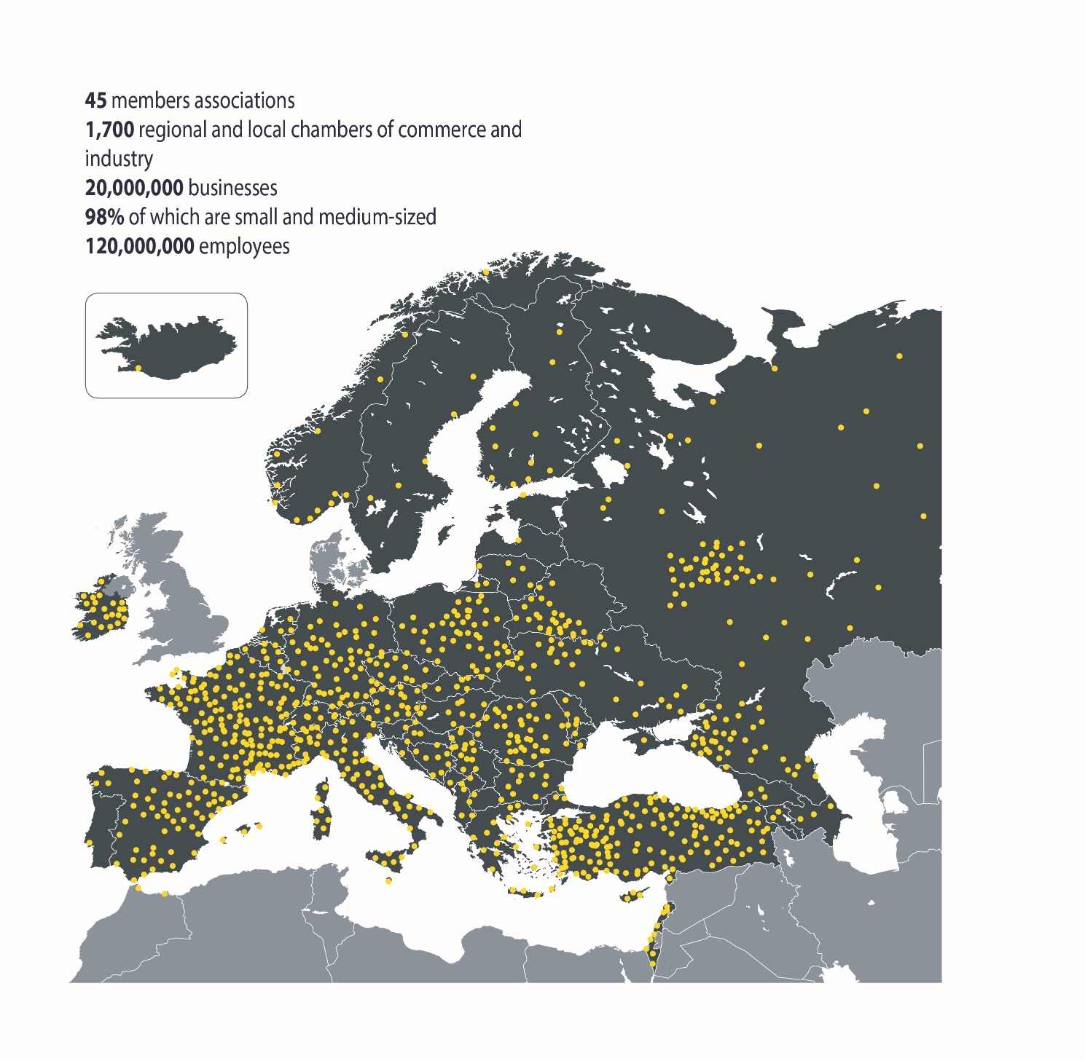
OUR NETWORK
Notes:
Established in 1958 The Association of European Chambers of Commerce and Industry the business community at EU level. EUROCHAMBRES represents over 20 million businesses in Europe through 45 members (43 national associations of chambers of commerce and industry and two transnational chamber organisations) and a European network of 1700 regional and local chambers. More than 93% of these businesses are small and medium sized enterprises (SMEs).

Slide 3
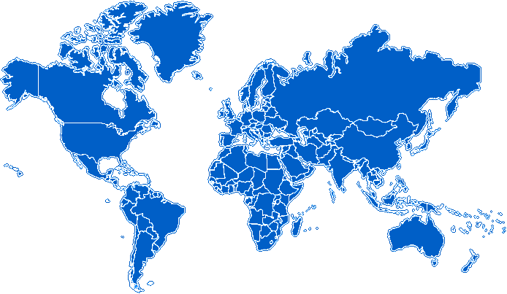
INTERNATIONAL PARTNERS
European Chambers Abroad
European Business Centres

Slide 4
GLOBAL CHAMBER PLATFORM
RF Chamber
EUROCHAMBRES
Iran CCI
US Chamber
CCPIT
ASCAME
FGCCI
CACCI
CAIC
FICCI
ACP CCI
SAARC
CCI
AILA
AICO
+ Global: JCI
Notes:
The Global Chamber Platform (GCP) brings together the major national and trans-national Chamber organisations from all over the world and develops joint initiatives to facilitate economic cooperation and to promote free trade initiatives.
It is coordinated by EUROCHAMBRES.
The G20 (or G-20 or Group of Twenty) is an international forum for the governments and central bank governors from 20 major economies.

Slide 5


OUR MISSION
To develop a business-friendly, competitive economic environment in Europe and support EU SMEs internationalization
MEMBERS

Slide 6
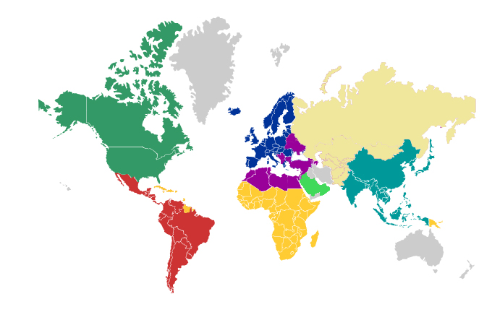
MARKETS
Internationalisation
To enhance external economic diplomacy, in a public private partnership at European level
To facilitate market access for EU SMEs
Notes:
Economic diplomacy is about using all the levers we have to promote our own economic interests beyond our borders.
Economic diplomacy is the use of the full spectrum economic tools of the state to achieve its national interest. Economic diplomacy includes all the economic activities, including but not limited to export, import, investment, lending, aid, free trade agreements etc.
Trade policy EU level – free trade agreement
Trade promotion – national level (ICEX, IVEX, CCI etc..)
Trade facilitation - Facilitating trade is about streamlining and simplifying international trade procedures

Slide 7
European Union – Latin American
- business context -
OPPORTUNITIES IN LATIN AMERICA FOR EU SMEs
  Free trade Agreements, positive prospects growth rates
  Need of economic diversification in Latin America
  Business partnership for technology transfer, investment and innovation
  High demand in cross cutting sectors such as ICT, bio and nanotechnologies, renewable energy, new materials etc.
Notes:
90% of world growth is expected to happen outside the EU in the next decade.
Emerging economies are not only growing fast but moving up the value chain [as a set of activities that a firm operating in a specific industry performs in order to deliver a valuable product or service for the market].

Slide 8
European Union – Latin American
- business context -
EU SME INTERNATIONALISATION | LATIN AMERICA
23 million SMEs in Europe | Various definitions for SMEs
25% export within the EU - 13% outside EU | Informal sector
29% import within the EU - 14% outside EU | Productivity gap between SMEs and large companies
2% active in FDI | Limited innovation
7-10% SMEs export to BRICs
* Source: DG GROW, European Commission
Notes:
BRICs: Brazil, Russia, India, China and South Africa

Slide 9
ELAN BIZ and
ELANNetwork

Slide 10

THE ELAN PROJECT
The ELAN project (“European and Latin American Services and Innovation Network”) has the general objective to increase trade between the EU and seven Latin American countries through two strategic components:

Slide 11


thE ELAN project
Provide EU SME’s with up to date information about how to do business in 7 Latin American countries through the ELANbiz platform
Generate tech-based business opportunities between European and Latin American SMEs and create a Network of innovation agents to support them.

Slide 12
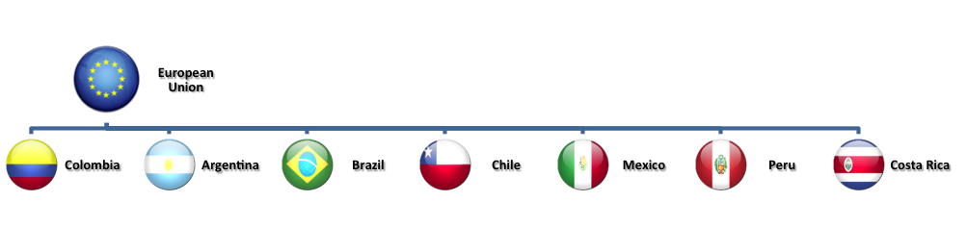
Countries
Notes:
nota bene: no Uruguay

Slide 13
Information services
Web ELANbiz platform
Contents
“Ask the Expert” service

Slide 14
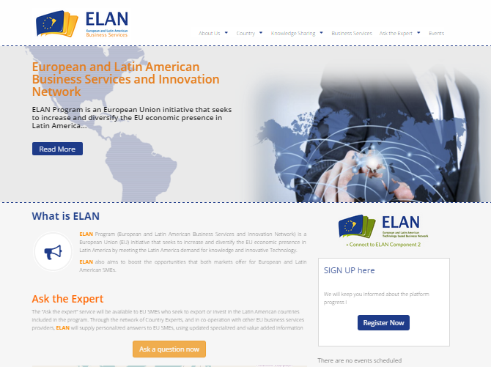
www.elanbiz.org

Slide 15
Contents
Fiches: How to do business – regulatory framework (agreements, trade fairs lists, import procedures, public procurement, investing in, sanitary and phytosanitary or SPS measures, Technical Barriers to Trade - TBT …)
FAQ: Frequently Asked Questions
External contents : shared with the ELAN platform by European and local stakeholders.

Slide 16
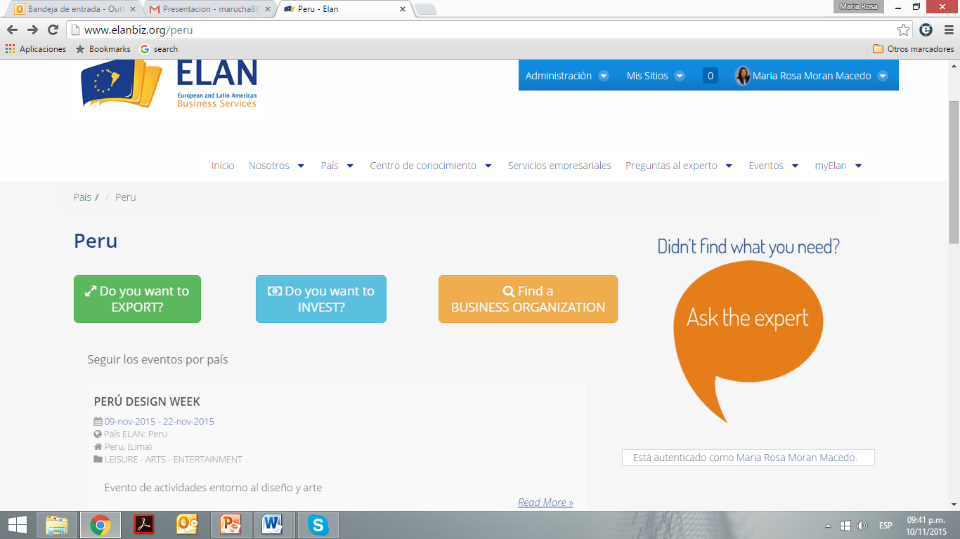
“Ask the Expert”
Provides tailored answers to SMEs and business organizations on how to access or invest in ELANbiz countries.
Experts provide free of charge short answers within 3 working days to the questions. They will in each case advise to contact the EU bilateral chambers and Member States trade offices.

Slide 17
UNDERSTANDING THE CONTEXT
Specific Objective ELAN Network: Establish a European and Latin American self-sustainable Network (ELAN) of research and innovation (R&I) actors, in order to promote lasting partnerships; to share knowledge and generate technology transfer, in particular in areas aligned with European applied research; and to increase SME competitiveness through the generation of technology-based business opportunities.
Notes:
Transfer of technology
Lasting partnerships
Share of knowledge + technology transfer
TBBO for increasing competitiveness

Slide 18
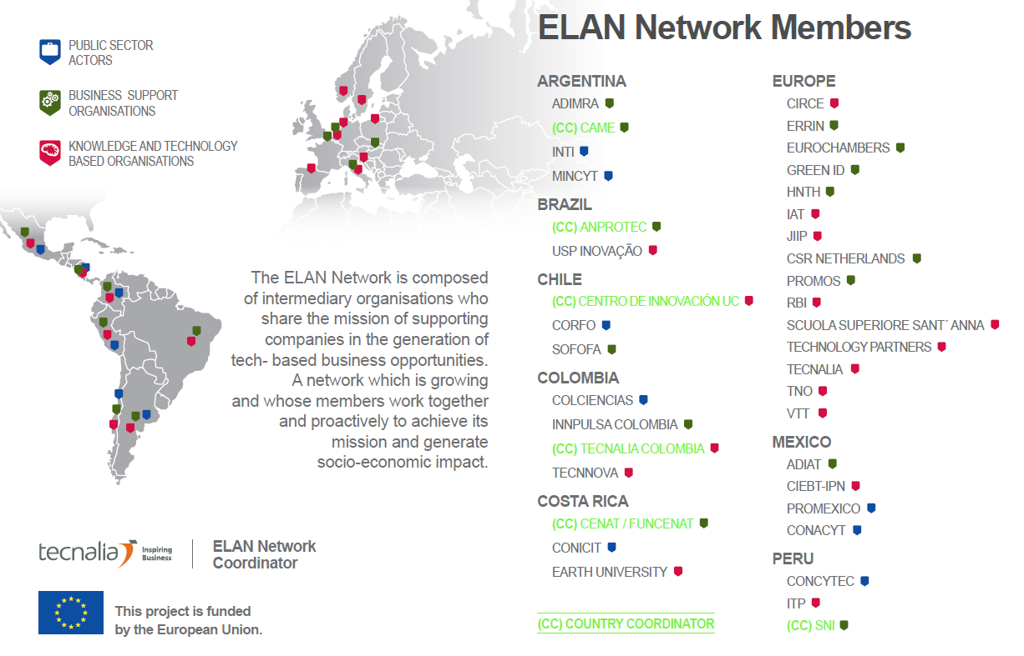

Slide 19







Sectors
HEALTH
RENEWABLE ENERGIES
NEW MATERIALS
ICT
ENVIRONMENTAL TECHNOLOGIES
NANO-TECHNOLOGIES
BIOTECHNOLOGY BIOECONOMY

Slide 20





Result 1: Strategic capacities, schemes and needs for collaboration between Europe and Latin America have been mapped and the framework to ensure effective transitional research created. Analysis of EU Industry needs to enter into innovation collaboration with Latin American partners conducted.
Main Activities
  A1. Analysis of European Industry needs to enter into innovation collaboration with LA partners.
  A2. R&I actors identified; needs, capacities and supporting schemes mapped in LA partner countries.
  A3. Best practices and exemplary cases in the innovation field in LA and Europe identified.
  A4. SWOT analysis of factors affecting EU-LA collaboration in industrial innovation provided.
Notes:
Mapping of
EU industrial needs,
R&I actors,
best practices & exemplary cases
SWOT analysis for collaboration btw the 2 regions

Slide 21
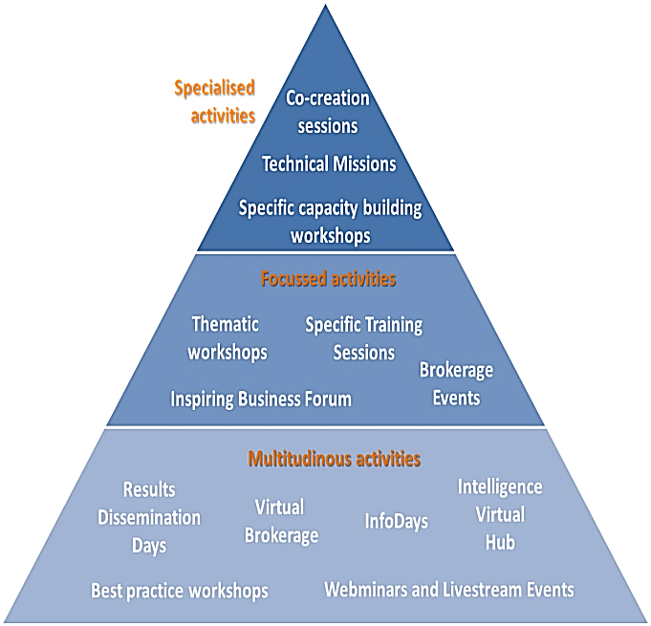
Result 2: Increased and better focused collaboration in innovation between EU and LA partners has been achieved:
Main Activities
A5. Planning and organising of network capacity building and partnership generating activities aimed at creating technology-based buisness opportunities between partners:
21 events in Latin America. One per year in each target LA country (Co-creation sessions, brokerage events, thematic workshops)
6 Technical missions in the EU
Strategic collaborations have been created among network partners (40 in total)
Notes:
Networking and capacity building for EU SMEs
Instrumental for generating TBBO
Partnership
Mature the business case
Mature the technolgy

Slide 22

TBBO: The partnership
ELAN Network helps SMEs generate & develop strong partnerships
Technology partnership
Licensor / Licensee
Commercial partnership
Customer / supplier
Partners & shareholders in a joint venture or start-up
Partners in the creation of a new lab or innovation centre to service companies
Notes:
A license or licence is an official permission or permit to do, use, or own something (as well as the document of that permission or permit).
A startup company (startup or start-up) is an entrepreneurial venture which is typically a newly emerged, fast-growing business that aims to meet a marketplace need by developing or offering an innovative product, process or service. A startup is usually a company such as a small business, a partnership or an organization designed to rapidly develop a scalable business model.
Scaleups evolve from startups as they cross the growth chasm; that is, once they solve the startup challenges of market research, development, and identifying a repeatable, scalable business model. This can be identified by a significant sustained repetition of critical mass in a particular startup’s most significant metric – generally, this metric is revenue, number of active users, number of active customers, or effective reach, relative to funds raised.[

Slide 23

TBBO: The business case
Partnerships will help mature business case. Some actions include:
Define market segment
Proof of concept
Contact with experts
International sales plan
Business & deployment plan
Attract private investors

Slide 24

TBBO: The technology
Actions to increase technology maturity include:
Develop a prototype
Technology acquisition
Combine with another technology
Apply for patent
Adapt to different sector or geographic market
Find R&D support programmes
ELAN Network can guide SMEs but these tasks are outside its scope.

Slide 25
Forthcoming events – web link
27-28 June, Buenos Aires, Argentina
New technological businesses between Europe and Argentina to address challenges in Industry 4.0, Energy and ICTs
4-5 July, Lima, Peru
Technological solutions for an integral urban growth. Sustainable business LAC-EU
4-5 October, São Paulo, Brazil
Health and Biotechnology for the generation of new business opportunities in Brazil
23-24 October, Santiago, Chile
Technologies and Business Models for the Energy Challenges of the 21st Century
14-15 November, Bogota, Colombia
The role of ICTs in the productive development agenda

Slide 27




Latin America IPR SME Helpdesk
An initiative funded under the European Union’s COSME Programme (2014-2020) and implemented by:
The Latin America IPR SME Helpdesk is a free service which provides practical, objective and factual information aimed to help European SMEs understand business tools for developing IPR value and managing risk. The services are not of a legal or advisory nature and no responsibility is accepted for the results of any action made based on its services. Before taking specific actions in relation to IPR protection or enforcement, all customers are advised to seek independent advice.
The content of this document represents the views of the author only and is his/her sole responsibility; it cannot be considered to reflect the views of the European Commission and/or the Executive Agency for Small and Medium-sized Enterprises or any other body of the European Union. The European Commission and the Agency do not accept any responsibility for use that may be made of the information it contains.

Slide 28
Latin America IPR SME Helpdesk
- what you get -
Facilitate market access
Maximize the value of your intellectual property assets and improve your global competitiveness.
Support you in your initial contacts with local law enforcement agencies in the target countries.
Strengthen the links between EU and Latin American companies with regards to the protection and enforcement of IPR.
Help you overcome the existing barriers:
  changing and complex regulatory frameworks
  local idiosyncrasies and lack of market information
  problems related with SMEs IPR protection and enforcement

Slide 29
Latin America IPR SME Helpdesk
-what we offer-
HELPLINE
TRAINING
BACKGROUND MATERIALS
State-of-the-art online publications on the protection and enforcement of IPR in Latin America specifically addressing IP matters from the SME business needs point of view
Online training kits
Webinars with IP experts from Latin America and Europe
Free of charge, first line advisory service on IP protection and enforcement mainly for EU SMEs working or planning to operate in Latin America. Responses within 3 working days, in 5 operating languages (EN-SP-FR-GE-PT) Helpline
Targeted trainings on IPR protection and enforcement mainly for EU SMEs (including sector-specific approaches)
Notes:
Factsheet on specific topic: patent/ trade market/ author rights and specific sectors

Slide 30
Latin America IPR SME Helpdesk
-what we offer-
PARTNERING SERVICES
Partnering services for Latin American companies and SMEs engaged in commercial cooperation with EU SMEs to strengthen the links between both, with regards to the protection and enforcement of IPR
POLICY ADVICE
PHYSICAL OFFICES IN LATIN AMERICA AND EUROPE
The physical offices in Latin America (Brazil, Chile, Mexico) and Europe (Alicante, Spain) facilitate direct contact with our users
Monitoring relevant IPR developments affecting SMEs in the territories covered by the project. Provision of basic support for initial contacts with local law enforcement agencies in Latin America
Networking and dissemination actions to raise awareness about our service. Helpdesk contact offices

Slide 31
Latin America IPR SME Helpdesk
-who can use our services-
European SMEs
SMEs from Latin America engaged in business cooperation with EU firms
Intermediary & multiplier organisations in Europe and Latin America (business support organisations, Chambers of Commerce, Eurocámaras, SME umbrella associations, Trade Fairs in Latin America and Europe etc.)
Policy-makers
Other stakeholders:
  Large enterprises
  Higher education & research institutions and organisations

Slide 32
Latin America IPR SME Helpdesk
- team and duration -
Funded by the EU COSME Programme (2014-2020)
Latin America IPR SME Helpdesk follows the successful MERCOSUR IPR SME Helpdesk (2013-2015) and expands its geographical area to offer improved services to SMEs interested in or already operating in all 18 Latin American countries
CONSORTIUM:
  Universidad de Alicante, Spain (coordinator)
  EUROCHAMBRES, Belgium
  Instituto Nacional da Propriedade Industrial (INPI), Portugal
  Instituto Tecnológico de Monterrey (ITESM), Mexico
  Fundacion Empresarial Comunidad Europea Chile Eurochile, Chile
  Instituto Nacional de Propiedad Industrial, Chile
  IDS-Instituto Dannemann Siemsen de Estudos Juridicos e Tecnicos, Brazil
Duration: July 2015 – June 2018
Notes:
Take note that two official partners are Chilean

Slide 33
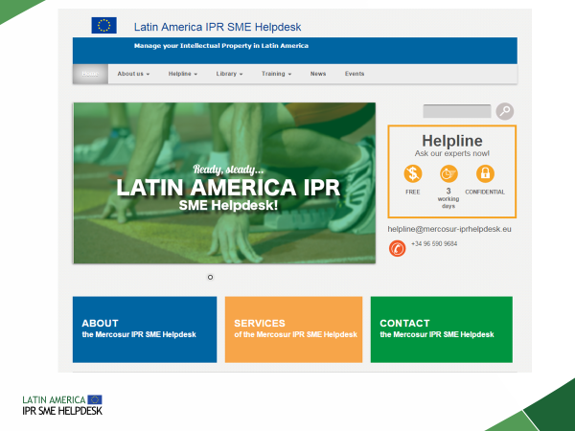
Latin America IPR SME Helpdesk
-contact-
http://www.latinamerica-ipr-helpdesk.eu/

Slide 34
Latin America IPR SME Helpdesk
- complementary services -
EU IPR Helpdesk
China IPR SME Helpdesk
SOUTH EAST ASIA IPR SME Helpdesk
EBTC IPR Helpdesk
Knowing how to manage Intellectual Property (IP) and Intellectual Property Rights (IPR) is the ticket to innovation and competitiveness in Europe. The European IPR Helpdesk offers FREE OF CHARGE, FIRST LINE SUPPORT on IP and IPR matters to beneficiaries of EU funded research projects and EU SMEs involved in transnational partnership agreements, especially within the Enterprise Europe Network (EEN)
Managing IPR in Mainland China, Hong Kong, Macao and Taiwan. The China IPR SME Helpdesk provides IP FACTSHEETS, BUSINESS TOOLS AND CASE STUDY CATALOGUES
The South East Asia IPR Helpdesk provides FREE INFORMATION AND SERVICES for European businesses to protect and enforce their intellectual property rights (IPR) in the ASEAN region, specifically: Brunei-Darussalam, Cambodia, Indonesia, Laos PDR, Malaysia, Myanmar, Philippines, Singapore, Thailand and Vietnam
EBTC's IPR Helpdesk assists European organizations in the protection, management, enforcement and commercialization of Intellectual Property in India. It offers INFORMATION SERVICES, FILING SERVICES, TECHNOLOGY LANDSCAPES, LICENSOR/LICENSEE SEARCHES, DUE DILIGENCE and other IP services

