Slide 1
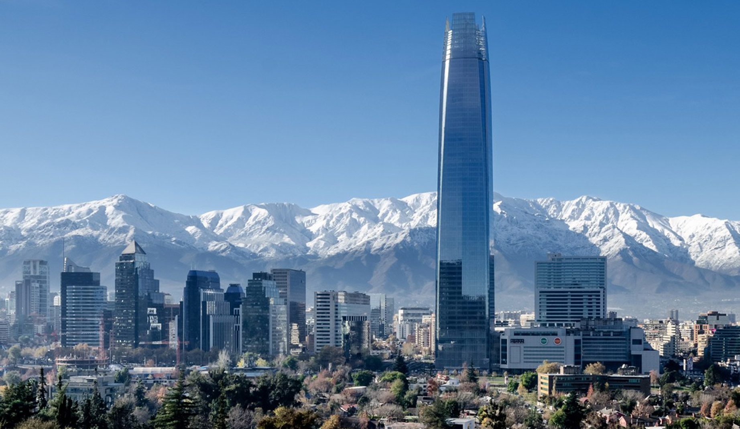
THE CHILEAN MARKET – BUSINESS & CULTURAL APPROACH

Slide 2
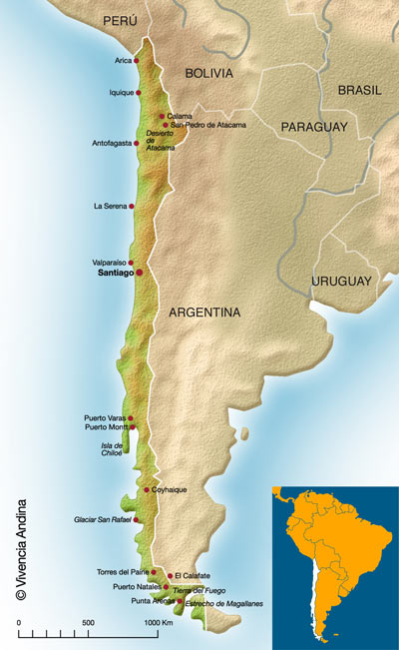
MAIN FACTS
Total Area: 756,950 km²
Currency: peso (1€ = $750)
Population: 17.8 million
Density: 24 habitants/km2
Life Expectancy: 81.7 years
Literacy: 98.55 %
Centralised country, 15 regions

Slide 3
MARKET APPROACH
Initial market survey – be informed
Prospection trip – personal contacts
Trade fairs, e.g. EXPOMIN 2018 (Chile)
Consider local presence

Slide 4
KEY MARKET FACTORS
Price is important
Price-competitive products from places such as Taiwan, China, India or South Korea
Quality, durability, innovation, customer support and availability of service are key factors
All sales materials should be in Spanish

Slide 5
MARKET ENTRY --- STRATEGY
Agent or a representative
with good access to relevant buyers
and solid technical expertise
Local subsidiary or branch office in Chile
if a large sales volume
requiring local service support
or localized inventory

Slide 6
MARKET ENTRY --- CHALLENGES
High degree of competition
Relatively small market size
Its open trade and investment policy has attracted the attention of many foreign firms
Chile is open to new products and technology,
BUT Chilean business people tend to be more conservative and cautious than the average European business person

Slide 7
MARKET ENTRY --- YOUR PARTNER
What can your agent or distributor do for you?
Use their business and social connections
Open doors to end-clients
Overcome regulatory, cultural and language barriers
IMPORTANT: A small number of economic groups and families control most of Chilean businesses

Slide 8
WORKING WITH AN AGENT
Commissions: 5% to 10%
Relationships are the key --- select the RIGHT agent
Due diligence: qualifications, reputation, capabilities

Slide 9
SELLING TO THE GOVERNMENT
The Government of Chile procurement website (www.chilecompra.cl) was established in March 2000 to increase transparency, to get better opportunities, and reduce government procurement costs
Bidding is best done through a local agent who is registered, well connected, and familiar with Chilean government bidding procedures

Slide 10
IMPORTS & PRICING
Pricing starts with the CIF value
E.U.- Chile FTA: elimination of tariffs (95% of goods, otherwise general tax = 6%)
Margins for consumer goods: 30% to 50%
VAT/IVA = 19%
Tariffs & VAT usually paid by importer
Luxury goods & alcohols: higher taxes
Certificate of Origin EUR.1 is necessary

Slide 11
IMPORT REQUIREMENTS
Commercial invoices, certificates of origin, bills of lading, freight insurance and packing lists
Special permission, certificates, and approval documents, such as sanitary and phytosanitary certificates, are required for most agricultural products and in special cases for industrial products
For documentation requirements specific to agricultural imports, see the SAG website www.sag.cl

Slide 12
LABELLING & MARKING
Labelling must be in Spanish and measurements must be in the metric system
Products must display the country of origin
Must be marked to show the quality, purity, ingredients or mixtures, and the net weight or measure of the contents

Slide 13
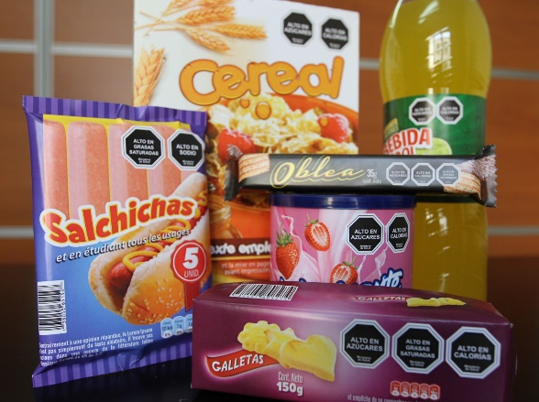
FOOD LABELLING
Law 20606 (26/06/2015) regulates the labelling of the nutritional compositions of food products
Target: food products for children under 14 years of age that exceed specified limits of sodium, sugar, calories and saturated fats --- enforced since 27/06/2016
Black stop sign shaped labels with the legend “High in salt, sugar, energy or saturated fat”

Slide 14
PROMOTION & ADVERTISING
Broadcast media in Chile includes:
open broadcast television networks/local TV stations
cable and satellite TV networks,
radios, newspapers and magazines
which reinforce in-store merchandising methods
Most advertising is handled by private agencies
the majority belongs to the Chilean Association of Advertisement Agencies (ACHAP) www.achap.cl.

Slide 15
SALES SERVICE/CUSTOMER SUPPORT
Any product that requires operator training or needs after-sales technical service must have a qualified local company ready and able to assist the customer
Due to Chile’s relatively close-knit society, company reputations can be made or lost in a fairly short period of time

Slide 16
PROTECTING INTELLECTUAL PROPERTY
Rights must be registered and enforced in Chile, under local laws
Due diligence on potential partners is a must
(Central Bank of Chile: www.bcentral.cl)
A good partner is an important ally in protecting IP rights.
Be aware: allowing your partner to register your IP rights on your behalf may create the risk that your partner will list itself as the IP owner

Slide 17
METHODS OF PAYMENT
In Chile, payment to foreign suppliers is often made via an irrevocable letter of credit from a Chilean commercial bank: payments are made upon receipt of notice of shipment of goods
Other methods of payment to suppliers include cash against documents and open account
The credit insurance industry is developed in the country and major private agencies such as Mapfre, Continental, and Coface have local offices in Santiago

Slide 18
FOREIGN EXCHANGE CONTROLS
No restrictions on incoming and outgoing foreign capital
Currency may be freely traded in two markets: the informal market and the interbank market (formal)
Prior to receiving authorization, Chile’s Central Bank requires confirmation that the trade finance transactions, foreign loans, capital flows, and profit repatriation will be executed through a commercial bank (formal market)

Slide 19
INVESTMENT CLIMATE
Very positive attitude toward FDI = key to growth
Very few restrictions upon FDI
Chile has signed 55 BITs, of which 41 are in force
Agreement in force with Belgium
http://www.ciechile.gob.cl/en/guia-del-inversionista/

Slide 20
ESTABLISHING AN OFFICE
Via traditional means with a Chilean attorney US$1,500 for legal fees and US$300 for expenses such as notary public, commercial registry, and the official gazette publication
Or via self-service online, user-friendly and free (other than a fee of approximately US$10 for notary public expenses) to create a new business in 24 hours: www.tuempresaenundia.cl

Slide 21
JOINT VENTURE/LICENSING
In Chile, joint ventures and licensing arrangements require the participation of a legally established local partner who can be responsible for Chilean legal and tax obligations.

Slide 22
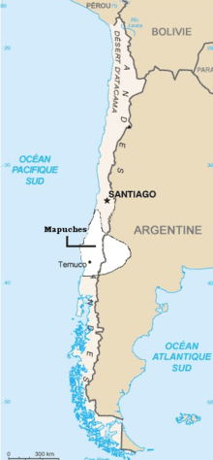
SOCIOPOLITICAL CLIMATE
Low levels of civil disturbance and terrorist activity --- little impact on the economy
Indigenous communities --- growing trend of violent incidents related to the land claims of the Mapuche people in the Araucania region

Slide 23
BUSINESS PRACTICES
Spanish is a must (spoken, brochures, etc.)
Be on time for business meetings
Dress code: business attire
Name cards in Spanish and English
Shake hands with everyone in the room
Generally strong awareness of CSR(Corporate Social Responsibility)
Modern, efficient banking system
Bank opening hours: Mon-Fri 9:00 to 14:00

Slide 24
Local Time & Business Hours
In Belgian winter Chili is 4 hours behind
In Belgian summer Chile is 6 hours behind
Business hours: 9:00 – 18:00
Lunch time: 13:00 – 15:00

Slide 25
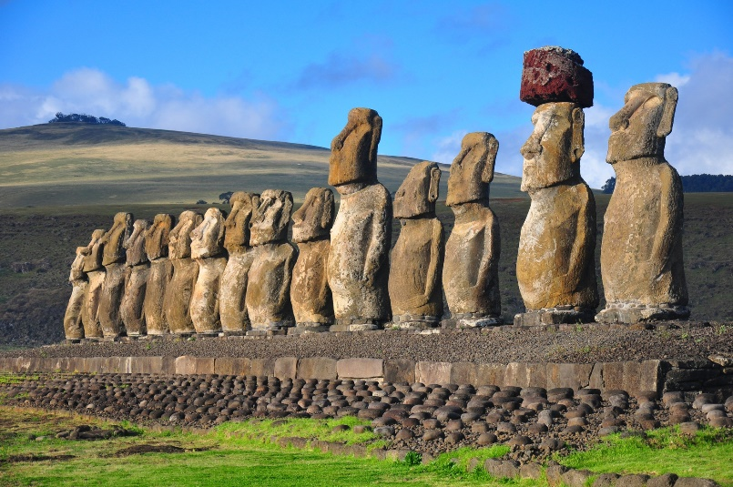
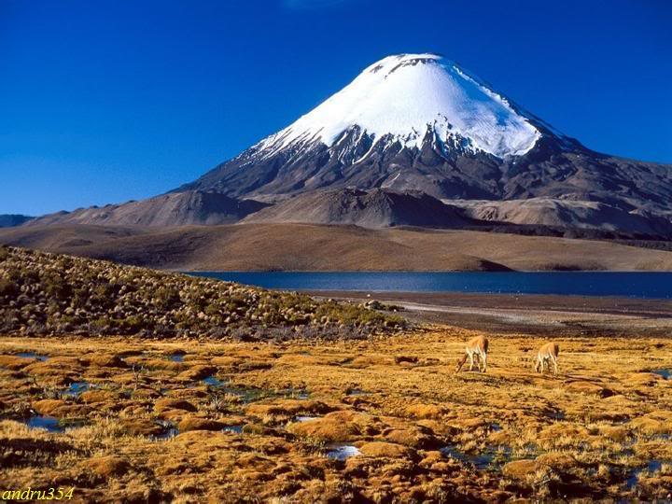
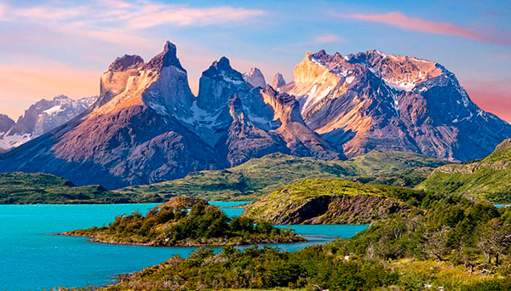
HOLIDAYS
Avoid Chilean summer holidays from 15/12 to end of February
Managers, CEOs, directors, will probably be on holidays at that time.

Slide 26
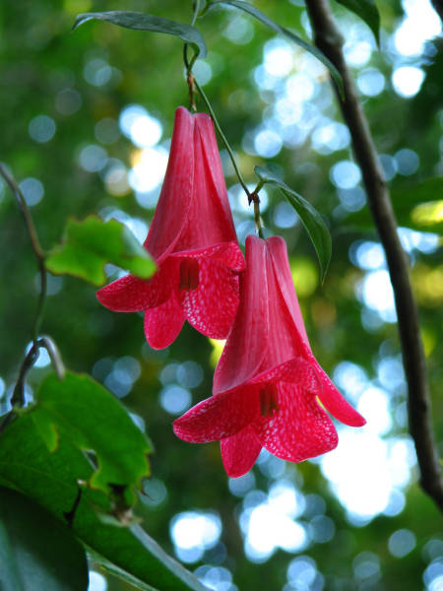
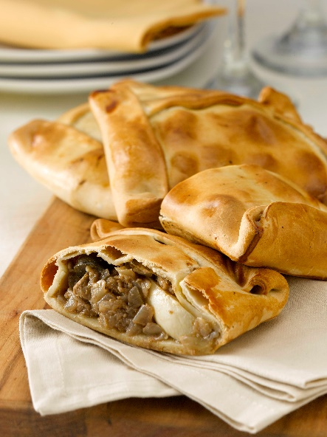
Welcome to
National Dance: Cueca
National Flower: Copihue
Typical Food:
Empanada
Wine

Slide 27
ALL THE BEST IN SANTIAGO!

