Slide 1
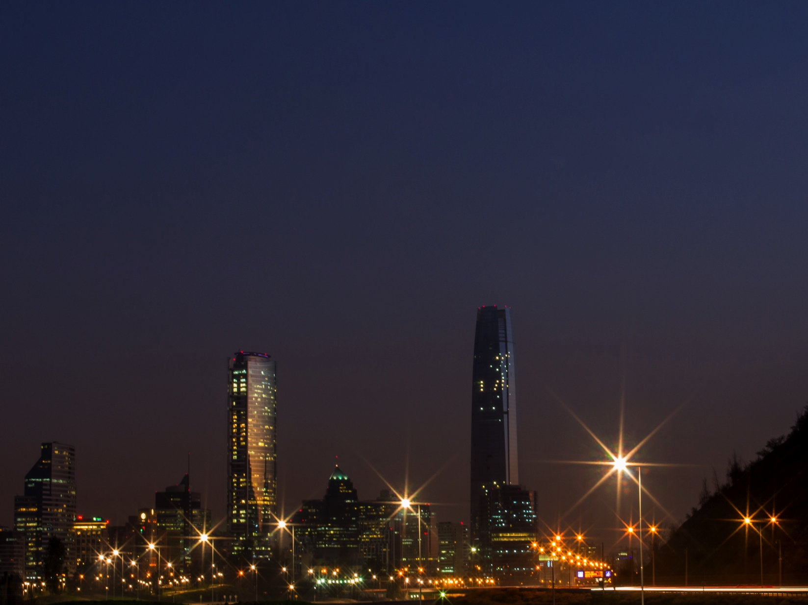
Business Opportunities in Chile
Susana Véliz
Luxembourg, June 2017

Slide 2
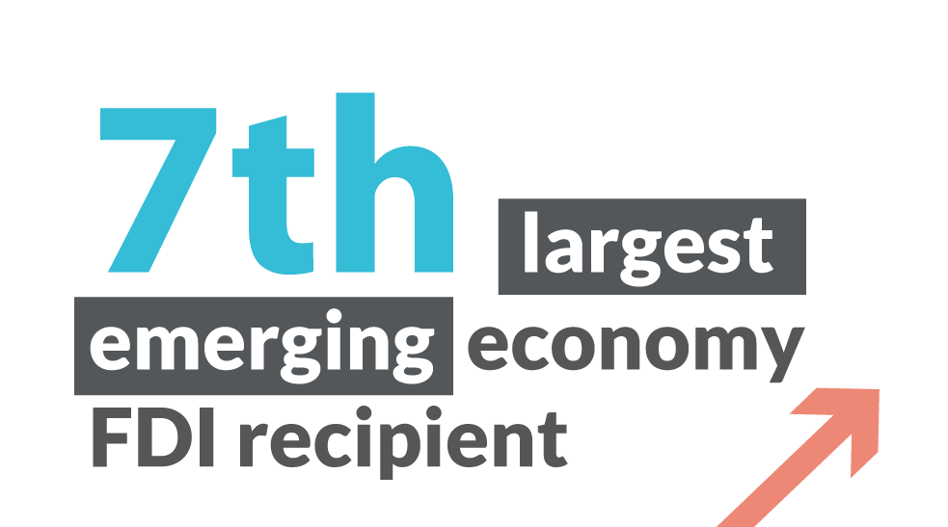
CHILE AT A GLANCE
2017 estimated GDP per-capita PPA :
USD$24,710 PPA
Total Area:
756,102.4 km²
2017 estimated population::
18,373,917
Foreign Direct Investment,
A dynamic growth source
for Chile
Chile’s Sovereign Ratings:
Standard & Poor’s: AA-
Moody’s: Aa3
20
8.3%
of GDP
among 202 world’s economies
as FDI recipient
11%
Annual average
FDI 2007–2016 growth
Notes:
Foreign Direct Investment (FDI) has played a very important role in the growth of Chile and the government welcome international investors. Particularly in the sectors that drive export growth, innovation and generation of quality jobs.
Chile is among the 20 countries with the largest foreign direct investment receipts, out of a total of 202 (UNCTAD’s world investment report).
FDI represents 8.3% of the GDP.
Chile is the 7th largest economy FDI recipient with 11% annual average growth of inflow foreign direct investment in the last 10 years.
Excellent business environment and high levels of competitiveness.
Institutional consistency.

Slide 3
STRONG INSTITUTIONAL PILLARS:
High Stability and Respect for Government Institutions.
Strong commitment to mantain healthy inflation levels.
The healthiest fiscal position in the region
World-class Sovereign risk levels
Notes:
Excelente ambiente de negocios y altos niveles de competitividad.
Consistencia institucional.
Chile lidera América Latina y está cercano a niveles OCDE para países de mayores ingresos.

Slide 4
Robust Foreign
Investment Regime
Equal treatment before the law: all of enterprises established in Chile declare its taxes according to the Chilean rules.
Moderate income tax on companies
Access to the formal foreign exchange market, including free remittance of capital and profits
New types of companies allow foreigners to create a business without needing a local partner
Investments of at least USD 5 million are exempt from VAT on imports of capital goods for seven types of investment projects, including mining
Notes:
Los inversionistas internacionales gozan de garantías de trato igualitario y ….. (pedir a Magdalena un párrafo que resuma el régimen de inversión extranjera en Chile)
Marco legal de Inversión Extranjera en Chile
Aspectos relevantes para la IED en Chile
100% del capital de una empresa constituida en Chile puede ser extranjero.
Principios de la igualdad de trato y no discriminación arbitraria: Aplicación a inversionistas extranjeros del mismo régimen jurídico que a inversionistas nacionales.
Principales derechos que otorga la Ley Marco para la Inversión Extranjera:
A remesar al exterior el capital transferido y las utilidades líquidas que sus inversiones generen, después de pagar los impuestos correspondientes.
Acceder al mercado cambiario formal para liquidar las divisas constitutivas de su inversión y repatriar el capital y utilidades líquidas, según tipo de cambio que acuerden las partes.
Solicitar la exención del IVA (19%) en la importación de bienes de capital que cumplan con los requisitos que establece la ley.
Solicitar la firma de un contrato de invariabilidad tributaria hasta el 31 de diciembre de 2019, estableciendo una carga tributaria total a la renta del 44,45% por 10 años, o del 14% del impuesto a la minería, según ventas anuales, por 15 años, para proyectos en ese sector de US$ 50 millones o más.
Solicitar el Certificado de Inversionista Extranjero emitido por InvestChile, necesario para solicitar los beneficios señalados en las letras c) y d) anteriores.

Slide 5
CHILE: A WORLD OF OPPORTUNITIES
Notes:
Chile cuenta con oportunidades en sectores donde tiene claras ventajas competitivas y también en aquellos donde existe importante potencial por desarrollar.
Chile has opportunities in sectors where it has clear competitive advantages and also in those where there is significant potential to be developed.

Slide 6
INVESTMENT OPPORTUNITIES PER SECTOR
MINING
ENERGY
INFRASTRUCTURE
FOOD INDUSTRY
GLOBAL SERVICES
TOURISM
Notes:
Mining:
Equipment and supplies
Engineering and consulting
Construction
Support services construction
Use of Chile as a platform to export to other countries of the region
Energy:
Generation: new projects in order to satisfy the raising in regular and free clients demand. Between 2014 and 2015, 45% of the new capacity of generated electricity will proceed from ERNC.
Tenders of distributors to supply regular clients:
There was a tender for 13,750 Gwh for a period of 20 years. Deadline: April 2016
Infraestructure:
For the period 2014-2020, there is a portfolio of projects of concessions for more than US$ 13 000 million, which include airports, highways, dams, Etc.
During the period 2014-2020 there will be a strong investment in regional projects of infrastructure for an amount of US$ 18 000 million.
Food:
Goal: positioning Chile in the 10 leading countries in healthy food for 2025.
Increasing the production and exportation of healthy, natural and “ready to eat” food, in order to conform the growing global demand of this kind of products.
Developing process and technologies for the creation of new products and packaging (functional and respectful for the environment)

Slide 7
CHILE:
Global Service
a Dynamic Business

Slide 8
CHILE: CONNECTED AND INTEGRATED
EXPORTS
(Millions dollars)
Global Services Exports
(Yearly Rate of Growth, Average 2010-2015)
GLOBAL SERVICES WINE
WORLD CHILE
Source: Chile Central Bank
Notes:
' This integration of Chile to the rest of the world is not just commercial. Chile exported services for more than USD9,500 MM, where an important part of these were business and technological services, surpassing USD 3,000 MM in 2016
In the last 15 years, exports of services amounted to over 3 billion dollars, practically doubling national exports of an emblematic product such as wine.
En los últimos 15 años, las exportaciones de servicios llegaron a superar los 3 mil millones de dólares, prácticamente duplicando las exportaciones nacionales de un producto emblemático como es el vino.
The statistics of exports of business services and information technology show an average growth of 11% for Chile in the last 5 years, higher than the growth rate of world trade in these items, which reaches 6.1%. This shows two things: that this is a sector of high global (and national) dynamism and that Chile has been able to grow steadily at rates higher than the world, which reveals the country's competitiveness.
Las estadísticas de exportaciones de servicios empresariales y de tecnología de información evidencian un crecimiento promedio de un 11% para Chile entre los últimos 5 años, superior a la tasa de crecimiento del comercio mundial en esos rubros que alcanza a un 6.1%. Ello evidencia dos cosas: que este es un sector de alto dinamismo mundial (y nacional) y que Chile ha sido capaz de crecer sostenidamente a tasas mayores que el mundo, lo que revela la competitividad del país.
These services cover subsectors such as:
Shared Services / Captive
Experian: IT & BP (Monitoreo de red, soporte remote; Back Office - Analytics)
Becton Dickinson, BP (F&A)
Synopsis: IT; Citi : IT; Equifax : IT
IT Services (Software development)
-Nisum ; -Everis
IT Infrastructure - Google / Data Center / Cloud
KPO
-Evalueserve

Slide 9
THOLONS:
“An innovative and enterprising
digital ecosystem”
Digital Nations: Tholons Services Globalization Index 2017
Rank | Countries
1 | India
2 | China
3 | Philippines
4 | Brazil
5 | Mexico
6 | Canada
7 | Chile
8 | Vietnam
9 | Poland
10 | Russia
Workforce Population
Innovation / Digital
Number of Startups
Talent, Skills & Quality
Open Innovation Ecosystem
Cost
Startup Diversity & Maturity
Risk & Quality of Life
Innovation Policy / Incentives
Business Catalyst
Unicorns
Infrastructure
Notes:
Tholons, on a recently released report on Digital Nations, placed Chile at 7th place worldwide in the Tholons Services Globalization Index 2017, highlighting the open innovation Ecosystem, Startup Diversity and Maturity, as well as the Innovation Policy And Incentives.

Slide 10
A.T Kearney:
“One of the most accommodating business environments in all of Latin America and a strong education system”
Notes:
Furthermore, Chile ranks 9th in A.T Kearny Global Services Location Index - With one of the most accommodating business environments in all of Latin America and a strong education system, Chile is a destination for high-end offshore functions such as research centers for global banking clients and R&D centers as well as more traditional back-office jobs.

Slide 11
A SOPHISTICATED TALENT HUB
Chile is among the 40 best countries in the global talent competitiveness index 2017
Notes:
'- The dynamism of our people, our entrepreneurial spirit and creativity set a trend in the region, making us a hub of attraction and retention of qualified talent in Latin America.
Chile is among the 40 best countries in the global talent competitiveness index 2017, a situation that is clearly reflected in the exponential increase in applications for temporary and contract work visas (381% and 206%, respectively)
'- In line with these trends, and in a coordinated effort between the public and private sectors to strengthen human capital for this industry, a human capital agenda has been developed including, among others : Training programs and certification in ICTs, languages and soft skills, along a Technological Visa allowing entry of highly qualified talent to the technology industry, called "Visa Tech".

Slide 12
Sophisticated Talent Hub
LATAM BUSINESS SCHOOLS INDEX 2016
11 Chilean universities are among the top 50 in the region
# 4 UNIVERSIDAD CATÓLICA
# 6 UNIVERSIDAD DE CHILE
#2 UNIVERSIDAD ADOLFO IBAÑEZ
# 13 UNIVERSIDAD DEL DESARROLLO
# 14 UNIVERSIDAD DIEGO PORTALES
Source: América Economia
Source: QS World University Ranking
Notes:
- Chile’s higher education system is recognized as one of the most competitive in Latin America.
- Eleven Chilean universities are among the top 50 in the region. More than 50,000 students graduate from these universities each year. Compared to Chile’s 18 million inhabitants, this indicates an important comparative advantage in terms of higher education.
- In addition to a supply of managers and executives with international postgraduate degrees, Chile itself has six business schools which are among the best in Latin America.
From our higher education system, more than 100,000 professionals are graduated per year for this industry, in areas such as engineering, architecture, science and technology, as well as in the field of administration and law. Figures have shown sustained growth for at least a decade 11% anual average.
- La calidad del sistema educacional chileno lidera en América Latina.
Chile ha obtenido sostenidamente los mejores resultados a nivel latianoamericano en la prueba PISA, en todas las categorías.

Slide 13
ENTREPRENEURSHIP ECOSYSTEM
Source: Global Entrepreneurship and Development Institute
Notes:
The Chilean entrepreneurial ecosystem is located at 18 out of 100 in the world.
In the first place, and as a central theme, the level of sophistication and knowledge of human capital in Chile places us in a clearly advantageous place in the region.
Our corporate ecosystem has a set of professionals and technicians with global orientation, capable and prepared to face the challenges of the new economy.
El ecosistema emprendedor Chileno está ubicado en la posición 18 de 100 en el nivel global.
En primer lugar, y como tema central, el nivel de sofisticación y conocimiento del capital humano en Chile nos sitúa en un lugar claramente ventajoso en la región.
Nuestro ecosistema empresarial cuenta con un conjunto de profesionales y técnicos con orientación global, capaces y preparados para afrontar los desafíos de la nueva economía.

Slide 14
CHILE: CONNECTED AND INTEGRATED
Source: Telecommunications Ministry of Chile
Notes:
In terms of Internet access speed, urban centers across the country are consistently ranked among the highest in the region, as are internet penetration levels (84% as of October 2016).

Slide 15
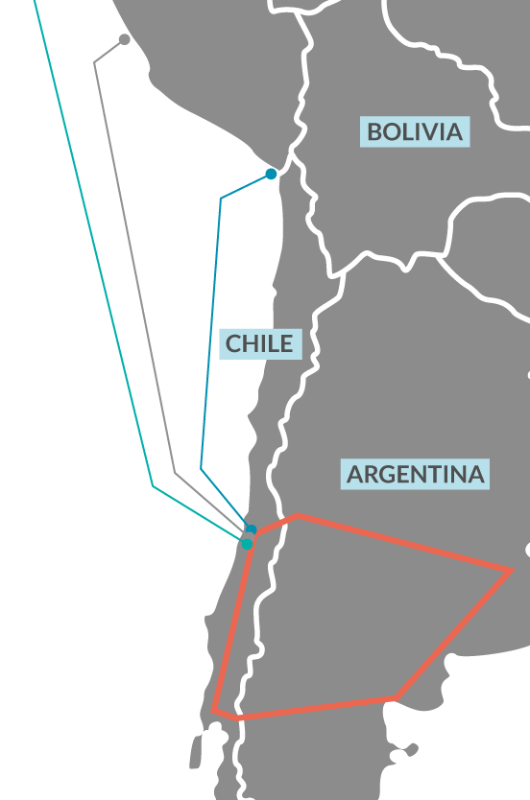
High Standards of Connectivity and Technological Infrastructure
Access to 3 large fiber optic networks, extended from northernmost Chilean City- Arica- (near Peruvian border) till the southern city of Puerto Montt.
Reaching country’s main urban areas and economic development poles, by over 18,000 kmts. length all fibers together.
Notes:
'In trunk terms, Chile has three large fiber optic networks, ranging from Arica (on the Peruvian border) to Puerto Montt in the south. Together they have a length of about 18,000 km. Its route takes them through the main urban centers of the country, as well as of the most important poles of economic development.

Slide 16
CHILE: THE PLATFORM FOR EXPORTING TALENT AND KNOWLEDGE

Slide 17
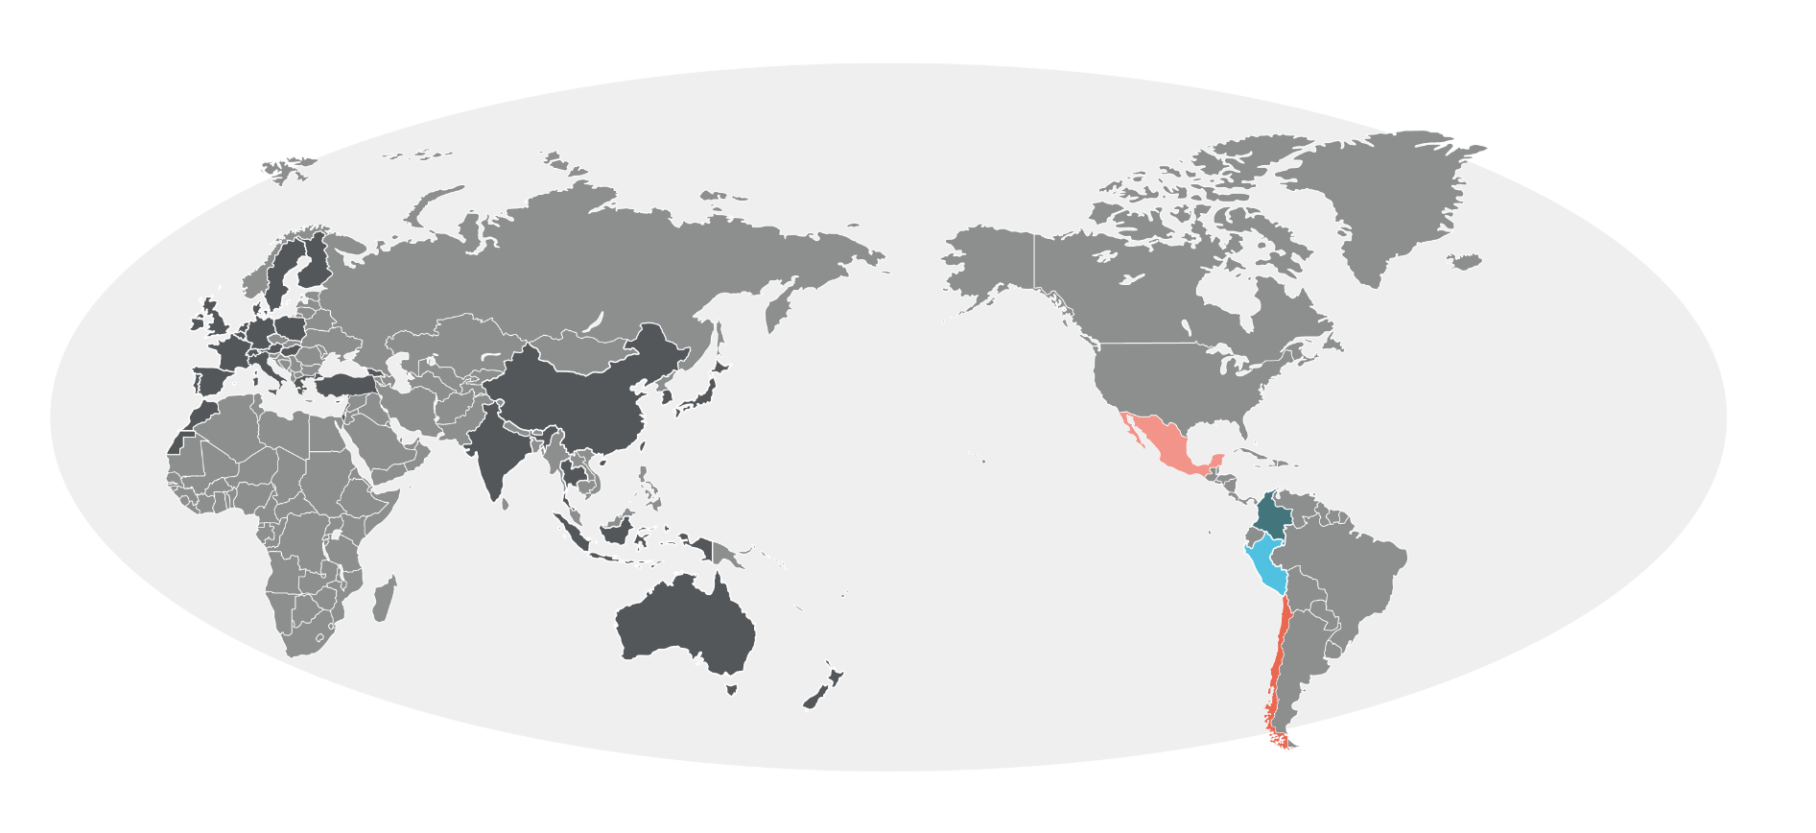
CHILE: CONNECTED AND INTEGRATED
Access to markets
85% of global GDP
93.8% of Chile’s export markets
65% of world population
26 free trade agreements and double taxation with 64 countries
Investment protection agreements and clauses with 76.4% of global GDP
Notes:
This dynamism is explained by the excellent access conditions Chile has negotiated, signing 26 free trade agreements with 64 trading partners.
These agreements and partners represent 65% of the world's population and 85% of global GDP.
We are the world's leader economy in terms of trade agreements. with 64 international agreements and 26 double taxation treaties , allowing us to trade with 86.3% of world GDP and access to 4.3 billion potential consumers under preferential tariff conditions

Slide 18
BUSINESS AND DIGITAL SERVICES
Source: QS World University Ranking
Notes:
Business and Digital Services:
Chile offers extremely favorable conditions for the Global Services Industry development. The availability of sophisticated talent with global orientation, highest standards of connectivity and technological infrastructure, along with an legal and institutional framework, coordinated government policies to foster service exports and our convenient time zone, makes Chile an attractive location for specialized business services, in key processes and high added value, as well as for Knowledge processes. The talent and skills of our people position us as an excellent location for Services regarding Analytics, Consulting, Financial Analysis, Design, Engineering, Legal consulting, Anti Seismic Architecture and much more.

Slide 19
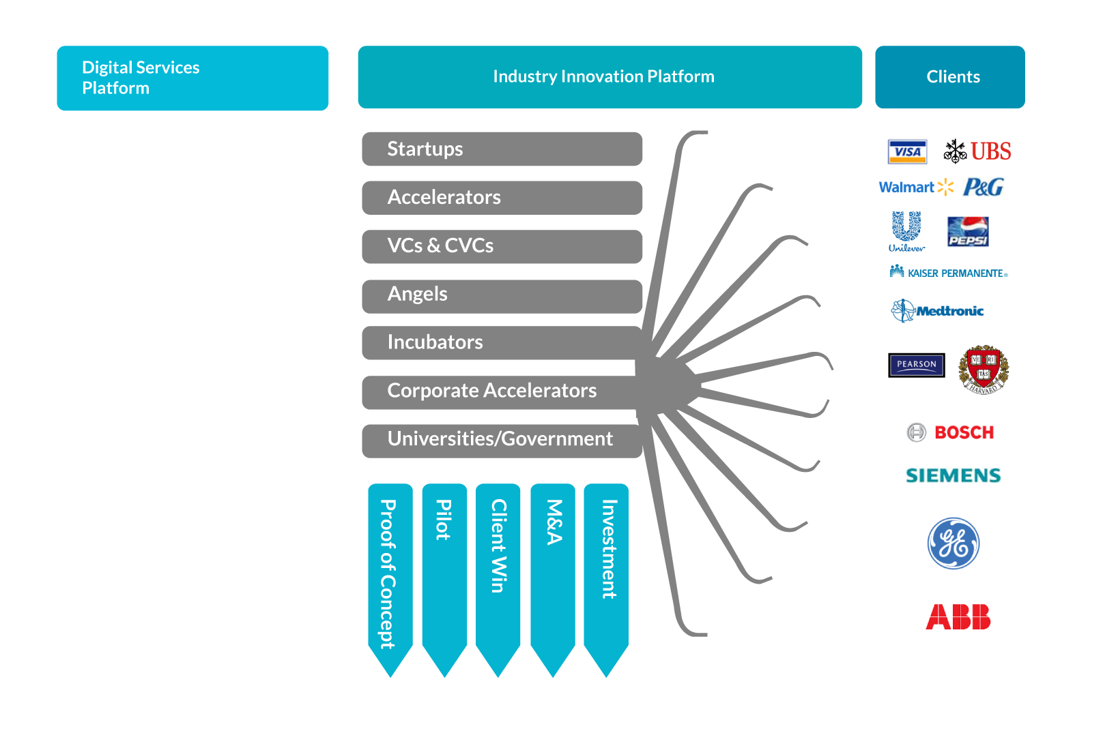
DIGITAL ECOSYSTEM
Content
Mgmt.
Social Media
Marketing
Cloud
Interactive/
Design
Big Data
Analytics
Mobility /
Apps
IOT
Source: QS World University Ranking
Notes:
Digital Ecosystem:
A highly innovative and enterpreneurship ecosystem, sophisticated talent and highest standards of connectivity and technological infrastructure, place us as a privileged destination for investments seeking to strengthen and complement the digital ecosystem, in areas such as: Cloud computing services, Software, Apps Development and IT Infraestructure among others.
Such as xxxx y xxxxxx , Companies dedicated to xxxx and xxxxx which are currently operating in Chile, from where they export their services to the rest of the world.

Slide 20
INDUSTRY 4.0
Source: QS World University Ranking
Notes:
Industry 4.0
Chile's leadership and maturity in key industries such as Mining, Forestry, the Financial industry and Retail, among others, are generating new challenges to be addressed through the application of new technologies and trends brought about by the digital revolution in each one of them.
All of these challenges are being addressed through a private public alliance through CORFO's intelligent industries programs, where these challenges are projected within a country strategy
Big data, Internet of things, Cloud computing, Automation and Robotics, Artificial Intelligence, 3D printing, Fintech, Augmented Reality, today are part of our key industries … where we face new challenges every day and great opportunities open up.

Slide 21
OPPORTUNITIES IN
ENERGY
In 2016, 41% of electric energy generated in the SIC and SING systems came from renewable sources.
Source: QS World University Ranking
Notes:
Demand for electricity, which is vital for growth and economic development, is increasing in Chile. The country’s opportunities in generation include both non-conventional technologies and conventional technologies, implemented in accordance with sustainability criteria.
According to the government’s program Energy 2050, the goal is that at least 70% of electricity generation should come from renewable sources by 2050. Furthermore, the 2035 goal is that at least 60% of electricity generation should come from renewable sources. In 2016, 41% of the electricity generated in the SIC (Central Interconnected System) and SING (Norte Grande Interconnected System) interconnected systems, which comprise 99% of Chile’s total installed capacity, came from renewable sources (1).

Slide 22
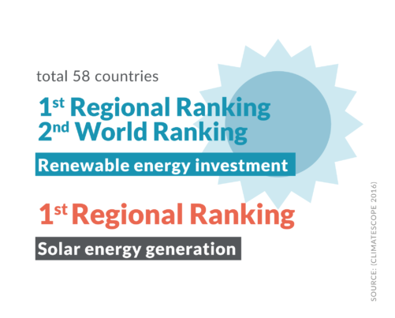
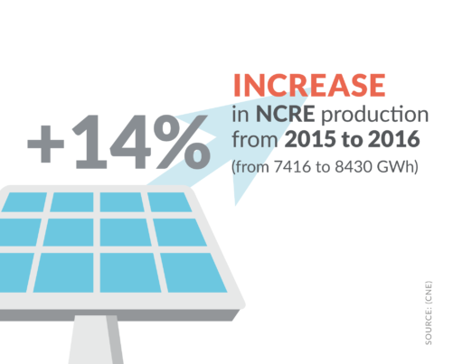
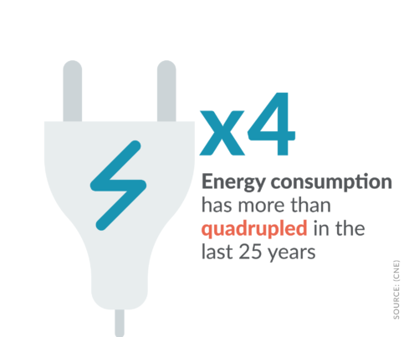
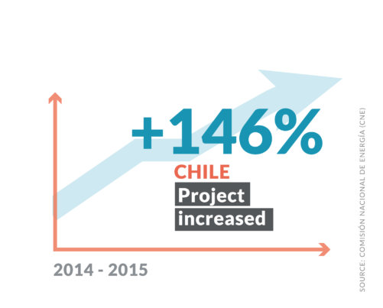
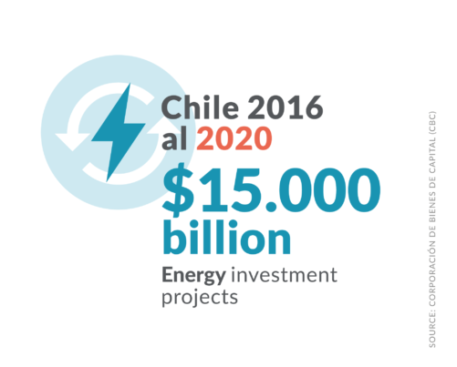
ENERGY: FACTS
Notes:
An other area in which there are opportunities is that of non-conventional renewable energies.
In Chile, we did have a power supply crisis but the outlook has since become very promising.
A few weeks ago, the Energy Ministry announced the results of a tender that will mean prices of below 60 dollars per megawatt hour, less than half their level two and a half years ago.
The contribution of these new generation sources has allowed Chile to reduce energy costs by more than 60% in the last 3 years.
Nowadays (actualmente), the Chilean electricity market is highly competitive and there has been an important increase in the contribution that renewable energies make to the matrix. In recent years, Chile has consolidated a position as the world's fourth most attractive country for investment in renewable energies. (E&Y, 2016).
Chile offers clean energy sources for its operations. World’s highest solar radiation: a privileged place for the development of solar energy.

Slide 23
ENERGY: CHALLENGE
Diversify the matrix, incorporate new players in the market and consolidate energy independence, efficiency and sustainability.
Notes:
We are talking about a country where demand for power will grow at an annual rate of 3.5% in the next few years, that currently has an installed capacity of 22.8 gigawatts and is addressing the challenge of diversifying its matrix, incorporating new players and consolidating its energy independence, efficiency and sustainability.

Slide 24
Energy Challenges/Opportunities
Target of 70% share of renewable energies in energy matrix by 2050
Opportunities in generation (regulated and non-regulated clients)
Tenders for regulated clients
Generation
Attraction of foreign investment in order to increase robustness and security of transmission lines
Tender for US$288 million was awarded in May 2017.
Transmission
High-radiation solar energy (CORFO Solar Program)
Development of related technologies, products and services
Photovoltaic Systems Technological Program for deserts (US$17 million of which US$12 million financed by government)
Promotion of Solar Technological District (1 GW in northern Chile).
Notes:
GENERATION
The target the government has set is for renewable energies to account for 70% of the country's electricity matrix by 2050.
2. TRANSMISSION
Further opportunities in the energy field will arise in 2017 and 2018 with the tender of supply contracts for more than 10,000 gigawatt hours and, this year, there was also a transmission tender worth 288 million dollars. InvestChile will be happy to provide you more details about these bidding processes which is managed by the Energy Ministry.
3. HIGH RADIATION SOLAR ENERGY
In this context, solar energy is playing and will continue to play a fundamental role.
Northern Chile has the world's highest level of solar radiation. This constitutes an opportunity not only for the production of solar energy but also for the development of related products and services, with an emphasis on innovation and the testing of new technologies for harnessing high-radiation solar energy. Chile can, in other words, serve as a unique test bed for the solar technologies of the future.
The Chilean Government has a strategic solar program that aims at developing the solar industry in Chile.
This solar program seeks to leverage the Atacama Desert’s unique features, which include the highest solar irradiance on earth. The objective is to develop a national solar industry with technological capacities and which will be export-oriented. To this end, an initial portfolio of 50 initiatives was identified, with a total budget of US$800 million.

Slide 25
SERVICES FOR INVESTORS
Promotion geared to showing the opportunities Chile offers investors in high-potential sectors.
Specialized sector-specific advice
Statistical information
Field visits
Scheduling of meetings
Legal advice
Advice on applying for support instruments.
Advice on setting up the company
Legal advice
Advice on applying for support instruments
Management of enquiries and concerns relating to other government services.
Advice on applying for support instruments
Management of enquiries and concerns relating to other government services.
Reinvestment opportunities.
Notes:
Promotion geared to showing the opportunities that Chile offers to investors in sectors of high potential.
Specialized sectoral consultancy (Statistical information, field visits, Meeting agenda, Legal advice, advice for applying to instruments.
Advice for the installation of company: Legal advice, Advice for application to instruments, Management of queries to public organisms.
Export support: Advice for application to instruments, Management of queries to public agencies, Opportunities for reinvestment.
And that is not all.
As from this year, with the creation of InvestChile, our country has innovated in its approach to FDI, launching a series of new services to assist companies through the different stages of their projects, from the first contact through to the reinvestment of profits.
Through its strategy for the attraction and promotion of foreign investment, Chile is going out to seek more and better investment, doing so proactively and with the backing of an improved institutional framework that is better able to respond to the needs of overseas companies in their decision-making processes.
The services that InvestChile provides include general information about the country, sector-specific advice, the organization of meetings and field visits, legal advice on applying to use policy instruments and incentives, management of queries relating to other government agencies and advice on reinvestment.
Promoción orientada a mostrar las oportunidades que Chile ofrece a los inversionistas en sectores de alto potencial.
Asesoría sectorial especializada (Información estadística, visitas a terreno, Agenda de reuniones, Asesoría legal, asesoría para postulación a instrumentos.
Asesoría para la instalación de empresa: Asesoría legal, Asesoría para postulación a instrumentos, Gestión de consultas e inquietudes ante organismos públicos.
Apoyo para la exportación: Asesoría para postulación a instrumentos, Gestión de consultas e inquietudes ante organismos públicos, Oportunidades para la reinversión.

Slide 26
THANK YOU!

