Slide 1




Costa Rica
Land of Opportunities for
Trade & Investment
Alexander Mora Delgado
Minister of Foreign Trade
February, 2017

Slide 2
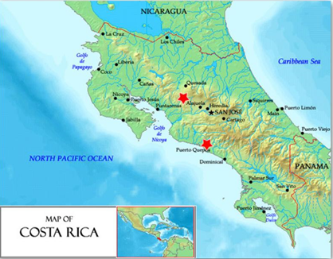






Costa Rica in the World
UPPER MIDDLE INCOME ECONOMY
GDP: US $49.6 billion
GDP growth rate (real): 3.5%
GDP per capita PPP: $ US14.919 *
*Has multiplied by more than 5 in the last 35 years.
#1
#1
#2
96%
Education & Health
Global Green Economy Index
Adult literacy rate
Social progress
79 yrs
Life expectancy
in Latin America
in Latin America
  in Latin America
(Social Progress Imperative)
(WEF, 2016)
(Dual Citizen, 2016)
Societal pillars

Slide 3

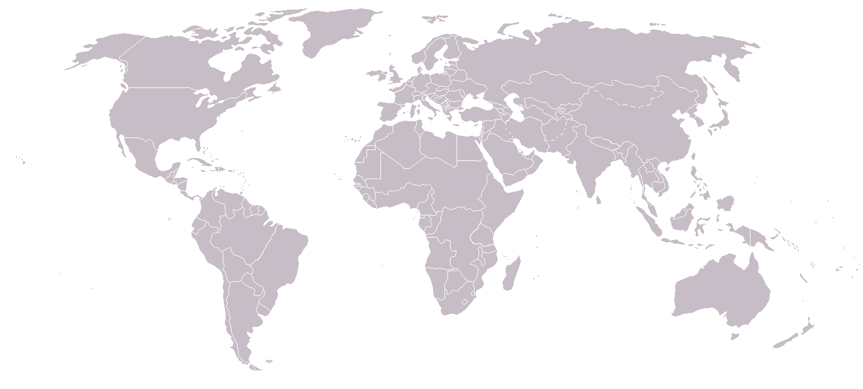



















Broad platform for
trade & investment
*
FTAs with
+50 countries
Potential consumers
2.5 billion
Global GDP
2/3
BITs with
14 countries
…and 40+ trade promotion offices
*Pending ratification

Slide 4









































Solid track record
Resultados alcanzados por el país
Costa Rica: Attraction of FDI
2010
2015
2005
1997
Blue-Chip companies
1995
Back office
1990
First contact centers
1986
1st leading company in medical devices to invest
1960
Pioneer in manufacturing
…to operate successful global businesses

Slide 5
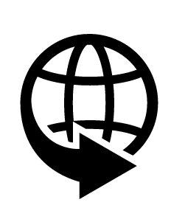
GVC-Centered Trade & Investment Policy
Key Drivers
Efficient integration to the world economy
1

Slide 6
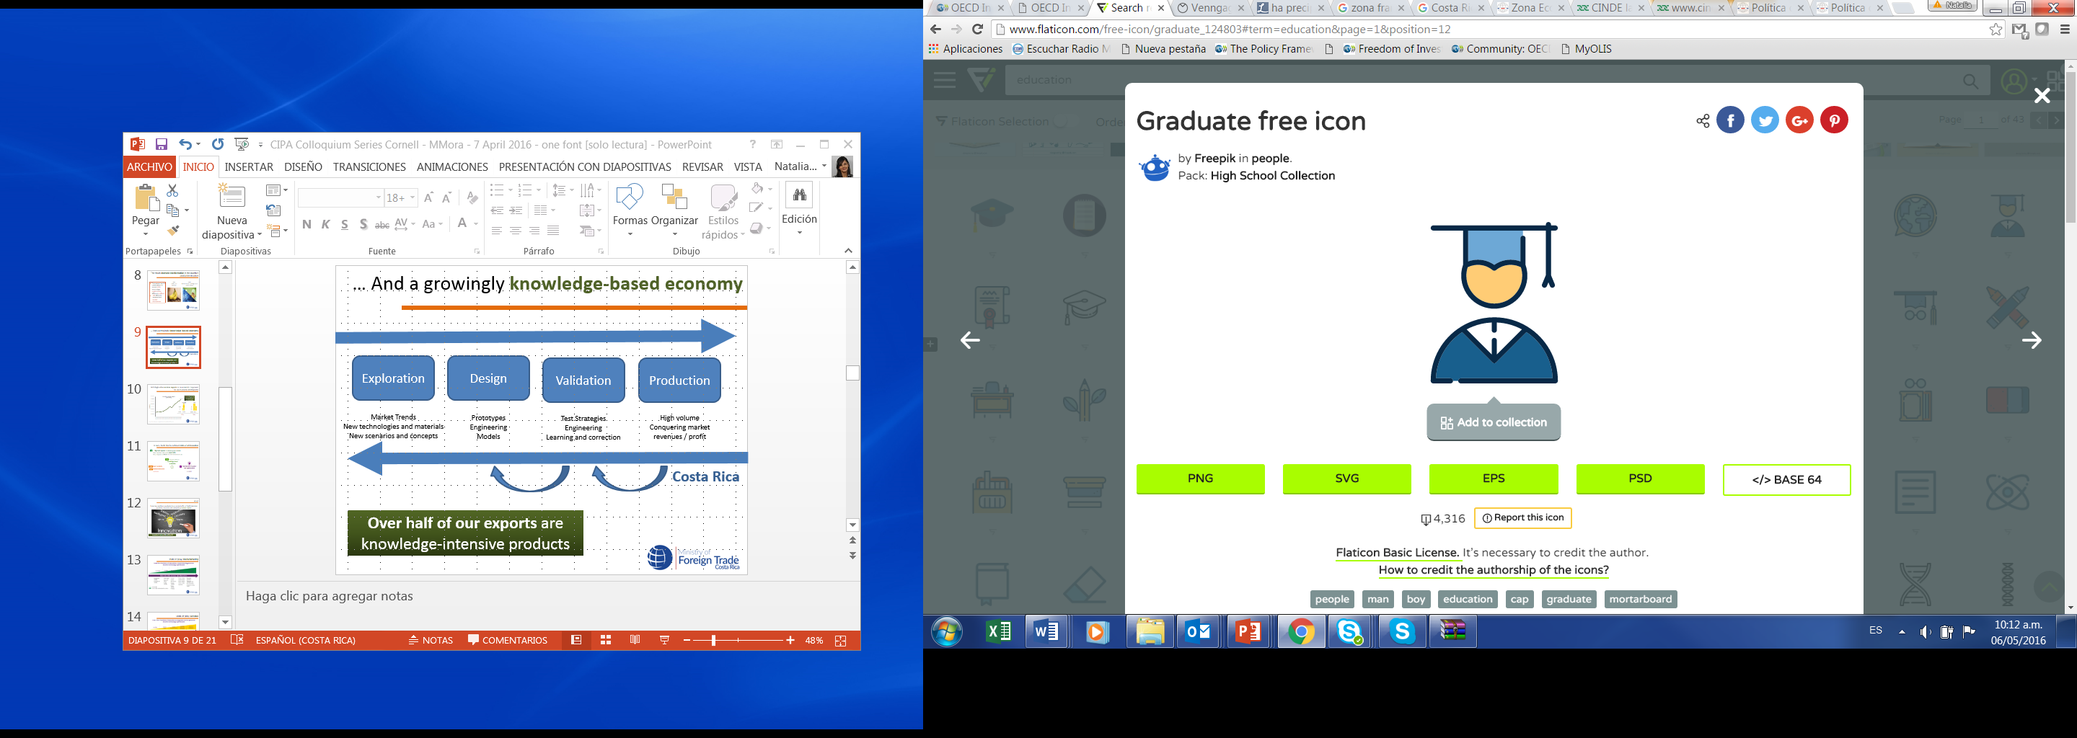
GVC-Centered Trade & Investment Policy
Key Drivers
Efficient integration to the world economy
1
2
Cradle of human talent

Slide 7
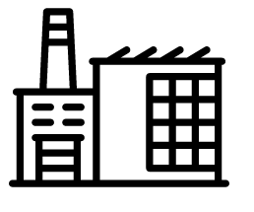
GVC-Centered Trade & Investment Policy
Key Drivers
Competitive package of investment incentives
Efficient integration to the world economy
1
3
2
Cradle of human talent

Slide 8
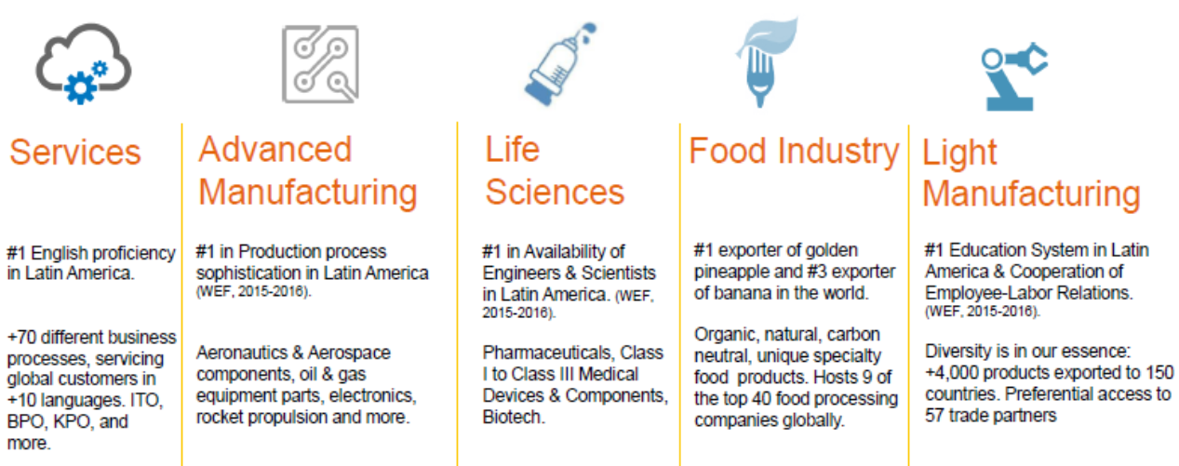
Investment sector opportunities

Slide 9



Costa Rica: Foreign Direct Investment
In 2015, 57% of total EU investments came from Holland
from the European Union*
2005-2015
FDI inflows from the EU represent 29.1% of total inflows to Costa Rica
33%
Industries
48%
Source: COMEX, based on data from BCCR.

Slide 10
Costa Rica and the European Union
Partners in trade

Slide 11
Partners in trade
Association Agreement Central America-EU
AACUE: Tariff Reductions for Tariff Lines
In force between Costa Rica and the EU since October 2013.
Trade liberalization.
18 categories for tariff elimination, from inmediate free trade to exempted goods.
Source: COMEX.

Slide 12
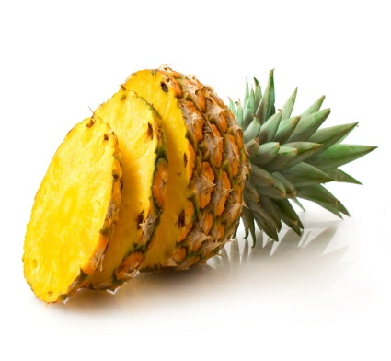


Partners in trade
Tariff reduction in the EU (examples)
Products | Category
Processors and controllers, pineapple, coffee, syringes, needles, catheters, prosthesis articles and devices, medical instruments and apparatus, pineapple juice, melon, shrimp, cassava, palm oil, vegetables, tuna, orange concentrate, flowers and plants, textiles and clothing | Inmediate
Bottled rum, fresh artichokes, rice for sowing | 3 years
Cured hams and bacon, hides and skins of bovine, aluminum alloys | 5 years
Pork, bacon, pork fat, fluid milk, cheese | 7 years
Yogurt, pastries, ice creams | 10 years
Tomato, corn meal, wheat flour, poultry feed | Exclusión
9 of the top 10 CR export products in 2014

Slide 13
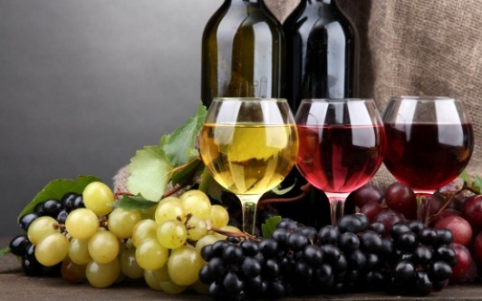
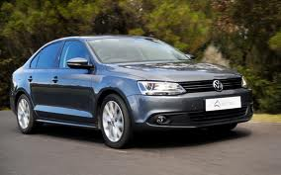
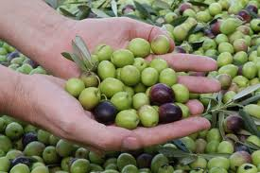
Partners in trade
Tariff reduction in CA (examples)
Products | Category
Containers, vehicles, antisera, generators of alternating current, tractors, turbines and hydraulic wheels, olive oil, wines, grapes, apples, olives, malt extract, scales, cranes, lenses and prisms | Inmediate
Evaporated and condensed milk, pears, makeup and cosmetics | 5 years
Whisky | 6 years
Peaches and nectarines | 7 years
Blue Cheese, Sweetcorn, Vodka, Asparagus | 10 years
Meat (beef, chicken, pork), fluid milk, butter, yogurt, vegetable oils, egg-free pasta, tomatoes, potatoes, onions, rice, chewing gums, snacks, waffles, ice creams, toasted potatoes, margarine | Exclusion
7 of the top 10 EU export products to CR in 2014

Slide 14
Partners in trade
Except for the 2009 decline, trade flows show growth in the last decade
CR exports to the EU have grown at an average annual rate of 2.5%
Imports from the EU currently represent 9.4% of total imports to the country
Costa Rica: Trade in goods with the European Union
2005-2015
Source: COMEX, based on data from BCCR and PROCOMER.

Slide 15
Partners in trade
Costa Rica: Main trading partners
2015**
in the European Union*
Exports
Imports
 | Destination | Millions US$ | %
 | European Union | 1.785,4 | 100
1 | Holland | 440,5 | 24,7
2 | Belgium | 426,3 | 23,9
3 | United Kingdom | 178,6 | 10,0
4 | Italy | 168,8 | 9,5
5 | Germany | 149,0 | 8,3
6 | Spain | 126,5 | 7,1
7 | France | 112,4 | 6,3
8 | Ireland | 70,8 | 4,0
9 | Greece | 30,1 | 1,7
10 | Finland | 26,0 | 1,5
 | Origin | Millions US$ | %
 | European Union | 1.444,3 | 100
1 | Germany | 378,5 | 26,2
2 | Spain | 218,1 | 15,1
3 | Italy | 179,3 | 12,4
4 | United Kingdom | 9,2% | 9,2
5 | France | 120,1 | 8,3
6 | Holland | 89,8 | 6,2
7 | Denmark | 58,3 | 4,0
8 | Ireland | 49,8 | 3,4
9 | Belgium | 48,9 | 3,4
10 | Sweden | 32,2 | 2,2
Source: COMEX, based on data from PROCOMER.
*EU corresponds to the EU-27 block, trading partner with whom Costa Rica has a preferential trade agreement in force (Croatia in progress).
** Preliminary data, subject to revision.

Slide 16
Partners in trade
Costa Rica: Main traded products
with the European Union*
Exports 2015**
Imports 2015**
Costa Rica: Exports to EU-27 |  |  |  | Costa Rica: Imports from EU-27
Main products, 2015 |  |  |  | Main products, 2015
Products | Millions US$ | Perc.% |  | Products | Millions US$ | Perc.%
Bananas | 438,2 | 24,5% |  | Medicines | 145,5 | 10,0%
Tropical pineapples, fresh or dried | 360,6 | 20,2% |  | Vehicles | 86,0 | 5,9%
Other prosthetic devices and articles | 130,9 | 7,3% |  | Antiserums | 50,3 | 3,5%
Other syringes, needles, catheters, cannulae and similar instruments | 117,6 | 6,6% |  | Containers | 45,3 | 3,1%
Other instruments and appliances of medical, surgical and veterinary | 101,7 | 5,7% |  | Food preparations | 30,4 | 2,1%
Coffee, not roasted and not decaffeinated | 96,7 | 5,4% |  | Diesel vehicles, with displacement greater than 2500 cm3 | 27,7 | 1,9%
Tropical pineapple juice, of a Brix value not exceeding 20 | 60,6 | 3,4% |  | Devices for reception, conversion or broadcast of voice or images | 24,2 | 1,7%
Other – Tropical pineapple juice | 49,4 | 2,8% |  | Fungicides | 20,9 | 1,4%
Other fruit, nuts and other edible parts of plants, otherwise prepared or preserved | 40,7 | 2,3% |  | Diagnostic reagents | 18,6 | 1,3%
Medical equipment and precision devices exports, 24% of our exports to the EU (similar to bananas)
Source: COMEX, based on data from PROCOMER.
*EU corresponds to the EU-27 block, trading partner with whom Costa Rica has a preferential trade agreement in force (Croatia in progress).
** Preliminary data, subject to revision.

Slide 17




In sum, we welcome and invite you!
Costa Rica offers a wide array of opportunities to potential buyers, investors and visitors, and aspires to work closely to identify new partners and embark jointly on initiatives and projects of mutual interest, so as to promote these opportunities even more broadly

Slide 18
Costa Rica
Land of Opportunities for
Investment & Trade
Alexander Mora Delgado
Minister of Foreign Trade
February, 2017

